Slide 1
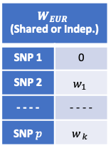



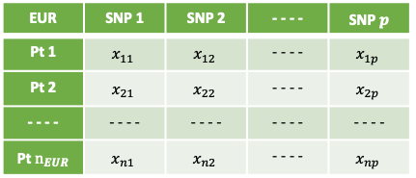


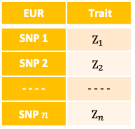
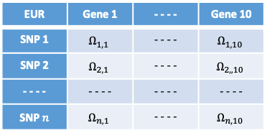
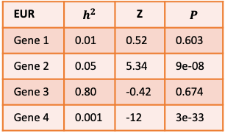

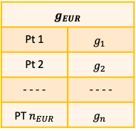
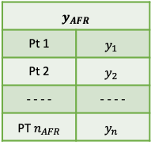



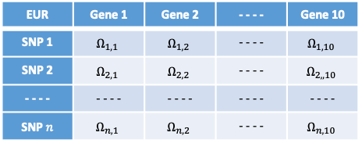


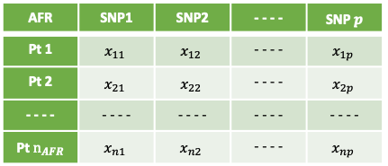
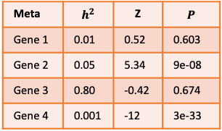

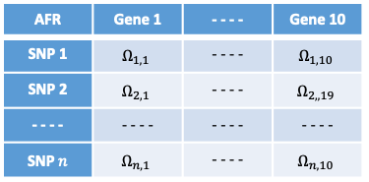
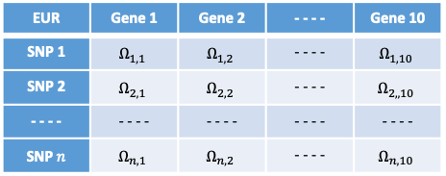
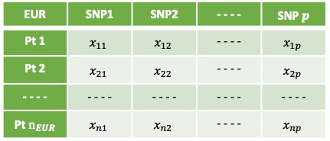
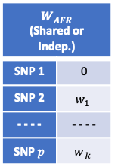

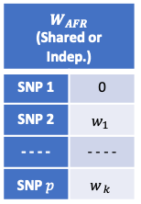

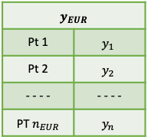

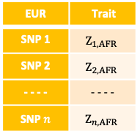
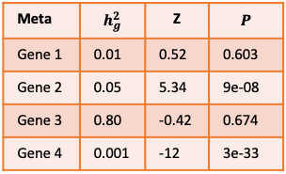
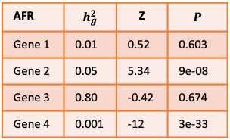
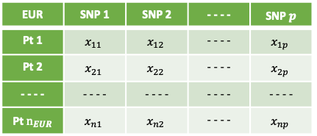
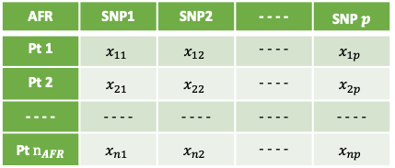

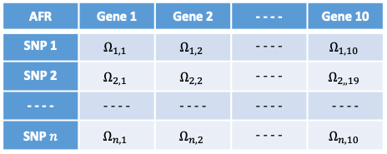

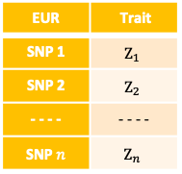

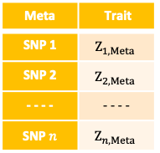
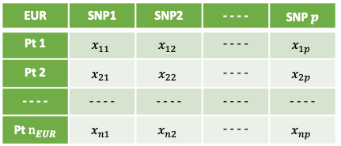

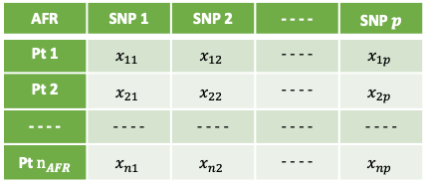




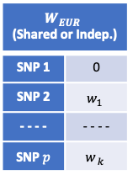



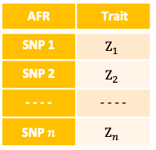


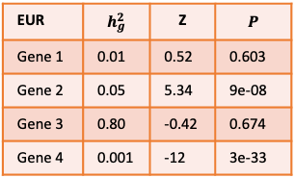
Step 1: Simulate LD Reference Panel and eleven sets of genotypes
Indep. Regions by modified LDetect
Construct LD panel $V$ from 1000G
Ten Sets of Genotypes (1) for GE Panel
One Set of Genotypes (2) for GWAS Panel
CHR | Start | End
1 | 10583 | 2880092
1 | 2880092 | 5001596
- - - - | - - - - | - - - -
22 | 49777734 | 51243298
AFR | SNP1 | SNP2 | - - - - | SNP $p$
Pt 1 | $$x_{11}$$ | $$x_{12}$$ | - - - - | $$x_{1p}$$
Pt 2 | $$x_{21}$$ | $$x_{22}$$ | - - - - | $$x_{2p}$$
- - - - | - - - - | - - - - | - - - - | - - - -
Pt $n_{AFR}$ | $$x_{n1}$$ | $$x_{n2}$$ | - - - - | $$x_{np}$$
AFR | SNP1 | SNP2 | - - - - | SNP $p$
Pt 1 | $$x_{11}$$ | $$x_{12}$$ | - - - - | $$x_{1p}$$
Pt 2 | $$x_{21}$$ | $$x_{22}$$ | - - - - | $$x_{2p}$$
- - - - | - - - - | - - - - | - - - - | - - - -
Pt $n_{AFR}$ | $$x_{n1}$$ | $$x_{n2}$$ | - - - - | $$x_{np}$$
Pick One Region
$$N(0, V)$$
EUR | SNP1 | SNP2 | - - - - | SNP $p$
Pt 1 | $$x_{11}$$ | $$x_{12}$$ | - - - - | $$x_{1p}$$
Pt 2 | $$x_{21}$$ | $$x_{22}$$ | - - - - | $$x_{2p}$$
- - - - | - - - - | - - - - | - - - - | - - - -
Pt $n_{EUR}$ | $$x_{n1}$$ | $$x_{n2}$$ | - - - - | $$x_{np}$$
EUR | SNP1 | SNP2 | - - - - | SNP $p$
Pt 1 | $$x_{11}$$ | $$x_{12}$$ | - - - - | $$x_{1p}$$
Pt 2 | $$x_{21}$$ | $$x_{22}$$ | - - - - | $$x_{2p}$$
- - - - | - - - - | - - - - | - - - - | - - - -
Pt $n_{EUR}$ | $$x_{n1}$$ | $$x_{n2}$$ | - - - - | $$x_{np}$$
Step 2: Simulate Gene Expression Reference Panel
$ε_{g} \sim N\left(0, s_{g}^{2}\left(\frac{1}{h_{g}^{2}}−1\right)I_{n}\right)$
$$s_{g}^{2}=w^{T}Vw$$
Genotypes (1)
eQTL Effects by $N(0, \frac{h_{g}^{2}}{k}I_{k})$
$$k \sim Poisson(2)$$
Gene Expression Panel $Ω$
AFR | SNP 1 | SNP 2 | - - - - | SNP $p$
Pt 1 | $$x_{11}$$ | $$x_{12}$$ | - - - - | $$x_{1p}$$
Pt 2 | $$x_{21}$$ | $$x_{22}$$ | - - - - | $$x_{2p}$$
- - - - | - - - - | - - - - | - - - - | - - - -
Pt $n_{AFR}$ | $$x_{n1}$$ | $$x_{n2}$$ | - - - - | $$x_{np}$$
$W_{AFR}$ (Shared or Indep.) | $W$ (Shared or Indep.)
SNP 1 | 0
SNP 2 | $$w_{1}$$
- - - - | - - - -
SNP $p$ | $$w_{ k}$$
$$ε_{g, AFR}$$
$$ε_{g, 1}$$
$$ε_{g, 2}$$
- - - -
$$ε_{g, n}$$
$g_{AFR}$ | $W$ (Shared or Indep.)
Pt 1 | $$g_{1}$$
Pt 2 | $$g_{1}$$
- - - - | - - - -
PT $n_{EUR}$ | $$g_{ n}$$
AFR | Gene 1 | Gene 2 | - - - - | Gene 10
SNP 1 | $$Ω_{1, 1}$$ | $$Ω_{1, 2}$$ | - - - - | $$Ω_{1, 10}$$
SNP 2 | $$Ω_{2, 1}$$ | $$Ω_{2, 2}$$ | - - - - | $$Ω_{2, ,19}$$
- - - - | - - - - | - - - - | - - - - | - - - -
SNP $n$ | $$Ω_{n, 1}$$ | $$Ω_{n, 2}$$ | - - - - | $$Ω_{n, 10}$$
EUR | SNP 1 | SNP 2 | - - - - | SNP $p$
Pt 1 | $$x_{11}$$ | $$x_{12}$$ | - - - - | $$x_{1p}$$
Pt 2 | $$x_{21}$$ | $$x_{22}$$ | - - - - | $$x_{2p}$$
- - - - | - - - - | - - - - | - - - - | - - - -
Pt $n_{EUR}$ | $$x_{n1}$$ | $$x_{n2}$$ | - - - - | $$x_{np}$$
$W_{EUR}$ (Shared or Indep.) | $W$ (Shared or Indep.)
SNP 1 | 0
SNP 2 | $$w_{1}$$
- - - - | - - - -
SNP $p$ | $$w_{ k}$$
$$ε_{g, EUR}$$
$$ε_{g, 1}$$
$$ε_{g, 2}$$
- - - -
$$ε_{g, n}$$
$g_{EUR}$ | $W$ (Shared or Indep.)
Pt 1 | $$g_{1}$$
Pt 2 | $$g_{2}$$
- - - - | - - - -
PT $n_{EUR}$ | $$g_{n}$$
EUR | Gene 1 | Gene 2 | - - - - | Gene 10
SNP 1 | $$Ω_{1, 1}$$ | $$Ω_{1, 2}$$ | - - - - | $$Ω_{1, 10}$$
SNP 2 | $$Ω_{2, 1}$$ | $$Ω_{2, 2}$$ | - - - - | $$Ω_{2, ,10}$$
- - - - | - - - - | - - - - | - - - - | - - - -
SNP $n$ | $$Ω_{n, 1}$$ | $$Ω_{n, 2}$$ | - - - - | $$Ω_{n, 10}$$
LASSO
10 times
Step 3: Simulate GWAS Panel (pick one of the 10 genes as causal in Step 2 to use its eQTL effects )
Genotypes (2)
eQTL Effects
$ε \sim N\left(0, s^{2}\left(\frac{1}{h_{GE}^{2}}−1\right)I_{n}\right)$
$$s^{2}=α^{T}w^{T}Vwα$$
GWAS Panel $Z$
AFR | SNP 1 | SNP 2 | - - - - | SNP $p$
Pt 1 | $$x_{11}$$ | $$x_{12}$$ | - - - - | $$x_{1p}$$
Pt 2 | $$x_{21}$$ | $$x_{22}$$ | - - - - | $$x_{2p}$$
- - - - | - - - - | - - - - | - - - - | - - - -
Pt $n_{AFR}$ | $$x_{n1}$$ | $$x_{n2}$$ | - - - - | $$x_{np}$$
$W_{AFR}$ (Shared or Indep.) | $W$ (Shared or Indep.)
SNP 1 | 0
SNP 2 | $$w_{1}$$
- - - - | - - - -
SNP $p$ | $$w_{ k}$$
EUR | SNP 1 | SNP 2 | - - - - | SNP $p$
Pt 1 | $$x_{11}$$ | $$x_{12}$$ | - - - - | $$x_{1p}$$
Pt 2 | $$x_{21}$$ | $$x_{22}$$ | - - - - | $$x_{2p}$$
- - - - | - - - - | - - - - | - - - - | - - - -
Pt $n_{EUR}$ | $$x_{n1}$$ | $$x_{n2}$$ | - - - - | $$x_{np}$$
$W_{EUR}$ (Shared or Indep.) | $W$ (Shared or Indep.)
SNP 1 | 0
SNP 2 | $$w_{1}$$
- - - - | - - - -
SNP $p$ | $$w_{ k}$$
GE Effects $\sim N(0, 1)$
$$ε_{AFR}$$
$$ε_{1}$$
$$ε_{2}$$
- - - -
$$ε_{n}$$
$y_{AFR}$ | $W$ (Shared or Indep.)
Pt 1 | $$y_{1}$$
Pt 2 | $$y_{2}$$
- - - - | - - - -
PT $n_{AFR}$ | $$y_{n}$$
AFR | Trait
SNP 1 | $$Z_{1}$$
SNP 2 | $$Z_{2}$$
- - - - | - - - -
SNP $n$ | $$Z_{n}$$
$$α$$
$$ε_{EUR}$$
$$ε_{1}$$
$$ε_{2}$$
- - - -
$$ε_{n}$$
$y_{EUR}$ | $W$ (Shared or Indep.)
Pt 1 | $$y_{1}$$
Pt 2 | $$y_{2}$$
- - - - | - - - -
PT $n_{EUR}$ | $$y_{n}$$
EUR | Trait
SNP 1 | $$Z_{1}$$
SNP 2 | $$Z_{2}$$
- - - - | - - - -
SNP $n$ | $$Z_{n}$$
SLR
GWAS Panel $Z$ for EUR
GWAS Panel $Z$ for AFR
Meta GWAS Panel $Z$
AFR | Trait
SNP 1 | $$Z_{1, EUR}$$
SNP 2 | $$Z_{2, EUR}$$
- - - - | - - - -
SNP $n$ | $$Z_{n, EUR}$$
EUR | Trait
SNP 1 | $$Z_{1, AFR}$$
SNP 2 | $$Z_{2, AFR}$$
- - - - | - - - -
SNP $n$ | $$Z_{n, AFR}$$
Meta | Trait
SNP 1 | $$Z_{1, Meta}$$
SNP 2 | $$Z_{2, Meta}$$
- - - - | - - - -
SNP $n$ | $$Z_{n, Meta}$$
Meta-Analysis
Step 4: Perform TWAS on EUR, AFR, and Meta separately
GWAS Panel $Z$
Gene Expression Panel $Ω$
Construct LD panel $V$ from 1000G
TWAS Results
Meta | Trait
SNP 1 | $$Z_{1}$$
SNP 2 | $$Z_{2}$$
- - - - | - - - -
SNP $n$ | $$Z_{n}$$
AFR | Gene 1 | Gene 2 | - - - - | Gene 10
SNP 1 | $$Ω_{1, 1}$$ | $$Ω_{1, 2}$$ | - - - - | $$Ω_{1, 10}$$
SNP 2 | $$Ω_{2, 1}$$ | $$Ω_{2, 2}$$ | - - - - | $$Ω_{2, ,19}$$
- - - - | - - - - | - - - - | - - - - | - - - -
SNP $n$ | $$Ω_{n, 1}$$ | $$Ω_{n, 2}$$ | - - - - | $$Ω_{n, 10}$$
Meta | $$h_{g}^{2}$$ | Z | $$P$$
Gene 1 | 0.01 | 0.52 | 0.603
Gene 2 | 0.05 | 5.34 | 9e-08
Gene 3 | 0.80 | -0.42 | 0.674
Gene 4 | 0.001 | -12 | 3e-33
AFR | Trait
SNP 1 | $$Z_{1}$$
SNP 2 | $$Z_{2}$$
- - - - | - - - -
SNP $n$ | $$Z_{n}$$
EUR | Gene 1 | Gene 2 | - - - - | Gene 10
SNP 1 | $$Ω_{1, 1}$$ | $$Ω_{1, 2}$$ | - - - - | $$Ω_{1, 10}$$
SNP 2 | $$Ω_{2, 1}$$ | $$Ω_{2, 2}$$ | - - - - | $$Ω_{2, ,10}$$
- - - - | - - - - | - - - - | - - - - | - - - -
SNP $n$ | $$Ω_{n, 1}$$ | $$Ω_{n, 2}$$ | - - - - | $$Ω_{n, 10}$$
AFR | $$h_{g}^{2}$$ | Z | $$P$$
Gene 1 | 0.01 | 0.52 | 0.603
Gene 2 | 0.05 | 5.34 | 9e-08
Gene 3 | 0.80 | -0.42 | 0.674
Gene 4 | 0.001 | -12 | 3e-33
EUR | Trait
SNP 1 | $$Z_{1}$$
SNP 2 | $$Z_{2}$$
- - - - | - - - -
SNP $n$ | $$Z_{n}$$
TWAS
EUR | $$h_{g}^{2}$$ | Z | $$P$$
Gene 1 | 0.01 | 0.52 | 0.603
Gene 2 | 0.05 | 5.34 | 9e-08
Gene 3 | 0.80 | -0.42 | 0.674
Gene 4 | 0.001 | -12 | 3e-33
Step 5: Perform fine-mapping using MA-FOCUS on EUR and AFR, and FOCUS on EUR, AFR, and Meta separately
TWAS Results
Gene Expression Panel $Ω$
Construct LD panel $V$ from 1000G
MA-FOCUS and FOCUS Results
Meta | $$h^{2}$$ | Z | $$P$$
Gene 1 | 0.01 | 0.52 | 0.603
Gene 2 | 0.05 | 5.34 | 9e-08
Gene 3 | 0.80 | -0.42 | 0.674
Gene 4 | 0.001 | -12 | 3e-33
AFR | Gene 1 | - - - - | Gene 10
SNP 1 | $$Ω_{1, 1}$$ | - - - - | $$Ω_{1, 10}$$
SNP 2 | $$Ω_{2, 1}$$ | - - - - | $$Ω_{2, ,19}$$
- - - - | - - - - | - - - - | - - - -
SNP $n$ | $$Ω_{n, 1}$$ | - - - - | $$Ω_{n, 10}$$
Meta | GENE | PIP | nPIP | In CS
Region 1 | Gene 3 | 0.5 | 0.8 | Yes
Region 1 | Gene 1 | 0.09 | 0.15 | Yes
Region 1 | Gene 2 | 0.02 | 0.035 | No
Region 1 | Gene 4 | 0.01 | 0.01 | No
Region 1 | Null | 0.003 | 0.005 | No
AFR | $$h^{2}$$ | Z | $$P$$
Gene 1 | 0.01 | 0.52 | 0.603
Gene 2 | 0.05 | 5.34 | 9e-08
Gene 3 | 0.80 | -0.42 | 0.674
Gene 4 | 0.001 | -12 | 3e-33
EUR | Gene 1 | - - - - | Gene 10
SNP 1 | $$Ω_{1, 1}$$ | - - - - | $$Ω_{1, 10}$$
SNP 2 | $$Ω_{2, 1}$$ | - - - - | $$Ω_{2, ,10}$$
- - - - | - - - - | - - - - | - - - -
SNP $n$ | $$Ω_{n, 1}$$ | - - - - | $$Ω_{n, 10}$$
AFR | GENE | PIP | nPIP | In CS
Region 1 | Gene 3 | 0.5 | 0.8 | Yes
Region 1 | Gene 1 | 0.09 | 0.15 | Yes
Region 1 | Gene 2 | 0.02 | 0.035 | No
Region 1 | Gene 4 | 0.01 | 0.01 | No
Region 1 | Null | 0.003 | 0.005 | No
EUR | $$h^{2}$$ | Z | $$P$$
Gene 1 | 0.01 | 0.52 | 0.603
Gene 2 | 0.05 | 5.34 | 9e-08
Gene 3 | 0.80 | -0.42 | 0.674
Gene 4 | 0.001 | -12 | 3e-33
MA-FOCUS
EUR | GENE | PIP | nPIP | In CS
Region 1 | Gene 3 | 0.5 | 0.8 | Yes
Region 1 | Gene 1 | 0.09 | 0.15 | Yes
Region 1 | Gene 2 | 0.02 | 0.035 | No
Region 1 | Gene 4 | 0.01 | 0.01 | No
Region 1 | Null | 0.003 | 0.005 | No
MA-FOCUS | GENE | PIP | nPIP | In CS
Region 1 | Gene 3 | 0.5 | 0.8 | Yes
Region 1 | Gene 1 | 0.09 | 0.15 | Yes
Region 1 | Gene 2 | 0.02 | 0.035 | No
Region 1 | Gene 4 | 0.01 | 0.01 | No
Region 1 | Null | 0.003 | 0.005 | No
FOCUS

