Slide 1
StudentSaver
CP476 Project
Rob Fedorowicz
Hayden Jeanson
Patrick Mandarino

Slide 2
Our Goal
University textbooks are very expensive and it can be stressful for students to spend so much on something they will only need for one semester.
StudentSaver provides a more budget-friendly option for students.
We sell used textbooks for many common fields directly to students through our online storefront.

Slide 3
Home Page
Upon arriving at StudentSaver, the customer is greeted by a clean and simple home page
Here, they can register for a new account, or log into an existing account
Once the customer has registered/logged in, they have two options to search for available books:
By quick search where they choose a field/topic
By custom search, where they can search by any field, including title, author, etc.

Slide 4
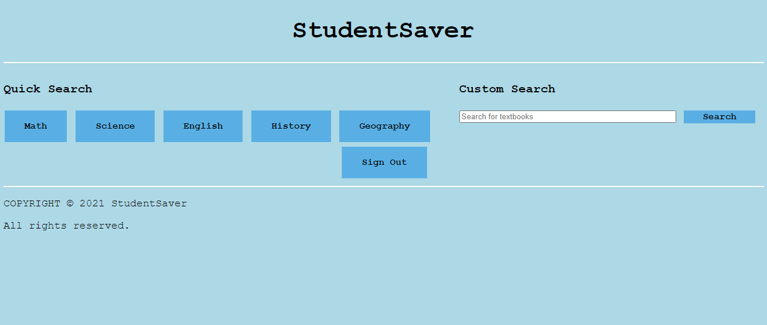

Slide 5
Search Page
Here, the customer will see the results from their search
If they so choose, they can try searching again directly on the search page
All of the important information about their results are shown, including the title, author, field, description, etc.
If the customer is interested in a book, they can then add it to their cart
Once, they are satisfied with their choices, they can check out

Slide 6
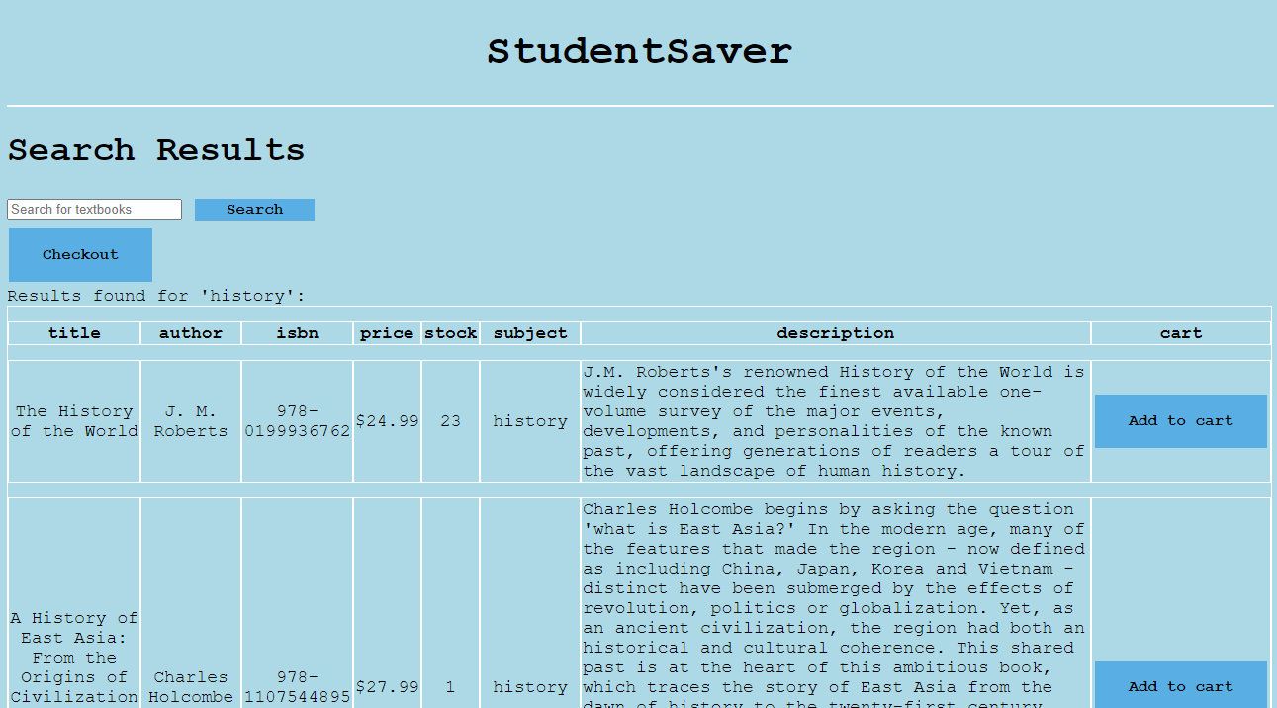

Slide 7
Checkout Page
Finally, the customer can check out and pay
They will see the contents of their cart, including the book titles, authors and prices
In addition, they will see their subtotal, tax and final total cost
After filling out their shipping and payment information, and clicking the Order button, they will be greeted by a success page, which will redirect them back to the home page

Slide 8
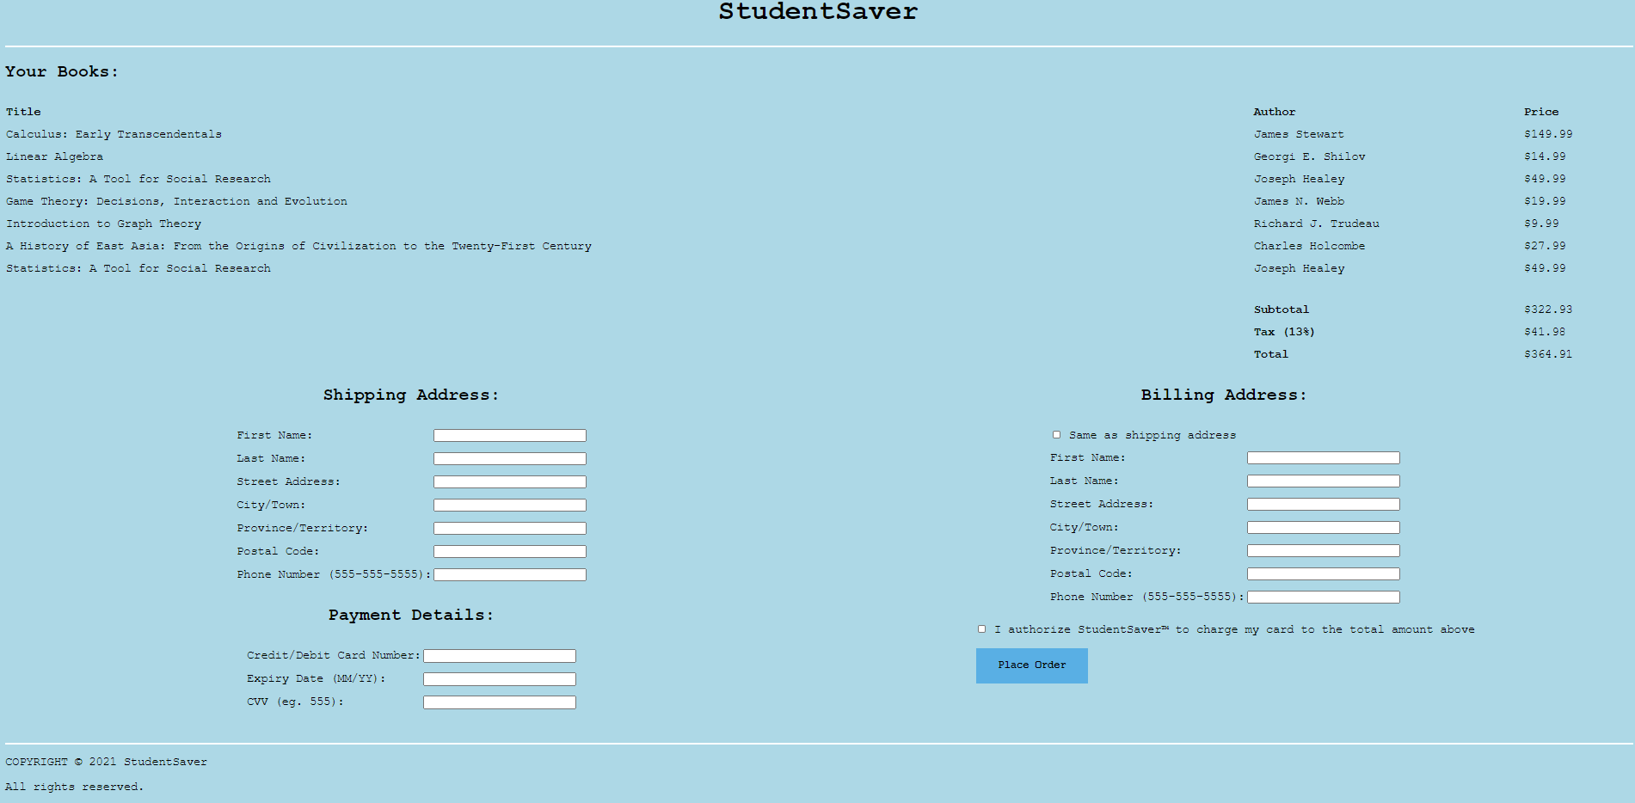

Slide 9
Conclusion
The front end of the website was built using HTML, CSS, JavaScript and AJAX
The backend is comprised of much PHP, with a dedicated API created to interface with the database layer
Finally, MongoDB was used for the database layer to store customer and book data

