Slide 1
Dijet rho unfolding
2018, Jacobian statistical propagation, ratio-curvature regularization
Key outputs: unfolded spectra, response/correlation matrices, L-curves, grouped uncertainties, and diagnostics.
Generated from outputs/dijet/2018/rho/unfolding_jacobian_reg

Slide 2
Run configuration and scope
dijet 2018 rho | Jacobian + ratio-curvature regularization
•
Command: python scripts/run_unfolding.py --channel dijet --observable rho --year 2018 --jacobian --regularization ratio_curvature
•
Output: outputs/dijet/2018/rho/unfolding_jacobian_reg/
•
Resolved tau: ungroomed 0.7907, groomed 0.6954
•
Uncertainties are partial: input-data statistics plus available response variations.
•
Excluded by design for dijet/trijet inputs: response MC statistics and HERWIG/model uncertainty.
Generated from outputs/dijet/2018/rho/unfolding_jacobian_reg

Slide 3
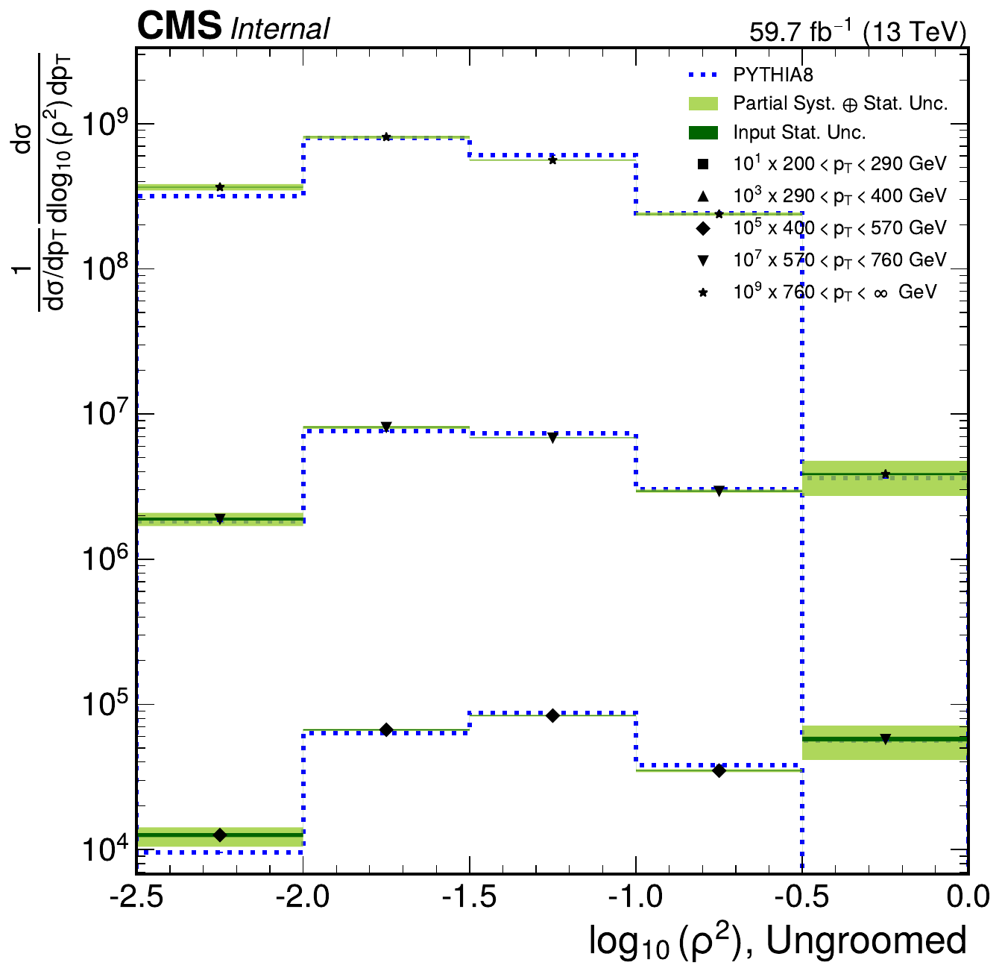
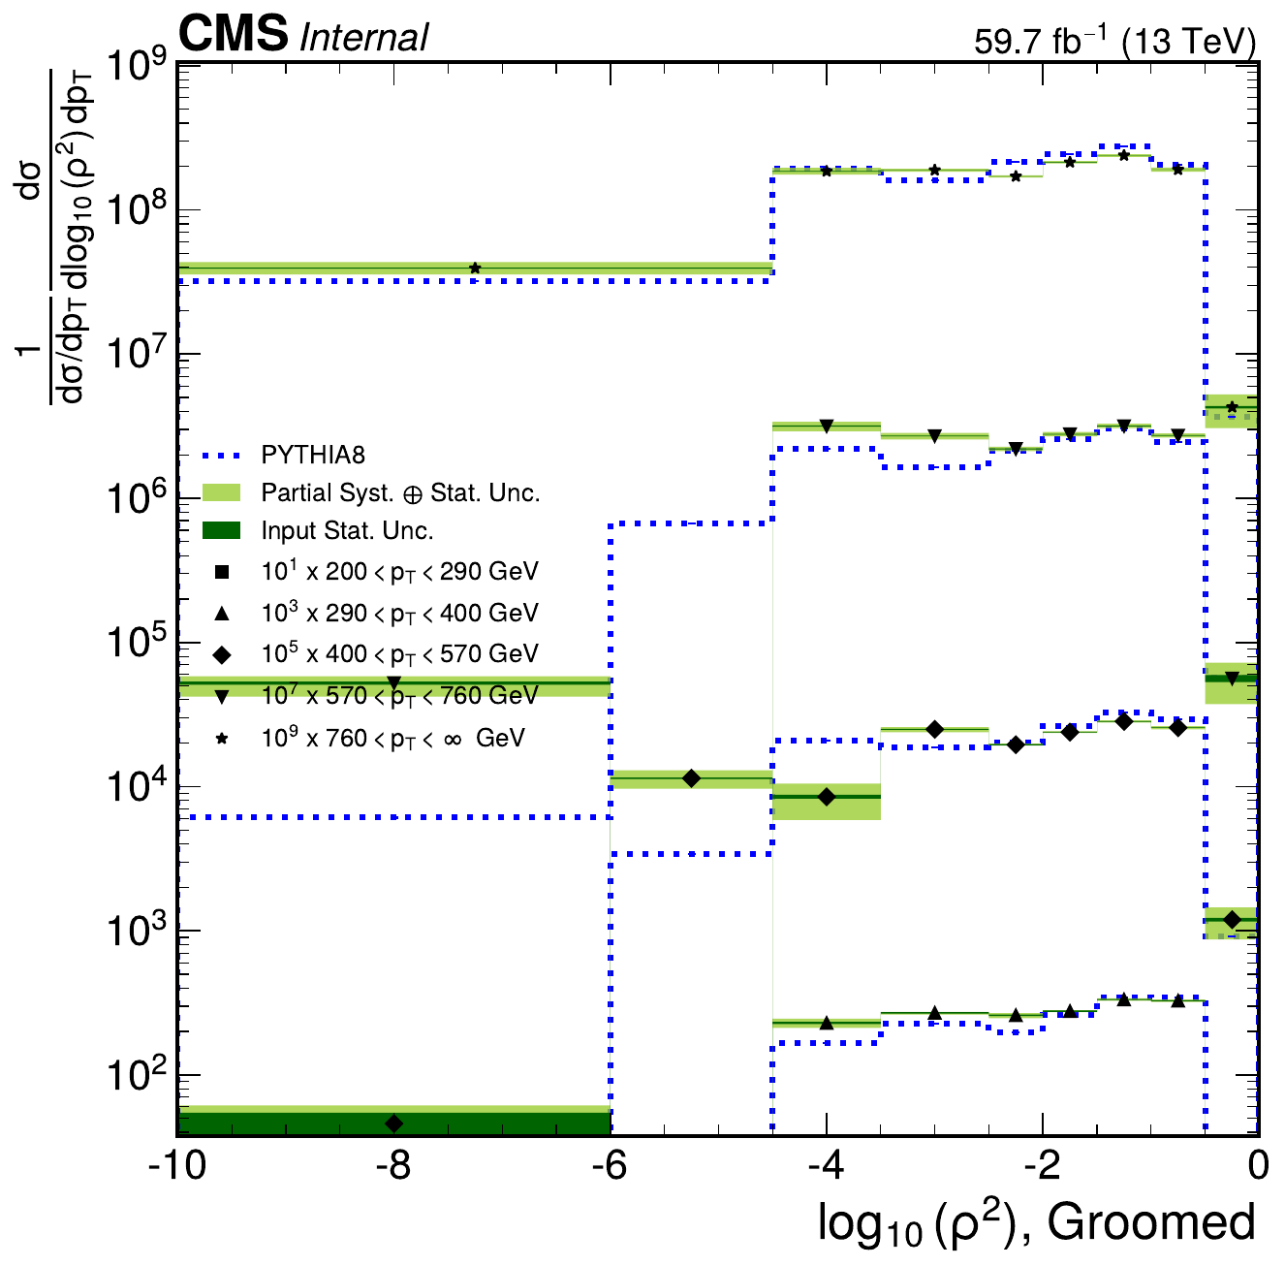
Unfolded results: summary overview
dijet 2018 rho | Jacobian + ratio-curvature regularization
Ungroomed
Groomed
Generated from outputs/dijet/2018/rho/unfolding_jacobian_reg

Slide 4
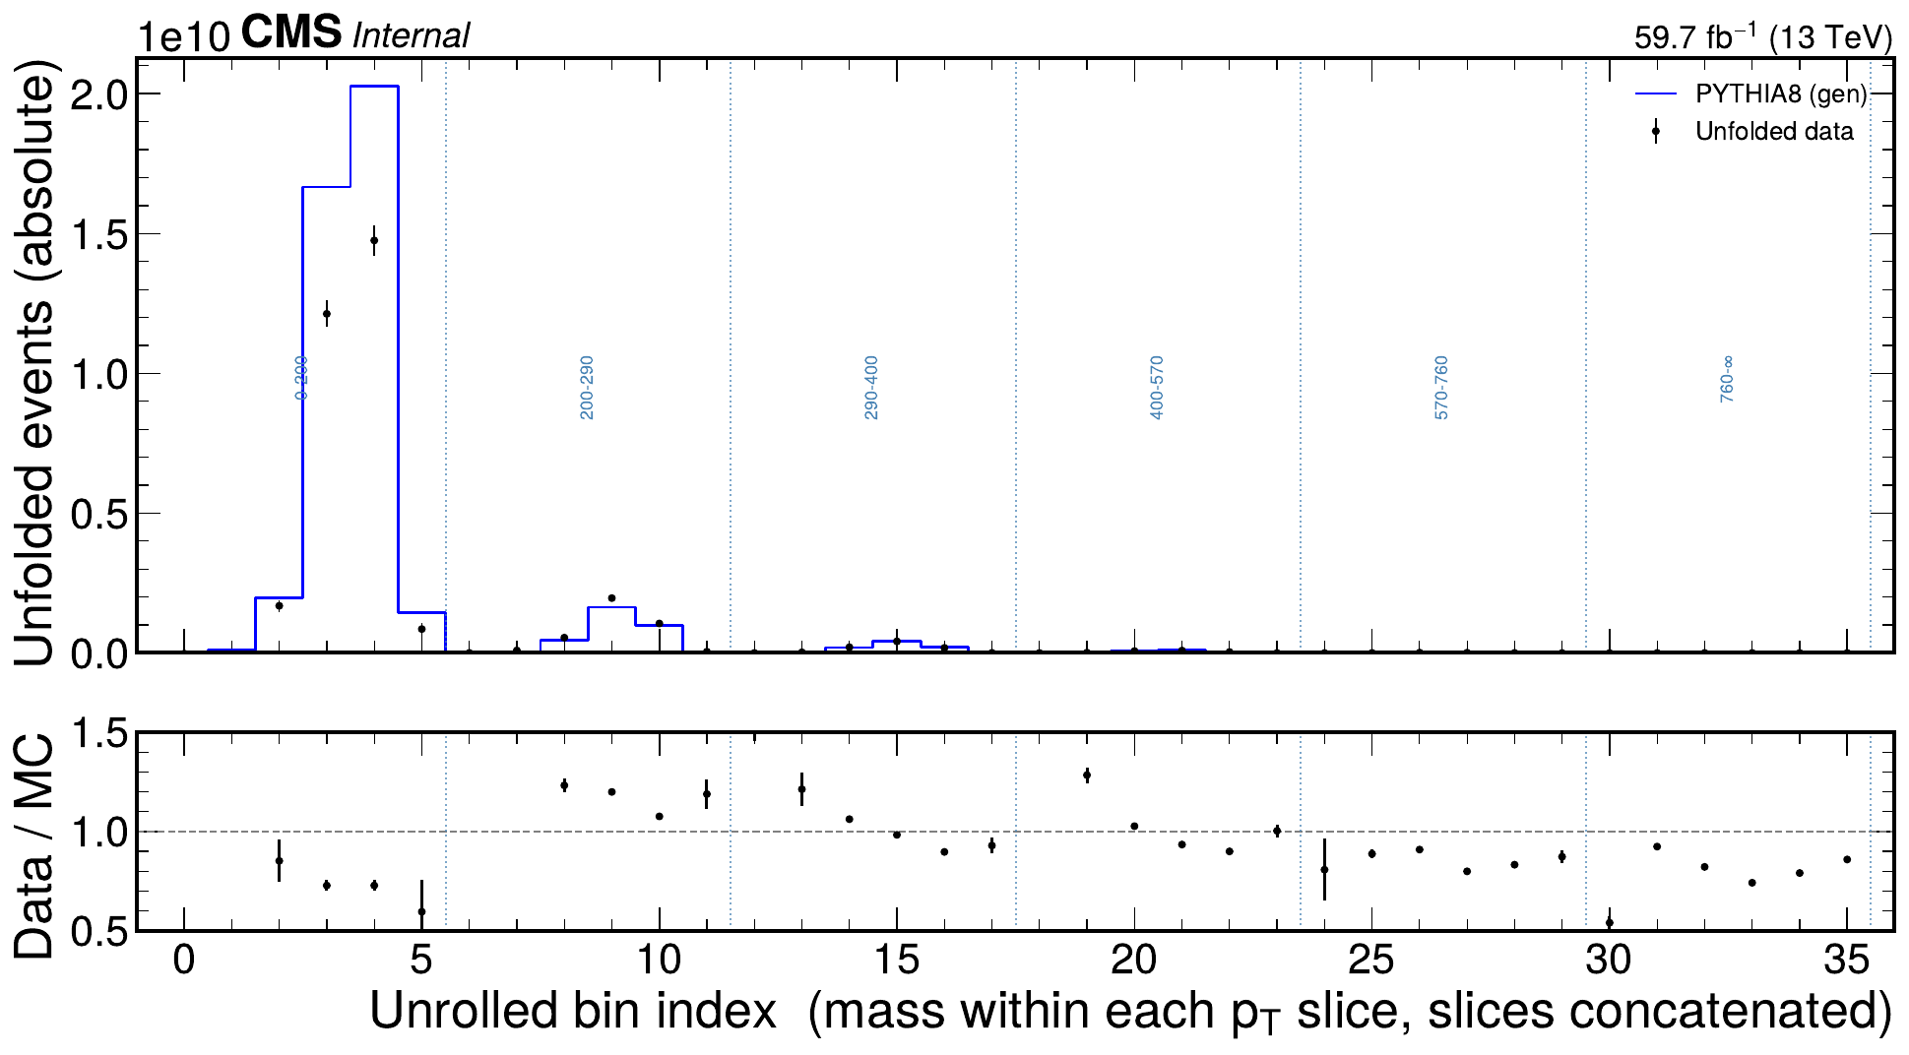
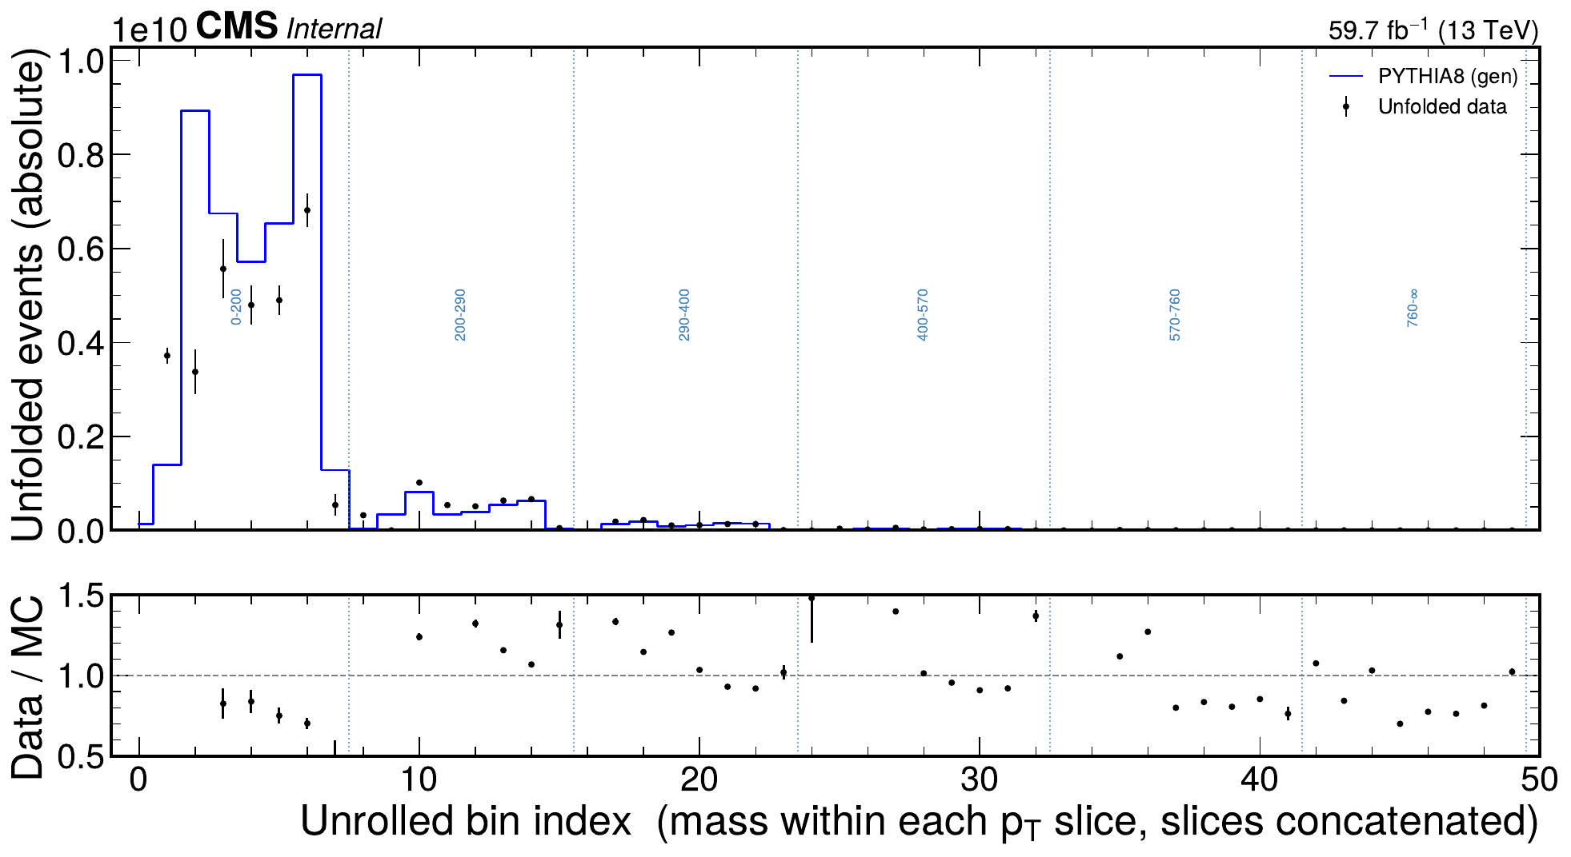
Unfolded results: full unrolled spectra
dijet 2018 rho | Jacobian + ratio-curvature regularization
Ungroomed
Groomed
Generated from outputs/dijet/2018/rho/unfolding_jacobian_reg

Slide 5
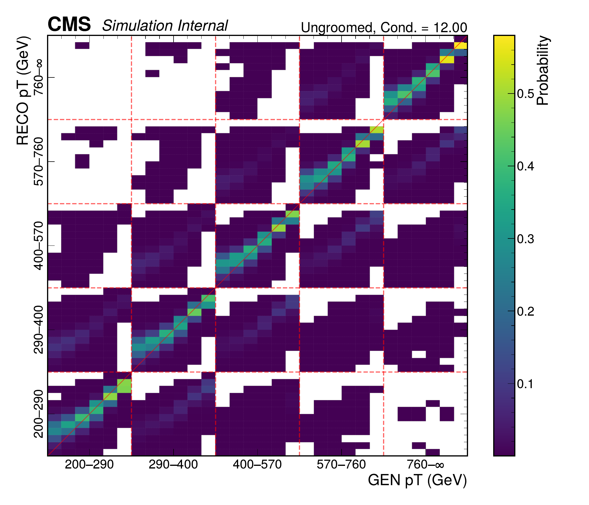
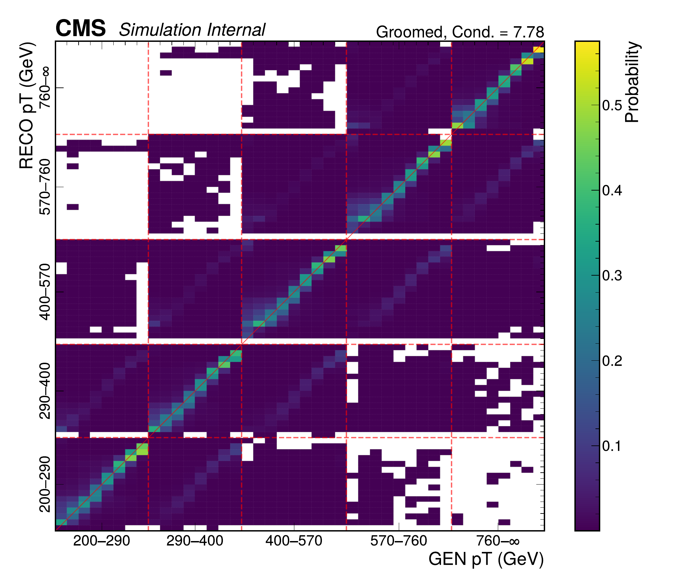
Response matrices
dijet 2018 rho | Jacobian + ratio-curvature regularization
Ungroomed
Groomed
Generated from outputs/dijet/2018/rho/unfolding_jacobian_reg

Slide 6
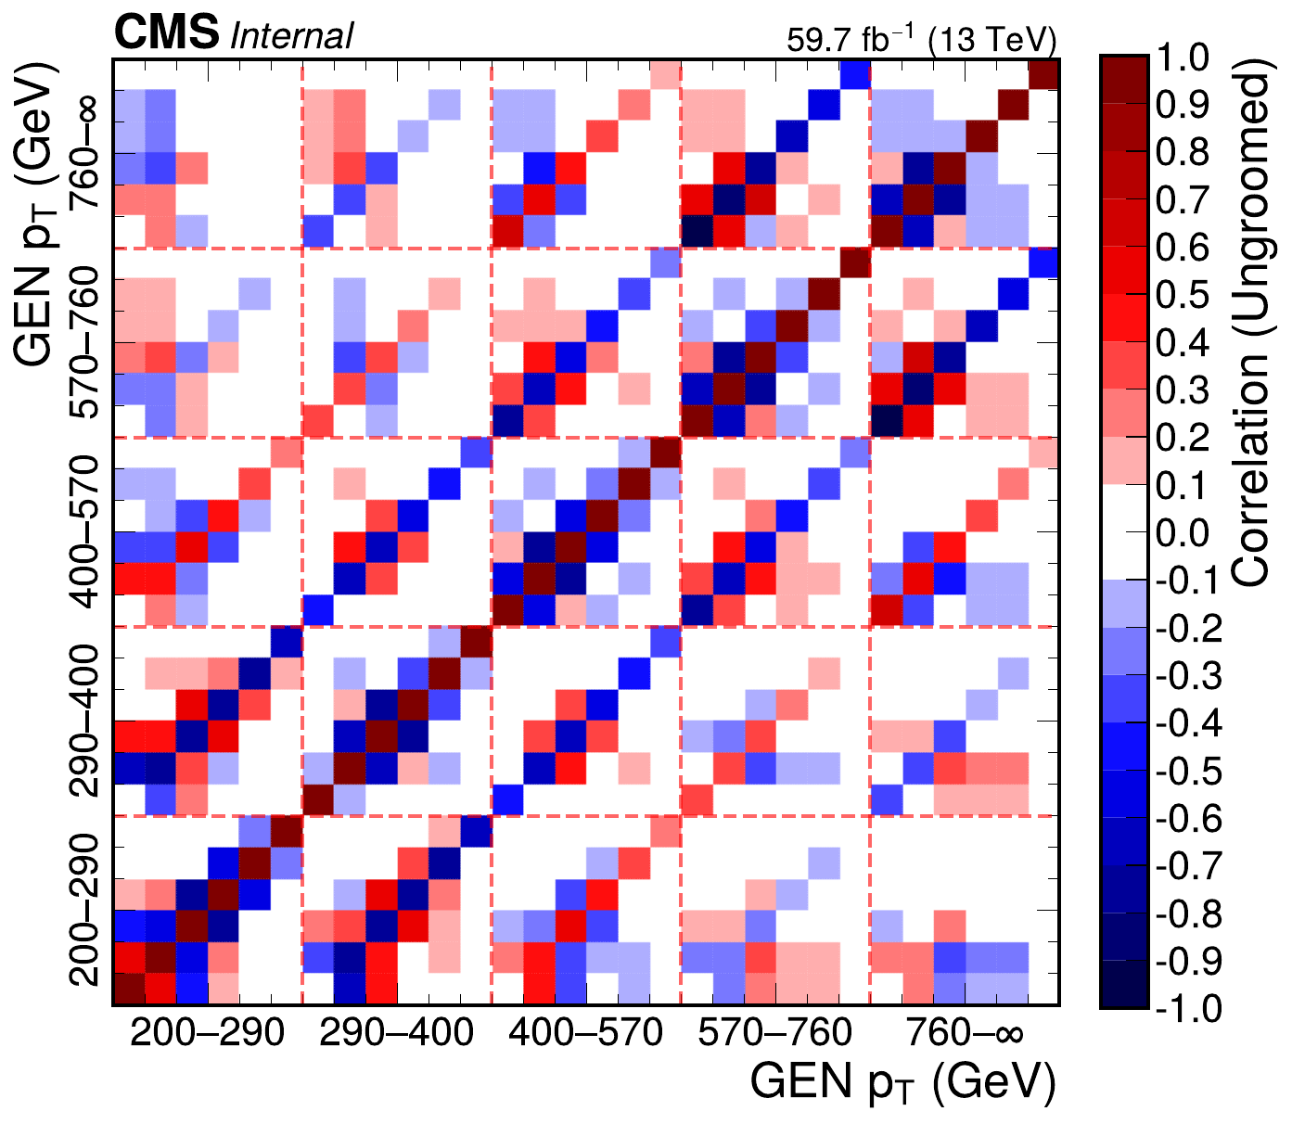
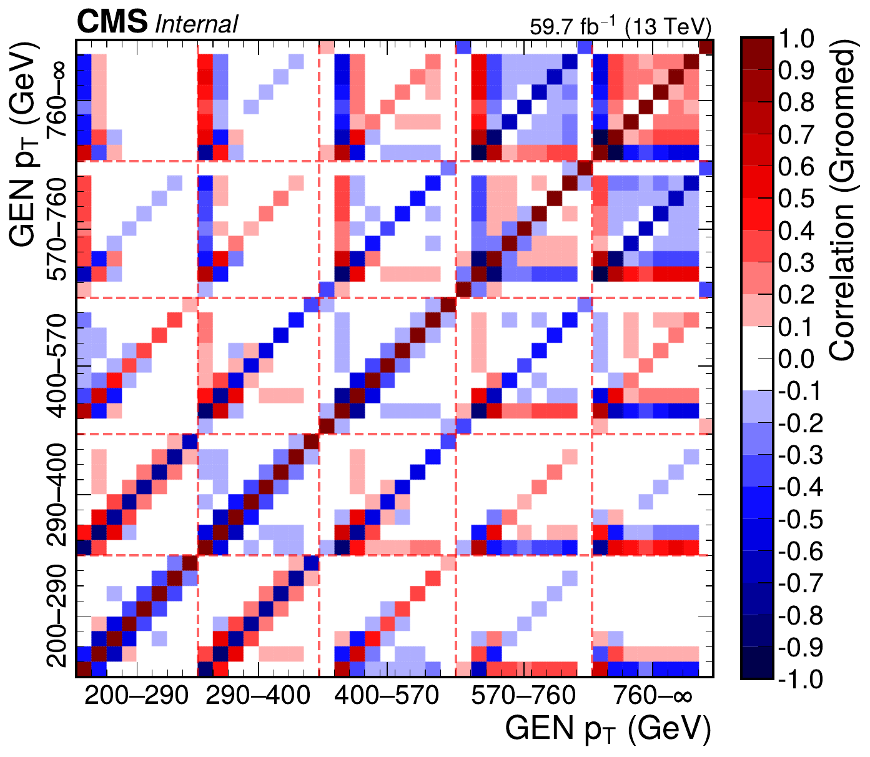
Normalized statistical correlations
dijet 2018 rho | Jacobian + ratio-curvature regularization
Ungroomed
Groomed
Generated from outputs/dijet/2018/rho/unfolding_jacobian_reg

Slide 7
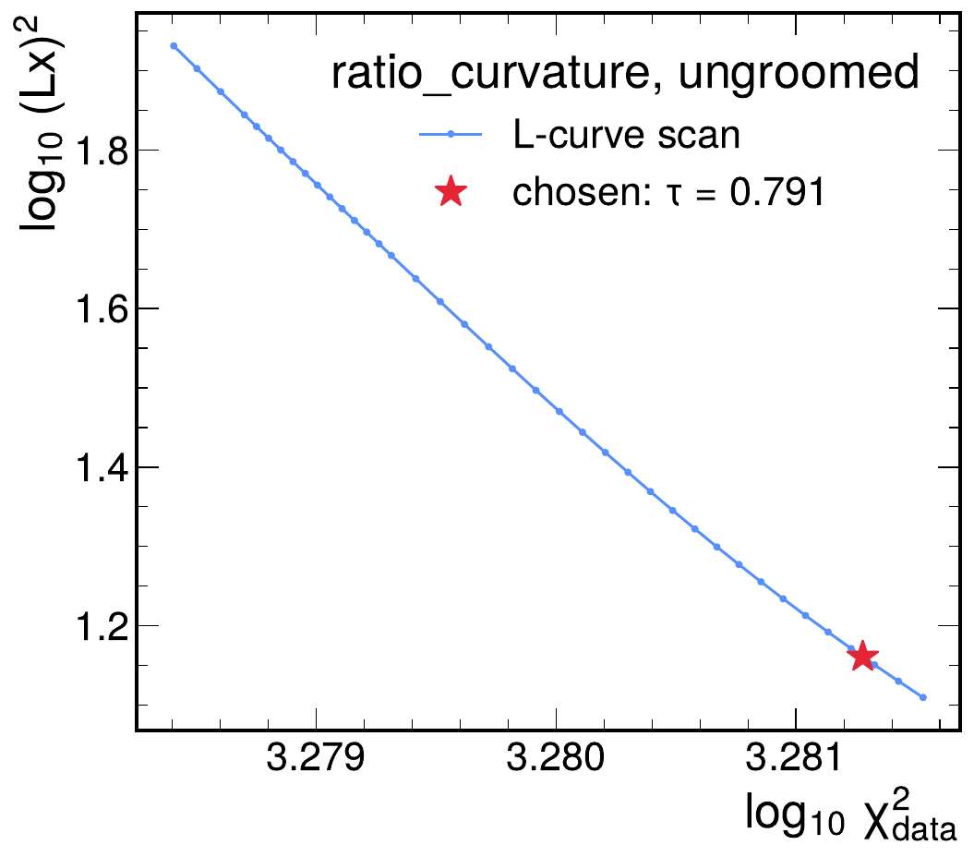
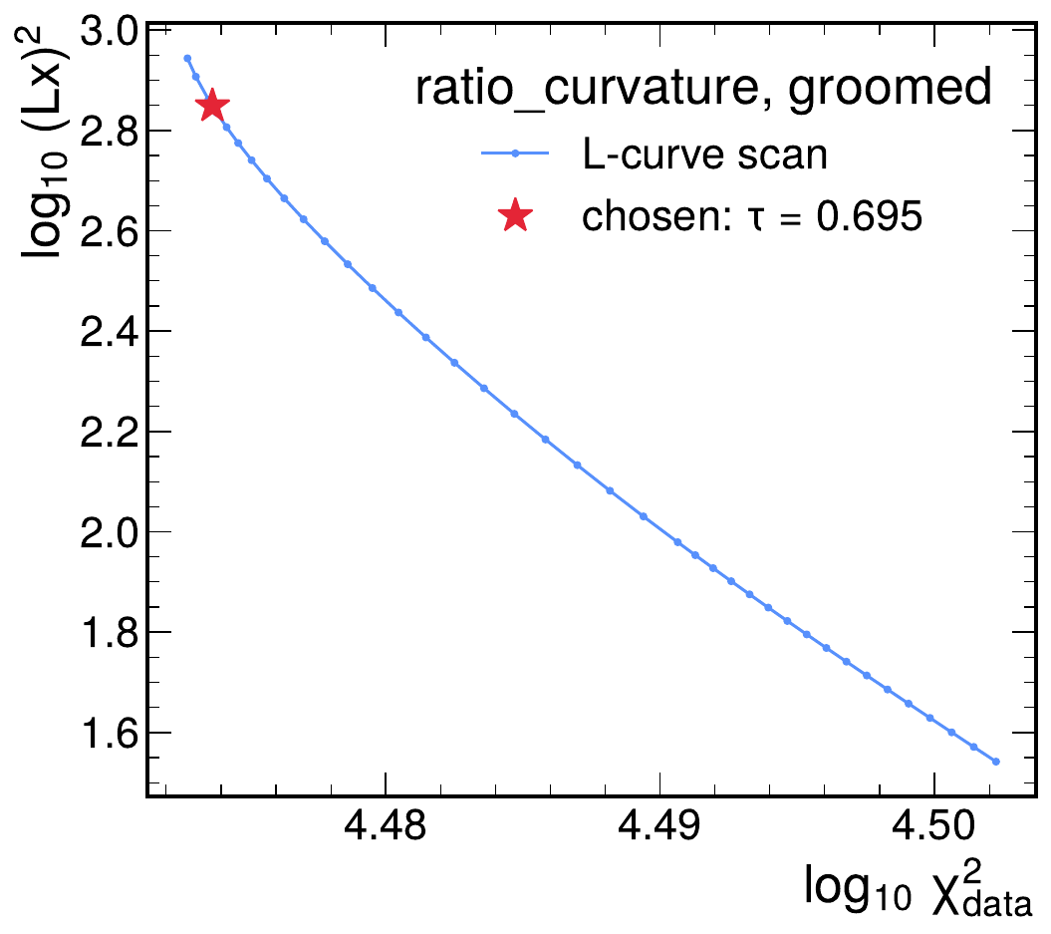
L-curve regularization scans
dijet 2018 rho | Jacobian + ratio-curvature regularization
Ungroomed tau = 0.7907
Groomed tau = 0.6954
Generated from outputs/dijet/2018/rho/unfolding_jacobian_reg

Slide 8
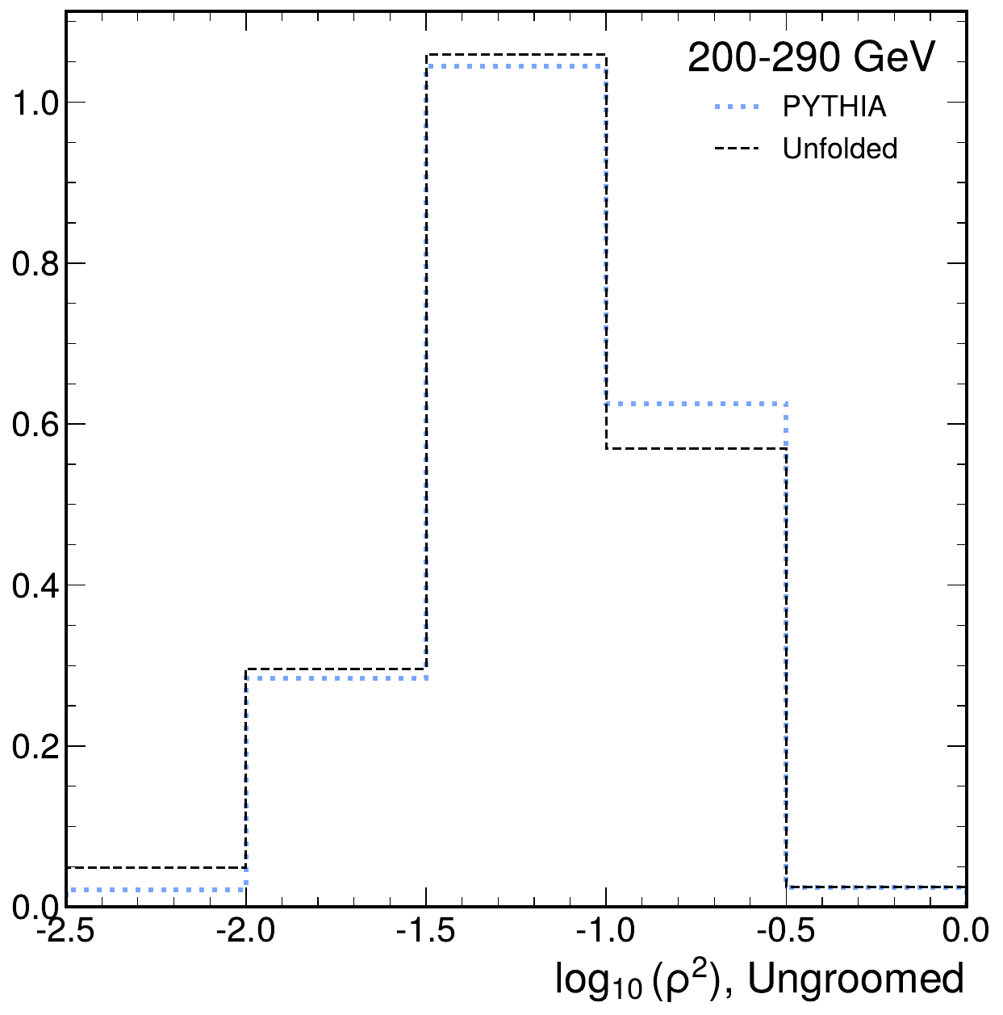
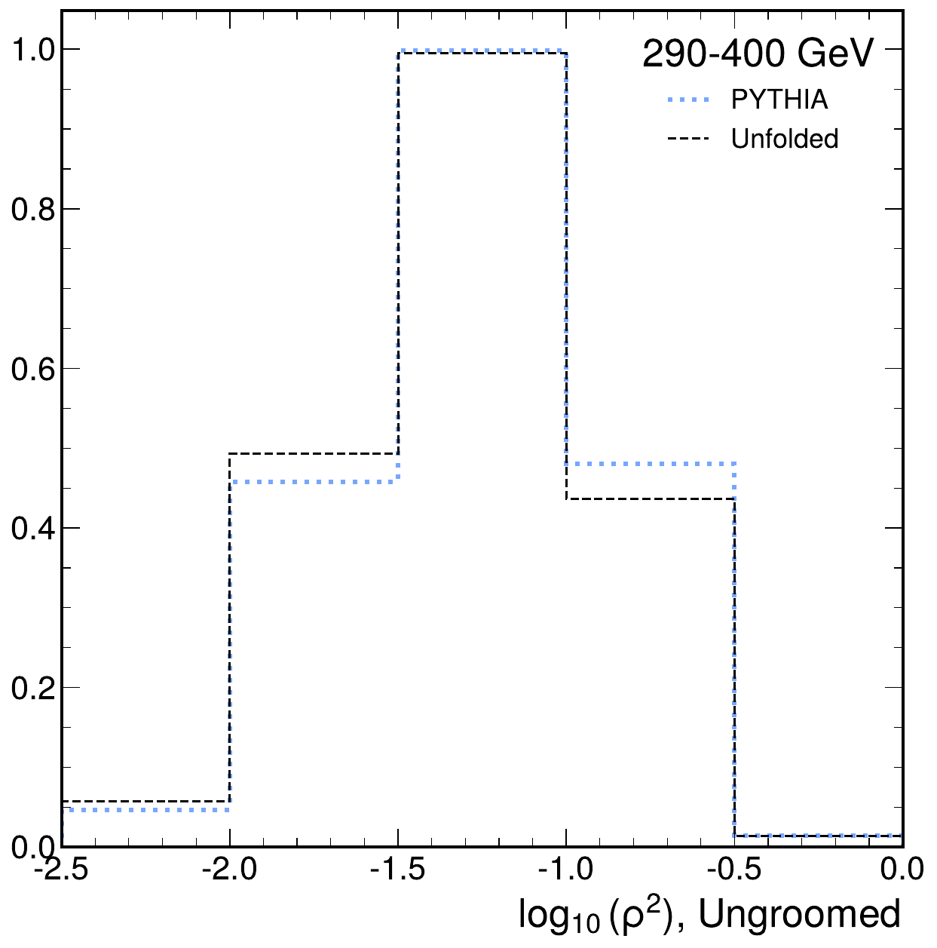
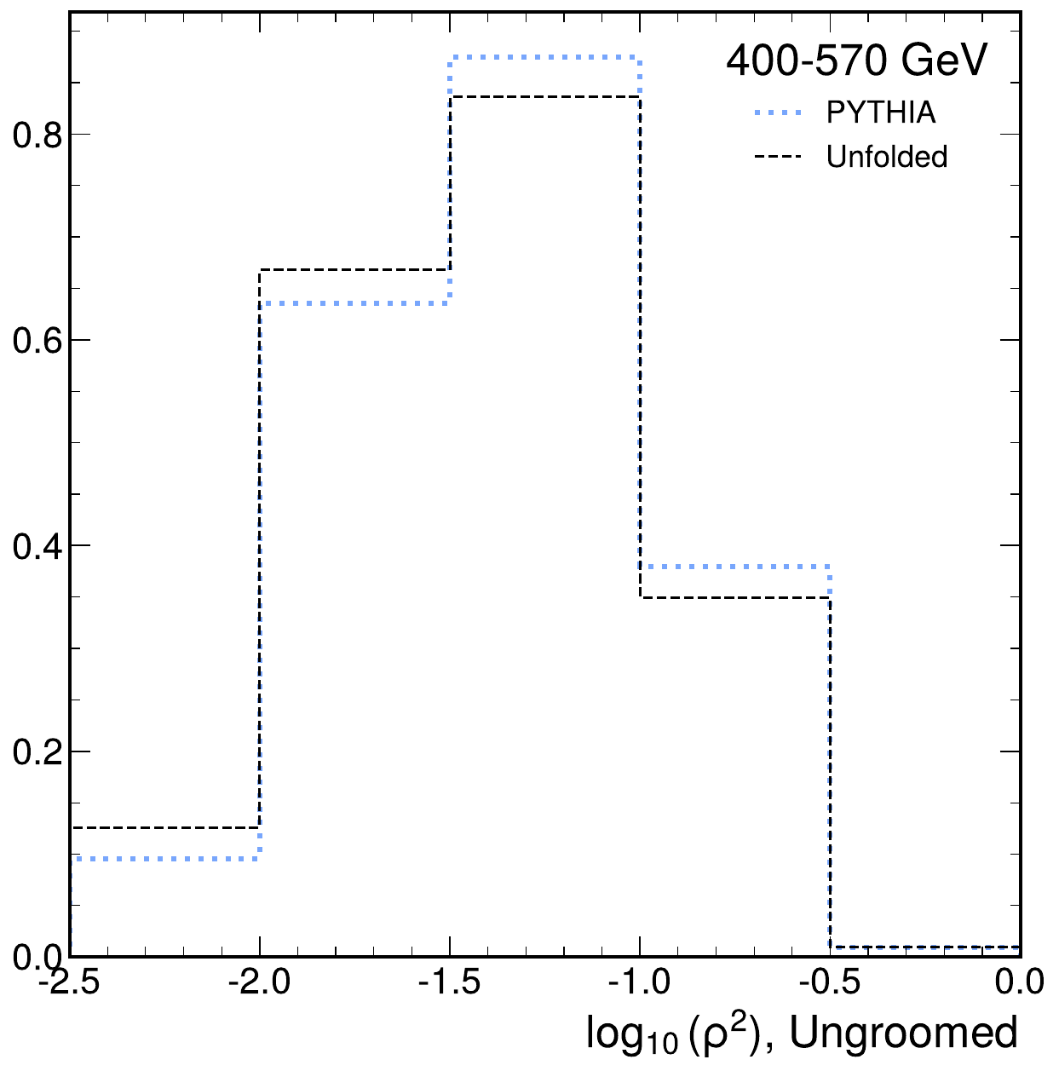
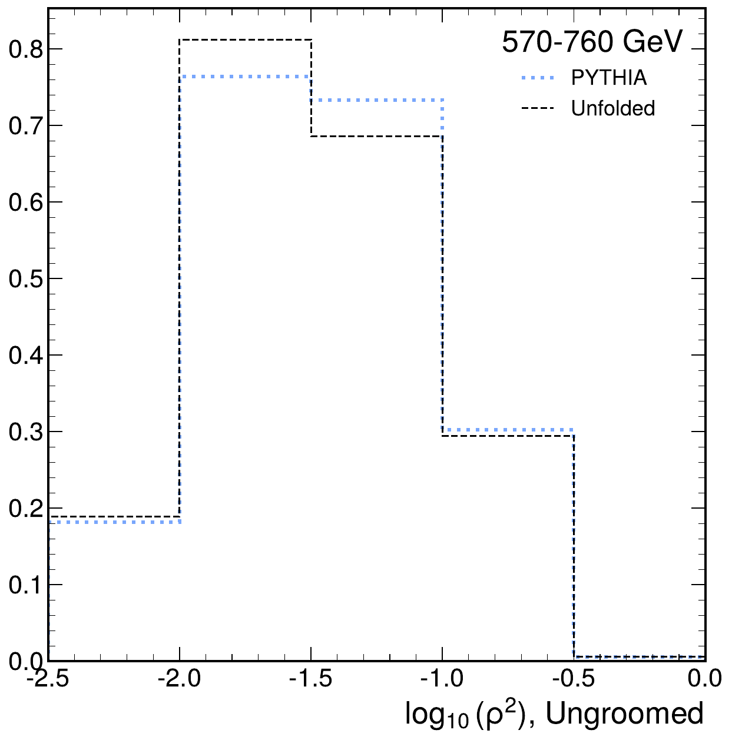
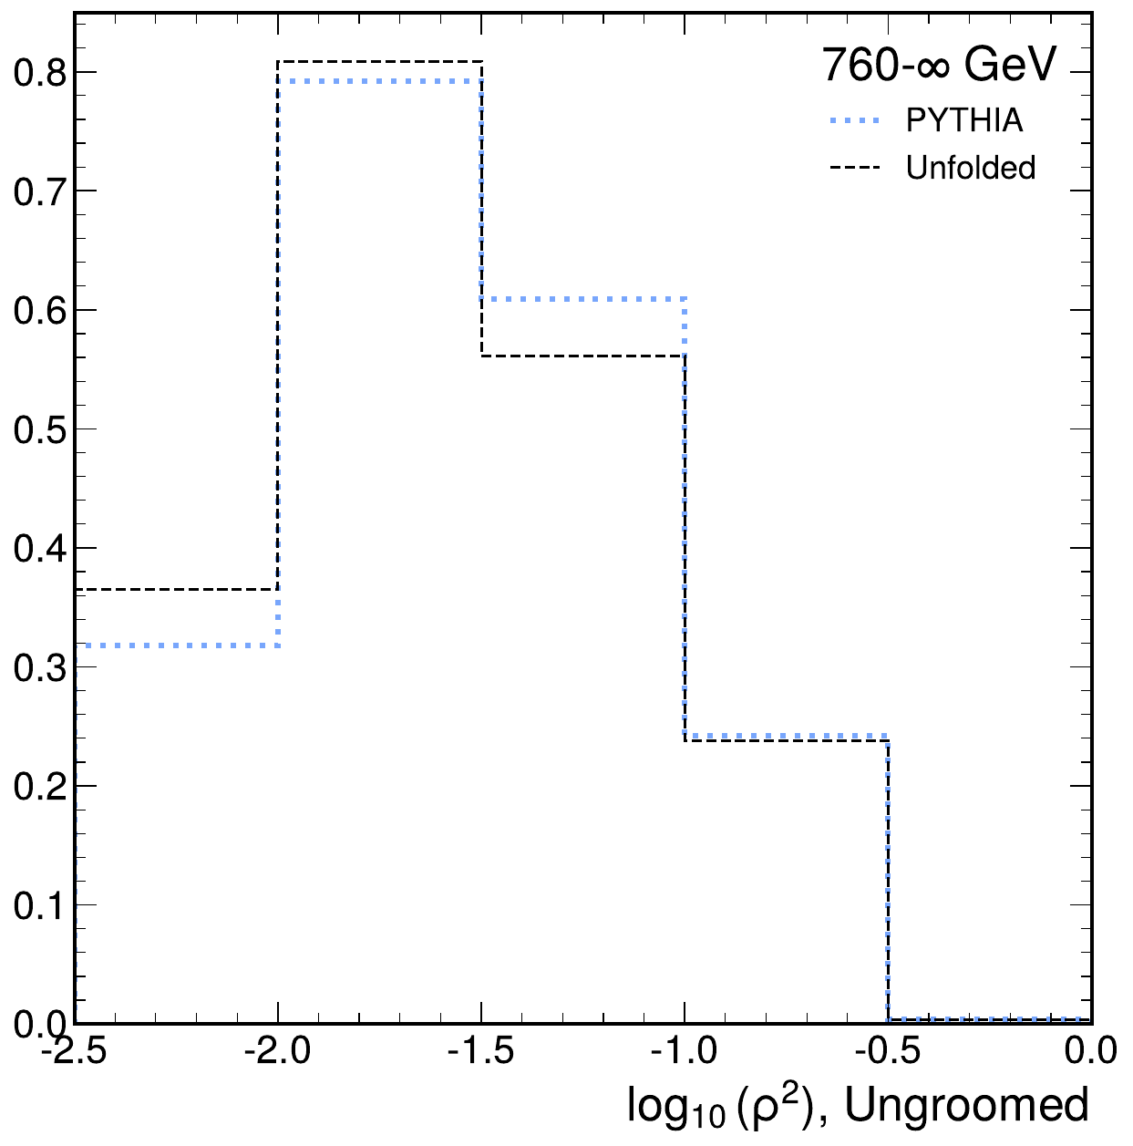
Unfolded panels: ungroomed
dijet 2018 rho | Jacobian + ratio-curvature regularization
200-290 GeV
290-400 GeV
400-570 GeV
570-760 GeV
> 760 GeV
Generated from outputs/dijet/2018/rho/unfolding_jacobian_reg

Slide 9
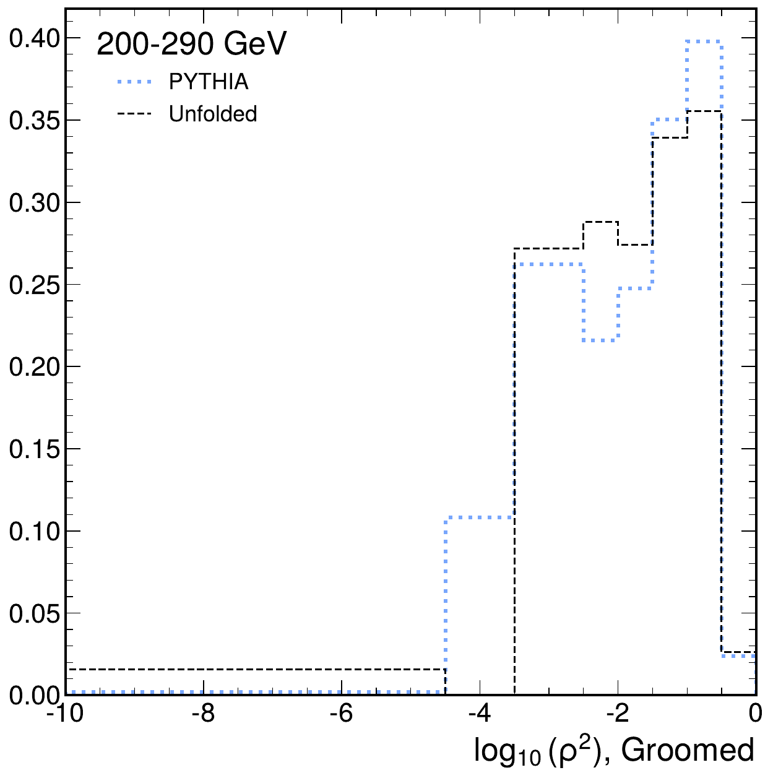
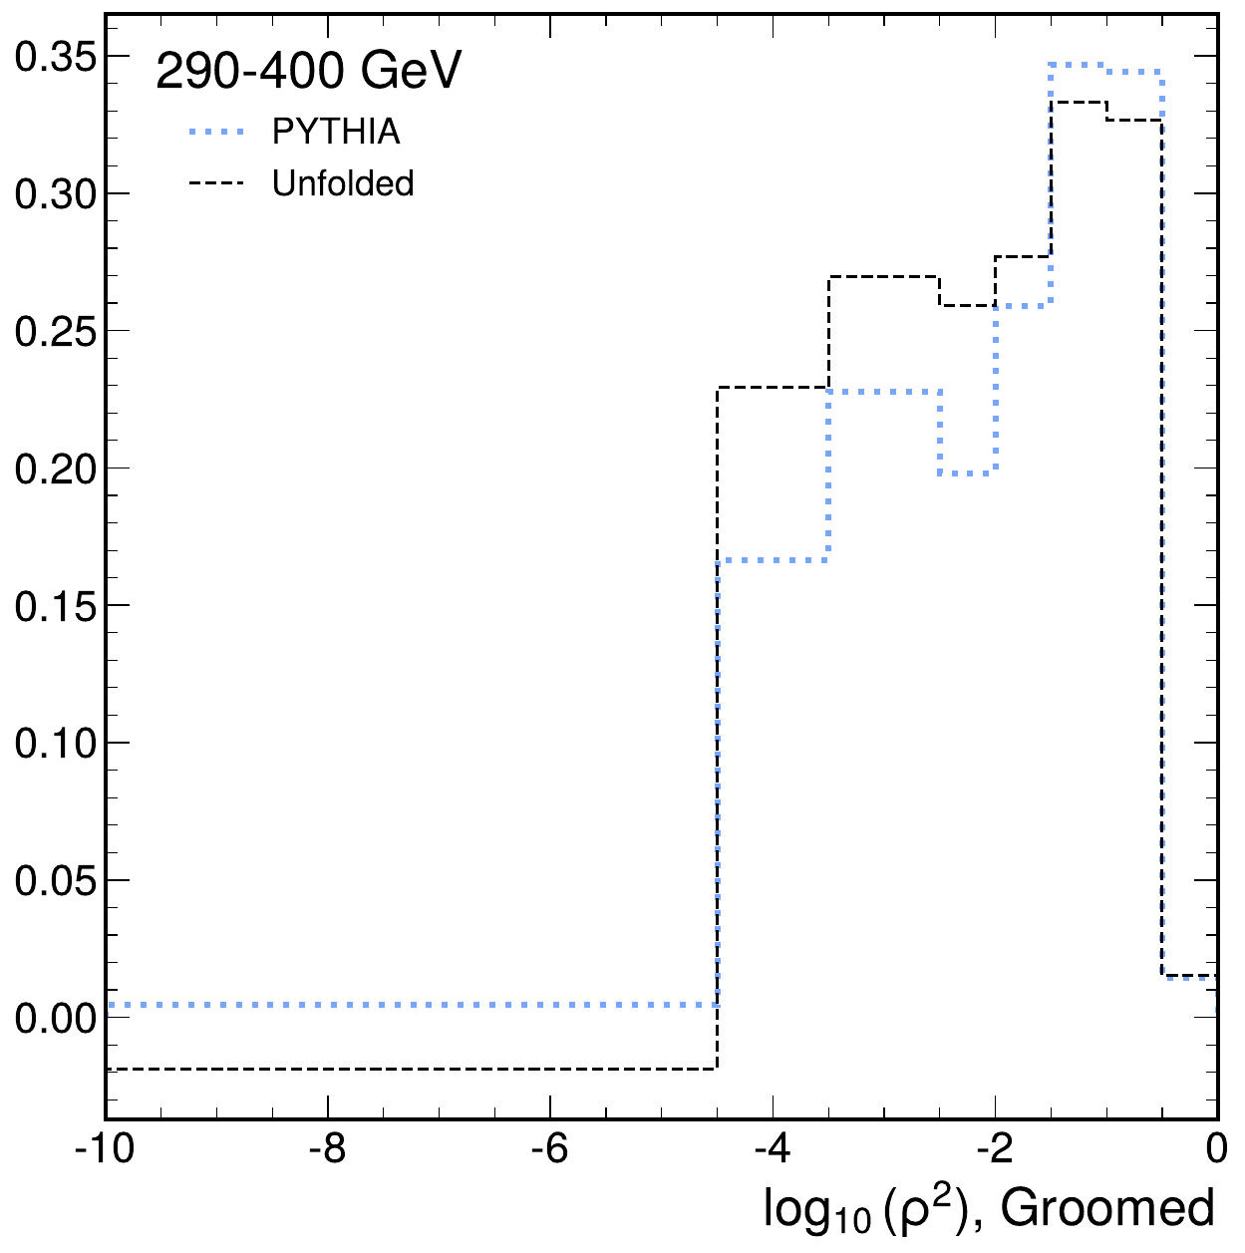
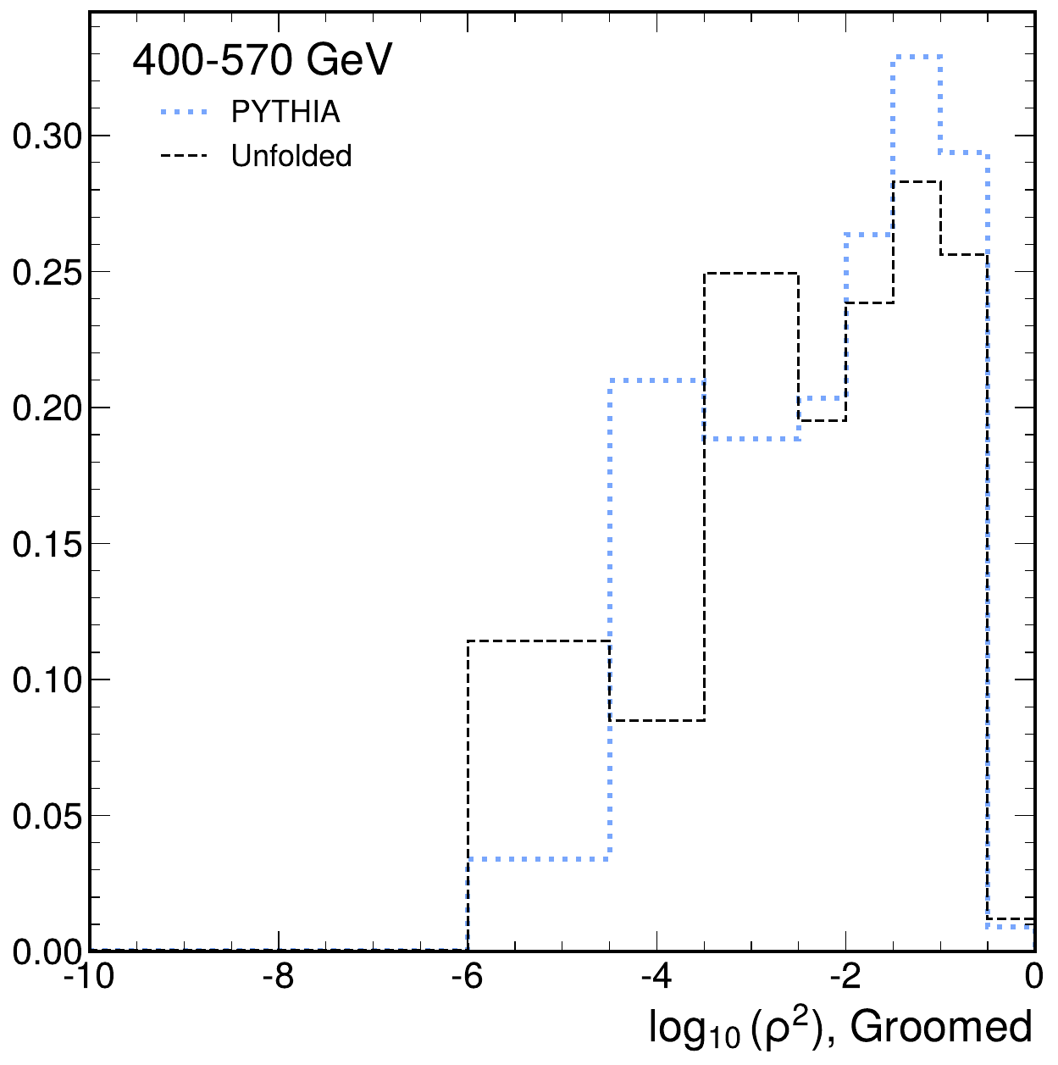
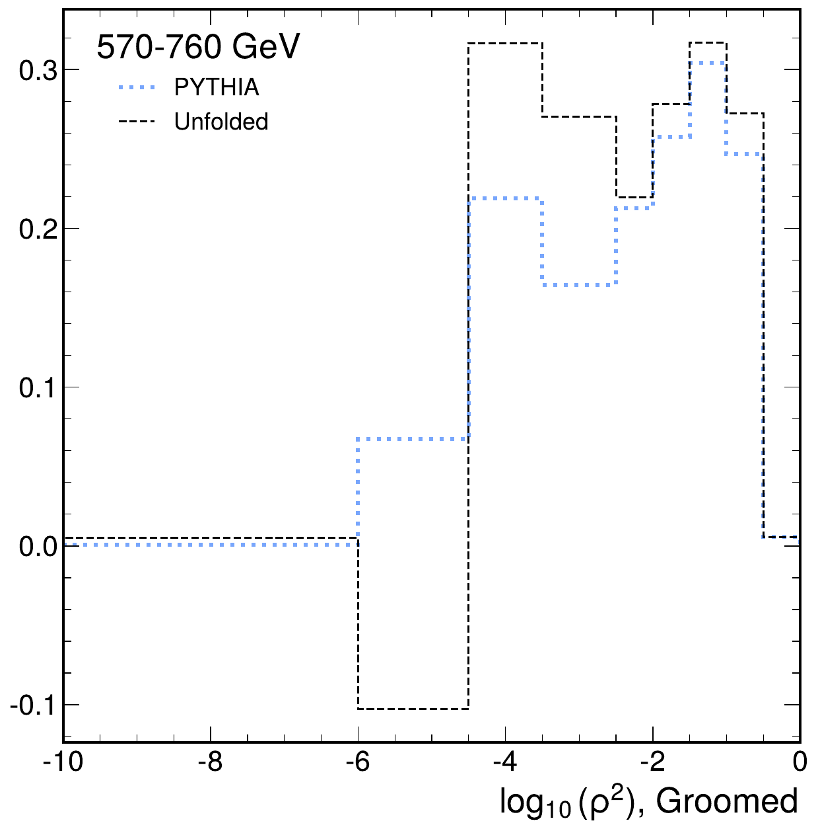
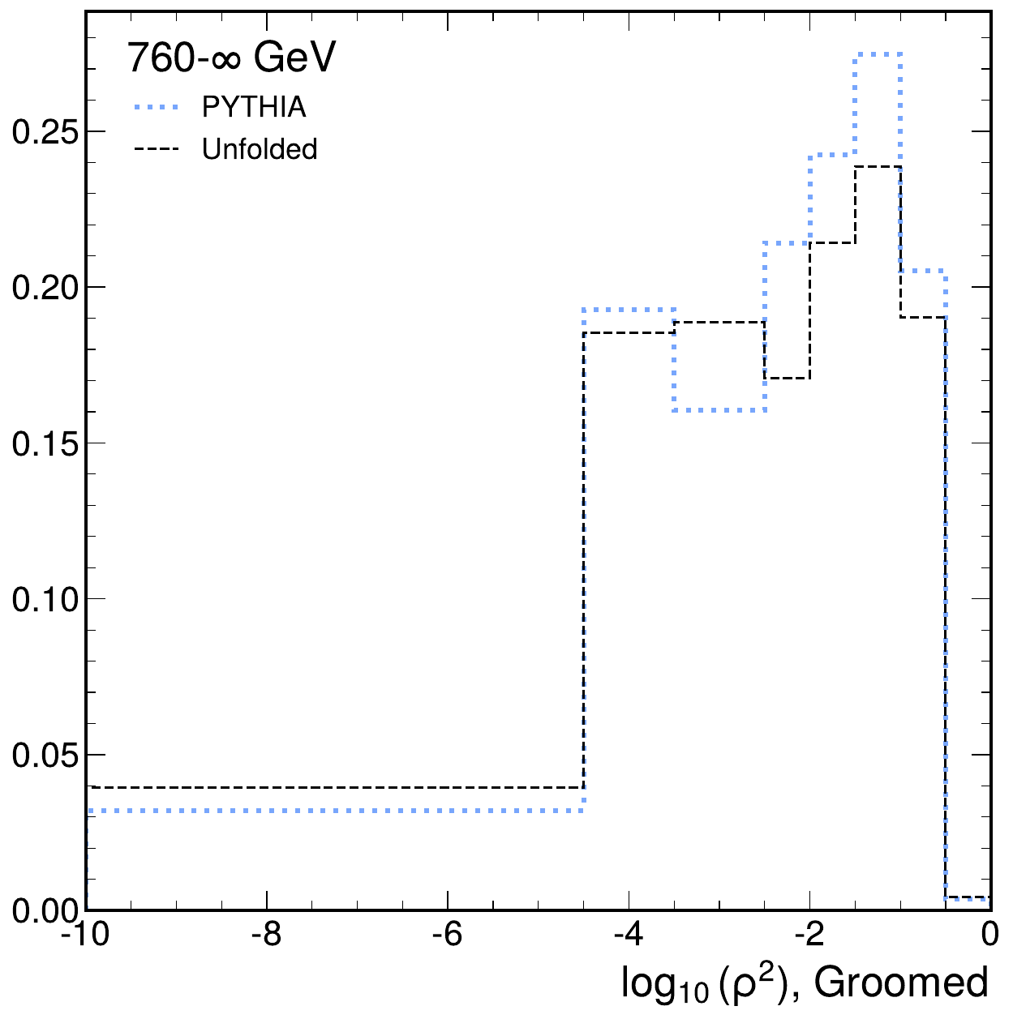
Unfolded panels: groomed
dijet 2018 rho | Jacobian + ratio-curvature regularization
200-290 GeV
290-400 GeV
400-570 GeV
570-760 GeV
> 760 GeV
Generated from outputs/dijet/2018/rho/unfolding_jacobian_reg

Slide 10
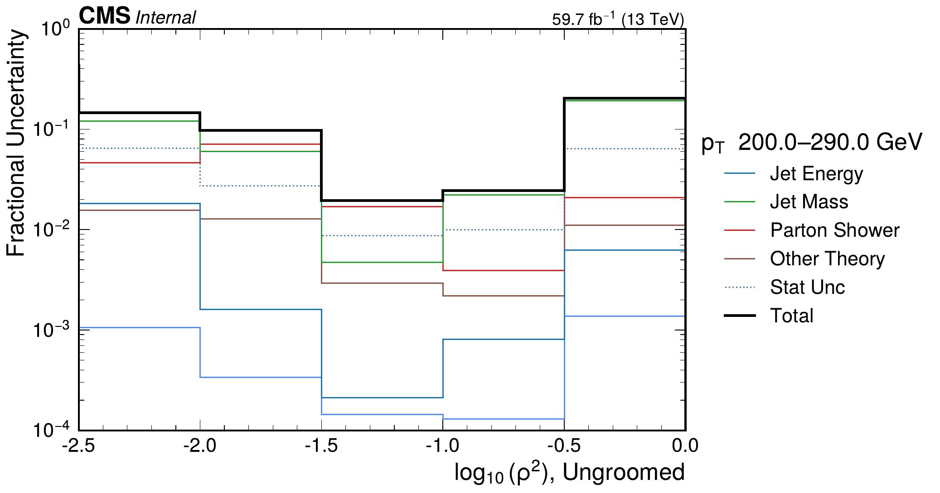
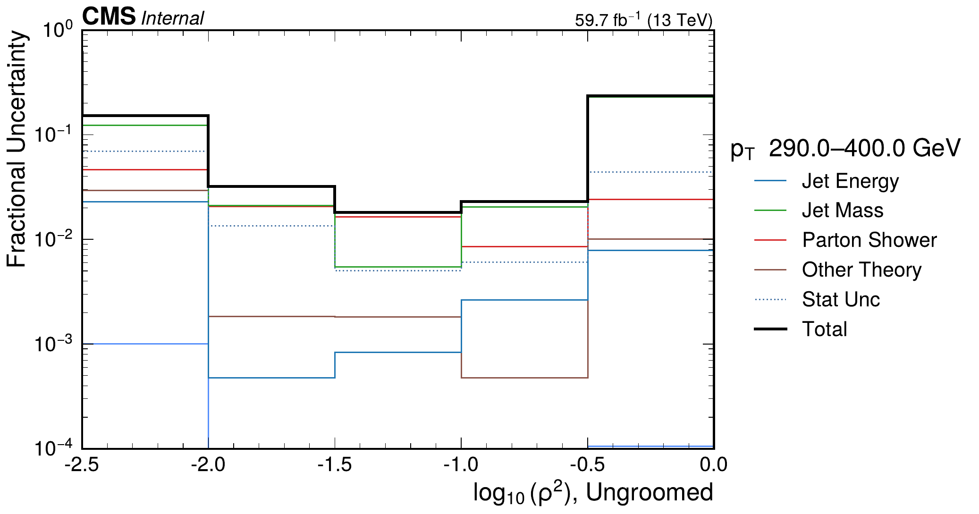
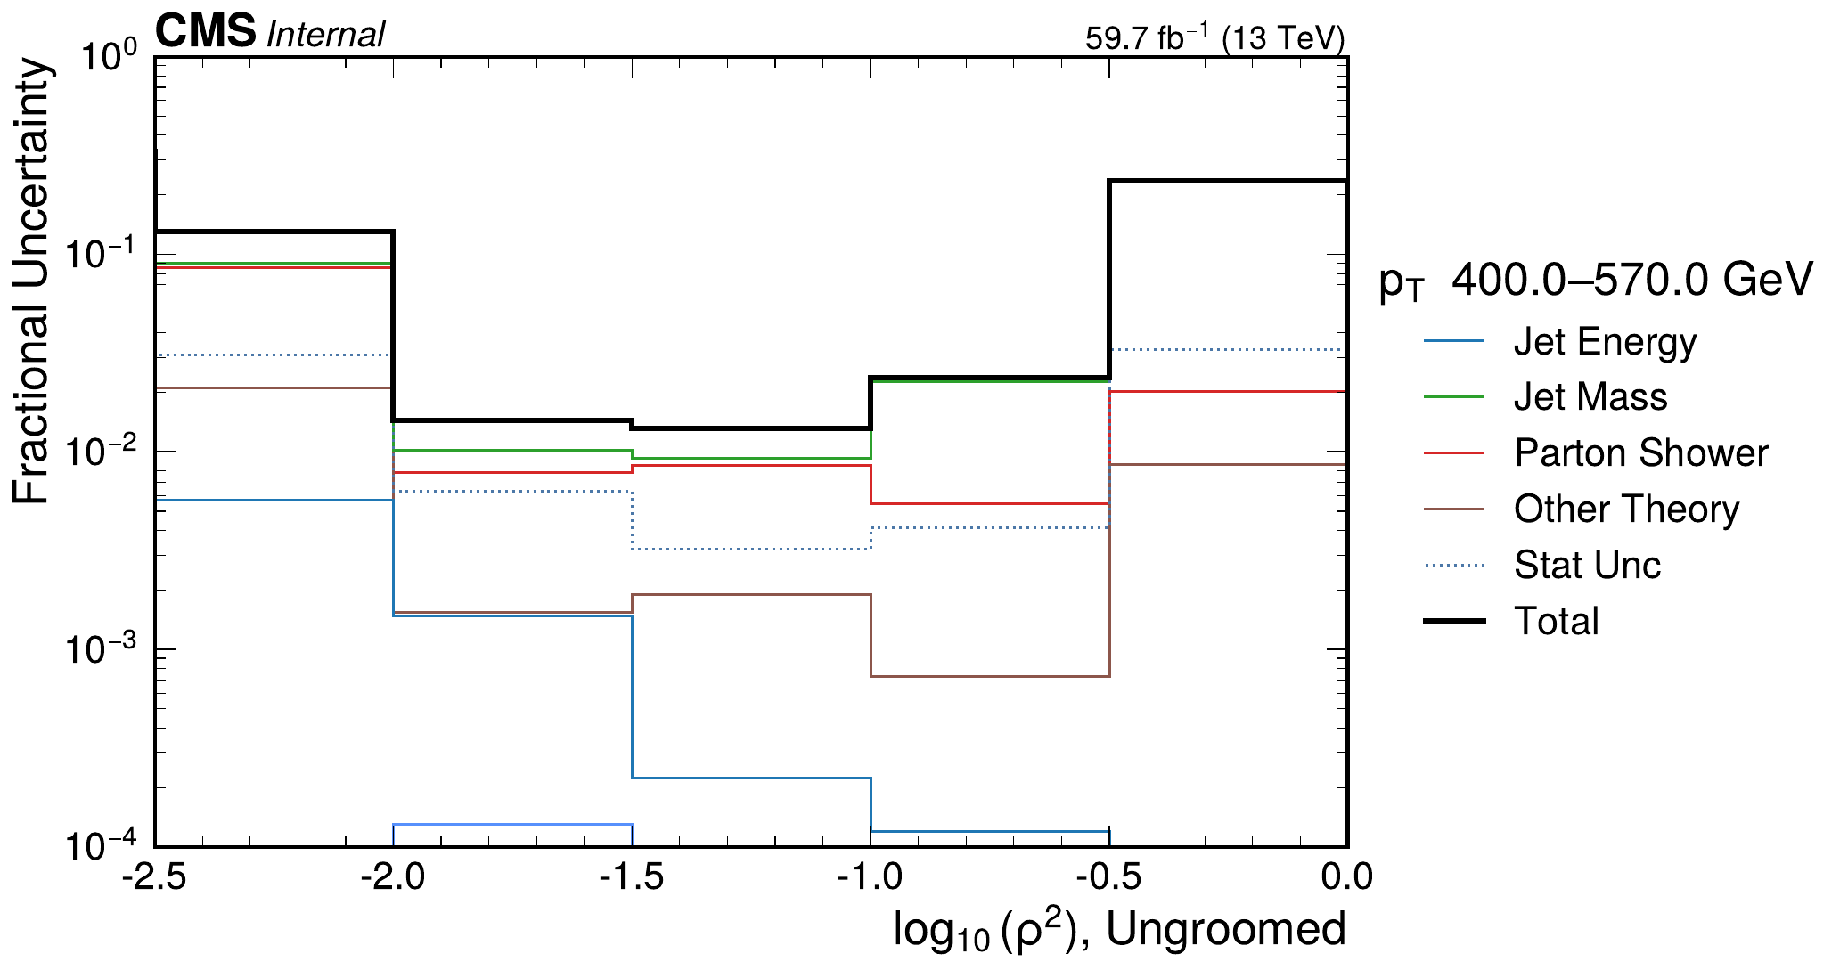
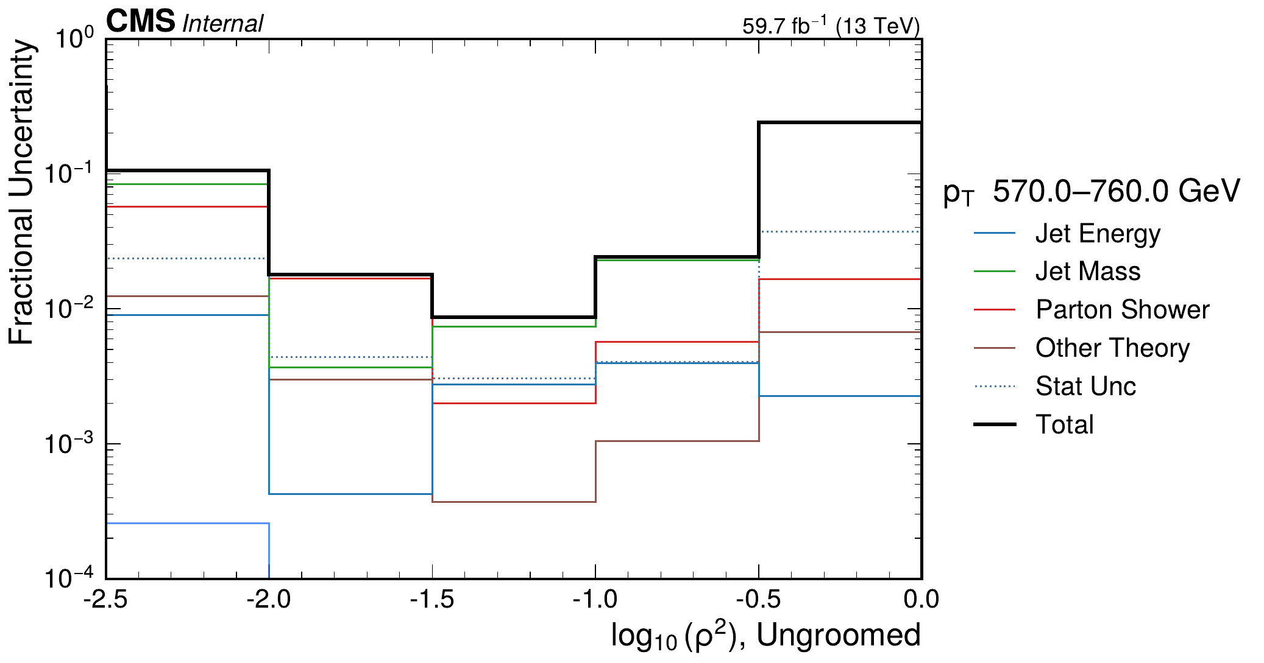
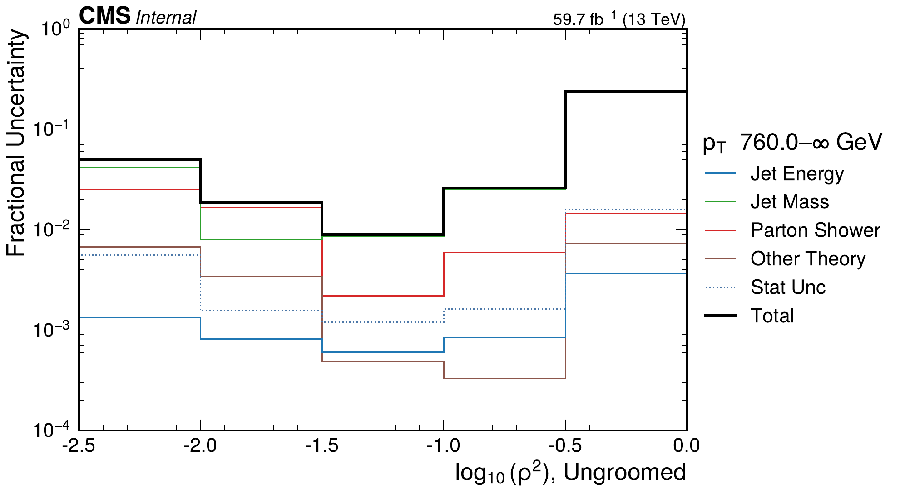
Grouped uncertainty summary: ungroomed
dijet 2018 rho | Jacobian + ratio-curvature regularization
200-290 GeV
290-400 GeV
400-570 GeV
570-760 GeV
> 760 GeV
Generated from outputs/dijet/2018/rho/unfolding_jacobian_reg

Slide 11
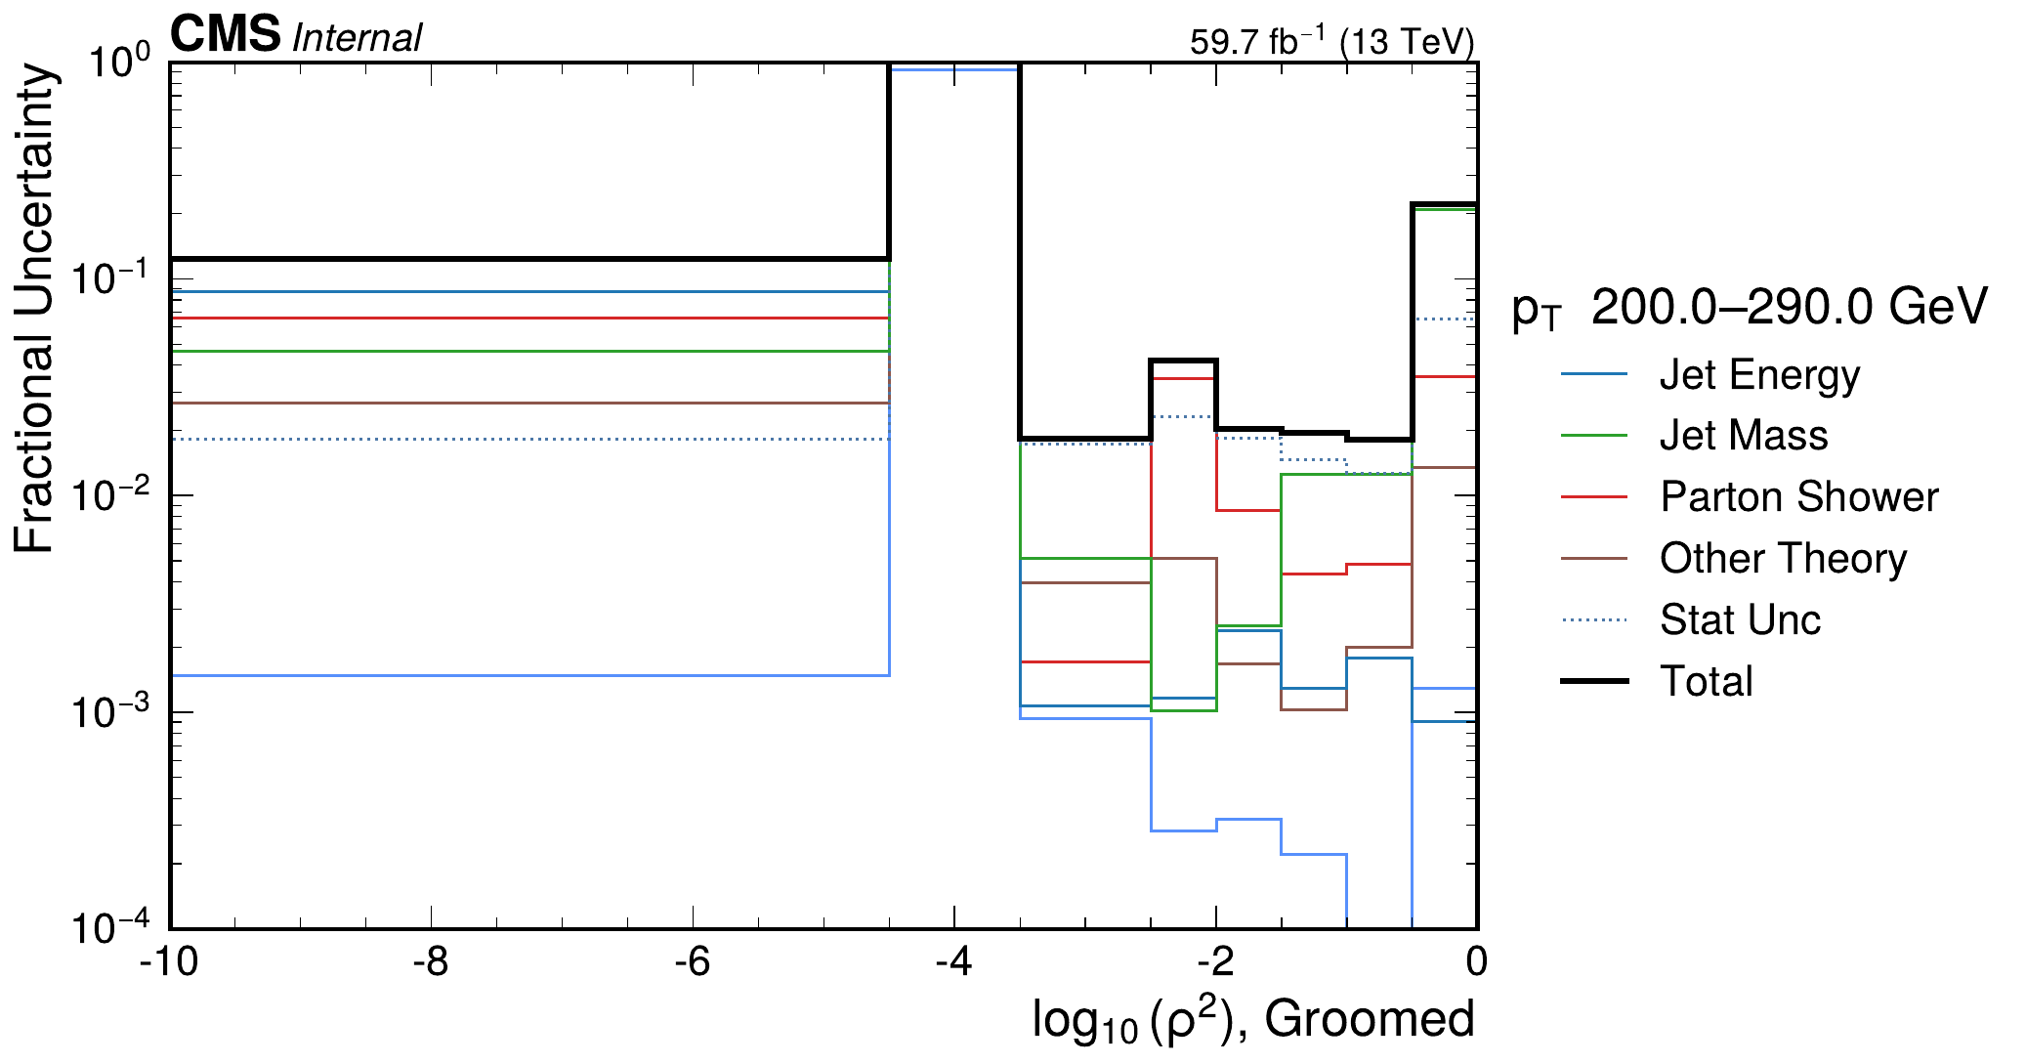
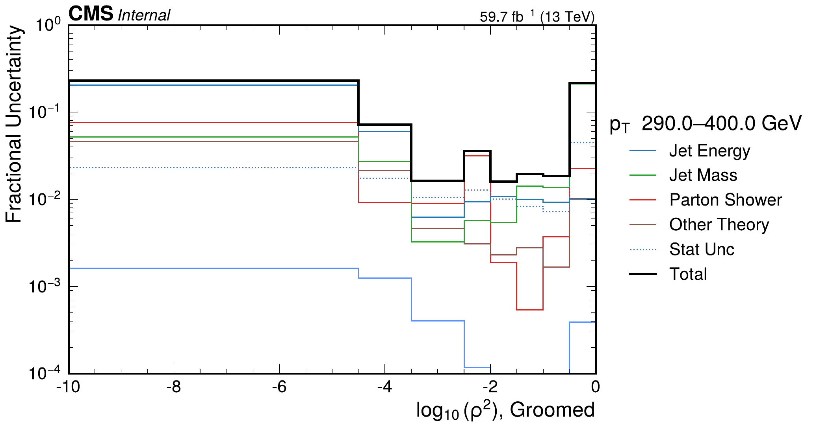
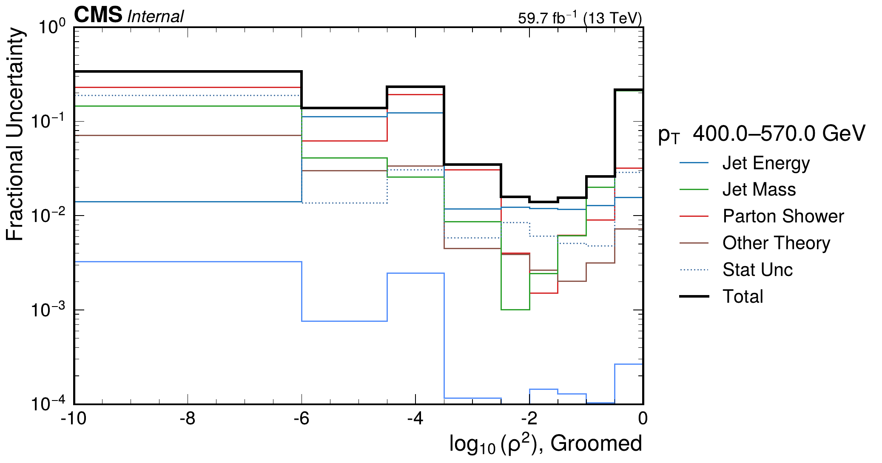
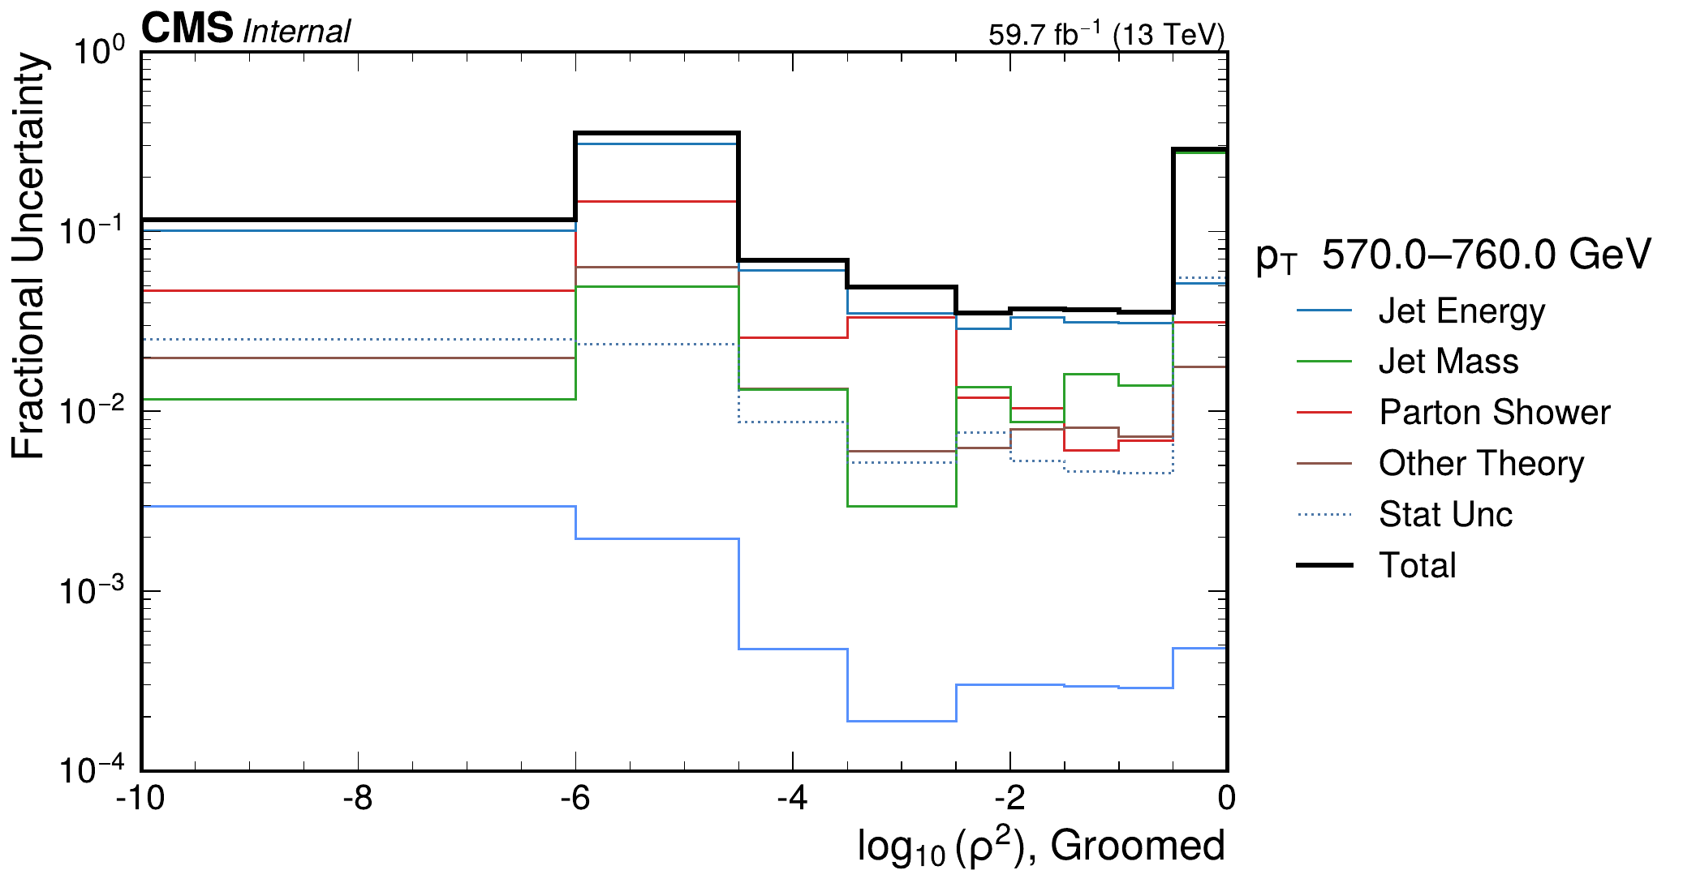
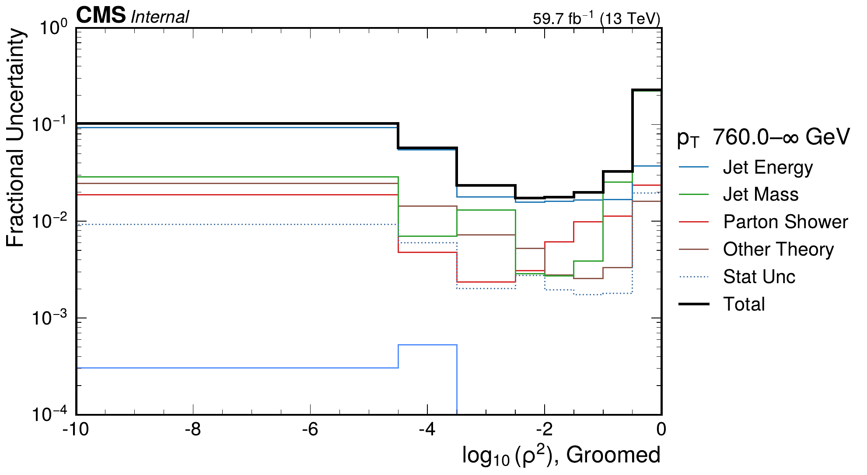
Grouped uncertainty summary: groomed
dijet 2018 rho | Jacobian + ratio-curvature regularization
200-290 GeV
290-400 GeV
400-570 GeV
570-760 GeV
> 760 GeV
Generated from outputs/dijet/2018/rho/unfolding_jacobian_reg

Slide 12
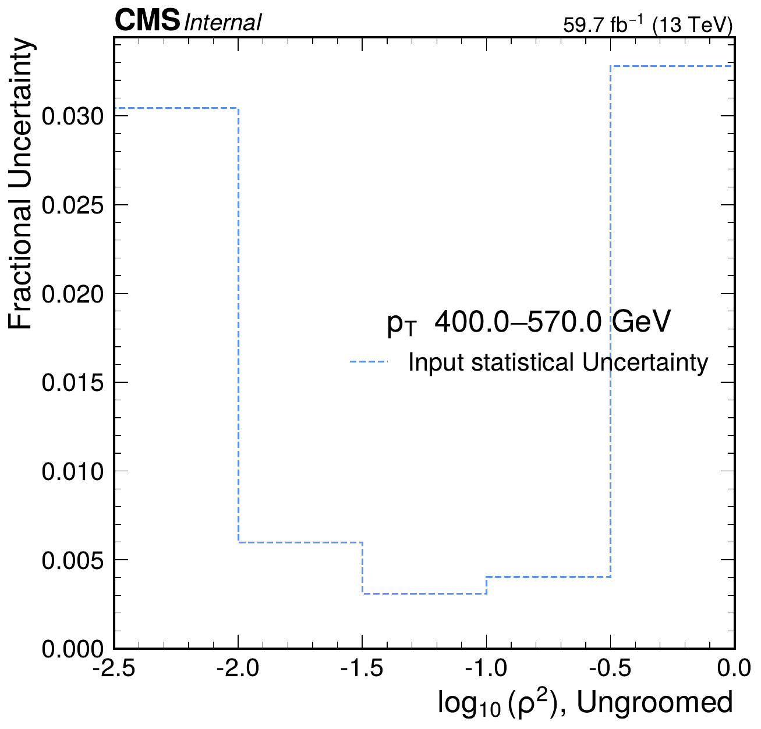
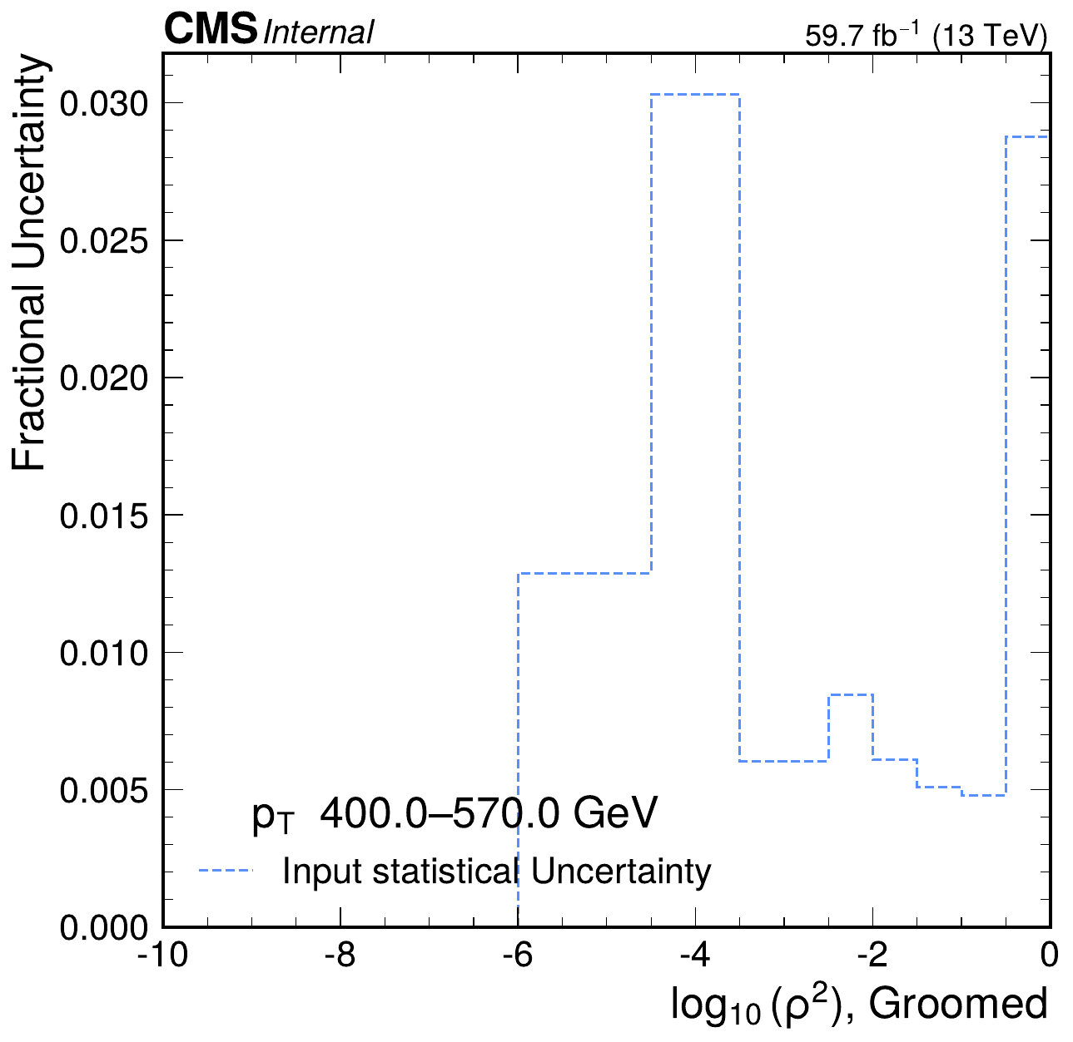
Statistical uncertainty fractions
dijet 2018 rho | Jacobian + ratio-curvature regularization
Ungroomed, 400-570 GeV
Groomed, 400-570 GeV
Generated from outputs/dijet/2018/rho/unfolding_jacobian_reg

Slide 13
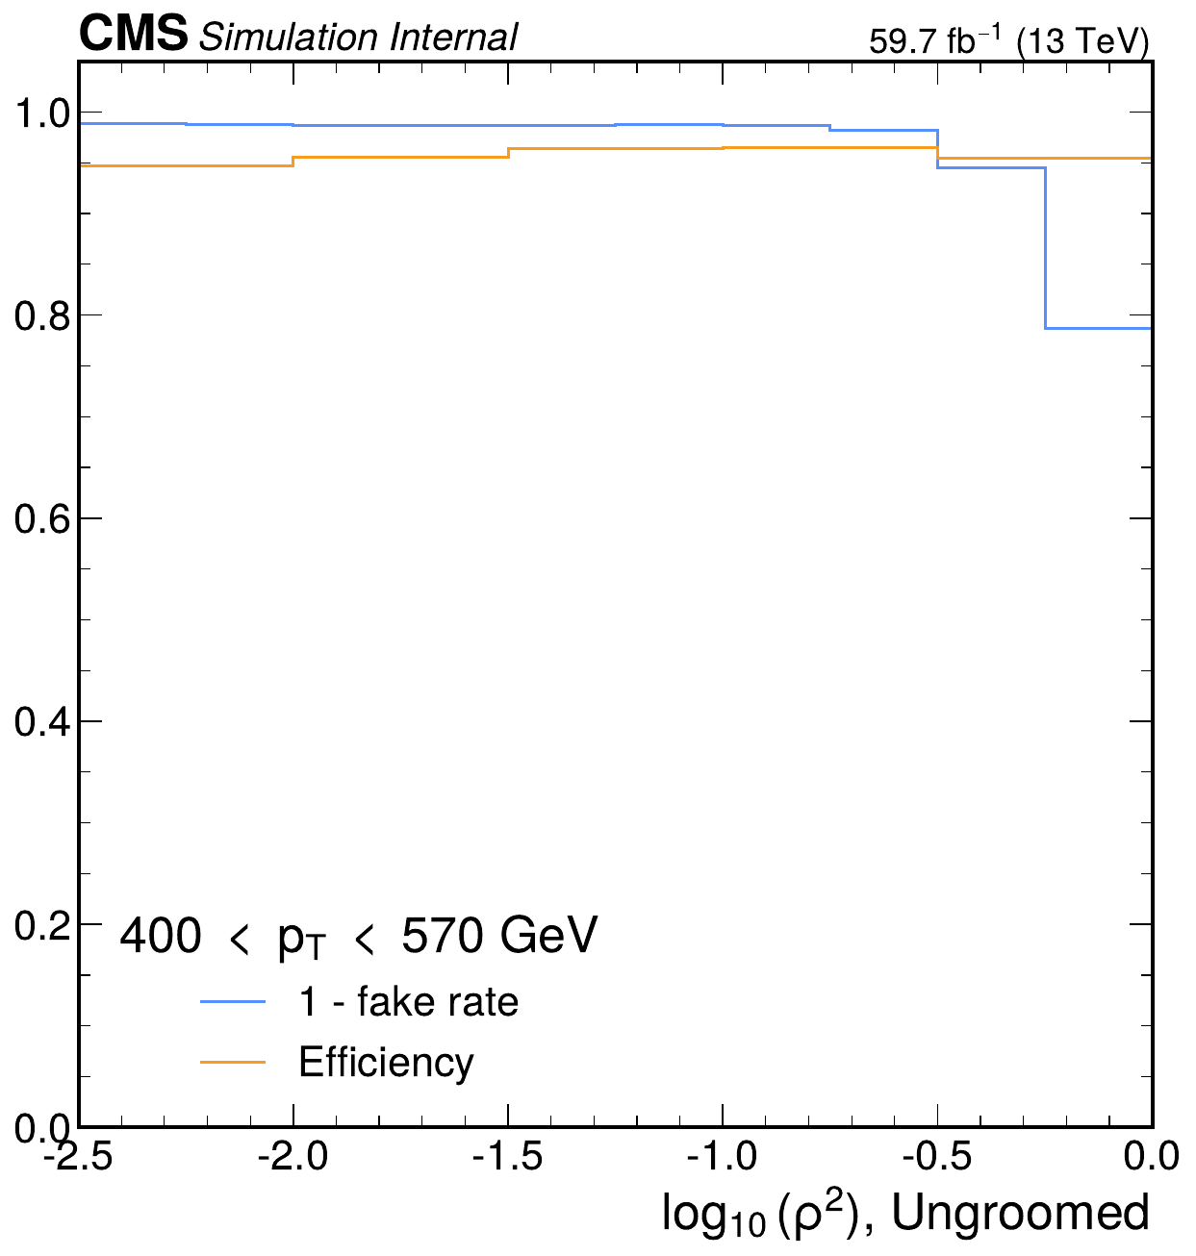
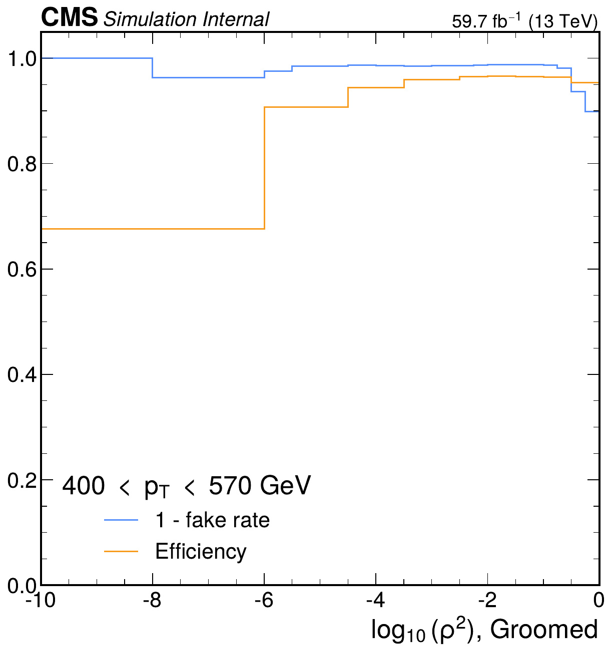
Fake-rate and efficiency diagnostics
dijet 2018 rho | Jacobian + ratio-curvature regularization
Ungroomed, 400-570 GeV
Groomed, 400-570 GeV
Generated from outputs/dijet/2018/rho/unfolding_jacobian_reg

Slide 14
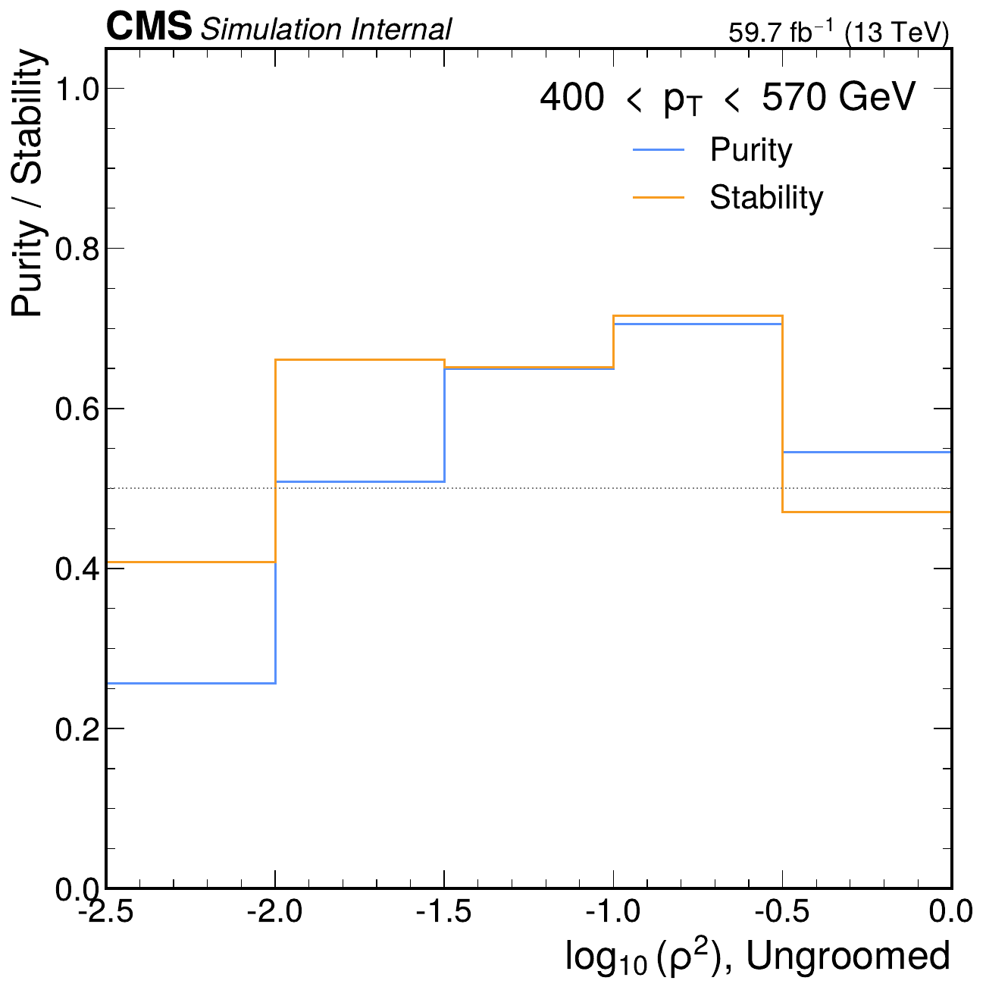
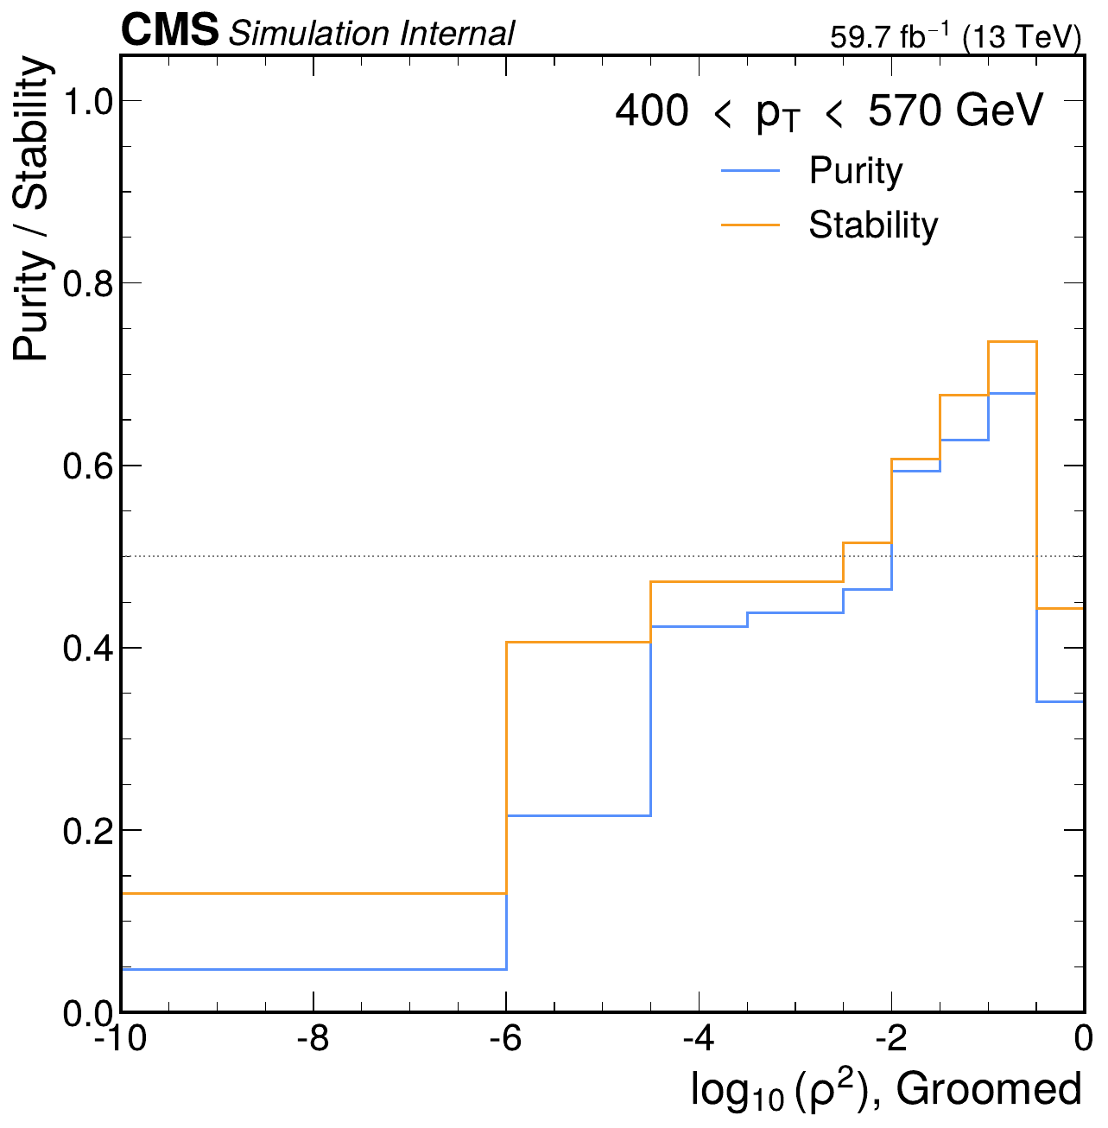
Purity and stability checks
dijet 2018 rho | Jacobian + ratio-curvature regularization
Ungroomed, 400-570 GeV
Groomed, 400-570 GeV
Generated from outputs/dijet/2018/rho/unfolding_jacobian_reg

