Slide 1
Multi-Label Land-Cover Recognition Using Sentinel-2 Multispectral Classification
Evaluating the Contribution of Visible, NIR, and SWIR Bands on European Satellite Imagery
Author: Sai Charan (Mandala Sai Charan) | Admission No.: 24JE1093
Course: Applied Remote Sensing Practical | Department: Applied Geophysics, IIT (ISM) Dhanbad
Dataset: BigEarthNet v2.0 (Sentinel-2 Level-2A BOA Surface Reflectance) | Date: October 2026

Slide 2
APPLIED REMOTE SENSING | FINAL PROJECT
Background & Motivation: The Mixed Landscape Challenge
The Single-Label Classification Dilemma
• Landscapes are inherently mixed: A single 1.2 km × 1.2 km satellite patch contains pastures bordering woodlots, rivers cutting through fields, and village houses.
• Single-label forces artificial exclusivity: Assigning only 'Forest' completely discards secondary classes like pastures or streams.
• Boundary noise & ambiguity: Ecotones and mixed pixels create severe labeling conflict in conventional remote sensing.
The Multi-Label Paradigm
• Independent Bernoulli Formulation: Each class is treated independently: y = [y₁, y₂, ..., y₇] where yₖ ∈ {0, 1}.
• 94.4% Empirical Multi-Label Prevalence: 94.4% of patches in our curated dataset contain at least two land-cover classes.
• Realistic Ecological Mapping: Accurately detects co-occurring agricultural parcels, woodlands, and built infrastructure without mutual exclusion.

Slide 3
APPLIED REMOTE SENSING | FINAL PROJECT
Research Questions & Project Objectives
Central Research Question
Can multispectral Sentinel-2 observations (Visible, NIR, SWIR) accurately resolve multiple co-occurring surface types, and how does expanding spectral dimensionality affect multi-label classification accuracy on small curated datasets?
Controlled Band Ablation
Systematically compare 3 spectral configurations under identical architectures and splits:
• M1 (Visible RGB): Bands B02, B03, B04 (3 ch)
• M2 (Visible + NIR): Bands B02, B03, B04, B08 (4 ch)
• M3 (Full Multispectral): B02, B03, B04, B08, B11, B12 (6 ch)
Evaluation & Minority Diagnostics
Measure Macro-F1, Micro-F1, and Exact Match subset accuracy. Specifically assess the behavior of minority classes (Wetland, Shrub) and evaluate decision threshold calibration without data leakage.

Slide 4
APPLIED REMOTE SENSING | FINAL PROJECT
Sentinel-2 Spectral Bands & BigEarthNet v2.0 Dataset
Diagnostic Spectral Bands Used
• B02 (Blue - 490 nm, 10m): Sensitive to atmospheric haze and water clarity.
• B03 (Green - 560 nm, 10m): Captures green chlorophyll peak and vegetation vigor.
• B04 (Red - 665 nm, 10m): Maximum chlorophyll-a absorption; defines red edge.
• B08 (NIR - 842 nm, 10m): Internal spongy mesophyll leaf scattering; total absorption by open water.
• B11 (SWIR-1 - 1610 nm, 20m): Foliar water content, soil moisture, and impervious built-up.
• B12 (SWIR-2 - 2190 nm, 20m): Mineral background, dry biomass, and bare soil.
Dataset Geography & Partitions
• Provenance: BigEarthNet v2.0 (reBEN), Sentinel-2 Level-2A (Sen2Cor atmospheric correction).
• Geographic Origin: Tile T33UUP in Austrian Central Alps (UTM Zone 33N).
• Dataset Size: 500 genuine patches (1.2 km × 1.2 km, 120×120 pixels).
• Official Splits: 300 Train (60%), 100 Validation (20%), 100 Test (20%).
• Zero Data Leakage: Strictly disjoint partitions; 0 duplicate patch IDs.
• Inspection Patches: All 5 Phase 1 inspection patches preserved strictly in Test.

Slide 5
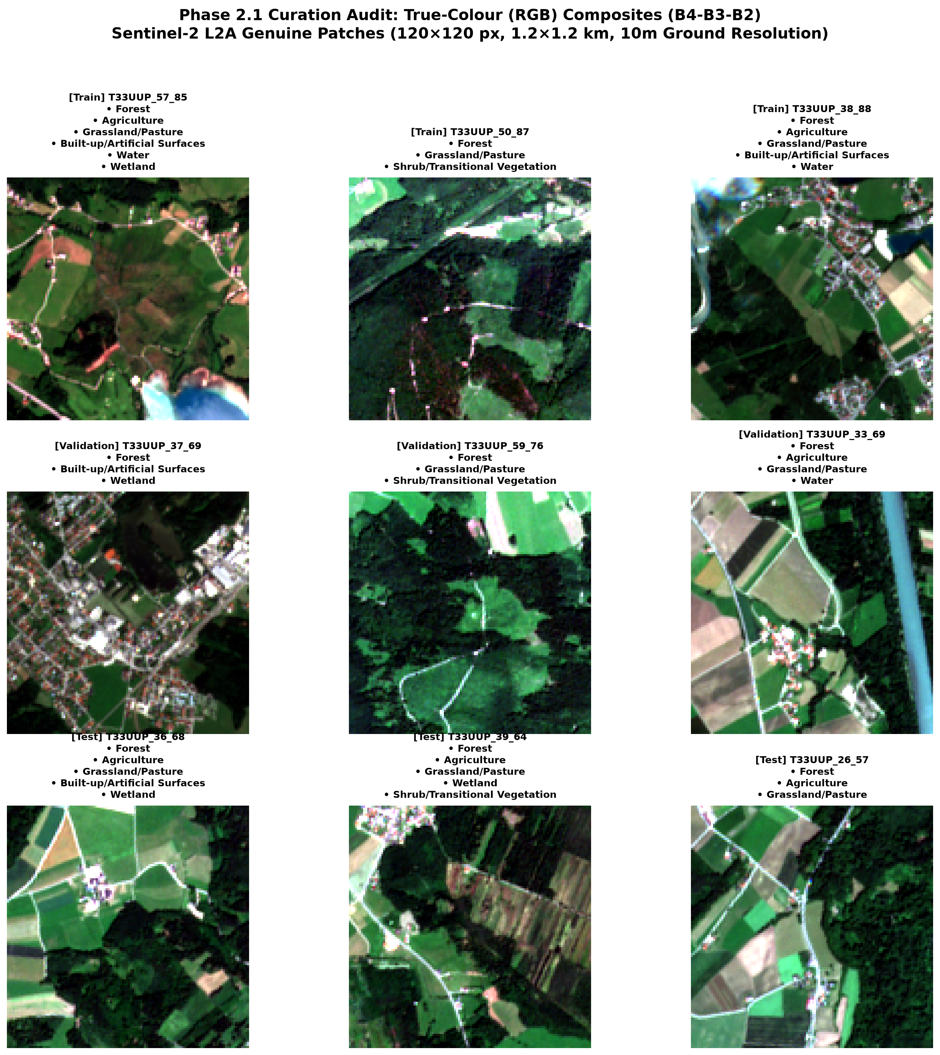
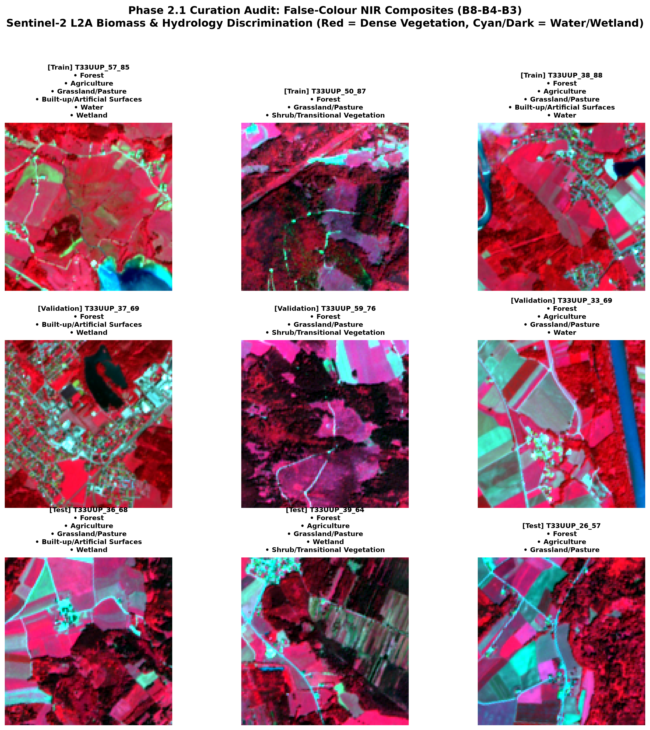
APPLIED REMOTE SENSING | FINAL PROJECT
Reflectance Preprocessing & Multispectral Views
Harmonization Pipeline
• Bilinear Resampling: Resampled 20m bands (B11, B12) from 60×60 to 120×120 to align with 10m bands without blocky artifacts.
• Surface Reflectance Scaling: ρ = clip(DN / 10000.0, 0.0, 1.0) maps raw DN to physical BOA reflectance [0, 1].
• Specular Glint Handling: Rare reflections > 10,000 DN (<0.0042% of pixels) cleanly bounded without distorting dynamic range.
• True Colour vs False Colour: CIR (B8-B4-B3) renders dense biomass in vibrant red, while open water absorbs NIR and appears jet black.

Slide 6
APPLIED REMOTE SENSING | FINAL PROJECT
Seven Target Classes & Label Distribution
Target Class Name | Train (N=300) | Val (N=100) | Test (N=100) | Dataset Prevalence
Forest | 258 (86.0%) | 84 (84.0%) | 95 (95.0%) | 437 (87.4%) - Dominant
Agriculture | 142 (47.3%) | 74 (74.0%) | 52 (52.0%) | 268 (53.6%) - Widespread
Grassland / Pasture | 209 (69.7%) | 75 (75.0%) | 39 (39.0%) | 323 (64.6%) - Alpine meadows
Built-up / Artificial | 130 (43.3%) | 58 (58.0%) | 31 (31.0%) | 219 (43.8%) - Settlements
Water | 41 (13.7%) | 28 (28.0%) | 21 (21.0%) | 90 (18.0%) - Lakes & rivers
Wetland | 8 (2.7%) [RARE] | 16 (16.0%) | 27 (27.0%) | 51 (10.2%) - Severe imbalance
Shrub / Transitional | 59 (19.7%) | 13 (13.0%) | 42 (42.0%) | 114 (22.8%) - Clear-cuts/scrub

Slide 7
APPLIED REMOTE SENSING | FINAL PROJECT
CNN Architecture & Multi-Label Training Methodology
MultispectralCNN Architecture
• Input Flexibility: Dynamically accepts C ∈ {3, 4, 6} channels at 120×120 resolution.
• 4 Convolutional Blocks: [32, 64, 128, 256 filters] with Batch Normalization, ReLU, and Max Pooling (120→60→30→15→7).
• Spatial Pooling & Dropout: AdaptiveAvgPool2d(1, 1) + dual dropout (p=0.4, 0.3) to prevent overfitting on 300 patches.
• Parameter Count: Lightweight model (~617k parameters), ideal for small remote sensing datasets.
• Independent Logits: Outputs 7 raw unbounded logits, mapped via Sigmoid to [0, 1].
Training Protocol & Validation Calibration
• Loss Function: BCEWithLogitsLoss evaluates 7 independent binary cross-entropy losses simultaneously.
• Optimizer & LR Schedule: AdamW (lr=1e-3, weight_decay=1e-4) with CosineAnnealingLR (T_max=35).
• Validation Early Stopping: Monitored validation loss with patience of 8 epochs (saved best weights).
• Threshold Calibration: Tuned per-class thresholds over [0.2, 0.8] strictly on validation data.
• Zero Test Leakage: Model weights, normalization, and decision thresholds NEVER touched test labels.

Slide 8
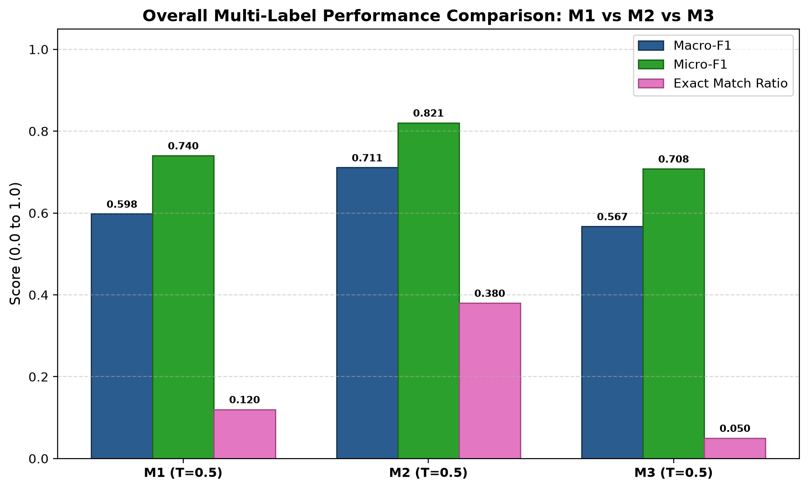
APPLIED REMOTE SENSING | FINAL PROJECT
Experimental Results: M1 vs M2 vs M3 Band Ablation
Test Evaluation Results (T=0.5)
• M1 (Visible RGB): Macro-F1 = 0.5978, Micro-F1 = 0.7403, Exact Match = 12.0%. Baseline optical model.
• M2 (Visible + NIR): Macro-F1 = 0.7110 (+11.32 pp), Micro-F1 = 0.8205 (+8.02 pp), Exact Match = 38.0% (+26 pp). WINNER!
• M3 (Multispectral): Macro-F1 = 0.5673, Micro-F1 = 0.7081, Exact Match = 5.0%. The six-band model (M3) underperformed compared with the RGB+NIR model (M2) on the observed test metrics. Possible explanations include the small training sample, spectral collinearity, resampling effects, and optimization instability. These explanations were not independently tested.
• Validation-Tuned: M1 Tuned = 0.7076, M2 Tuned = 0.7020, M3 Tuned = 0.6559. Calibrating thresholds closed M1's gap by lowering cutoffs on minority classes.

Slide 9
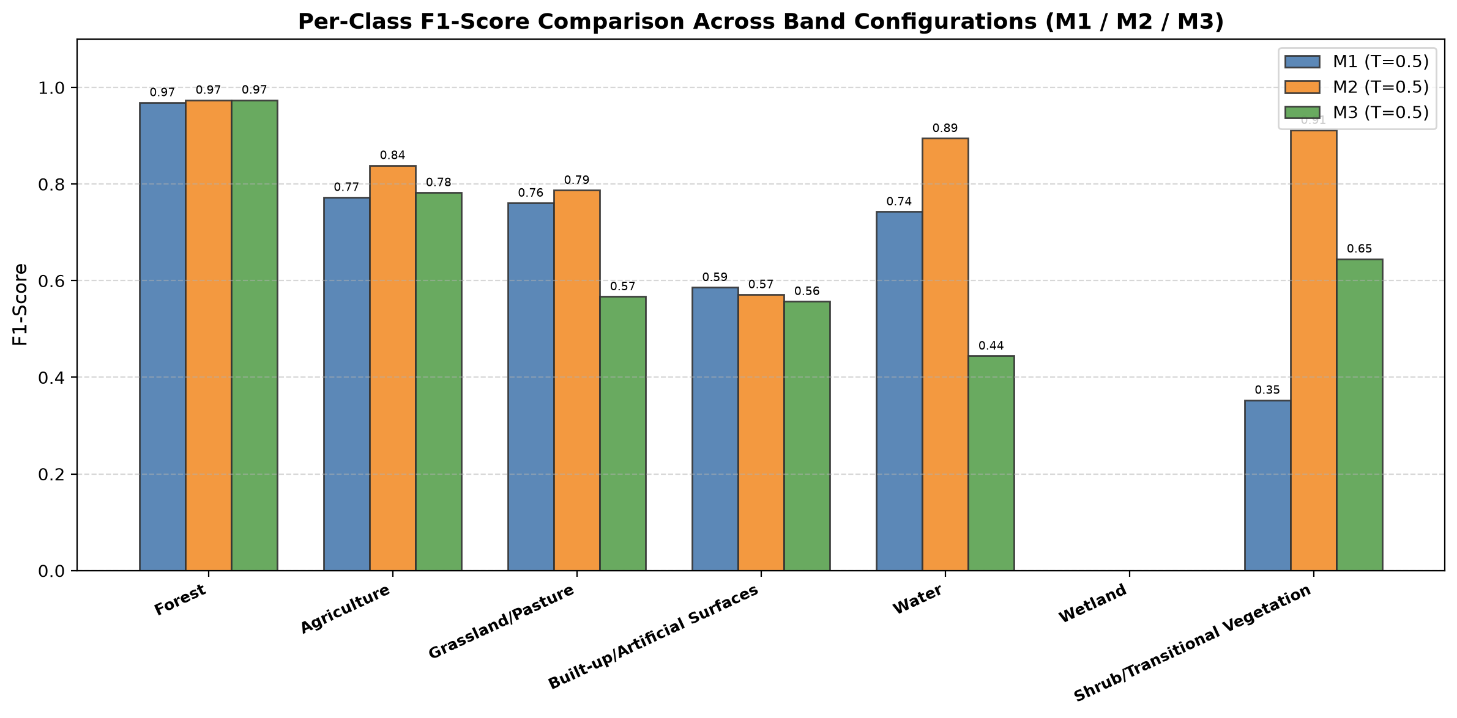
APPLIED REMOTE SENSING | FINAL PROJECT
Per-Class Performance, Error Analysis & Wetland Failure
Key Per-Class Findings
• Forest & Agriculture: Very stable across all models (Forest F1 > 0.96; Agriculture F1 ~0.77-0.84).
• Shrub Breakthrough in M2: F1 surged from 0.3529 (M1) to 0.9114 (M2)! NIR mesophyll scattering separates scrub from mature tree canopy.
• Water Recognition in M2: F1 rose from 0.7429 (M1) to 0.8947 (M2) with 100% precision due to NIR water absorption.
• M3 Grassland Over-Prediction: M3 produced 57 False Positives on Grassland (precision collapsed to 40%), explaining M3's lower score.
• The Wetland Failure (0.0000 F1): All 3 models scored 0 TP on Wetland at T=0.5. With only 8 positive training patches (2.7%), unweighted BCE suppressed predictions.

Slide 10
APPLIED REMOTE SENSING | FINAL PROJECT
Conclusions, Limitations & Future Directions
Key Scientific Conclusions
• Multi-label recognition is vital: 94.4% of patches in our curated dataset contain at least two land-cover classes.
• NIR is the most valuable spectral addition: M2 (Visible+NIR) gained +11.32 pp Macro-F1 and tripled Exact Match (38%).
• Performance of M3: The six-band model (M3) performed worse than the RGB+NIR model (M2) on the observed test metrics. Small sample size, spectral collinearity, resampling effects, and optimization instability are possible explanations, but they were not independently tested.
Project Limitations
• Single-Tile Scope: All 500 patches originate from Tile T33UUP in the Austrian Alps. Findings do not generalize globally.
• Severe Minority Imbalance: Wetland had only 8 training examples, causing zero-recall.
• 20m Spatial Interpolation: SWIR bands were bilinearly resampled, lacking native 10m high-frequency detail.
Future Research Directions
• Positive-Class Weighting / Focal Loss: Compensate for minority classes like Wetland.
• Transfer Learning: Pre-train on the full continental BigEarthNet archive before fine-tuning.
• Geographic Expansion: Evaluate generalization across Mediterranean, Scandinavian, and arid biomes.

