Slide 1
↗
CLARISK
NEXUS 2026 · FINAL ROUND
Investor Portfolio Monitoring
& Risk Management System
See your risk clearly.
Team Yash Mandaliya · Kaivan Parikh
M.Sc. Information Technology · GLS University, Ahmedabad

Slide 2
THE PROBLEM
Problem Statement
Individual investors hold assets across multiple platforms, resulting in fragmented information and limited visibility into their overall financial position. Without a centralized system, tracking portfolio performance, assessing diversification, monitoring risk exposure, and identifying trends becomes difficult.
!
!
!
Fragmented
Risk is invisible
No insight
Holdings scattered across brokers — no single view.
Apps show profit, never downside exposure.
Diversification and trends go unnoticed.
Build a system that consolidates portfolio data, monitors performance, analyzes asset allocation, and generates risk insights.

Slide 3
OUR SOLUTION
Clarisk — a unified risk dashboard
A single web platform where an investor signs in by phone, consolidates holdings from any platform, and instantly sees a live valuation, a full quantitative risk profile, a rebalancing suggestion, and real-time alerts — refreshing itself automatically.
1
2
3
Consolidate
Analyse
Act
Sign in by phone; add holdings by hand, CSV, or simulated broker sync — one unified portfolio.
Live valuation, allocation, and a full risk engine — VaR, beta, Sharpe, drawdown, correlation.
Rebalancing suggestion, live breach alerts, and a downloadable PDF risk report.
Working product — not a mockup. Backed by 550+ automated tests.

Slide 4
COVERAGE
Every requirement, delivered
REQUIREMENT
HOW CLARISK DELIVERS IT
STATUS
Consolidates portfolio data
Per-user portfolio; add by hand, CSV, or broker sync
Done
Multi-platform aggregation
Simulated broker connect (Zerodha/Groww/Upstox/ICICI) + CSV
Demo
Monitors performance
Live valuation, P/L, value & drawdown charts
Done
Analyses asset allocation
Allocation by holding and sector
Done
Risk exposure metrics
VaR (3 methods), CVaR, beta, volatility, Sharpe, Sortino, drawdown
Done
Diversification insights
Correlation matrix + concentration (HHI)
Done
Identifies trends
Performance curve & underwater drawdown over time
Done
Reporting tools
One-click PDF risk report
Done

Slide 5
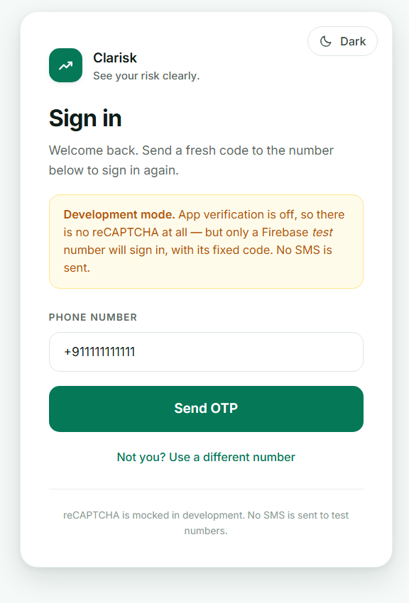
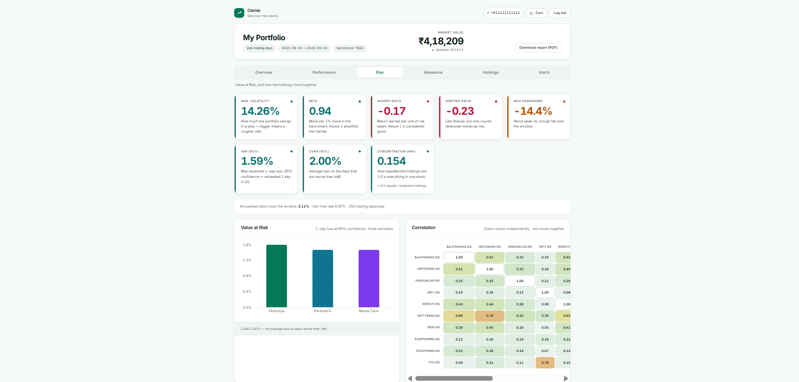
LIVE PRODUCT
A real, working platform
Risk dashboard — VaR, beta, Sharpe, drawdown, correlation, all computed live from market data
Phone-OTP sign in

Slide 6
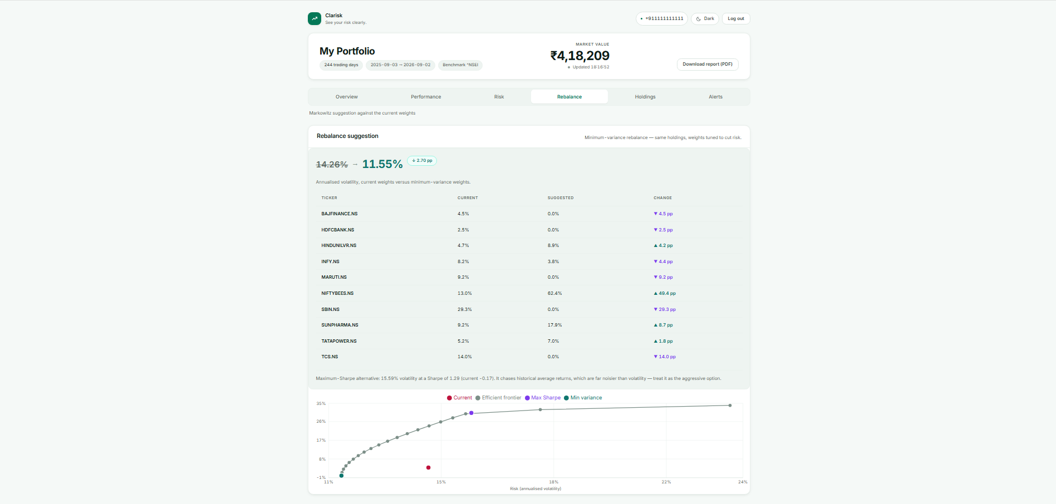
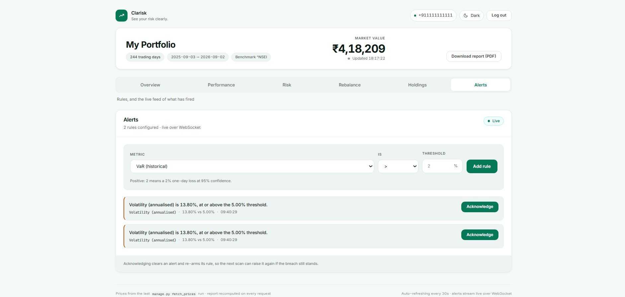
LIVE PRODUCT
Rebalancing & real-time alerts
Markowitz rebalance + efficient frontier — cuts volatility 14.3% → 11.6%
Live risk alerts pushed over WebSocket the moment a limit breaks
₹4.18L
60 sec
Live
Live portfolio value
Auto-refresh cycle
WebSocket alerts

Slide 7
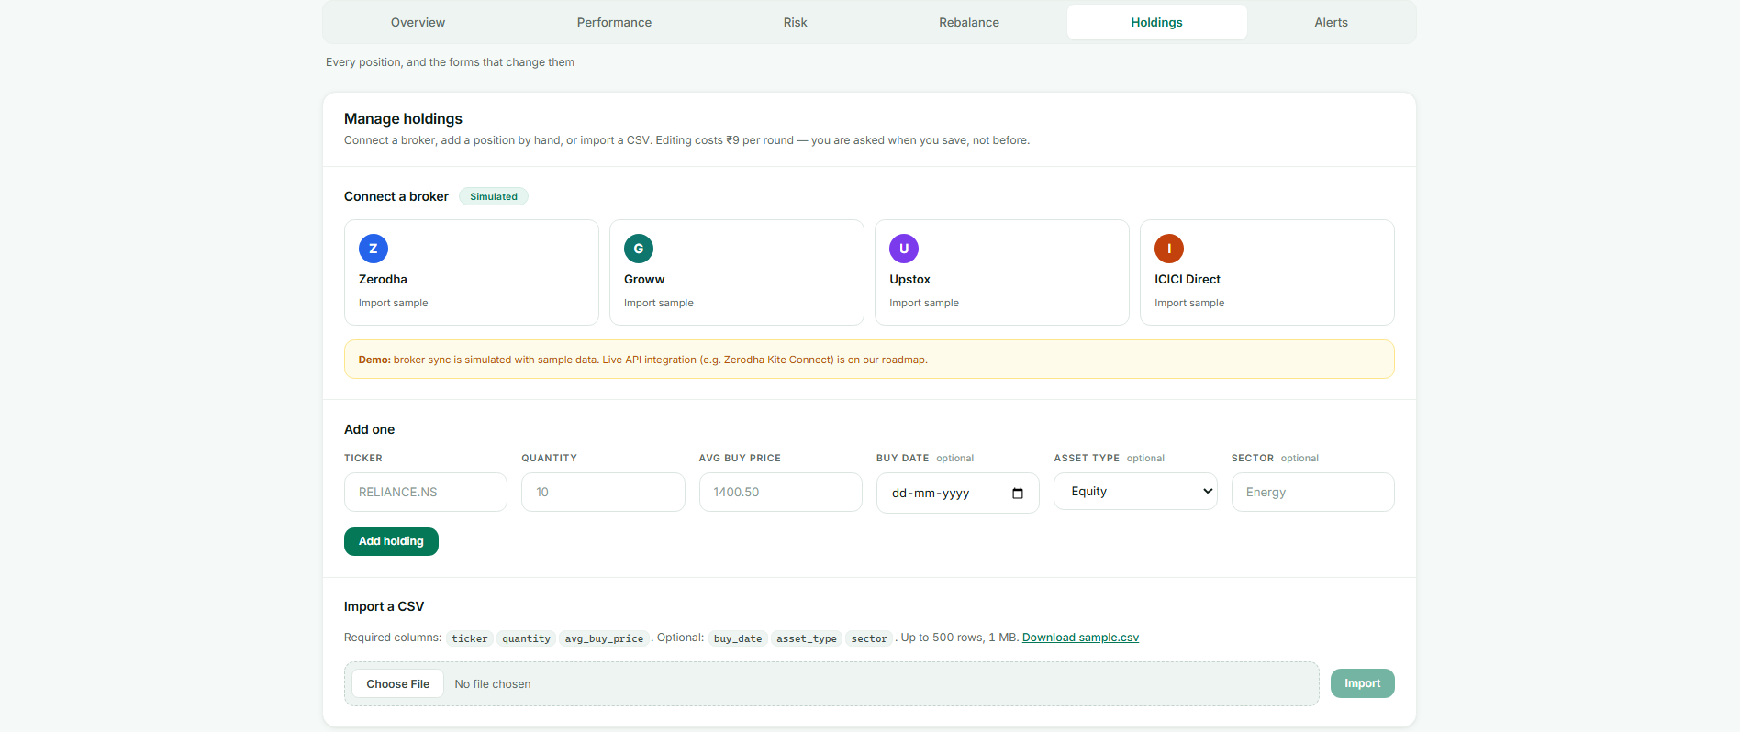
MULTI-PLATFORM AGGREGATION
Consolidating across platforms
Honest by design
Today — holdings consolidate from any platform via CSV export + our simulated broker connect.
Next — live broker API sync (Zerodha Kite Connect). Our swappable data-provider layer already supports it — the seam is built.
Connect Zerodha, Groww, Upstox or ICICI — holdings flow into one portfolio; overlapping stocks consolidate automatically.

Slide 8
ARCHITECTURE
How it works
React Dashboard
Django + DRF API
Risk Engine
Market Data
tabs · charts · modals
verify token / signature
pure NumPy / SciPy
yfinance
Firebase Auth
Razorpay
Celery + Beat
Redis
phone OTP
₹9 unlock, verified
auto-refresh 60s
broker + WS
Data flow
Sign in (OTP) → add / import holdings (₹9 gate) → fetch live + 252-day history → align returns → risk engine builds the report → dashboard renders it → Celery re-scans and pushes alerts every 60 seconds.

Slide 9
THE QUANT CORE
Institutional-grade risk analytics
Every metric is a pure, independently-tested function — verified against known mathematical results, not assumed.
3
7+
Markowitz
VaR methods
Risk metrics
Optimiser
Historical · Parametric · Monte Carlo
Beta · Sharpe · Sortino · CVaR · Drawdown · HHI
Min-variance + efficient frontier
Why minimum-variance leads
It needs only the covariance matrix. Maximum-Sharpe depends on noisy return forecasts and over-concentrates — so we show it as a labelled footnote, not the recommendation. Knowing that distinction is the difference between using a formula and understanding it.

Slide 10
STACK
Built to be real
Backend
Risk maths
Django · DRF
NumPy · Pandas · SciPy
Market data
Auth
yfinance (NSE)
Firebase Phone OTP
Payments
Real-time
Razorpay
Django Channels · daphne
Scheduling
Frontend
Celery · Beat · Redis
React · Vite · Recharts
SQLite storage · ReportLab PDF · 550+ automated tests, all passing

Slide 11
TRANSPARENCY
What's real vs what's next
Working today
On the roadmap
Phone-OTP auth & per-user portfolios
Live valuation & full risk engine
Rebalancing + efficient frontier
Real-time WebSocket alerts
Auto-refresh every 60 seconds
CSV import & PDF report export
Razorpay ₹9 payment gate
Simulated multi-broker sync
Live broker API sync (Kite Connect)
Real SMS OTP + production reCAPTCHA
Multiple portfolios per user
Stress testing / scenario analysis
Multi-currency & FX risk
Mobile app + scheduled email reports

Slide 12
Why Clarisk stands out
✓
A working product — Not slides — a running platform with live market data, auth and payments.
✓
Real quant depth — VaR, CVaR, Markowitz — verified against known results, 550+ tests.
✓
Honest & adaptable — We name what's simulated, and the architecture is built to extend fast.
See your risk clearly.
Yash Mandaliya · Kaivan Parikh | GLS University

