Slide 1
CNN Based Stock Market Prediction
Deep Learning Research Implementation and Adaptation to Indian Stock Market
Nilabja Mandal

Slide 2
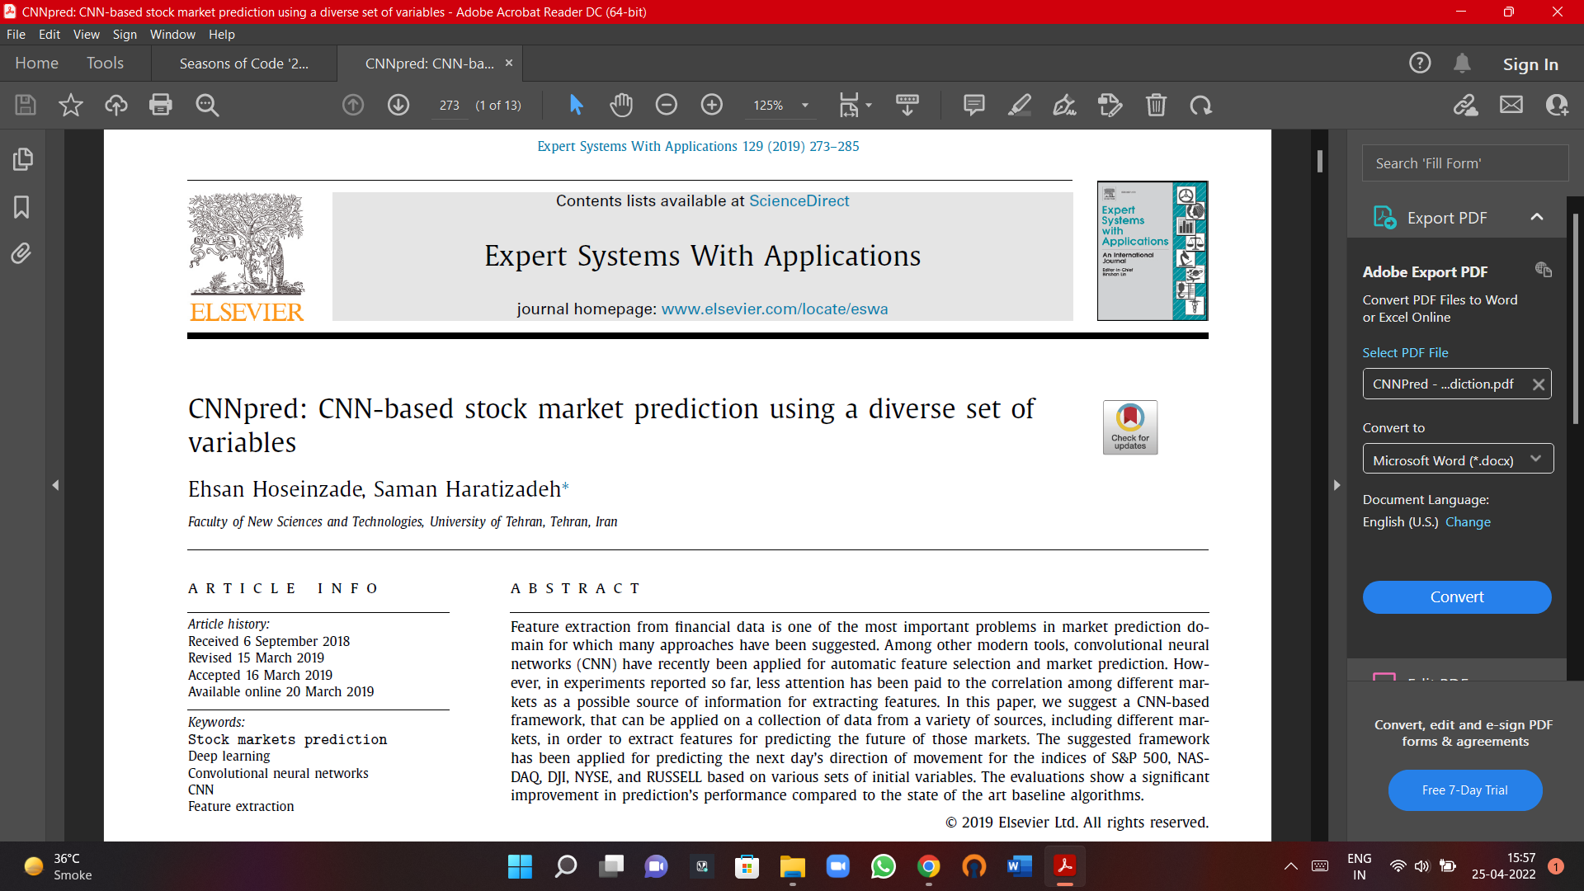
CNNpred: CNN-based stock market prediction using a diverse set of variables

Slide 3
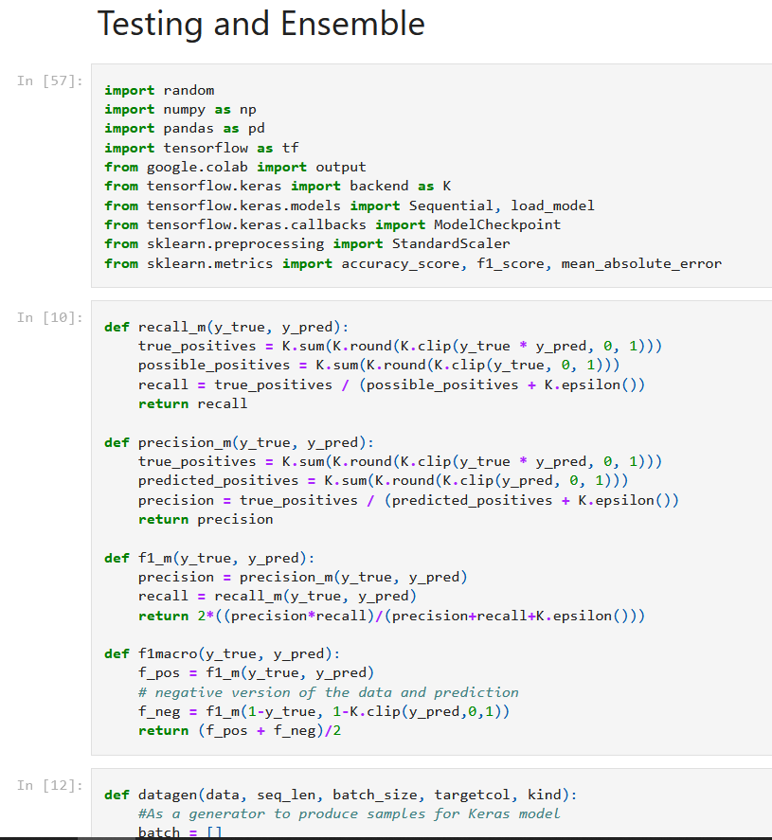
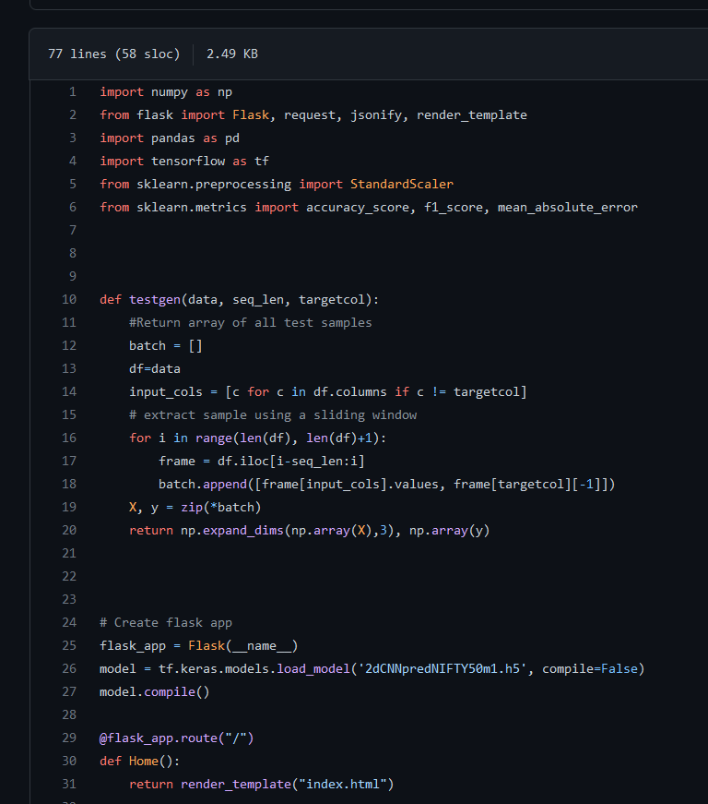
Code

Slide 4
Demo
2d CNNpred Model to predict Next Day’s Stock movement
NIFTY50
Model Deployed Using Flask API
http://127.0.0.1:5000

Slide 5
Transcription
Hi, I am Nilabja. I will be demonstrating my project with mentor Shivprasad Kathane “CNN Based Stock Market Prediction”. This is an implementation of the research paper “CNNpred: CNN-based stock market prediction using a diverse set of variables” by Ehsan Hoseinzade and Saman Haratizadeh. A 2d CNN with 82 features and 6 layers was trained on DJI, NASDAQ, NYSE, RUSSELL, S&P with data from OHLCV, commodities, futures and macroeconomic factors. Optimization using hyperparameter tuning was done. Further accuracy was improved using Bagging Ensemble, which outperformed the literature model. A similar strategy was adopted to predict NIFTY50. This model is deployed using Flask API. Let me show you the demo.
Thus you can see the prediction for next day’s stock price movement given historical data.

