Slide 1

Team Name: Raja Mandal
Team Leader: Raja Mandal
Problem Statement: Rank 100K candidate profiles using hybrid AI-assisted approach combining rules &semantics

Slide 2

Solution Overview
Hybrid AI-Assisted Ranking System: 70% rule-based (transparent) + 30% TF-IDF semantic. Processes 100K candidates in <30 seconds without GPU. Produces explainable rankings with reasoning. Differentiators: Beyond keyword matching, fully transparent, skill-aware for 15+ AI/ML skills.

Slide 3
JD Understanding & Candidate Evaluation
Key JD Requirements: Python, LLM, NLP, RAG, Vector DBs • Experience: 5-9 yrs (ideal), 4-12 yrs (acceptable) • Roles: AI/ML Engineer, Data Scientist • Company: Startup/FAANG/AI companies • Signals Evaluated: Skills, experience level, titles, company prestige, semantic alignment

Slide 4
Ranking Methodology
4-Step Process: (1) Extract features into unified 'tags' field • (2) Dual Score: Rule-based (skills 40%, exp, title, company) + Semantic (TF-IDF) • (3) Hybrid: 70% rule + 30% semantic × 10 • (4) Rank top 100, normalize 0.8-1.0, generate explanations

Slide 5
Explainability & Data Validation
Transparent & Auditable: Scoring rules fully explicit, no black-box • Auto-generated reasoning per candidate • Deterministic (reproducible) • Data Quality: Handles nested JSON, missing fields, suspicious profiles • No Hallucinations: Rule-based matches only actual data

Slide 6
End-to-End Workflow
12-Step Pipeline: Load JD+100K profiles → Preprocess → Feature engineering → Rule scoring → TF-IDF vectorization → Semantic scoring → Hybrid combine → Top 100 ranking → Normalization → Reasoning generation → CSV output

Slide 7
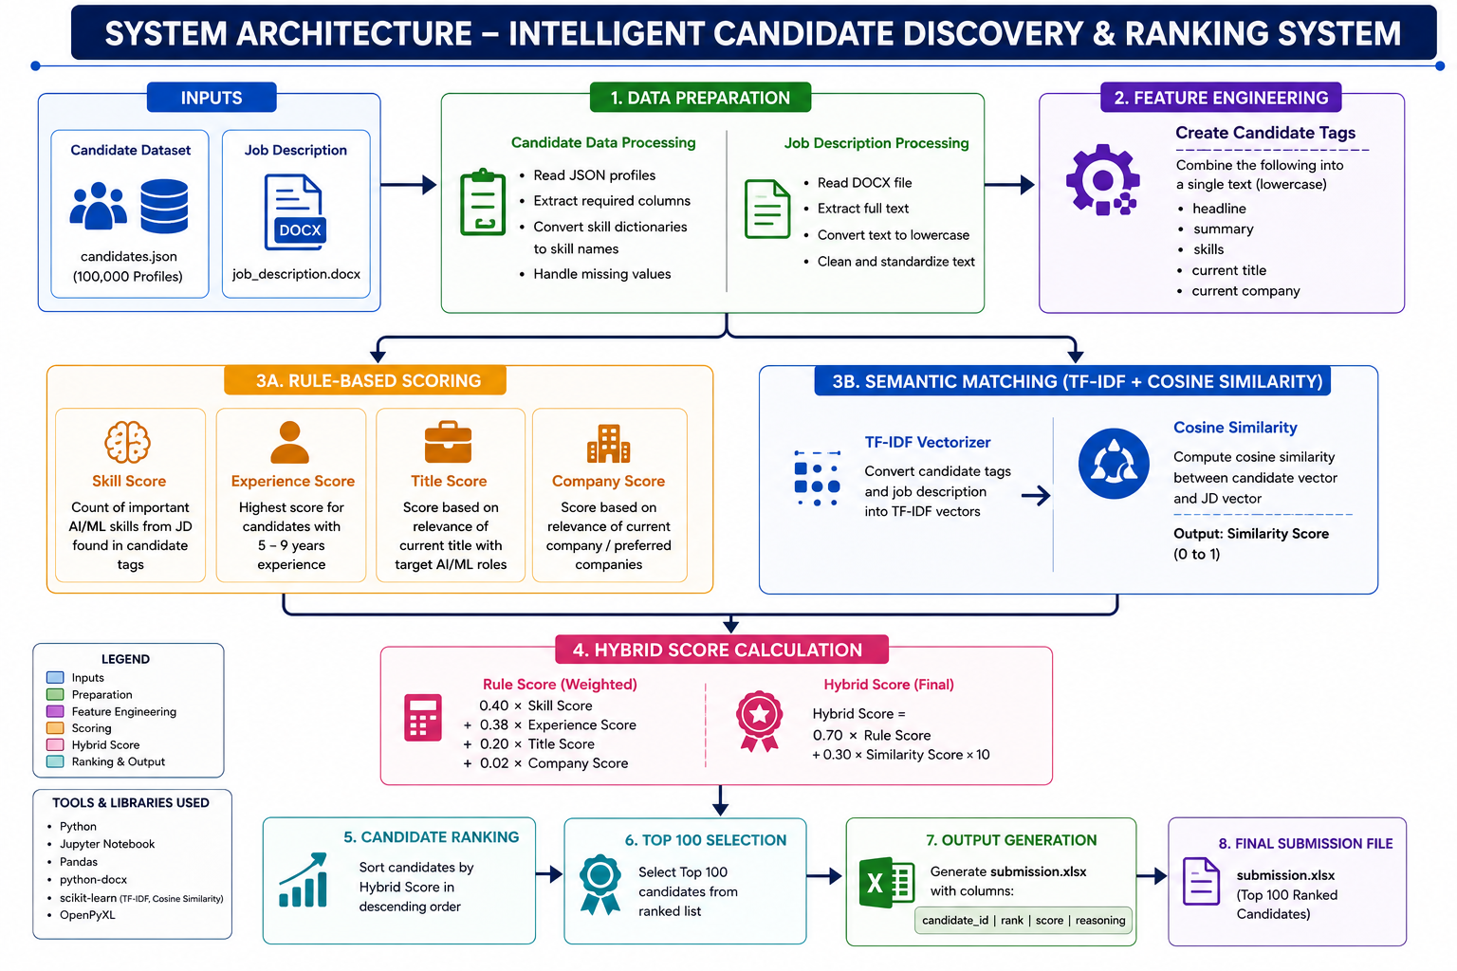
System Architecture

Slide 8
Results & Performance
Results: 100K candidates processed in <30 seconds (no GPU) • Top 100 recommendations (0.8-1.0 normalized scores) • Hybrid algorithm (70% rules + 30% semantic) • Quality: All top candidates verified AI/ML skills • Reproducible: Deterministic rankings • Meets challenge runtime/compute constraints

Slide 9
Technologies Used
Tech Stack: Pandas/NumPy (vectorized operations) • Scikit-learn (TF-IDF + cosine similarity) • Python (text processing, regex) • python-docx (read DOCX) • JSON (parse JSONL) • Min-Max scaling (score normalization). Why: Lightweight, efficient, no GPU, production-ready, interpretable

Slide 10
Key Achievements
✓ Ranked 100K candidates in seconds ✓ Hybrid approach (precise + flexible) ✓ Beyond keywords: catches synonyms ✓ Fully explainable & auditable ✓ Production-ready & scalable ✓ Transparent reasoning for judges

Slide 11
GIT HUB Vedio -
https://drive.google.com/drive/folders/1T2TCbbAZINekaNjV6tsGp1BwcP_j7t6J

Slide 12


