Slide 1
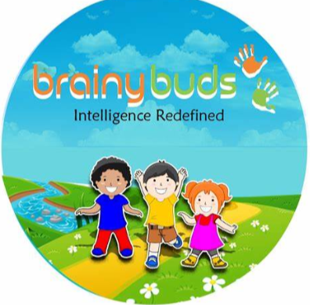
BrainyBuds
Personalized Learning Through Fun and Play!
- Presented by Team 16
(Arati, Ashwini, Ritesh, Anish, Lanka, Richa)

Slide 2
What is the BrainyBuds?
An AI-powered chatbot that delivers personalized trivia quizzes. It transforms learning into an engaging adventure tailored to each child’s interests and learning style.
Our Mission –
Our goal is to transform education into a fun and engaging experience by offering personalized quizzes tailored to each child's unique interests and learning style.
Key Features –
• Personalized quiz paths based on interests and learning style
• Fun, adaptive quizzes with friendly feedback
• Uses Open Trivia DB API for real-time questions

Slide 3
How it works
Categories
GK
Science
Mathematics
History
Geography
Computers
Sports
Politics
Art
Animals
Child launches bot
Prompt “start quiz”
Bot responds with category and difficulty level
Child selects interests and difficulty.
Questions are asked in a fun, iterative manner based upon category selection
Feedback as per the performance
Notes:
Intellectual development
Exposure to varied topics
2. Chatbot fetches questions using Open Trivia DB API
3. Questions are asked in a fun, interactive format
4. Child receives instant feedback

Slide 4
Benefits
Intellectual development
Exposure to varied topics
Encourages critical thinking
Screen time friendly
Goal oriented learning and motivation
Future Enhancements
Dynamic result for quiz performance
Child receives hints and fun facts along with response
Quiz adapts based on child’s answers and preferences quiz to be tailored to a child’s individual pace, age and curiosity.
The chatbot to learn from interactions and adjusts questions to support deeper understanding and sustained engagement.
Integrating BrainyBuds with Schools ecosystems

Slide 5
Integrating BrainyBuds with Schools
Connect teachers, students and curriculum
Share performance insights with educators
Adapt quiz topics to classroom objectives
Students get personalized quizzes
Teacher receive actionable reports
Curriculum stays aligned and dynamic
🔍 For Teachers:
Track student performance and quiz outcomes
Personalized suggestions for each student's next steps
Alerts on learning gaps and progress trends
🎓 For Students:
Adaptive quizzes matched to curriculum and interests
Motivational feedback and gamified learning paths
Safe, encouraging environment for skill growth
🔄 School Ecosystem Integration:
Syncs with school subjects and learning plans
Recommends classroom activities based on quiz insights
Provides teacher reports with actionable feedback
🧑‍🏫
🧒
🏫

Slide 6
Use Case: Enhancing a History Lesson
A teacher introduces World War I in class.
BrainyBuds provides:
• A quiz on key World War I events
• Fun facts for classroom discussion
• Follow-up questions based on student answers
Keeps students engaged
Reinforces the lesson through play

