Slide 1

Senior Design Project 2023-2024
Mandana Zooyousefin
Muğla Sıtkı Koçman University
Advisor: DR.Tuğba ÖNAL SÜZEK Department of computer engineering

Slide 2
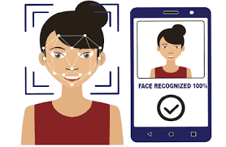
Automatic Attendence System Using Image Processing

Slide 3
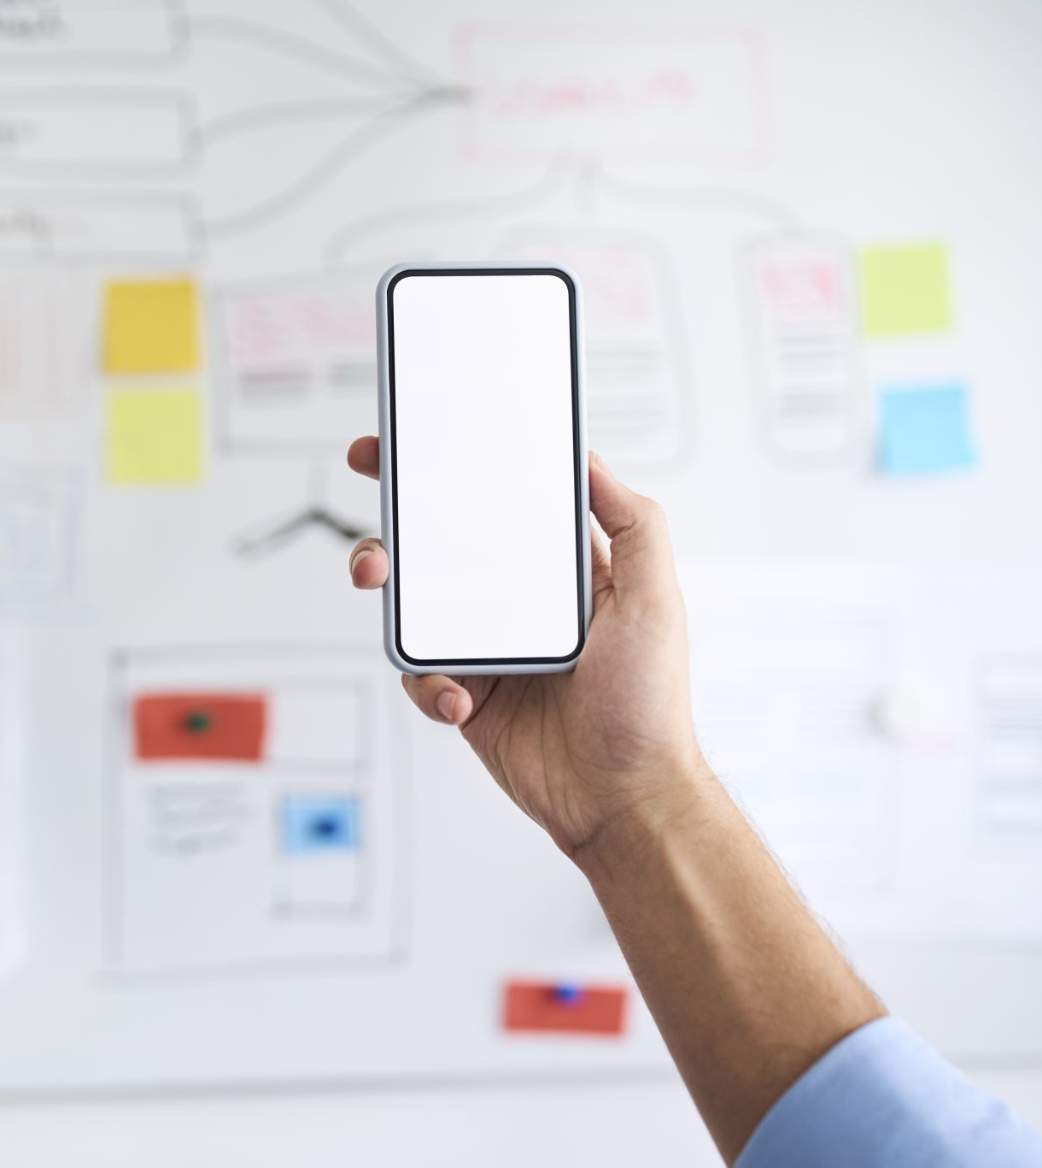
Goal
Create web application for attendece system using face

Slide 4


Libraries
OpenCV
Face Recognition

Slide 5
How does the codes work
For this attendence system, the codes, rcognize the face that show to the camera and and find the face between photoes of students

Slide 6

Language
PyCharm

Slide 7
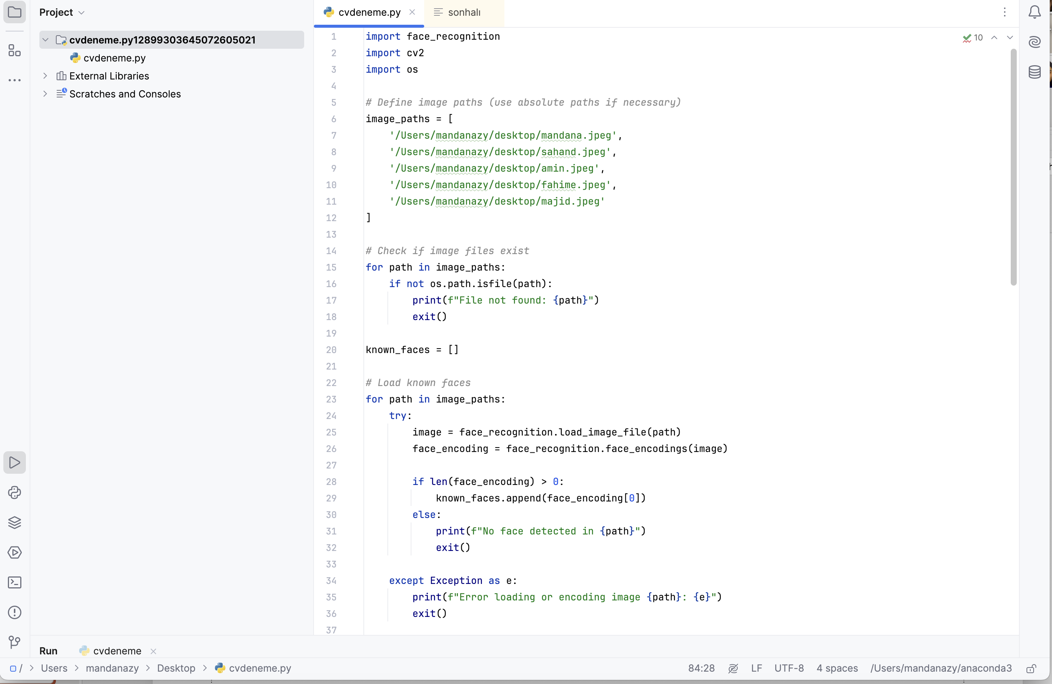
Demo codes

Slide 8

Code Description
Five images are specified and saved. When the code starts working, the camera is turned on and records the face image, and then recognizes the face from the saved images.

Slide 9
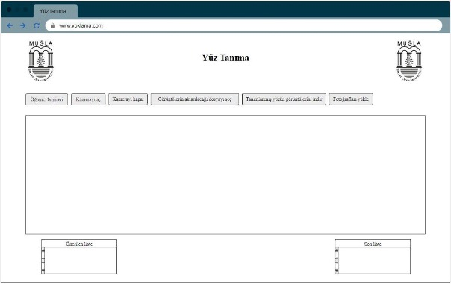
Graphical Usage Interface

Slide 10
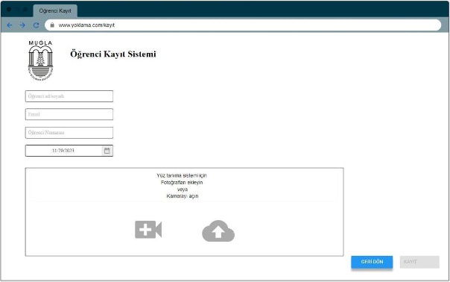
Student’s registering system

Slide 11

Thank you!
Email: zooyousefinmandana@gmail.com

