Slide 1
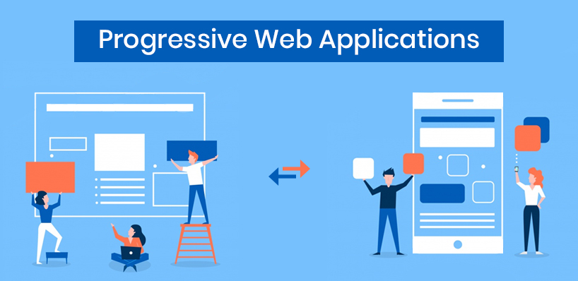

Slide 2



Team Members:

Slide 3
What is PWA...
Provide an installable, app-like experience on desktop and mobile that are built and delivered directly via the web.
- Kavya

Slide 4

Why do we need PWA ?
- Kavya

Slide 5
PWA because...
Fast
Engaging
Reliable
Conversion
Network independent
-Kavya

Slide 6
Steps to build PWA
Web App Manifest
Add to Home Screen banner
Service Worker
Push Notification -Sravani

Slide 7
Web App Manifest
Simple JSON file that tells the browser about your web application and how it should behave when 'installed' on the user's mobile device or desktop.
-Sravani

Slide 8
Service Workers
A service worker is a client side, programmable, network proxy that gives you fine control over the requests it handles. They are at the core of PWA techniques for resource-caching and push notifications.
-Sravani

Slide 9
Add to Home Screen Banner
Makes it easy for users to install your PWA on their mobile or desktop device.
After the user accepts the prompt, your PWA will be added to their launcher, and it will run like any other installed app.
-Sravani

Slide 10
Push Notification
Push messaging provides a simple and effective way to re-engage with the users of the page.
-Sravani

Slide 11





Websites using PWA

Slide 12
Conclusion
They might not be kill the Native apps in future but we can sense wide growing interest for this approach in the web development community.
-Satish

