Slide 1

Considering Block Popularity in Disk Cache Replacement with Solid State Drive

Slide 2
WHAT IS SSD ?
A Solid - State Drive (SSD) (also known as a solid-state disk) is a solid-state storage device that uses integrated circuit assemblies as memory to store data persistently.
Advantages :-
Disadvantages :-
Non-Volatility
Fast random access
Shock resistance
Small size
Low power consumption
High Cost
Limited erase/write cycles Shortened lifetime

Slide 3
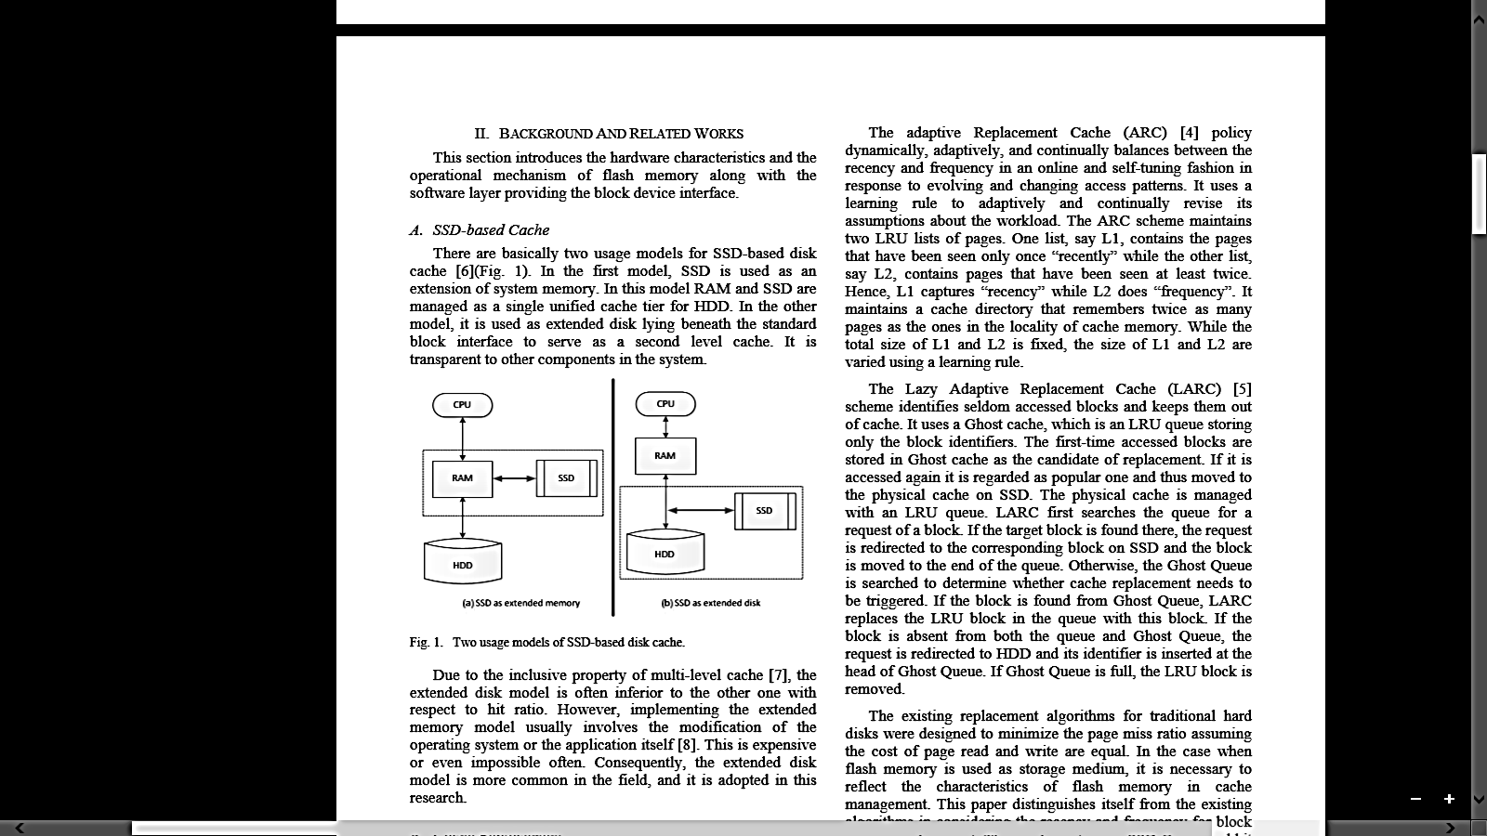
HOW TO USE SSD ?
Considering the Advantages and Disadvantages of SDD it is to be used as a Cache Storage for HDD.
Extension of system memory
Extended Disk As A Second Level Cache

Slide 4
NEED OF NEW ALGORITHM
Currently Being Used Replacement Policies
Least Recently Used
Multi Queue
Adaptive Replacement
Lazy Adaptive Replacement
Proposed System
Considers the recency and frequency for block or page replacement.
The residence time in SSD Queue and hit count of a block are used to decide the popularity

Slide 5
Block Replacement Based On Popularity (BRP)
This Page Replacement Algorithm calculates the block popularity to select the block which will be admitted to SDD or evicted from SSD by Using the frequency and recency of block access.
Recency – Last time of accessing a page
Frequency – How frequently page is being accessed.
This is achieved by the notion of block popularity, which is managed by S_Queue.
It also adopts Ghost queue as a filter used to reduce the SSD write operations.

Slide 6
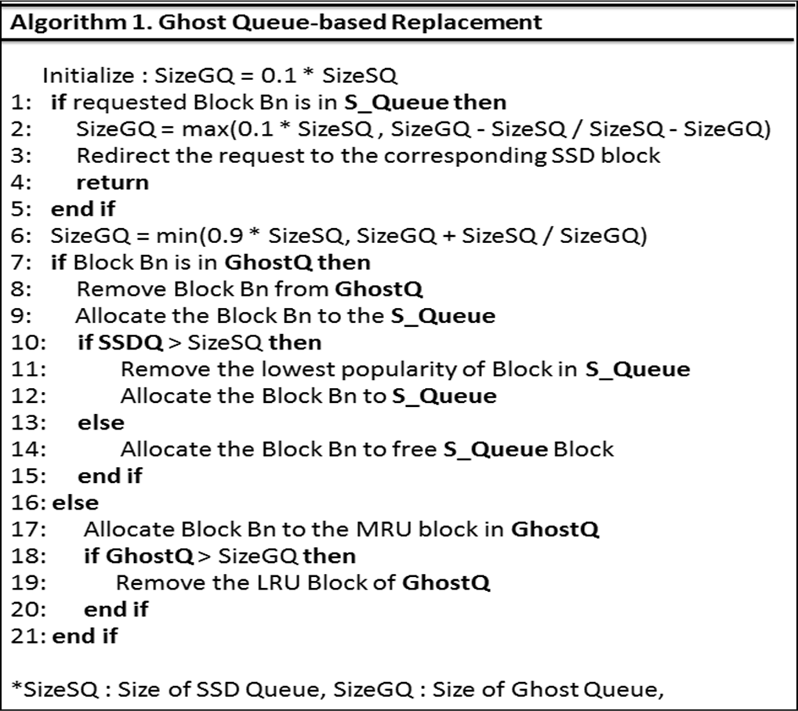
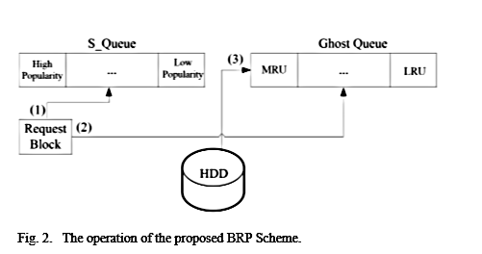
Algorithm For Entering In Proper Queue

Slide 7
Case (1):
When a request for a block arrives, SSD Queue is first checked if the requested block is in the SSD cache or not. If true, the access information on the block is updated.
Requested
Block
SDD Queue
4
4
1
3
1
3
4
5
Ghost Queue
8
7

Slide 8
Case (2):
If the requested block is not found, Ghost Queue is checked for its presence. Then the requested block is moved to the SSD cache by referring to the metadata of the block in Ghost Queue.
SDD Queue
1
1
3
4
7
3
4
5
5
Requested
Block
Ghost Queue
7
8
7

Slide 9
Case (3):
When the requested block is not in both SSD Queue and Ghost Queue, the metadata of the request block is put in the head of Ghost Queue.
Requested
Block
SDD Queue
6
1
3
4
5
Ghost Queue
8
7

Slide 10
Case (3):
When the requested block is not in both SSD Queue and Ghost Queue, the metadata of the request block is put in the head of Ghost Queue.
SDD Queue
1
3
4
5
Requested
Block
Ghost Queue
6
6
8
7
8
7

Slide 11
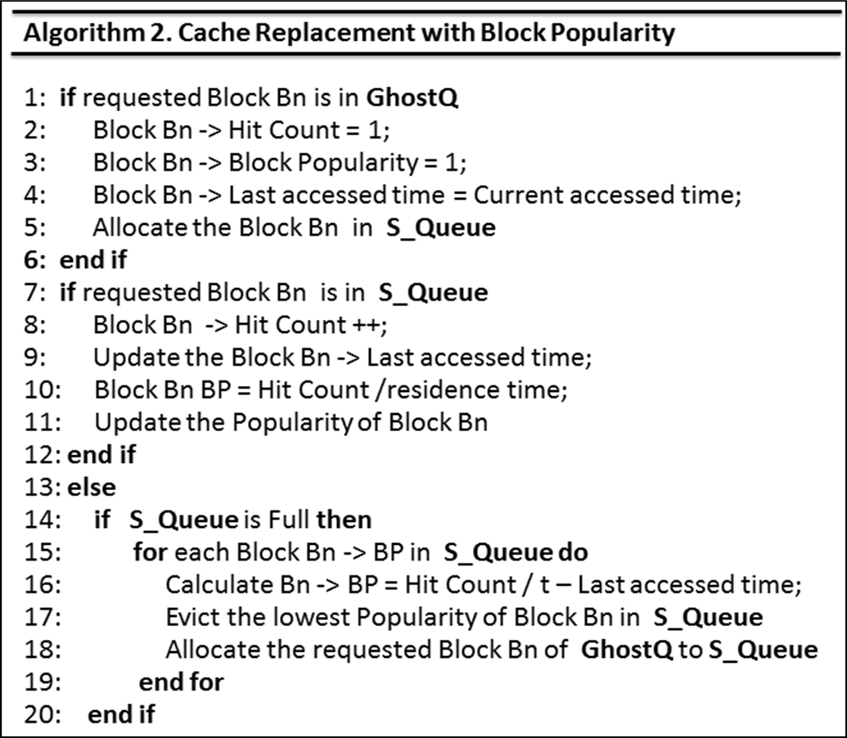
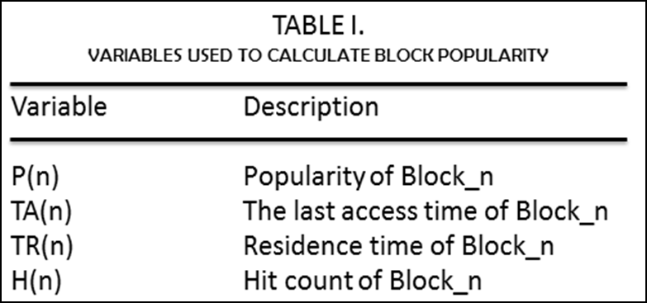

Algorithm For Maintaining Priority of Blocks
T_{R}(n)=t−T_{A} (n)

Slide 12
Maintaining Priority of Blocks
If Block is already present in SDD Queue
If Block is newly added in SDD Queue
Last access time
Residence time
Hit Count
Popularity
: Current Time
: 0
: increment by 1
: Hit count / Residence Time
Last access time
Residence time
Hit Count
Popularity
: Current Time
: 0
: 1
: 1

Slide 13
Conclusion
In this paper we have proposed an enhanced cache replacement scheme for flash-based disk cache.
It considers both the frequency and recency of the access to the blocks to decide whether the blocks are kept in SSD or not.
This avoids cache pollution and keeps popular blocks in SSD cache, leading to high hit ratio.
Also, the proposed scheme reduces the frequency of block replacement, and thus incurs less write operations to SSD.
Consequently, it enhances the performance of the storage and lifetime of the SSD.

Slide 14
Thank You…
Presented By
Mandar Tawde

