Slide 1

Social Media in Business
Presented By
- Jagdish Bokil(11)
-Vivek Jadhav(23)

Slide 2

Importance of Social Media in Business
Brand Visibility
Customer Engagement
Cost-Effective Marketing
Social media allows businesses to showcase their products, services, and brand personality, reaching a wider audience and improving brand recognition.
Platforms like social media enable businesses to interact directly with customers, gather feedback, and build stronger relationships.
Compared to traditional advertising, social media marketing is often more budget-friendly and can deliver higher return on investment.

Slide 3

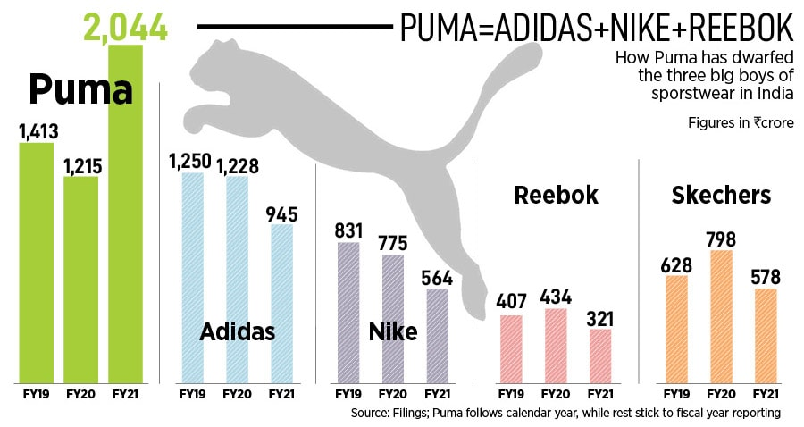
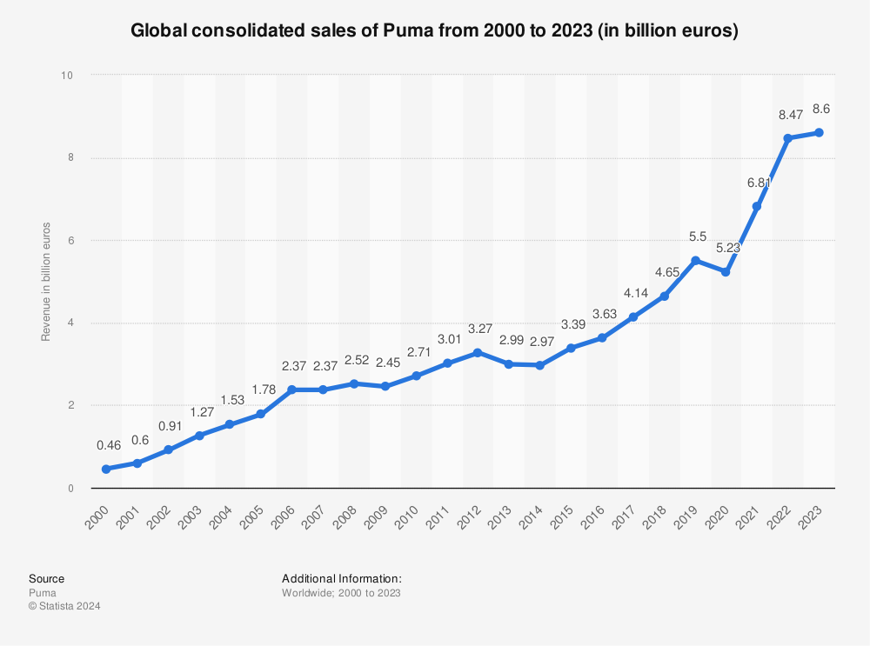
Puma's Social Media Strategy: Strategic Collaborations Driving Growth
Influencer Partnerships
Innovative Campaigns
Puma collaborates with influential athletes, celebrities, and content creators to reach new audiences and build brand credibility.
Puma's social media campaigns often feature unique, attention-grabbing content that sparks engagement and drives conversation.

Slide 4
Puma's Product
• Puma has a wide range of Products: Shoes, Clothing, Accessories and sports goods.
• Puma is also the main producer of enthusiast driving shoes and race suits.
• Provide Product for All age groups
• The company has partnership with BMW and Ferrari.

Slide 5
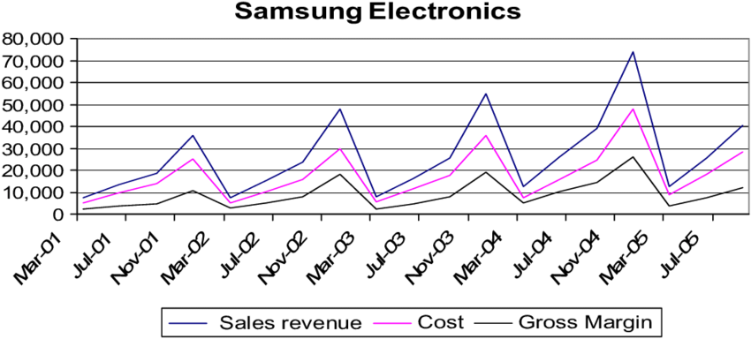
Samsung's Social Media Strategy: Widespread Reach With Curated Content
Diverse Content Mix
Audience Targeting
Samsung's social media strategy encompasses a diverse range of content, from product launches and tutorials to lifestyle and entertainment-focused posts.
By tailoring content to specific demographics and interests, Samsung effectively engages users and strengthens its brand presence across platforms.

Slide 6
Samsung's Promotions
1. Teasers and Pre-Launch Hype
Early teasers on Twitter, Instagram, YouTube with hashtags like #GalaxyS24Ultra.
Focus on key features: camera, design, performance.
2. Unpacked Event
Live-streamed event showcasing features like 200MP camera, S Pen, and Snapdragon 8 Gen 3.
Clips and highlights shared on social media for wider reach.
3. Influencer Collaborations
Tech influencers and YouTubers share unboxing and review videos.
Focus on real-world performance: camera, display, battery.
4. Social Media Engagement
AR filters, contests, and user-generated content campaigns on Instagram and TikTok.
Features like moon shots and night mode promoted with challenges and giveaways.

Slide 7
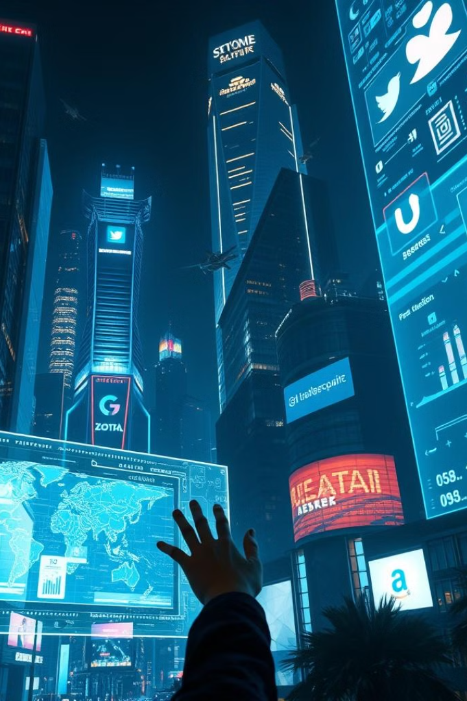
Conclusion & Future Trends
Continued Growth
Emerging Technologies
As more businesses embrace social media, its importance in marketing and customer engagement will continue to increase.
Advancements in artificial intelligence, augmented reality, and video content will shape the future of social media marketing.
Personalization
Businesses will focus on delivering highly personalized experiences to their customers through targeted social media campaigns.

Slide 8
Thank You…

