Slide 1


University of Pune
Savitribai Phule Pune University
A Project On
“STATISTICAL ANALYSIS OF GOLD INVESTMENT -PERCEPTION & FORECASTING”
Submitted in the partial fulfilment of the requirements _ for the award of the Degree of
Bachelor of Science in Statistics
Submitted by
Shubham Birari – 9809
Chetan Bagul – 9772
Tushar Patil –9785
Mandar Kad –9752
Dhiraj Patil -9810
Under support and guidance of
Dr. Sandesh Kurade Ms. Apoorva pali
Head, Department of Statistics
Maharashtra Education Society's
ABASAHEB GARWARE COLLEGE
Karve Road, Pune - 411004 2021-2022

Slide 2
INDEX
INTRODUCTION
ABSTRACT
MOTIVATION
RESEARCH OBJECTIVES
RESEARCH METHODOLOGY
TERMS & CONCEPTS
QUESTIONNAIRES
SURVEY REPORT

Slide 3
> CHI-SQUARE TEST OF
INDEPENDENCE
> GRAPHICAL REPRESENTATIONS
> TIME SERIES ANALYSIS FITTING ARIMA MODEL
> SUMMARY

Slide 4
INTRODUCTION
Gold has a dominant presence in Indian culture. It is
considered as an asset in a portfolio. Gold has a religious and sentimental value. Since gold is imported it impacts the current account deficit of India. To reduce the import of gold the government has introduced gold funds. People can now invest in gold funds instead of buying physical gold. These funds give same returns as investment in gold. Gold ETFs and various schemes enable people to invest in gold in the demat form. The paper tries to understand how the perceptions of people have changed from investing in physical gold to gold in demat form. Financial literacy would enhance and make people aware of these gold schemes and the safety and returns available. The paper also aims to study the different modes of investment in gold in India.

Slide 5
ABSTRACT
Gold is a precious commodity and most popular as an
investment in India. There are religious and sentimental values in buying gold. This study is conducted to evaluate the perception of consumers for investing in gold in India. The paper also aims to study the different modes of investment in gold. Primary research was conducted to know the perceptions of respondents. Survey was done to know about the awareness of options for investment in physical gold and the most preferred gold investment and gold fund. The survey shows that many people are aware of gold ETFs. 72 percent respondents perceive gold as a risk-free investment, 43 percent invest in gold funds while 36 percent respondents invest in physical gold. SBI Gold fund is the most preferred fund followed by HDFC Gold Fund. The analysis shows that people invest primarily for returns. Other reasons for investment in gold are safety and liquidity. Investment can be made in physical gold, Gold ETFs and E-Gold, Gold Monetisation Scheme, Gold Sovereign Bonds and Gold Mutual Funds.

Slide 6
MOTIVATION

Slide 7
RESEARCH OBJECTIVES
> To evaluate the perception of consumers for investing in gold in India
> To study the various modes of investment in gold in India
> To predict the future prices of gold.
RESEARCH METHODOLOGY
The paper aims at evaluating the perception of
consumers for investing in gold in India. The paper also aims at studying the various modes of investment in gold. Primary and secondary data has been collected for the purpose. For primary data, randomly approximate 300 people were distributed a questionnaire. For secondary data, taking history data from Government of India website. Used tools such as sums and percentages and charts for the quantitative data analysis and Participant Observation, Non-participant Observation, Field Notes, Analysis of documents and materials have been used for analysis

Slide 8
TERMS & CONCEPTS
■ Physical Gold - People buy gold in the form of jewelry, gold bars and coins
■ Gold Exchange Traded Funds (ETFs) - These units represent physical gold in dematerialized form or paper form. These funds are open-ended funds and are traded on major stock exchanges. One ETF unit is equal to one gram of gold. Investing in Gold ETF is cost efficient as there are no making charges unlike gold jewellery.
■ Gold in Electronic form (E-Gold) - E-Gold units can be bought and sold through National Stock Exchange (NSE) just like shares. Here, one unit of e-gold is equal to one gram of gold. E-Gold can be bought in small quantities and kept in demat account. These units can be encashed or converted to physical gold.
■ Gold Monetisation Scheme - The government has introduced this scheme which gives interest on gold deposits. Investors can deposit gold in any physical form. It works like a savings account.
■ Gold Mutual Funds - These are mutual funds that invest in gold ETFs and other related assets. These funds do not directly invest in physical gold but take the same position indirectly by investing in Gold ETFs.

Slide 9
QUESTIONNAIRES
Gender*
• male
• Female
Age*
• Less than 25
• 25-35
• 35-45
• more than 45
Occupation*
• Student
• Employee
• Business
• Household
Income per month (personally / family)
• <20k
• 20k - 40k
• 40k - 60k
• 60k - 80k
• >80k
Do you invest in Gold ?
• Yes
• No

Slide 10
Is Gold a Risk-free investment?
• Yes
• No
what is the Objective of Investment?
• Safety
• Liquidity
• Returns
• Low Risk
Most preferable mode of investment in Gold
• Physical Gold (People buy gold in the form of jewellery, gold bars and coins.)
• Gold ETF (units representing physical gold which may be in paper or dematerialised form.)
• E-Gold (units can be bought and sold through National Stock Exchange)
• Gold Monetisation Scheme (this scheme which gives interest on gold, It works like a savings account)
• Gold Mutual Funds ( These are mutual funds that invest in gold ETFs and other related assets)
Awareness of Gold Exchange Traded Funds (ETF)
• Yes
• No

Slide 11
Preferred Gold Funds
• Axis Gold fund
• HDFC Gold fund
• SBI Gold fund
• Kotak Gold fund
(Savings) : (Expenditure Ratio)
• 10 : 90
• 20 : 80
• 30 : 70
• 40 : 60
• 50 : 50
Preferred Period of Investment
• Long term (more than 3 years)
• Medium term (1-3 years)
• Short term (less than 1 year)
which are the primary sources of your knowledge about the gold investment?
• Television
• Internet / YouTube
• Books/class
• Friends/ Relatives

Slide 12
SURVEY REPORT
investing in gold male & female
 | Invest | Not Invest Total
Male | 141 | 57 | 198
Female | 100 | 8 | 108
Total | 241 | 65 | 306
We check whether male or female category invest in gold.
So, first we check for equal hypothesis of proportion test in R-software
Let,
X1: no. of male invest gold.
X2: no. of female invest gold.
N1: Total no. of male in survey.
N2: Total no. of female in survey.
To Test: -
Ho: Both purchase equal gold. (i.e P1= P2)
Against H1: Both not invest equal gold.(i.e P1not equal to P2)
R-software: -
command: - >prop.test(x,n)
> x=c(100,141)
> n=c(108,198)
> prop.test(x,n)
2-sample test for equality of proportions with continuity correction
data: x out of n
X-squared = 17.838, df = 1, p-value = 0.01620 alternative hypothesis: two. Sided 95 percent confidence interval:
0.1265441 0.3010654 sample estimates: prop 1 prop 2 0.9259259 0.7121212

Slide 13
Here we conclude that p-value is less than0.05 also confidence interval not contain the zero. i.e. p-value = 0.01620<0.05 Hence we have to reject Ho at 5% level of significance.
So, Both category male and female not invest gold equally.
CHI-SQUARE TEST OF INDEPENDENCE
R-software: -command:
> risk_free=matrix(c(131,59,67,49),nrow=2)
> rownames(risk_free)= c("risk free ","not risk free”)
> colnames(risk_free)= c("male","female")
> View(risk_free)
> model=chisq.test(risk_free)
> model
Pearson’s Chi-squared test with Yates’ continuity correction data: risk_free
X-squared = 3.4735, df = 1, p-value = 0.06236
> summary(risk_free)
male female
Min. | : 59 | Min. | :49.0
1st Qu. | : 77 | 1st Qu. | :53.5
Median | : 95 | Median | O CO LO
Mean | : 95 | Mean | o CO LO
3rd Qu. | :113 | 3rd Qu. | :62.5
Max. | :131 | Max. | :67.0
Ho: Gender and risk free investment are independent.
H1: Gender and risk free investment are dependent.
Since p-value is greater than level of significance (alpha) i.e. p-value = 0.06236 > 0.05
Therefore, we accept Ho i.e. Gender and risk free investment are dependent.

Slide 14
R-software: -command:
>ETF_ awareness=matrix(c(171,80,26,27),nrow=2)
> rownames(ETF_ awareness)= c("aware of ETF","not aware of ETF")
> colnames(ETF_ awareness)= c("male","female")
> View(ETF_ awareness)
> model=chisq.test(ETF_ awareness)
> model
Pearson's Chi-squared test with Yates' continuity correction data: ETF_ awareness
X-squared = 6.1667, df = 1, p-value = 0.01302
> summary(ETF_ awareness)
male female
Min. | : 80.0 | Min. | :26.00
1st Qu. | :102.8 | 1st Qu. | :26.25
Median | :125.5 | Median | :26.50
Mean | :125.5 | Mean | :26.50
3rd Qu. | :148.2 | 3rd Qu. | :26.75
Max. | :171.0 | Max. | :27.00
Ho: Gender and Awareness of ETF are independent. H1: Gender and Awareness of ETF are dependent
Since p-value is less than level of significance (alpha) i.e. p-value = 0.01302 < 0.05 Therefore, we reject Ho
i.e. Gender and Awareness of ETF are independent.

Slide 15
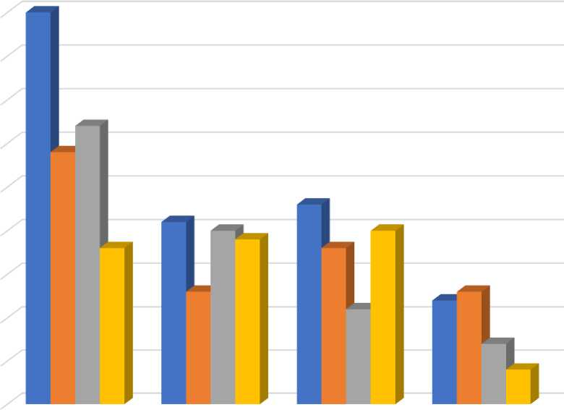
GRAPHICAL REPRESENTATIONS
Ages | Returns | Low Risk | Liquidity | Safety | Grand Total
35-45 | 45 | 29 | 32 | 18 | 124
25-35 | 21 | 13 | 20 | 19 | 73
more than 45 | 23 | 18 | 11 | 20 | 72
Less than 25 | 12 | 13 | 7 | 4 | 36
Grand Total | 101 | 73 | 70 | 61 | 305
45
40
35
30
25
20
15
10
5
0
■ Returns
■ Low Risk
■ Liquidity
■ Safety
35-45 25-35 more than 45 Less than 25
Interpretation: -
Above graph show that Gold Investor of age 25-35, 35-45, more than 45 are preferred to invest for Return, but Investor of age of less than 25 are preferred to play safe and their objective for invest is Low Risk

Slide 16
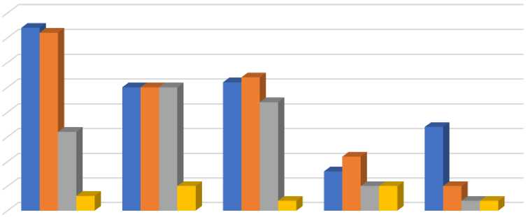
preferable mode of investment | Employee | Business | Household | Student | Grand Total
Gold Mutual Funds | 37 | 36 | 16 | 3 | 92
Physical Gold | 25 | 25 | 25 | 5 | 80
Gold ETF | 26 | 27 | 22 | 2 | 77
E-Gold | 8 | 11 | 5 | 5 | 29
Gold Monetisation Scheme | 17 | 5 | 2 | 2 | 26
Grand Total | 113 | 104 | 70 | 17 | 304
40
35
30
25
20
15
10
5
0
■ Employee
■ Business
■ Household
■ Student
Gold Mutual Funds ( These are mutual funds that invest in gold ETFs and other related assets)
Physical Gold (People buy gold in the form of jewelry, gold bars and coins.)
Gold ETF (units representing physical gold which may be in paper or dematerialised form.)
E-Gold (units can be bought and sold through National Stock Exchange)
Gold
Monetisation Scheme (this schem which gives interest on gold, It works like a savings account)
Interpretation: -
Above graph shows that occupation having Employee and business are most preferred to invest via Gold Mutual Fund. where as all type of investor preferred Physical Gold equally. Graph shows that E-Gold is least preferable mode to invest in Gold.

Slide 17
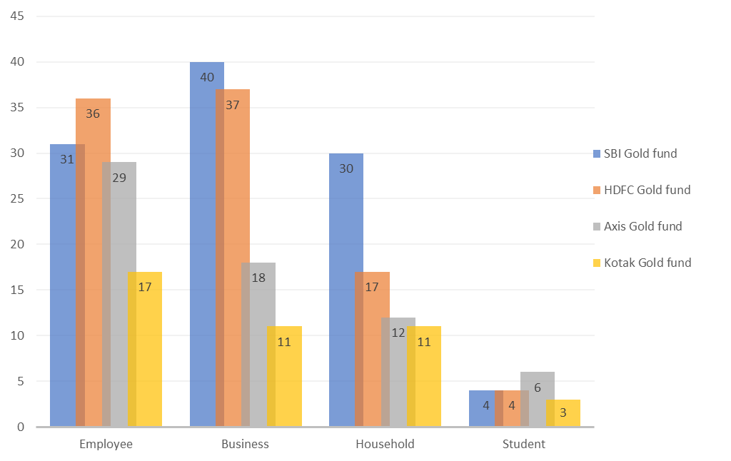
Occupation | SBI Gold fund | HDFC Gold fund | Axis Gold fund | Kotak Gold fund | Grand Total
Employee | 31 | 36 | 29 | 17 | 113
Business | 40 | 37 | 18 | 11 | 106
Household | 30 | 17 | 12 | 11 | 70
Student | 4 | 4 | 6 | 3 | 17
Grand Total | 105 | 94 | 65 | 42 | 306
Interpretation: -

Slide 18
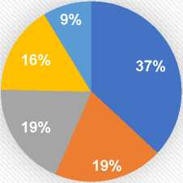
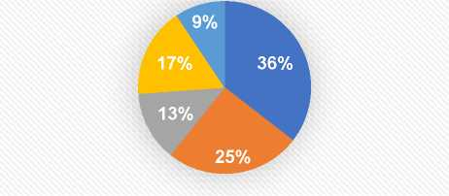
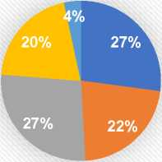
Income per month | Medium term (1-3 years) | Long term (more than 3 years) | Short term (less than 1 year) | Grand Total
60k - 80k | 51 | 38 | 16 | 105
40k - 60k | 27 | 27 | 13 | 67
20k - 40k | 26 | 14 | 16 | 56
>80k | 22 | 18 | 12 | 52
<20k | 12 | 10 | 2 | 24
Grand Total | 138 | 107 | 59 | 304
Medium term years)
(1-3
■ 60k - 80k 40k - 60k 20k - 40k
■ >80k
■ <20k
Long term (more than 3 years)
■ 60k - 80k ■ 40k- 60k ■20k- 40k «>80k «<20k ■
Short term (less than 1 year)
Interpretation: -
This multiple pie chart shows that Preferred Period of Investment of investors having income 60k-80k 37% in medium term,36% go for long term investment and 27% are preferred less than 1 tear investment, similarly for income 40k-60k are invest 19% in mesium term , 25% for long term which is most in that income renge and 22 % for short term. For 20k-40k , 19% for medium term ,13% for long term and 27% for short term. For inome having >80k most preferred short term and
<20k preferred medium & long term equally.
■ 60k - 80k ■ 40k - 60k ■ 20k- 40k «>80k «<20k

Slide 19
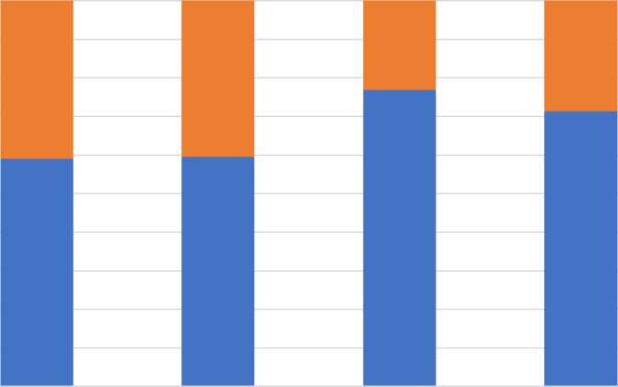
Preferred gold funds | male | Female | Grand Total
SBI Gold fund | 62 | 43 | 105
HDFC Gold fund | 56 | 38 | 94
Axis Gold fund | 50 | 15 | 65
Kotak Gold fund | 30 | 12 | 42
Grand Total | 198 | 108 | 306
100%
90%
80%
70%
60%
50%
40%
30%
20%
10%
0%
■ Female
■ male
SBI Gold fund HDFC Gold fund Axis Gold fund Kotak Gold fund
Interpretation: -
This graph shows that 78% Male preferred most to invest in axis gold fund while 40% Female preference most to SBI Gold fund and HDFC Gold fund equally.

Slide 20
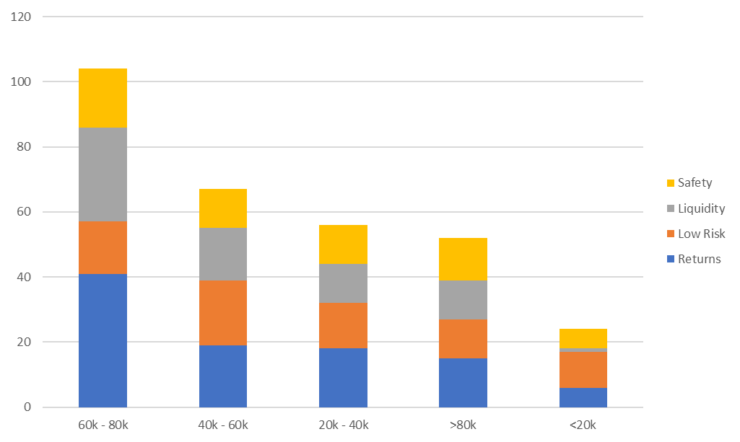
Income per month | Returns | Low Risk | Liquidity | Safety | Grand Total
60k - 80k | 41 | 16 | 29 | 18 | 104
40k - 60k | 19 | 20 | 16 | 12 | 67
20k - 40k | 18 | 14 | 12 | 12 | 56
>80k | 15 | 12 | 12 | 13 | 52
<20k | 6 | 11 | 1 | 6 | 24
Grand Total | 99 | 73 | 70 | 61 | 303
Interpretation: -
In the above graph objective of investment of investor having income 60k-80k is Returns. While investor of monthly income 40k-60k is Low Risk. For income of 20k-40k investor preference is safety, liquidity and low risk. For investor of More than 80k income objective is seems to equal for all type and for less than 20k obviously the objective is for low risk.

Slide 21
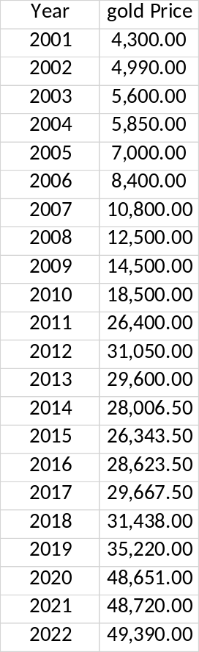
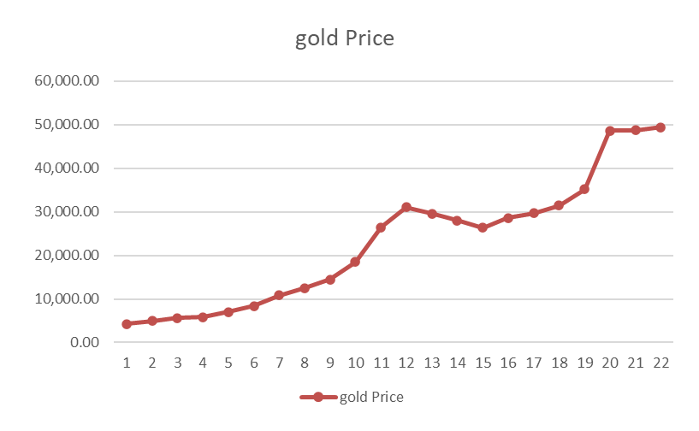
TIME SERIES ANALYSIS FITTING ARIMA
MODEL
A trend is a long-term increase or decrease in the data values. A trend can be linear. or it can exhibit some curvature. if our data exhibit a trend, you can use a time series analysis to model the data and generate forecasts values
We have data set of historical gold prices for India. We have data from 2001 to 2022. So, we have forecasted Gold Prices for 2023,2024,2024 using data from 2001 to 2022

Slide 22
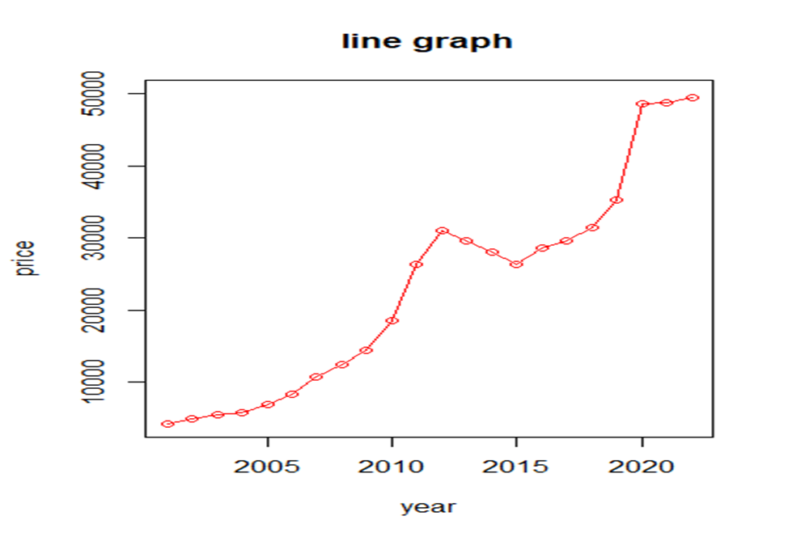
ARIMA MODEL USING R-SOFTWARE
># First, we install required libraries
> library(readxl)
> gold_project <- read_excel("~/r 2nd data.xlsx")
> View(gold_project)
> class(gold_project)
[1] "tbl_df" "tbl" "data.frame"
> #convert data into timeseries
>gold_projecttime=ts(gold_project$price,start=min(gold_project$year ),end=max(gold_project$year),frequency = 1)
> class(gold_projecttime)
[1] "ts"
> #use two packages forecast and tseries
> library(forecast)
> library(tseries)
> plot(gold_projecttime,type='o',main='line
graph',xlab='year',ylab="price",col="red",ylim=c(4300,50000),xlim=c
(2001,2022))

Slide 23
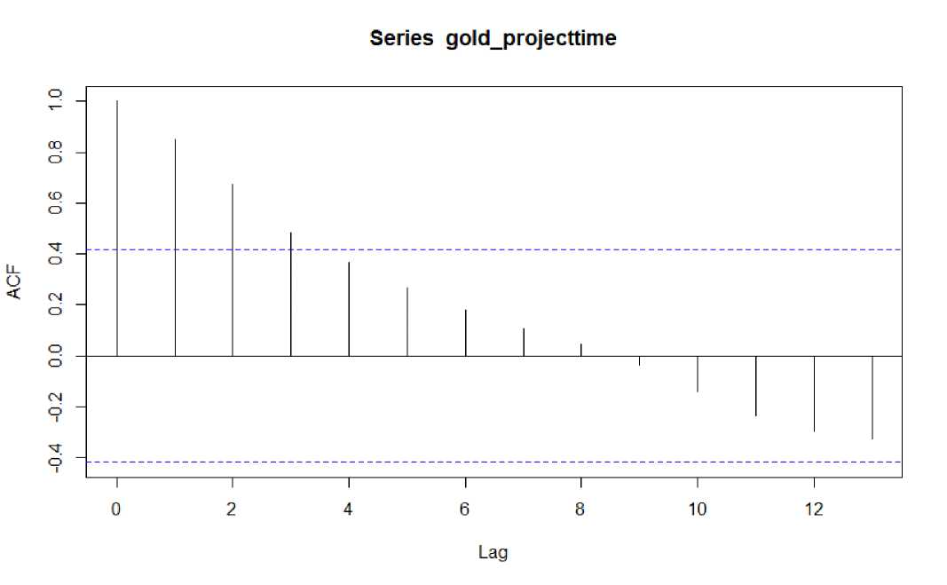
> # There is upper trends , assumption is you cant use arima model until unless data is stationary or not
> #First we check Autocorrelation
> acf(gold_projecttime)
> # if blue lines crossed then the data is highly corelated and not stationary.
> # autocorrelation means the gold price data having high correlation with itself.
> #This data is not stationary
> #after we check partial autocorrelation function, we are going to check data is stationary or not
> pacf(gold_projecttime)

Slide 24
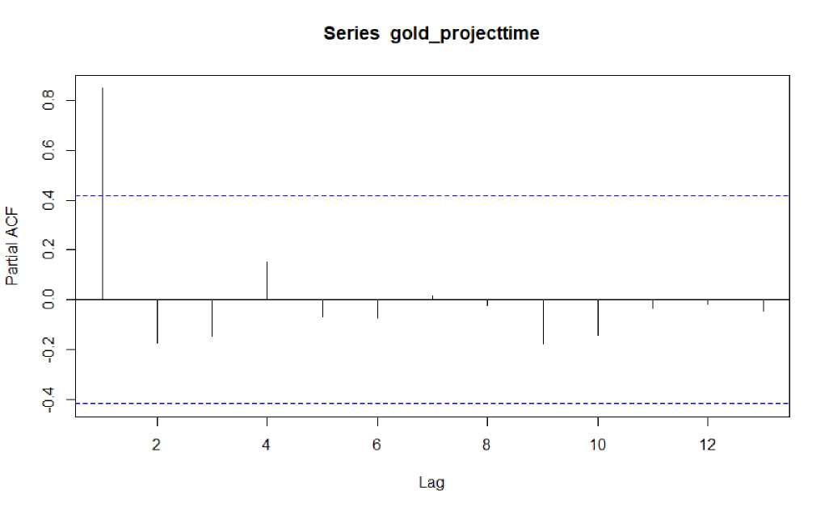
> #we checking augmented Dicky-fuller test
> adf.test(gold_projecttime)
Augmented Dickey-Fuller Test
data: gold_projecttime
Dickey-Fuller = -2.9766, Lag order = 2, p-value = 0.2003 alternative hypothesis: stationary
># if p value is not less than 0.05 then it means data is not stationary
>#converting non-stationary data into stationary > goldmodel=auto.arima(gold_projecttime,ic="aic",trace = TRUE) Fitting models using approximations to speed things up.....
ARIMA(2,1,2)
ARIMA(0,1,0)
ARIMA(1,1,0)
ARIMA(0,1,1)
ARIMA(0,1,0)
ARIMA(1,1,1)
with drift with drift with drift with drift
with drift
Inf
404.1713
405.2669
405.0289
409.4941
407.0156

Slide 25
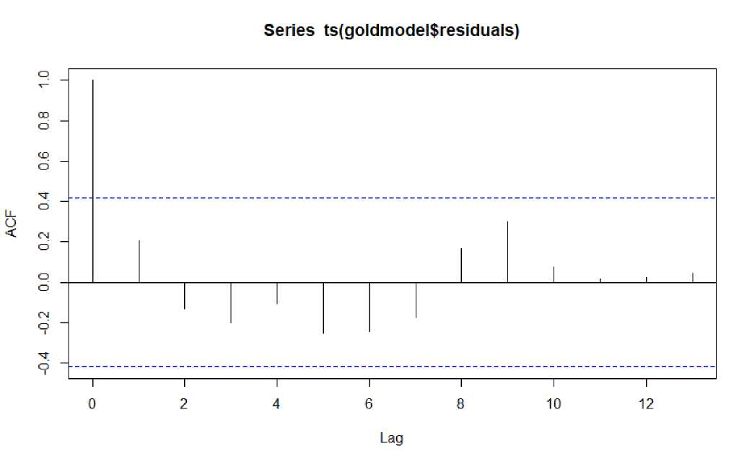
Now re-fitting the best model(s) without approximations... ARIMA(0,1,0) with drift : 404.1713
Best model: ARIMA(0,1,0) with drift
> goldmodel
Series: gold_projecttime ARIMA(0,1,0) with drift
Coefficients:
drift 2147.1429 s.e. 725.3764
sigma^{A}2 = 11602015: log likelihood = -200.09 AIC=404.17 AICc=404.84 BIC=406.26
#check that given data is stationary > acf(ts(goldmodel$residuals))

Slide 26
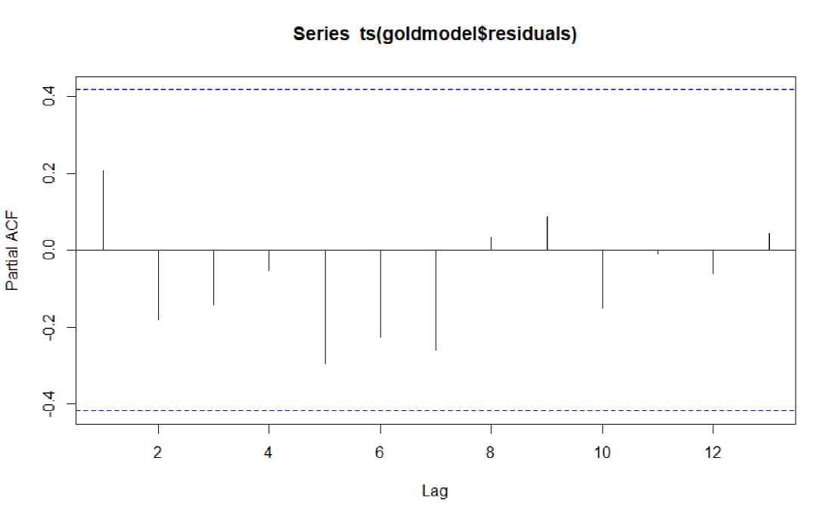
>#Now the lines are under control that means data has becomes stationary
>#The data has now stationary
># also check using partial autocorrelation function > pacf(ts(goldmodel$residuals))

Slide 27
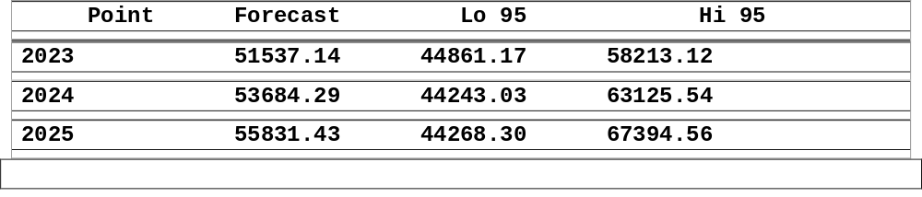
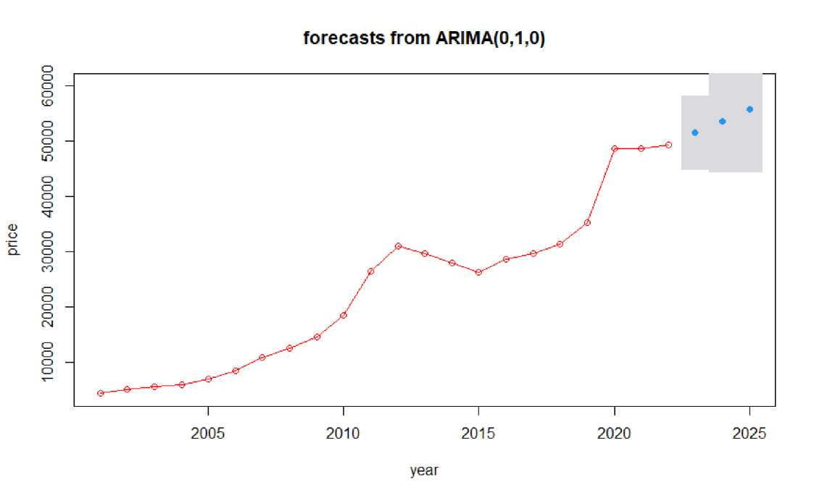
partial autocorrelation function is also stationary ># now forecasting the data using best fitted ARIMA model
mygoldforecast=forecast(goldmodel,level=c(95),h=3*1
> mygoldforecast
># forecast for high(Hi95) and low (Lo95) are nothing but confidence level because this is we are forecasting this says that values are may vary low to high
> plot(mygoldforecast,type='o',main='forecasts from
ARIMA(0,1,0)',xlab='year',ylab="price",col="red",ylim=c(4300,60000)
)

Slide 28
> #validate using Box.test
>#purpose to test this box.test is to check weather data is not having any autocorrelation,the p value should more than 0.05 if value is less then 0.05 still having autocorrelation issue
> Box.test(mygoldforecast$resid,lag=5,type = "Ljung-Box")
Box-Ljung test data: mygoldforecast$resid
X-squared = 4.9026, df = 5, p-value = 0.4279
> Box.test(mygoldforecast$resid,lag=15,type = "Ljung-Box")
Box-Ljung test data: mygoldforecast$resid
X-squared = 13.301, df = 15, p-value = 0.579
> Box.test(mygoldforecast$resid,lag=20,type = "Ljung-Box")
Box-Ljung test
data: mygoldforecast$resid
X-squared = 14.753, df = 20, p-value = 0.7904
># so no problem for autocorrelation
># That is how we finish our ARIMA MODEL

Slide 29
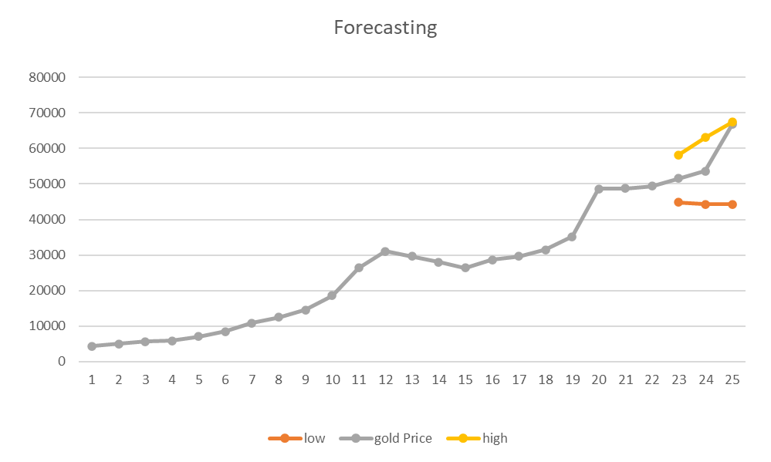
• SUMMARY
RESULT: -
Given below is the predicted prices of next years..
Year Forecast Lo 95 Hi 95
2023 51537.14 44861.17 58213.12
2024 53684.29 44243.03 63125.54
2025 55831.43 44268.30 67394.56
The above trend analysis plot shows a clear upward forecast trend. There may also be a slight curve in the data because the increasing in the data values seems to accelerate over time. there is clearly a positive, not nearly linear model trend.

Slide 30
Conclusion table for chi-square Test
Attribute | P value | Level of significance | Decision | Conclusion
Male & female purchase equally Vs Male & female not purchase equally | 0.01620 | 0.05 | Reject Ho | Both categories Male and Female not invest in Gold equally
Gender Vs Risk free investment | 0.06236 | 0.05 | Accept Ho | Gender & Risk free investment are dependent
Gender Vs Awareness of ETF | 0.01302 | 0.05 | Reject Ho | Gender & Awareness of ETF are independent

