Slide 1
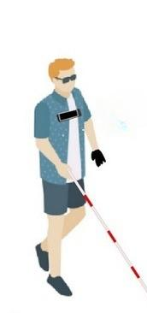
Navigator For Visually Impaired Person
Guide: Prof. S.S. Patil
Students: Dewoo Kudtarkar (27)
Mandar Naik (40)
Nikhil Kanitkar (23)
Pranit Patil (48)
Photo credit: fancycrave1 via Pixabay (Creative Commons Zero license)

Slide 2
Agenda
01
Introduction
04
Simulation
02
Literature Survey
05
Title
03
Methodology
06
Title

Slide 3
Introduction
01
Globally, At least 2.2 billion people have a near or distance vision impairment. In at least 1 billion – or nearly half – of these cases, vision impairment could have been prevented or has yet to be addressed.
In another way creating a fusion of sensing technology and voice-based guidance system, products can be developed which could give better results than individual technology.
The proposed system will be suitable to reduce collision risks by enabling an impaired person to walk outdoors easily. The currently used systems for navigating the visually impaired have several downsides similar to cost, reliance, and usability.

Slide 4
Literature Survey
02
IEEE ID | Name | Proposed Work | Drawbacks
ISBN:978-1-5386-2456-2 | Smart Cap Wearable Visual Guidance System For Blind | The System Uses tensorflow API For Object Detection. | Not Capable of recognizing object near to that person
ISBN:978-1-7281-1322-7 | Smart Assistive Navigation Devices for Visually Impaired People |  | This device is based on internet connectivity, hence not reliable.
ISBN:978-1-5386-9471-8 | Smart Eye for Visually Impaired-An aid to help the blind people |  | Dificult to identify object at the ground level
ISBN:978-1-7281-5197-7 | Smart Stick For Blind People

Slide 5
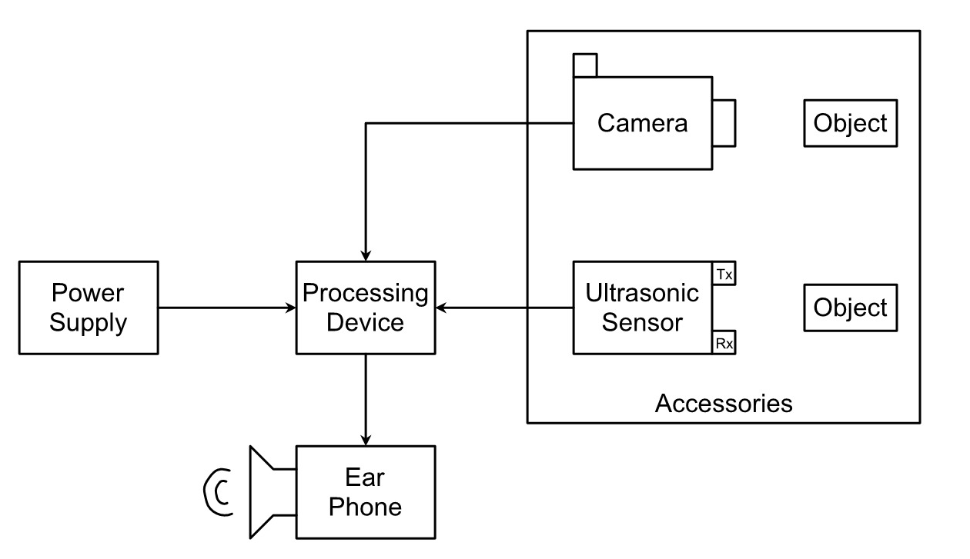
Methodology – Block Diagram
03

Slide 6
Methodology
03
The block diagram consists of camera unit, sensor unit, processing unit, power and output unit.
The camera unit is responsible for capturing objects while the sensor unit provides the distance of object from unit.
The processing unit plays an important role in detecting and identifying objects (image processing) ,it also receives data from ultrasonic sensor then instruct the user about object identified and distance it is located at (So the user can navigate accordingly).
The output is provided to user in terms of audio signal using ear phones

Slide 7
Future Scope
04
As the technology uses image processing for detecting objects. It can be trained to detect new objects.
OCR feature can be added to technology so that along with object detection the system can become capable of detecting languages.
The system can make use of GPS for long distances.
The system can be upgraded to mobile based application.

Slide 8
Thank You!
Photo credit: PeterArreola via Pixabay (Creative Commons Zero license)

