Slide 1
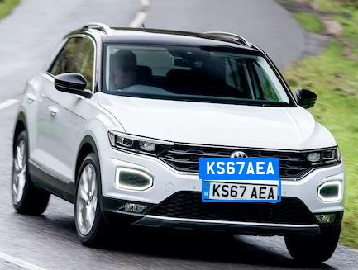
VEHICLE NUMBER PLATE
RECOGNITION USING
IMAGE PROCESSING &
DEEP LEARNING

Slide 2


BHARATI VIDYAPEETH COLLEGE OF ENGINEERING,NAVI MUMBAI
Department of Electronics and Telecommunication Engineering
Academic Year 2022-23
Group Members:
Sakshi Deshpande(08)
Hasan Khan(25)
Prajakta Mhatre(37)
Project Guide:
Prof.R.S.Patil

Slide 3

Introduction
Nowadays, “Image processing” is normally used by a wide range of applications and in different types of electronics like computers, digital cameras,mobile phones, etc. The image properties can be changed with the least investment such as contrast enhancement, borders detection, intensity measurement & apply different mathematical functions to enhance the imagery. Even though these methods can be very influential, the consumer frequently controls images with the dump, but understanding the fundamental values behind the effortless image processing routine is rare.

Slide 4
PLANNING & DESIGNING

Slide 5
Number plate recognition is a form of automatic vehicle identification. A number plate is the unique identification of vehicle.
Real time number plate recognition plays an important role in maintaining law enforcement and maintaining traffic rules.
Number plate recognition is designed to identify the number plate and then recognize the vehicle number plate from a moving vehicle automatically.
Automatic number plate recognition has two major parts:
Vehicle number plate extraction
Optical Character Recognition (OCR)

Slide 6
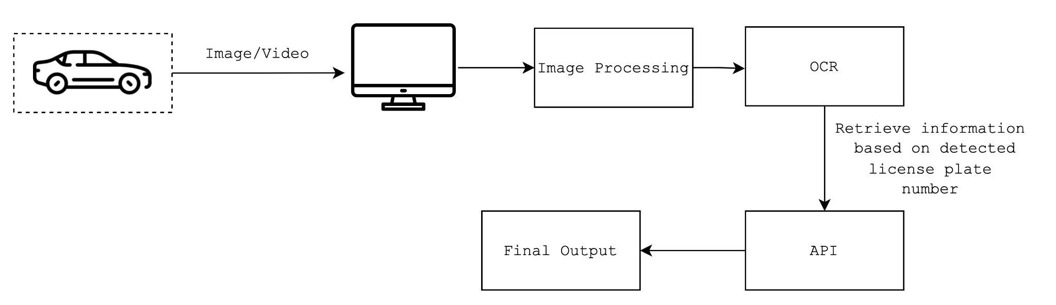
Basic overview

Slide 7
Parameters
Input Parameters | Output Parameters
Image (can have any amount of noise or unnecessary data). | Detects vehicles (with and without) license plate.
Images with some skew or invisibility in some portions may be present. | Number/license plate region is detected and tracked.
Video feed (can have a still or a moving subject whose information/text needs to be tracked). | Decodes license plate, vehicle make, model, color and more.
 | Stolen car detections using RTO API.

Slide 8
EXPLANATION

Slide 9
Workflow
Appropriate media is provided as input to the software, either in image or video format.
Vehicle number plate region is detected first by using Cascade Classifier.
The required region goes through a series of functions which take care of cropping the image, displaying it and extracting the plate number from the image.
Image is then converted to Binarized image.
Contours method of cv2 library is used to find all boundary points of image. Cropping and extraction of numbers will take place after this through segmentation.
Now to calculate the accuracy, ML and DL libraries such as SKlearn, keras and tensorflow are imported.
Augmented image data is generated which lets you augment your images in real time after image restoration while your model is still training.
The model is trained and created and the dimensions are performed.
At last to get the vehicle owner information, library such as REQUEST, xmltodict and JSON are used to convert the data into useful information and then the trained model is saved using pickle

Slide 10
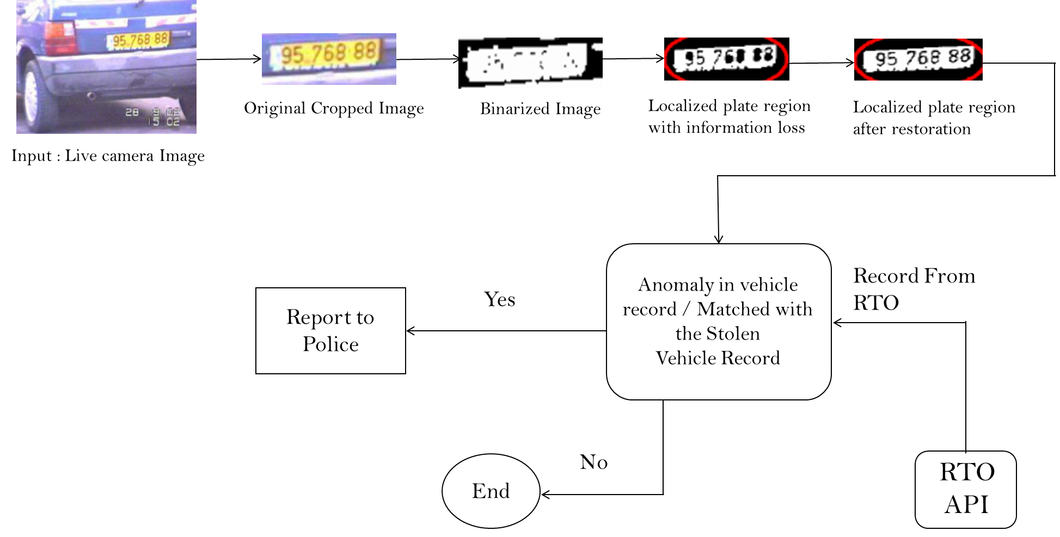
Flowchart

Slide 11


Slide 12
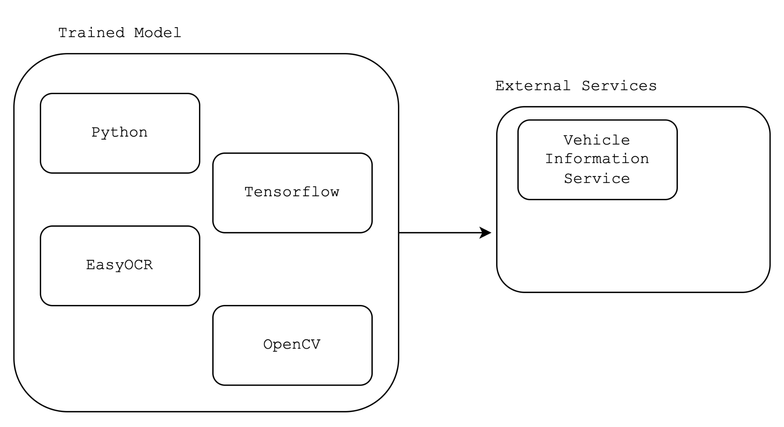
System Design

Slide 13
Future Scope
1)Finding stolen vehicles - This kind of system can be deployed on the roadside and makes a real time comparison between passing vehicles and the stolen vehicles.
2)Future extension of this work is to develop character recognition using template matching algorithm.
3) Recognitions may also use some image processing techniques in conjunction with neural networks to identify the number plate characters, moving distance images, numbering schemes, angled or side-view images.
4)Automatic gate open for entry of vehicle and Detecting in security threat.

Slide 14
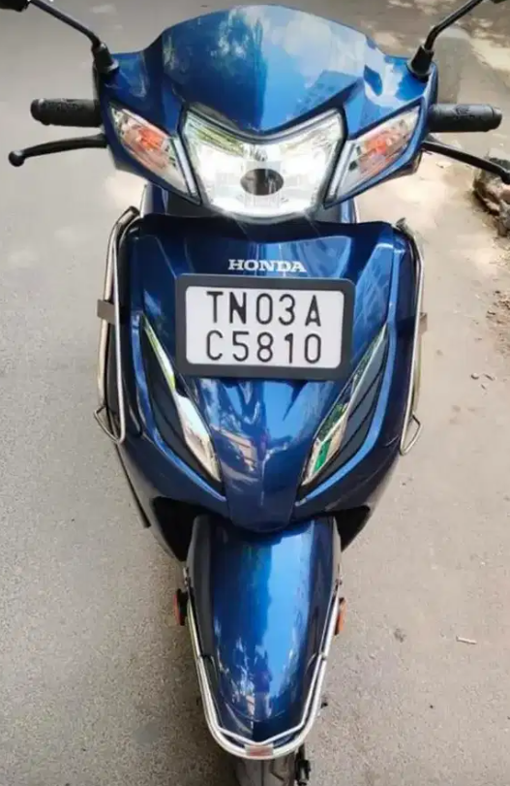
Results
Hence we propose to build a software system with the help of image processing and machine learning that aids in extraction of required information from provided images or appropriate media documents and retrieval of necessary information.
License Plate: TN03AC5810
Region: India
Vehicle Type: Motorcycle
Model: Honda
Color: Blue

Slide 15
Conclusion
This project presents a concise description of the vehicle number plate detection as well as recognition techniques. In the construction of a smart transport network, vehicle number plate detection, as well as a recognition system, plays an important role. It has provided a more robust utility to identify the stolen/suspicious vehicles without human intervention by validating through multiple vehicle attributes instead of just one i.e. registration number. At the same time, it has demonstrated the convenience and feasibility to develop a tailor-made system that uses a combination of deep learning methodologies to provide an automated solution to human complex tasks.

Slide 16
References
https://opencv.org/about/
https://github.com/JaidedAI/EasyOCR
https://www.tensorflow.org/api_docs/python/tf
https://en.wikipedia.org/wiki/Optical_character_recognition
https://www.irjet.net/archives/V5/i3/IRJET-V5I3218.pdf
https://in.mathworks.com/discovery/object-detection.html

Slide 17
Thank Y0u!

