Slide 1
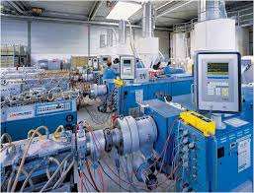
INDUSTRIAL TEMPERATURE CONTROLLER
GUIDED BY- PROF. P. A. KHARADE
PROJECT BY- POOJA PARDHI
JAYESH LAXKAR
PRAVIN LAD

Slide 2
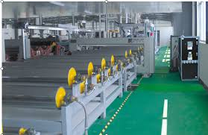
INTRODUCTION
Temperature controller is one of the most used control system in the industry.
Used in many industries like steel, plastic, paper, and many more
Its basic work is to monitor and control the temperature of plant or the processing environment in order to make processing smooth.

Slide 3
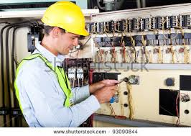
WHY THIS TOPIC
Temperature controller is comparatively simple control system.
But during projects it is not done with the industry requirements.
Limited interfaces limits the users accessibility.

Slide 4
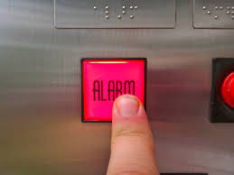
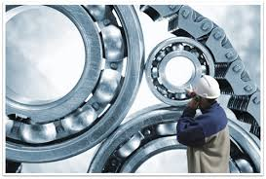
Pre and post failure alarm

Slide 5
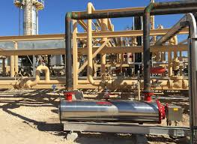
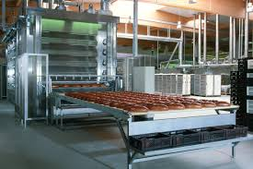
IN INDUSTRY FOR MOULDING

Slide 6
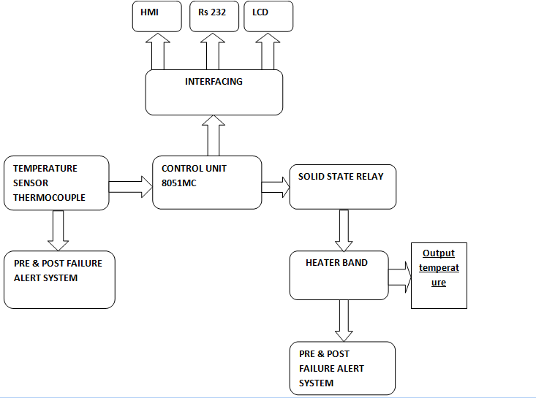
BLOCK DIAGRAM

Slide 7
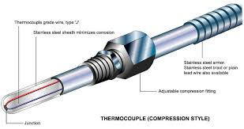
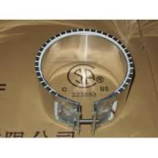
INPUT AND OUTPUTS
Input to the system is taken from thermocouple.
Why thermocouple?
Output side consists heater band.
Triggering circuit is solid state relays.

Slide 8
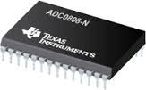
TIMER, ADC
Timers circuit using 555 is used to give clock input to the other circuits.
Astable multivibrator.
ADC is used to convert analog input from the transducer in to digital. So that the data can be processed and analyzed.
IC 0808

Slide 9
Atmega 16:-
ATmega16 is an 8-bit high performance microcontroller of Atmel’s Mega AVR family with low power consumption. Atmega16 is based on enhanced RISC (Reduced Instruction Set Computing, Know more about RISC and CISC Architecture) architecture with 131 powerful instructions. Most of the instructions execute in one machine cycle. Atmega16 can work on a maximum frequency of 16MHz.
ATmega16 has 16 KB programmable flash memory, static RAM of 1 KB and EEPROM of 512 Bytes. The endurance cycle of flash memory and EEPROM is 10,000 and 100,000, respectively.
ATmega16 is a 40 pin microcontroller. There are 32 I/O (input/output) lines which are divided into four 8-bit ports designated as PORTA, PORTB, PORTC and PORTD.

Slide 10
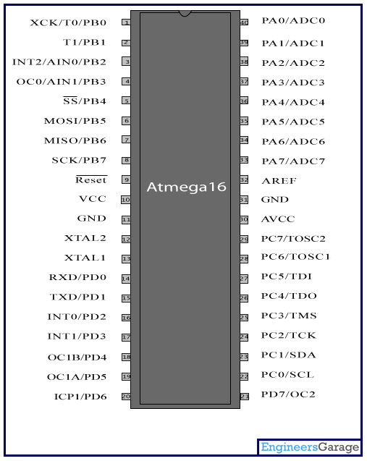
Pin Diagram:

Slide 11
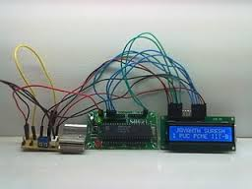
CONTROLLER
We can use any controller like aurdino board, atmega, 80XX,89XX, etc.
We are using 8051 , because we are most familiar with this controller.
It takes input, controls output as well as interfacing handling is also done by the ic.

Slide 12
INTERFACINGS
LCD interfacing.
RS232 interfacing to interface system with computer. (MAX 232)
HMI (human machine interface)
The user interacts directly with hardware for the human input and output such as displays, e.g. through a graphical user interface. The user interacts with the computer over this software interface using the giveninput and output (I/O) hardware. Software and hardware must be matched, so that the processing of the user input is fast enough, the latencyof the computer output is not disruptive to the workflow.

Slide 13
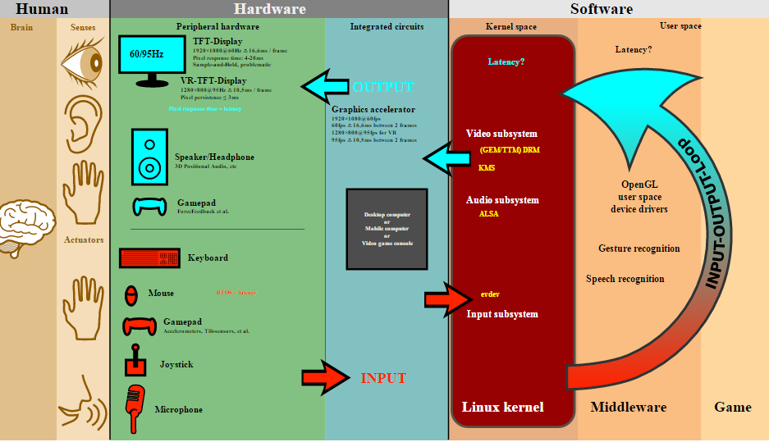
HMI EXAMPLE

Slide 14
ADVANTAGES
Fully automatic, so that it controls the temperature without using it manually.
Pre and post alarm reduces losses in production process
High temperature operation
Fastest response to temperature changes

Slide 15
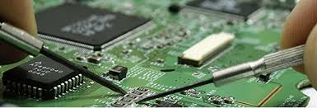
DISADVANTAGES
Low sensitivity to small temperature changes
Extension wire must be of the same thermocouple type
Wire may pick up radiated electrical noise if not shielded
Lowest accuracy

Slide 16
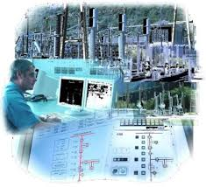
APPLICATION
Plastic injection molding machinery
Food processing equipment
Deicing
Semiconductor processing
Heat treating
Medical equipment
Industrial heat treating
Packaging equipment

Slide 17
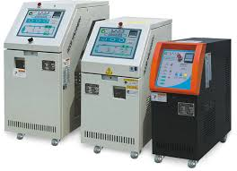
CONCLUSION
we can conclude that the proposed temperature controller design is good for commercial use. And can be considered for actual use in the process plant.

Slide 18
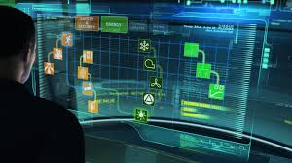
FUTURE SCOPE
Multiple heaters and sensors in same system to obtain desired output.
Processor of high capacity can be used if the requirement of application is demanding
Power supply circuit can be improved.

