Slide 1
Personalized Drug-Drug Interaction (DDI) Risk Assessment Using LLMs and Knowledge Graphs
By
Mandar Panse
[University Of Texas at Austin]

Slide 2
Abstract
Polypharmacy poses significant DDI risks.
Traditional databases ignore patient-specific factors.
Dynamic, personalized DDI risk assessment using:
Knowledge Graphs
Large Language Models (LLMs)
Chain-of-Thought prompting
Streamlit clinical interface

Slide 3
Introduction
Problem: Polypharmacy → Adverse DDIs → Hospitalizations and costs.
Static DDI tools are inadequate.
Need AI-driven risk predictions based on:
Age
Comorbidities (The simultaneous presence of two or more diseases or medical conditions in a patient.)
Lab results

Slide 4
Related Work
Zhang et al. (2017): RNNs for DDI extraction.
Lewis et al. (2020): Retrieval-Augmented Generation (RAG).
Alsentzer et al. (2019): ClinicalBERT for entity extraction.

Slide 5
Methodology Overview
Knowledge Graph Reasoning:
Map drugs to DRKG embeddings.
Calculate cosine similarity.
Chain-of-Thought Prompting:
Transparent DDI reasoning with GPT-4.
Streamlit App:
Clinician input ➔ DDI risk output dynamically.

Slide 6
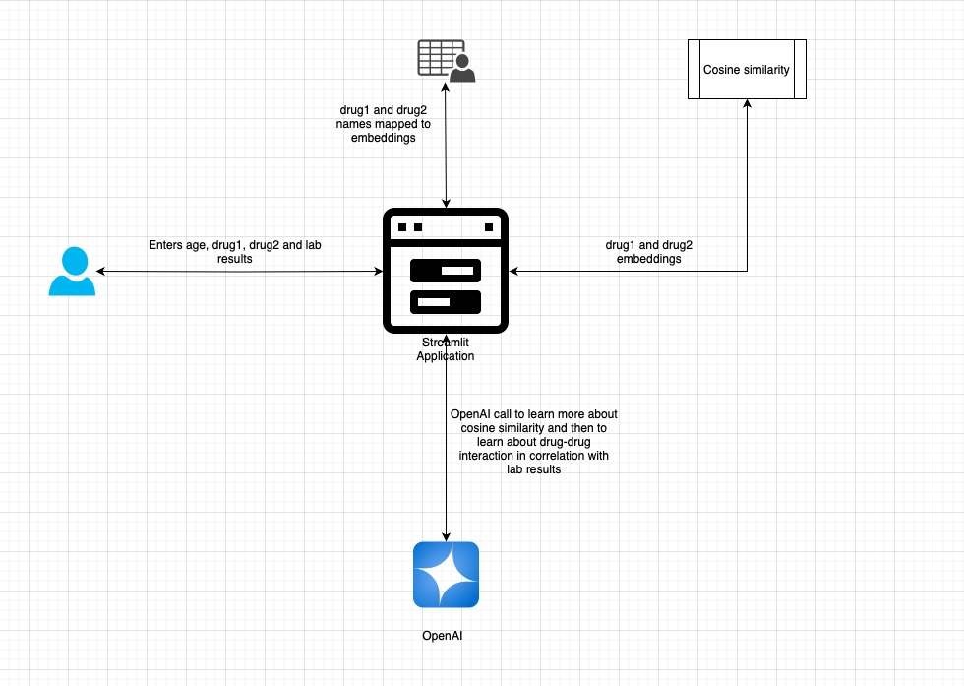
Architecture Diagram

Slide 7
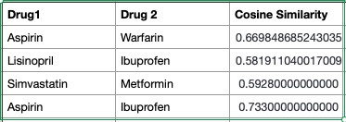
Results: Accuracy
Cosine similarity aligned with known interactions.
Example: Aspirin-Warfarin (0.66)

Slide 8
Results: Transparency and Efficiency
Chain-of-thought prompting enabled detailed reasoning.
Streamlit app produced results in ~5 seconds per input.

Slide 9
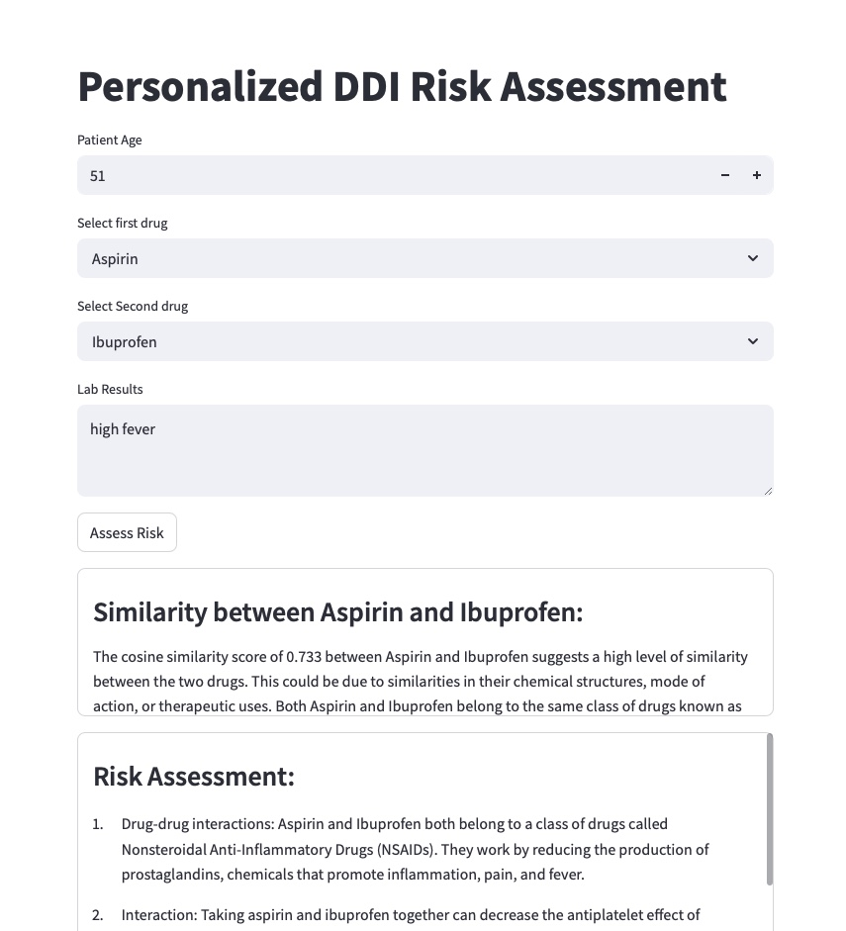
Streamlit Application Interface

Slide 10
Conclusion
Hybrid model (LLM + KG + CoT) improves DDI prediction.
Considers personalized contexts (age, labs).
Future Work:
RAG integration
Genomics incorporation
Rare DDI detection via few-shot learning

Slide 11
References
Wishart et al. (2018): DrugBank 5.0
Zhang et al. (2017): RNN DDI extraction
Lewis et al. (2020): RAG for NLP
Alsentzer et al. (2019): ClinicalBERT

