Slide 1
BREAKING THE LAW: AN INTRODUCTION TO NON-PARAMETRIC STATISTICS JANIQUE KRASNOWKSA

Slide 2
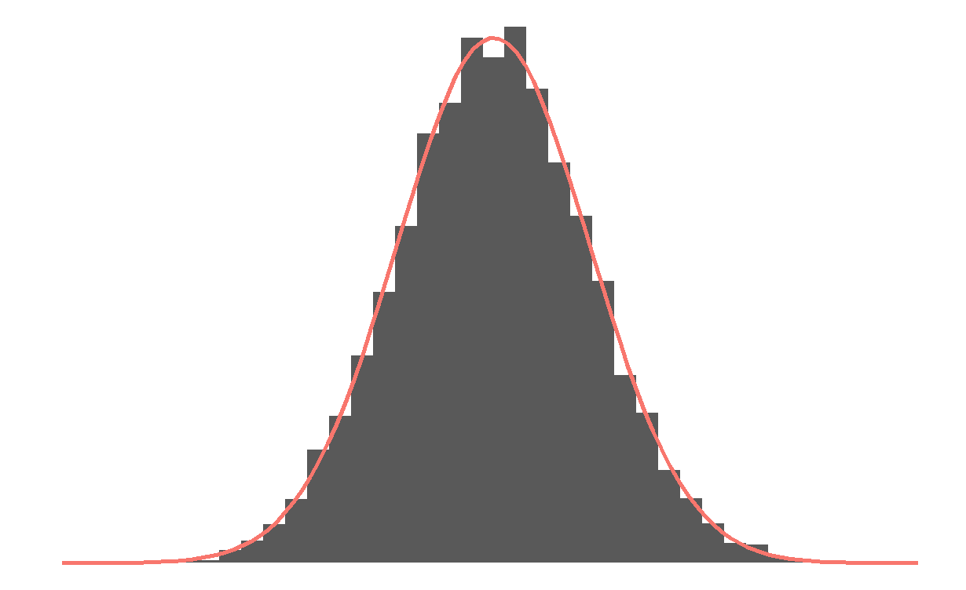
MOTIVATION
Medical data from questionnaires
Trials only including patients above/below a certain threshold

Slide 3
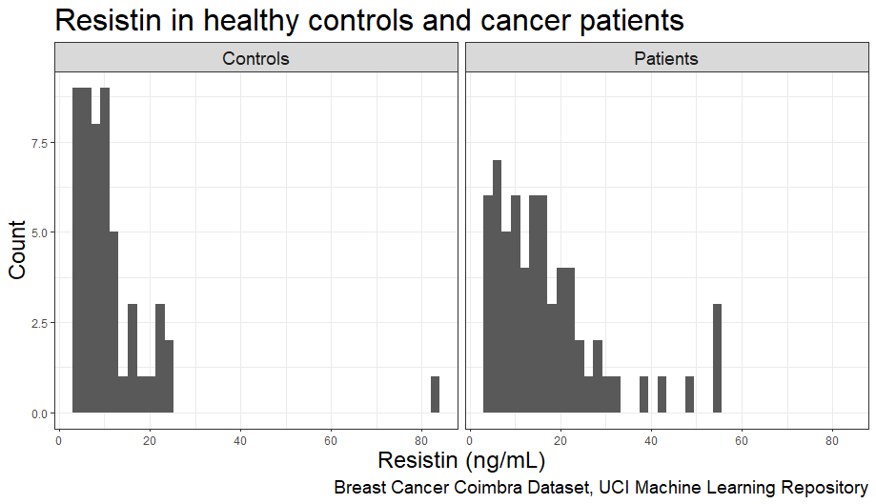
SIMPLE EXAMPLE
116 observations:
64 with breast cancer
52 healthy controls

Slide 4
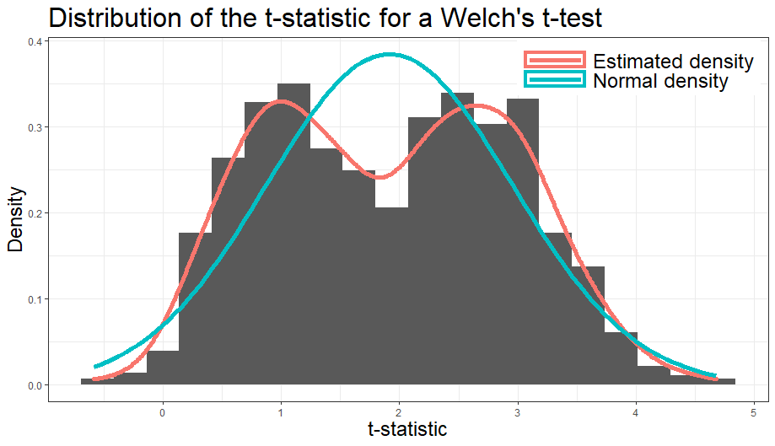
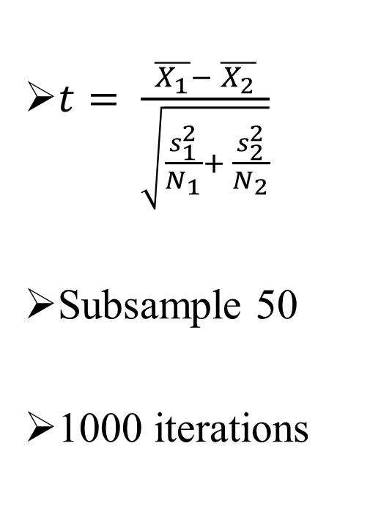
WELCH T-TEST FOR INDEPENDENT SAMPLES
$t= \frac{\overline{X_{1}}− \overline{X_{2}}}{\sqrt{\frac{s_{1}^{2}}{N_{1}}+ \frac{s_{2}^{2}}{N_{2}}}}$
Subsample 50
1000 iterations
Notes:
Plot t distribution here lol m8

Slide 5
NON-PARAMETRIC STATISTICS
Parametrised distributions → using mean, variance, degrees of freedom as the numerical characteristics of probability distributions
Non-parametric → distribution-free or distribution with unknown parameters
Order statistics → based on ranks of observations

Slide 6
MANN-WHITNEY U TEST
Aka Wilcoxon rank-sum test
For randomly selected values X and Y from two populations, the probability of X being greater than Y is equal to the probability of Y being greater than X

Slide 7
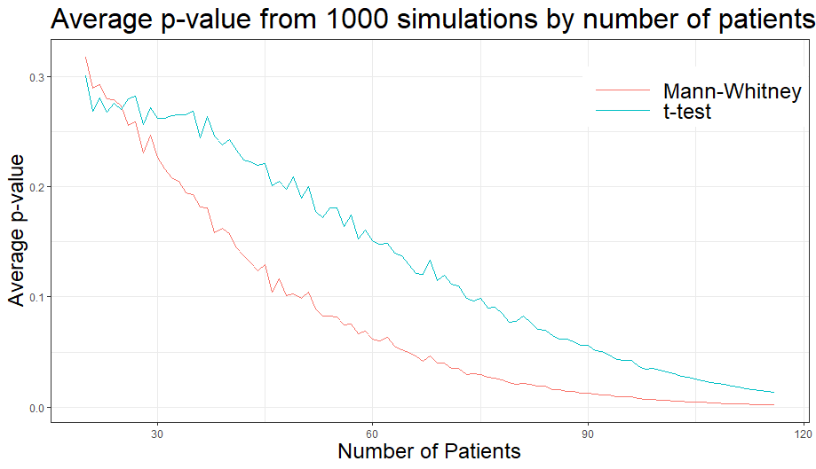
COMPARISON
Notes:
Calculate for 1000

Slide 8
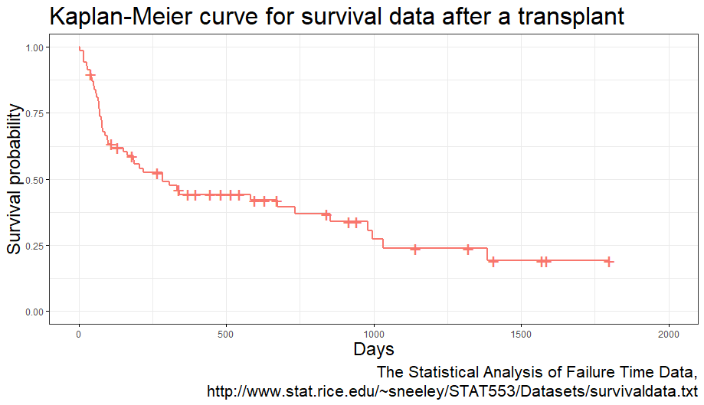
SURVIVAL DATA
Notes:
Censoring, crosses, median

Slide 9
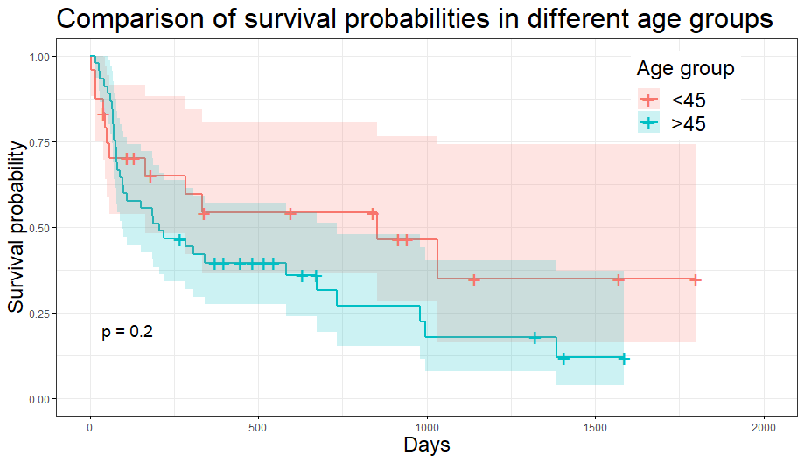
LOGRANK TEST
Notes:
More complicated, hazard function, hypergeometric distributions

