Slide 1
HydroPulse
Water Monitoring and
Analytics Dashboard
WATER
MONITORING
PROJECT
PRESENTATION
GUIDE
Dr. Karumuri Sri Rama Murthy
Assistant Professor • Department of CSE
KLU Hyderabad, Hyderabad
TEAM NO. 14
I. Joshitha (2520040062)
M. Surarichita Laxmi (2520040101)
SMART WATER MONITORING • DATA ANALYTICS

Slide 2
Abstract
HydroPulse is a web-based application designed to monitor and manage water resources efficiently. It displays important parameters such as water level, flow rate, temperature, and water quality through an interactive dashboard. The system helps users understand water conditions easily and supports better water management.
The application includes graphical analytics, automatic alerts, usage records, and maintenance tracking to improve monitoring and identify potential issues. Developed using React.js and Node.js, HydroPulse currently uses simulated sensor data to demonstrate its functionality. In the future, it can be enhanced by integrating physical sensors and a database for real-time monitoring and long-term data storage.
Goal: Simplify water monitoring and improve data visibility.
HYDROPULSE • 02

Slide 3
Technologies Used
FRONT-END
BACK-END / MIDDLEWARE
DATABASE
HTML5
CSS3 / Tailwind CSS
JavaScript / TypeScript
React.js
Chart.js
Node.js
Express.js
REST API
MongoDB or MySQL
Stores readings and history
HYDROPULSE • 03

Slide 4
Problem Description
Manual water monitoring takes time and makes it difficult to track water levels, quality, flow, and usage.
Manual Monitoring
Usage Tracking
Delayed Alerts
Requires regular effort to check water levels and usage.
Maintaining and reviewing water consumption records can be challenging.
Abnormal conditions may not be noticed promptly without a clear monitoring interface.
Solution: HydroPulse brings key readings together in one dashboard.
HYDROPULSE • 04

Slide 5
Architecture Diagram
Water Monitoring System.
Sensors / Input
Back-end / API
Database
Dashboard
Water level • flow • usage
Water level • flow rate • temperature
Process readings
Store readings
Values • charts • alerts
“Water monitoring data is processed and displayed on the dashboard.”
Input
Processing
Output
Sensor or sample data
Check and organize readings
Show values and alerts
HYDROPULSE • 05

Slide 6
Implementation Details
1. Frontend Development: React.js provides an interactive dashboard to display water level, flow rate, temperature, and water quality.
2. Backend Development: Node.js and Express.js handle API requests and provide readings to the frontend.
3. Data Visualization: Graphs and analytics help users understand water usage and monitor system conditions.
4. Simulated Data: The prototype uses simulated sensor readings to demonstrate monitoring functionality.
5. Monitoring Modules: Includes water level monitoring, analytics, usage records, and system alerts.
6. Local Deployment: The frontend and backend run on separate local servers.
HYDROPULSE • 06

Slide 7
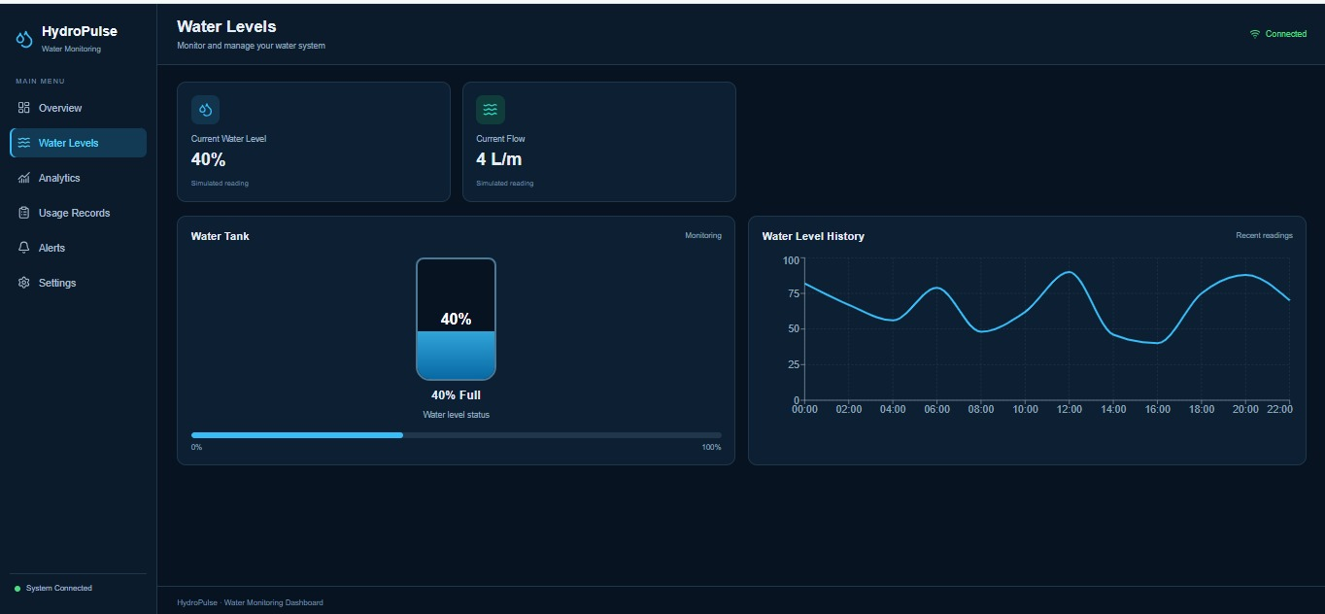
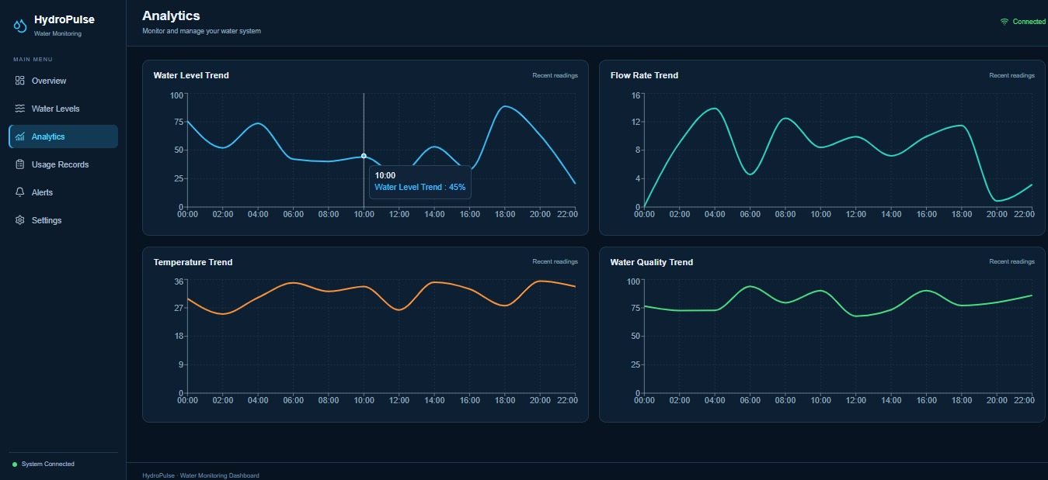
Output Screenshots
HYDROPULSE • 09

Slide 8
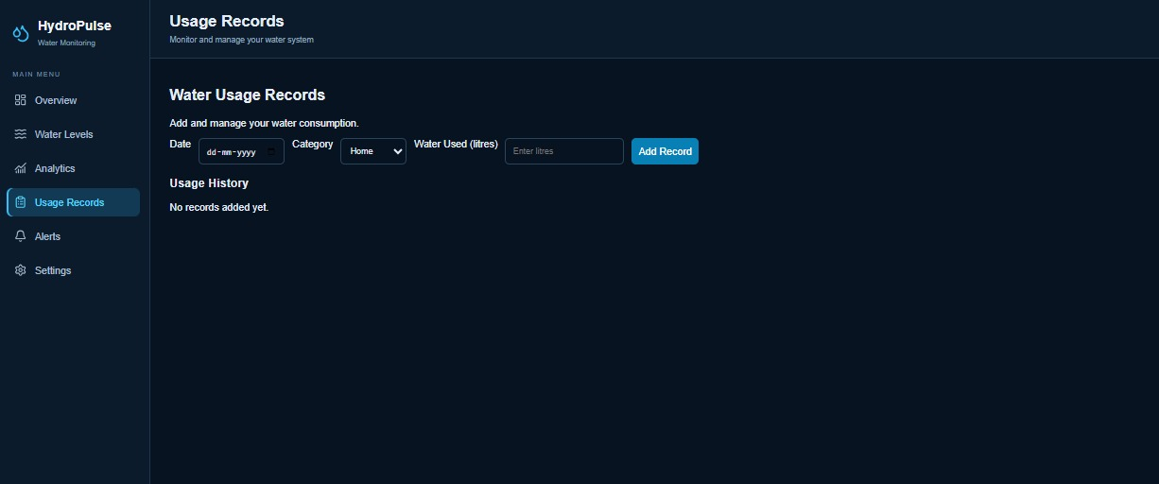
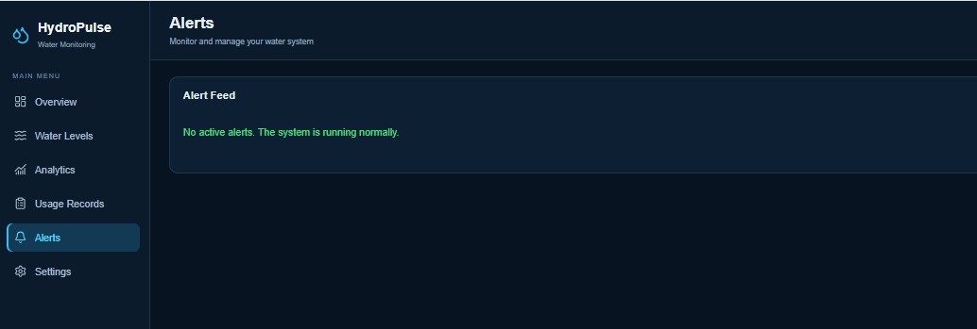
HYDROPULSE • 09

Slide 9
Future Enhancements
Real-time IoT
Automatic control
Mobile app
Connect physical sensors for live water readings.
Control pumps based on water levels.
Monitor the system on a phone.
Cloud storage
Smart alerts
AI prediction
Store readings and access records remotely.
Notify users about abnormal water conditions.
Analyze historical data to estimate water usage.
HYDROPULSE • 08

Slide 10
THANK YOU!
Team No. 14 • I. Joshitha • M. Surarichita Laxmi

