Slide 1

#Lending Club Case Study
Lending Club Case Study:
Assignment Presentation

Slide 2



Case Study :-
Lending Club
Group Members :-
Ashok Kumar Pagadala
Vijay Kumar Manda
Group Facilitator Name :-
Ashok Kumar Pagadala

Slide 3
The company is the largest online loan marketplace, facilitating personal loans, business loans, and financing of medical procedures. Borrowers can easily access lower interest rate loans through a fast online interface.
Like most other lending companies, lending loans to ‘risky’ applicants is the largest source of financial loss (called credit loss). Credit loss is the amount of money lost by the lender when the borrower refuses to pay or runs away with the money owed. In other words, borrowers who default cause the largest amount of loss to the lenders. In this case, the customers labelled as 'charged-off' are the 'defaulters'.
If one is able to identify these risky loan applicants, then such loans can be reduced thereby cutting down the amount of credit loss. Identification of such applicants using EDA is the aim of this case study.
In other words, the company wants to understand the driving factors (or driver variables) behind loan default, i.e. the variables which are strong indicators of default. The company can utilise this knowledge for its portfolio and risk assessment.
To develop your understanding of the domain, you are advised to independently research a little about risk analytics (understanding the types of variables and their significance should be enough).

Slide 4
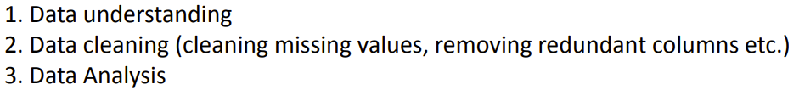
Once after the completion of Case Study, we followed the below steps towards the given input Loan.xlsx file data using Python.
Data Cleaning:-
Check the percentage of missing values
Remove all those with very high missing percentage
For columns with less missing percentage: perform Imputations You don’t need to impute the data, you can just identify the correct metric to impute the column.
You can drop rows where the missing percentage is quite high

Slide 5
Data Analysis:-
The objective is to identify predictors of default so that at the time of loan application, we can use those variables for approval/rejection of the loan.
There are broadly three types of variables –
those which are related to the applicant (demographic variables such as age, occupation, employment details etc.),
Loan characteristics (amount of loan, interest rate, purpose of loan etc.) and
Customer behavior variables (those which are generated after the loan is approved such as delinquent 2 years, revolving balance, next payment date etc.).

Slide 6
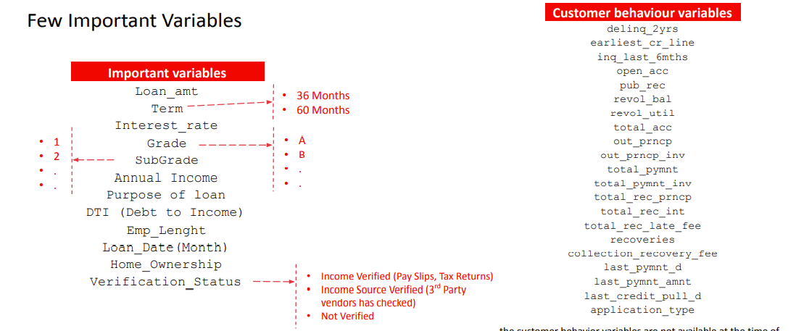

Slide 7
Required Details:- As a part of the Lending Club Case Study please find below required details:-
1. Please find the “Project Description.txt” text based content file.
2. Please find the Ashok_Kumar_Pagadala. Ipynb file to view the various results before and after applied the filters using Python on given source data file.
3. Please find the README.md file which is update accordingly in this regards.
4. Please find GIT-HUB link
https://github.com/mandavijaykumargmail/Lending-Club-Case-Study-Assignment

