Slide 1

DEVELOPING A QUADCOPTER CONTROLLER USING DEMES HOW TO EMBEDDED IT IN THE CRAZIFLIE 2.0.
Cristina Ruiz Martín
Laouen Belloli

Slide 2
AGENDA
Introduction
DEMES (Discrete-Event Modeling of Embedded Systems)
Crazyflie 2.0
DEVS Controller and Implementation
Results
Future Work

Slide 3
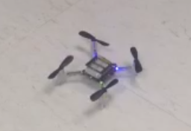
INTRODUCTION
More Complex Applications: Real-Time Embedded Systems
Traditional Design Methodologies: Not Enough
Use of DEMES (Discrete-Event Modeling of Embedded Systems)
Controller for Crazyflie 2.0

Slide 4
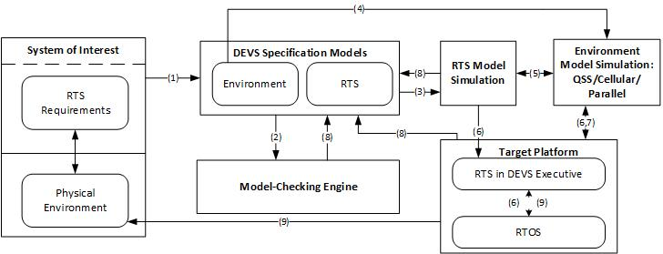
DEMES
Discrete-Event Modeling of Embedded Systems (Niyonkuru D., 2015)

Slide 5
CRAZYFLIE 2.0
Two microcontrollers
nRT51822 – radio & power management
STM32F405 – main application
FreeRTOS
Quadcopter controller
Sensors
Movement – PIDs
Led
Commands
…
Crazyflie 2.0

Slide 6
DEVS CONTROLLER & IMPLEMENTATION
Crazyflie 2.0
Discrete-Event Modeling of Embedded Systems (Niyonkuru D., 2015)
Review Crazyflie 2.0 controller
Identify relation between functions
Select scope of the project
Model basics components

Slide 7
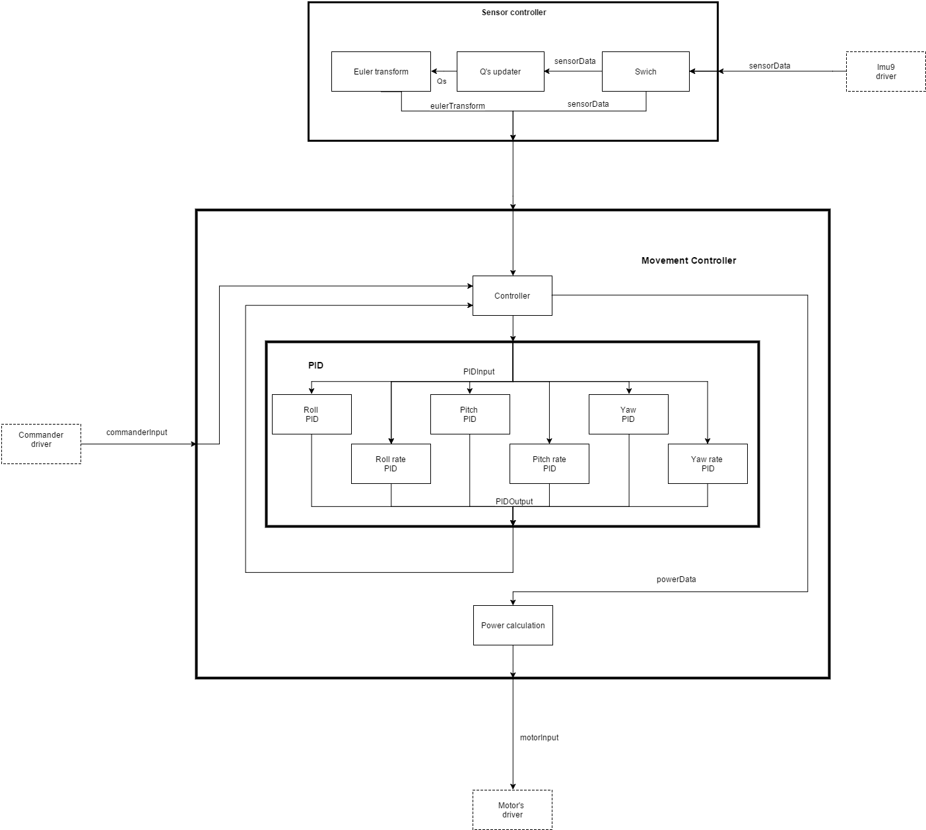
DEVS CONTROLLER & IMPLEMENTATION
Sensor Controller
Sensors
Movement Controller
Commands
Motors

Slide 8
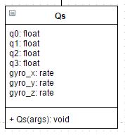
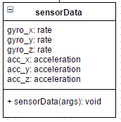
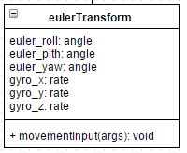
DEVS CONTROLLER & IMPLEMENTATION
Madwick’s Quaternion
Mahony’s Quaternion
Notes:
Madwick’s Quaternion
Mahony’s Quaternion
Computational algorithms to calculate the position.

Slide 9
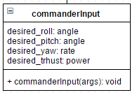
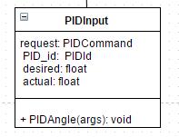
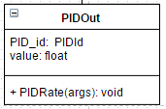
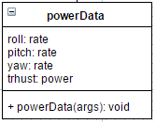
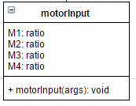
DEVS CONTROLLER & IMPLEMENTATION
Notes:
Request: reset - calculate

Slide 10
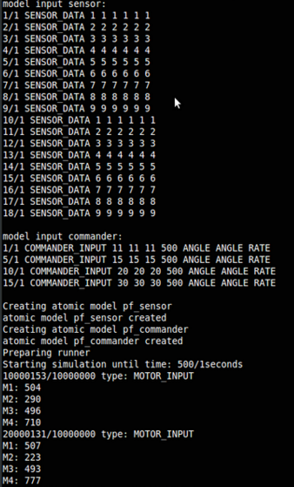
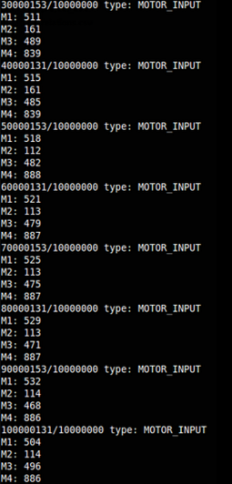
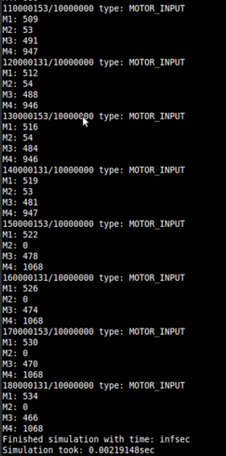
RESULTS
Log files need to validate

Slide 11
FUTURE WORK
Crazyflie 2.0
Discrete-Event Modeling of Embedded Systems (Niyonkuru D., 2015)
Model checking – logs
Drivers
imu6Read
motorsSetRatio
commanderInput
Embedded in the platform - ST-Link Utility

Slide 12
DEVELOPING A QUADCOPTER CONTROLLER USING DEMES HOW TO EMBEDDED IT IN THE CRAZIFLIE 2.0.
Cristina Ruiz Martín
Laouen Belloli
THANKS!
QUESTIONS?

