Slide 1
Quadcopter based on FlightDEVS
By SHAMOON IRSHAD

Slide 2
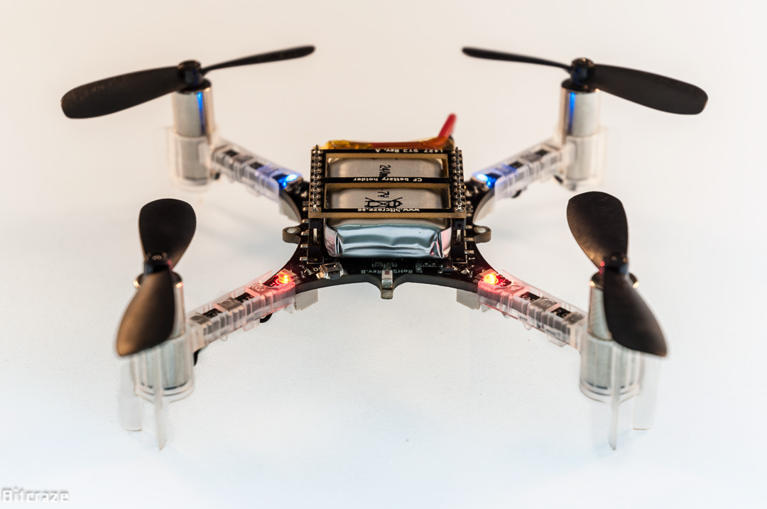
The Crazyflie 2.0 quadcopter
An Open Source Hardware developed by Bitcraze, Seeed Studio
Is programmable
Can be controlled via wireless/Bluetooth interface
Comes with its own Software based on the FreeRTOS operating system.
Expansion decks can be added as additional hardware, e.g. camera, sensors, etc.

Slide 3
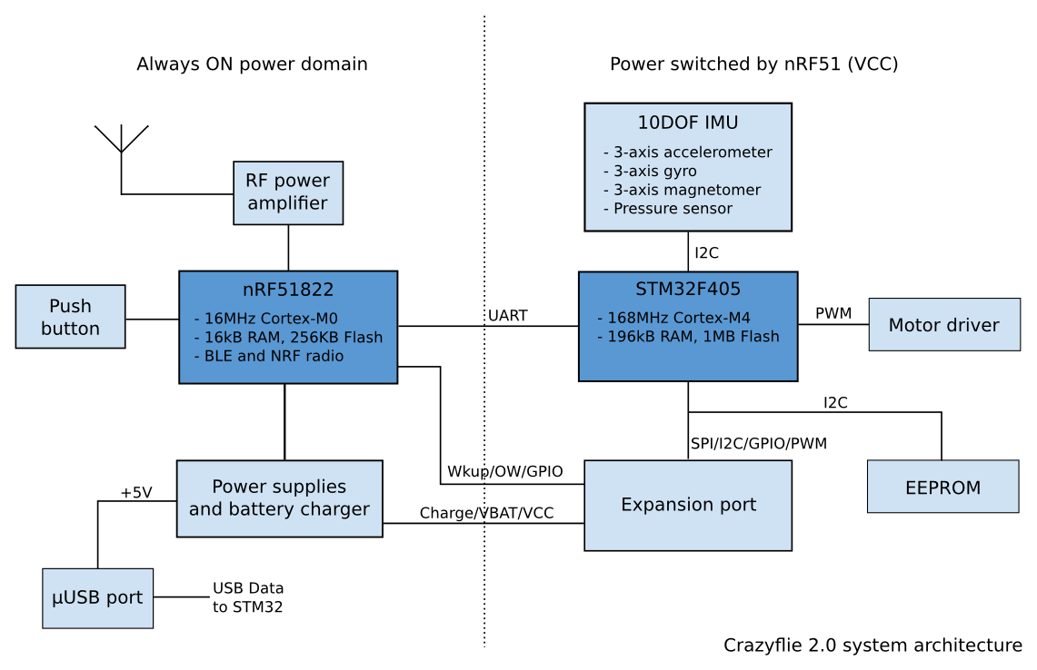
System Architecture

Slide 4
An integrated firmware solution Crazyflie + flightDEVS + ECDBoost

Slide 5
An integrated firmware solution: Crazyflie SW + flightDEVS + ECDBoost
A DEVS model based high level firmware “flightDEVS” is being developed.
The original operating system “FreeRTOS” is replaced by the ECDBoost bare metal kernel.
FlightDEVS can still make use of the high level functions used in the original Crazyflie code.
These functions were written as operating system tasks in accordance with FreeRTOS.

Slide 6
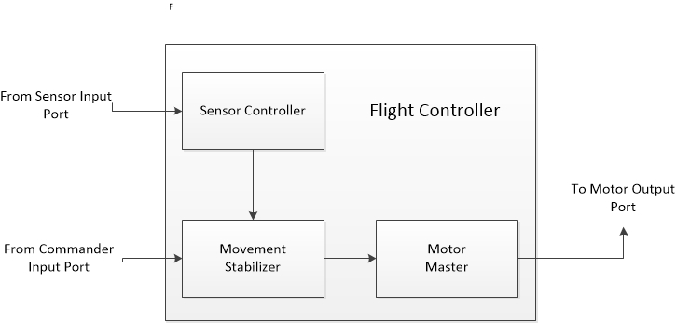
The Flight Controller Model
The complete flight operation of the quadcopter is managed by the Flight controller Model.
This is itself a coupled model comprised of three more coupled models.
Connections to “DEVS ports” are made for I/O.
DEVS ports are an interface between the DEVS models and the crazyflie hardware drivers.

Slide 7
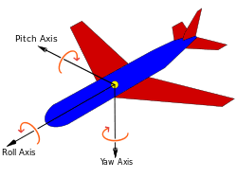
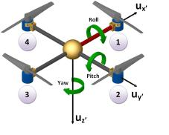
A little background in Aerodynamics..
Better understood here..
The space orientation of the aircraft is defined by the three Euler angles, roll, pitch, and yaw.
Together they are called the “attitude” of the aircraft.
In case of the quadcopter, is attitude can be fully be controlled by the four motors.
This means that the relative thrust/power in each of the four motors would define the attitude.

Slide 8
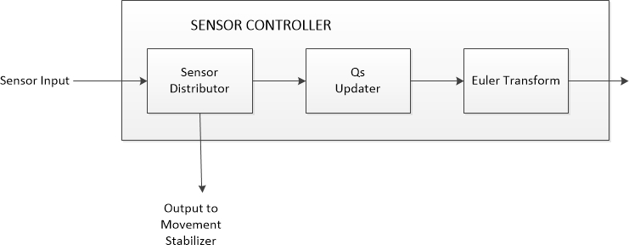
The Sensor Controller Coupled Model.
The qs updater calculates the q parameters from the accelerometer and the gyroscope readings, for gravity direction considerations.
The true Euler angles are calculated which should be sent to the movement stabilizer.

Slide 9
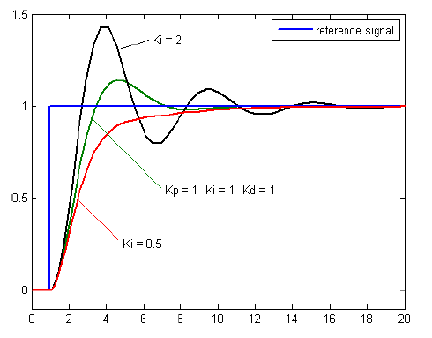
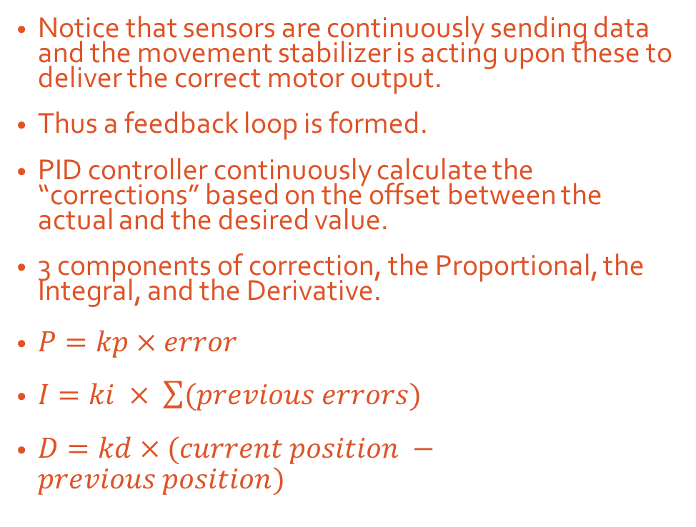
PID controllers.
Notice that sensors are continuously sending data and the movement stabilizer is acting upon these to deliver the correct motor output.
Thus a feedback loop is formed.
PID controller continuously calculate the “corrections” based on the offset between the actual and the desired value.
3 components of correction, the Proportional, the Integral, and the Derivative.
$P=kp×error$
$I=ki × \sum{(previous errors})$
$D=kd×(current position −previous position)$
$$error=current position −desired position$$

Slide 10
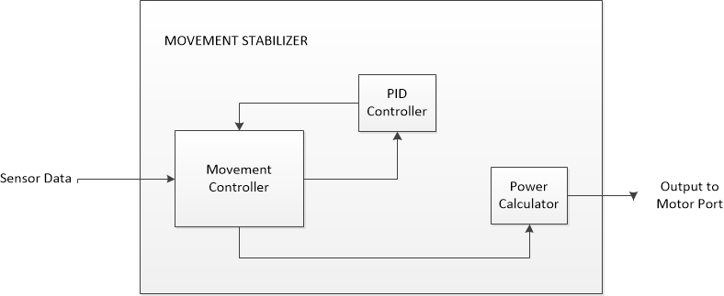
Movement Stabilizer Model
There is a PID atomic model for each of the three attitude axes. The PID controller is a coupled model of these atomic models.
The power calculator transforms the speed/angle requirements to actual motor power values (voltages)

Slide 11
Future Works..
The commander input is not utilized.
However we can still implement the “altitude hold” i.e. the hovering functionality of the quadcopter using just the sensor input.
Currently the quadcopter is not making use of the sensors, thus no PID based control is being implemented.
Sensor Controller model needs implementation. Subroutines from the original Crazyflie code can be used.

Slide 12
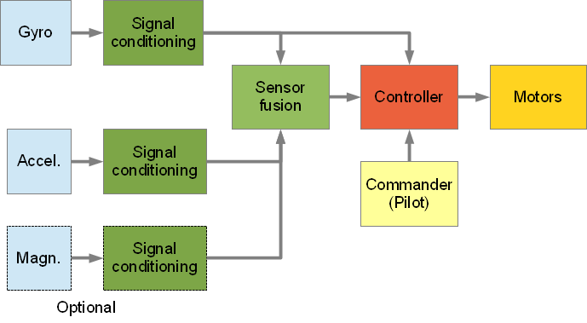
Understanding the original firmware

Slide 13
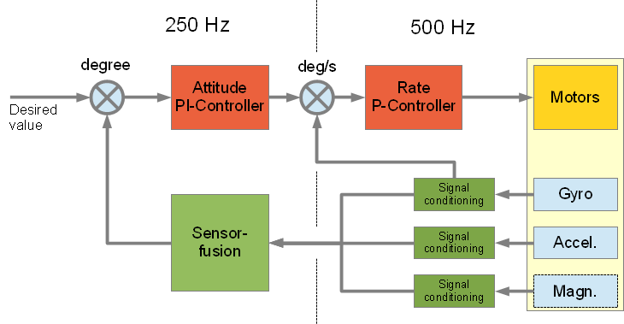
Understanding the original firmware
These diagrams were the only “documentation” provided by the developers of Crazyflie.
Actual Program flow doesn’t really match with these charts.
Some more documentation has been written. This would hopefully clear things about how the control software actually works. See “crazyflie2 firmware.docx”

Slide 14
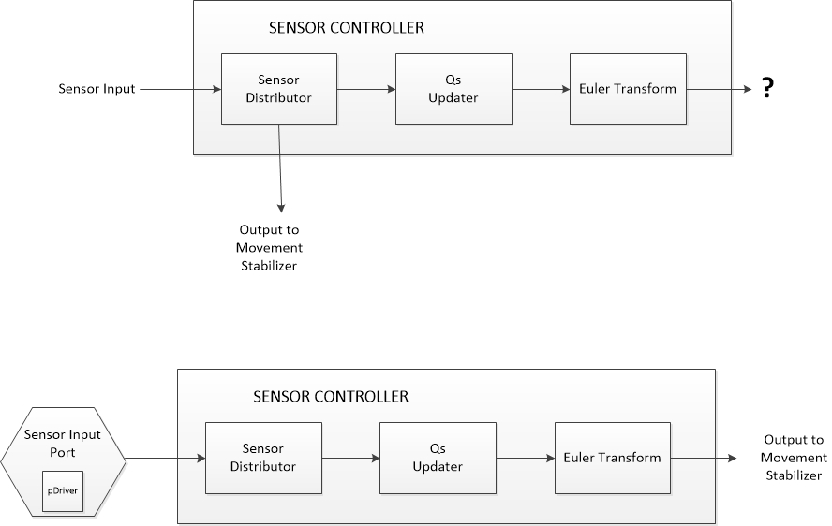
Improvements in the CrazyflieDEVS software
Sensor Port Driver Implementation was added. Sensor reading function was called in the port Driver. These are sent to the sensor distributor after appropriate type-casting.
Various message passing types are defined in the datagram.hpp file
The polling time can be set in the port class. This would have carry-forward consequences for the later models.
The output coupling for the sensor controller has been corrected. It has to be from the Euler Transform Model to the Movement Stabilizer.
I would suggest that there isn’t an actual need for splitting down the sensor controller. It can be implemented as a single atomic model with minimum states.
Notes:
[Aug 31, 2017] Christina says, Output from Sensor Distributor should have been removed.

Slide 15
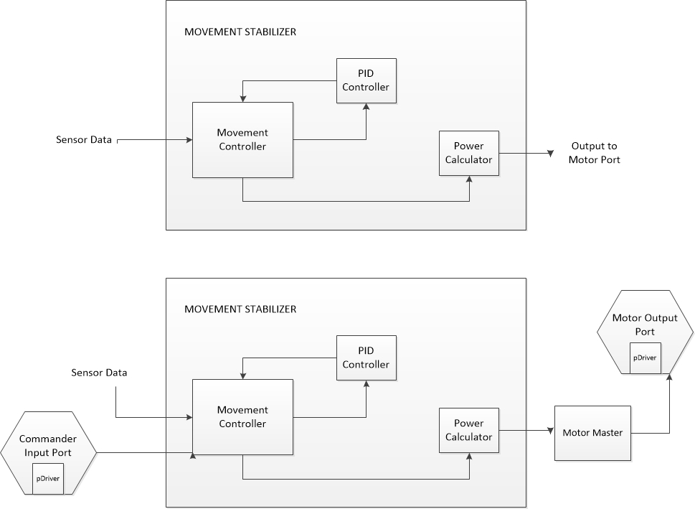
Improvements in the CrazyflieDEVS software
The commander input port Driver was written so that It implements: 1) A constant attitude of (Roll,Pitch,Yaw) = (0,0,0) degrees. This will make the quadcopter to remain in horizontal position.
2) The altitude hold functionality.
The altitude hold means making the quadcopter hover in a fixed vertical position. To implement this, the commander port driver is made to send appropriate thrust values to the movement controller.
Implementation Motor Port driver has been added.

Slide 16
Improvements in the CrazyflieDEVS software
Important system initialization function calls were missing. These were added in the main file.
These include initializations for: Motors (PWM drivers) Motion Sensors (imu6 chip drivers) Pressure Sensor (the lps25h barometer drivers)

Slide 17
Uploading / Flashing the Firmware
Ideally, the .bin or .hex file has to uploaded using the CrazyRadio USB dongle.
A simple ARM microcontroller flash utility does not work because the USB connection is for both the STM32 and the nRF microcontrollers.
There is a Device Firmware Upgrade mode which can be triggered on device power up. (Instructions provided)

Slide 18
Future Work
We need to compile the CrazyflieDEVS software and fix any problems. Hopefully these are syntactical only.
Flash the compiled program and test the device !

Slide 19
Thank You !

