Slide 1
Today’s Agenda
INTRODUCTION
MOTIVATION
PREVIOUS WORK
DATA
11:15 AM
11:16 AM
11:17 AM
11:19 AM
METHODS
EXPERIMENTS & RESULTS
CONCLUSION AND FUTURE WORK
TEAM & CONTACT US
11:19 AM
11:21 AM
11:23 AM
11:24 AM

Slide 2
Introduction
Portuguese Audio to English Text ASR-MT
Project
Method
Automatic Speech Recognition (ASR) with Wav2Vec2 on Portuguese Audio and translate it to English text
Fine-tuned XLSR-Wav2Vec2 Multilingual model using Huggingface Transformer, with Portuguese audio dataset from commonvoice.mozilla.org
Hyperparameter Tuning
WER Score
BLEU Score
XLSR-Wav2Vec2
Transformer
With pretrained Opentext Embedding
English Text
Portuguese Text
Audio Translation
Machine Translation

Slide 3
Motivation
Applications and Benefits
1
2
3
Travel assistants
Movie dubbing/subtitling
Crisis response
Two-way translation system on a mobile device
Dubbing movie and subtitling from one language to another
Translating audio messages and responding in case of crisis
4
5
6
Lecture translation
Economic Benefits
Social benefits
Simultaneous translation of language to other languages
More reach to different language speaking people which creates more business opportunities
More interactive-ness between different communities and people

Slide 4
Previous works
Automated Speech Recognition System
Paper published about ASR in 2017 mentioned about the history of speech translation back to 1952 where Audrey system designed at Bell Laboratories was the first speech recognition system which recognized only digits spoken by a single person. Speech Recognition has been in development of more than 60 years. Ref: http://www.ijetajournal.org/volume-4/issue-2/IJETA-V4I2P9.pdf
A survey on automatic speech recognition systems for Portuguese language and its variations
Current state of ASR is allowing the development of systems for objectives other than converting a signal to text, such as treatment of speech dysfunctions. An automatic answering system for call centers was developed, providing a better dialogue for clients when compared to traditional keyboard systems. A speech-to-speech translation system able to transform some speech signals to other languages. Several automatic transcription systems for TV shows, generally combining MLP with HMM to achieve a 21% Word Error Rate(WER).
Silva and Serra (2014) the author uses a hybrid model based on a Fuzzy Inference System and Genetic Algorithm trained on a corpus of the Portuguese language.
W. Silva and G. Serra J. Control, Autom. Electr. Syst., 25 (6) (2014), pp. 689-698, 10.1007/s40313-014-0148-0
Automatic voice recognition system based on multiple support vector machines and mel-frequency cepstral coefficients
Silva, Barbosa (2015) used an SVM approach to ASR for Portuguese. An investigation of the impact of Chaotic Particle Optimization (CPO) in the Gaussian Mixture Model (GMM) accuracy, and the HMM baseline system helped other researchers to follow this system.
W.L.S. Silva and F.G. Barbosa Proceedings of the 11th International Conference on Natural Computation (ICNC) (2015), pp. 665-670, 10.1109/ICNC.2015.7378069

Slide 5
Data
Audio Data Source : Portuguese audio data from commonvoice.mozilla.org
PT-EN aligned text - ‘TEDx talks for speech recognition and translation’ from http://openslr.org/100/
Audio Data | Data Information
Portuguese speech and transcripts data size | 2 GB
Talks | 1120
Audio Format | mp3
Sampling Rate | 48KHZ
Total hours of audio | ~63
Validated hours of audio | ~50
Set | Talks | Time (hours)
Train | 896 | ~51
Validation | 112 | ~6
Test | 112 | ~6
Text Data | Data Information
Portuguese speech and transcripts with aligned English translations | 10GB

Slide 6
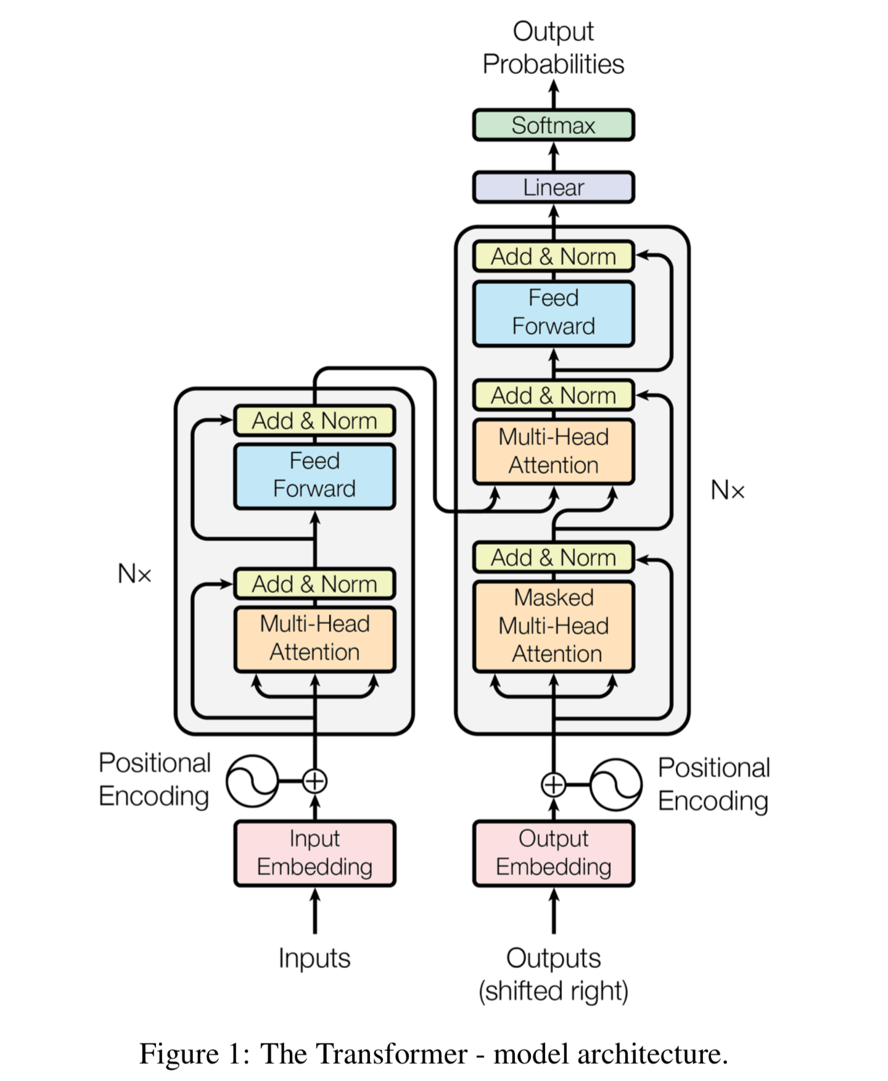
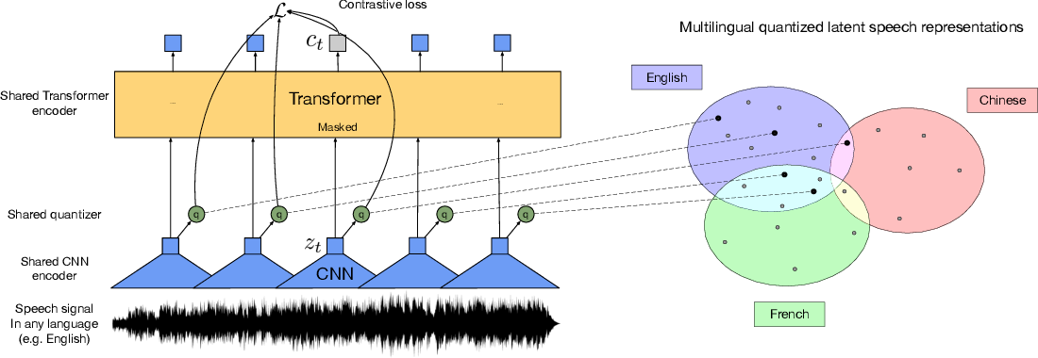
Models
XLSR-Wav2Vec2
Huggingface Transformer
Transformer with pretrained FastText Embedding
we are using Automatic Speech Recognition (ASR) with Wav2Vec2 on Portuguese Audio and convert it to Portuguese text.
The text output from XLSR is input to transformer model, which translates the Portuguese text to English text-based translation.

Slide 7
Experiments and Results
Baseline Model with Default Template model from Huggingface on Portuguese
Hyperparameter optimization for Portuguese model for Wav2vec2
Hyperparameter optimization with Wav2vec2 and MT model(Transformer with OpenText embeddings)
BLEU 9.0 – PT to English aligned text
BLEU 7.31 – Entire Pipeline
Baseline ASR
Fine-tuned PT-ASR
Entire Pipeline
WER 0.2860
WER 0.30
WER 0.2860
The BLEU score of 7.31 and WER score of 0.2860 are reasonable scores on a Low Resource language like Portuguese with very few validated hours. We have used Silver prediction list to get the BLEU scores. We used en_silver file from the Google translate instead of CoVoST 2 due to time restrictions.

Slide 8
CONCLUSION AND FUTURE WORK
Conclusion
We set out to make a pipeline consisting of working ASR model which converted Portuguese speech data into Portuguese text and MT model which translated Portuguese text to English text.
We can state that we have accomplished our task successfully. We have got WER score of 0.2860 and Overall BLEU score of 7.31
Adding Spellcheck/Language Model
Making an End-to-End model
Including a spellcheck model or Language model before MT model to enhance the performance
Instead of doing pipeline model we could have tried for tightly coupled End-To-End ST model for better results.
Training with High Resource Language
We could have gotten better scores if we can train on High Resource Language.

Slide 9


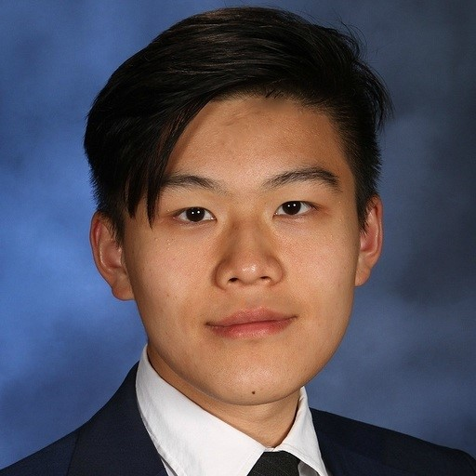


Meet Our Great Team
Mandeep Singh
Fasih Tiwana
Derek Chen
Jan Urquico
@mand2201
@tiwanafasih
@dinganc
@janurquico

Slide 10


Obrigado Professor
شكرا استاذ
Thank you
MDS-CL
Thanks Peter Sullivan, for guidance to make this project successful

