Slide 1

MGMT 58200
Final Project
Group 14
Yuqiu Chen
Amol P Pathak
Rachana Ramshetty
Ambati Yamini Praneetha
Mandeep Singh Rahi

Slide 2
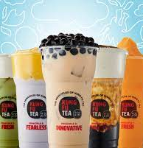
Client: Kung Fu Tea
Kung Fu Tea is a chain of milk tea shop founded in Queens, NY on April 30, 2010. As the largest American bubble tea brand, Kung Fu Tea has placed their stores all around the world.
Notes:
1 min

Slide 3
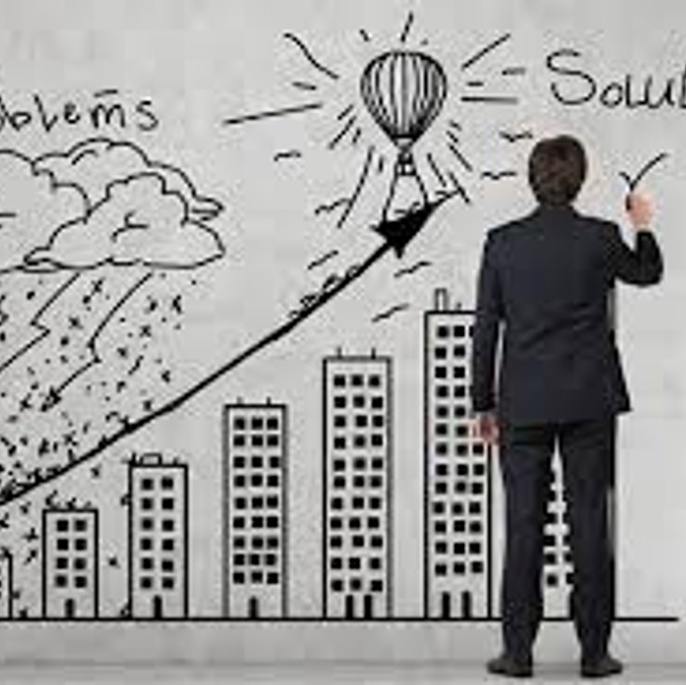
Business Scenario
Unorganized Data
Unable to predict demand
Supply chain issues
Notes:
1 min

Slide 4
D
Data Structure
Data tables originally provided by Kung Fu Tea:
Sales
Shifts
Employees
Orders
Materials
Additional Table created
Outlets

Slide 5
Normalization
Normality:
Beside the sales table, All tables are in 3NF
For Sales table:
Functional Dependency:
Primary Keys: Sales_ID, Product_ID
Non-key attributes: Sales_Vol, Product_Name, SalePrice, Product_Series
Sales_ID, Product_ID Sales_Vol
Product_ID Product_Name, SalePrice, Product_Series
Not all non-key attributes are fully functionally dependent on the entire primary key.
Solution:
To normalize the Sales table, we divide it into two tables: A Sale table contains only Sales_ID and Sale_Vol and Product table contains the rest of information.
6

Slide 6
Relationship cardinality
Outlets have 0-to-many Products, whereas Products are present in 0-to-many Outlets.
Outlets have 0-to-many Sales, whereas a Sale belongs to only 1 Outlet.
Products have 0-to-many Sales, whereas Sales can have 1-to-many Products.
Outlets have 0-to-many Employees, whereas Employees belong to only 1 Outlet.
Employees have 0-to-many Shifts, whereas Shifts can have 1-to-many Employees.
Outlets have 0-to-many Orders, whereas an Order belongs to only 1 Outlet.
Orders have 1-to-many Materials, whereas Materials can have 0-to-many Orders.

Slide 7
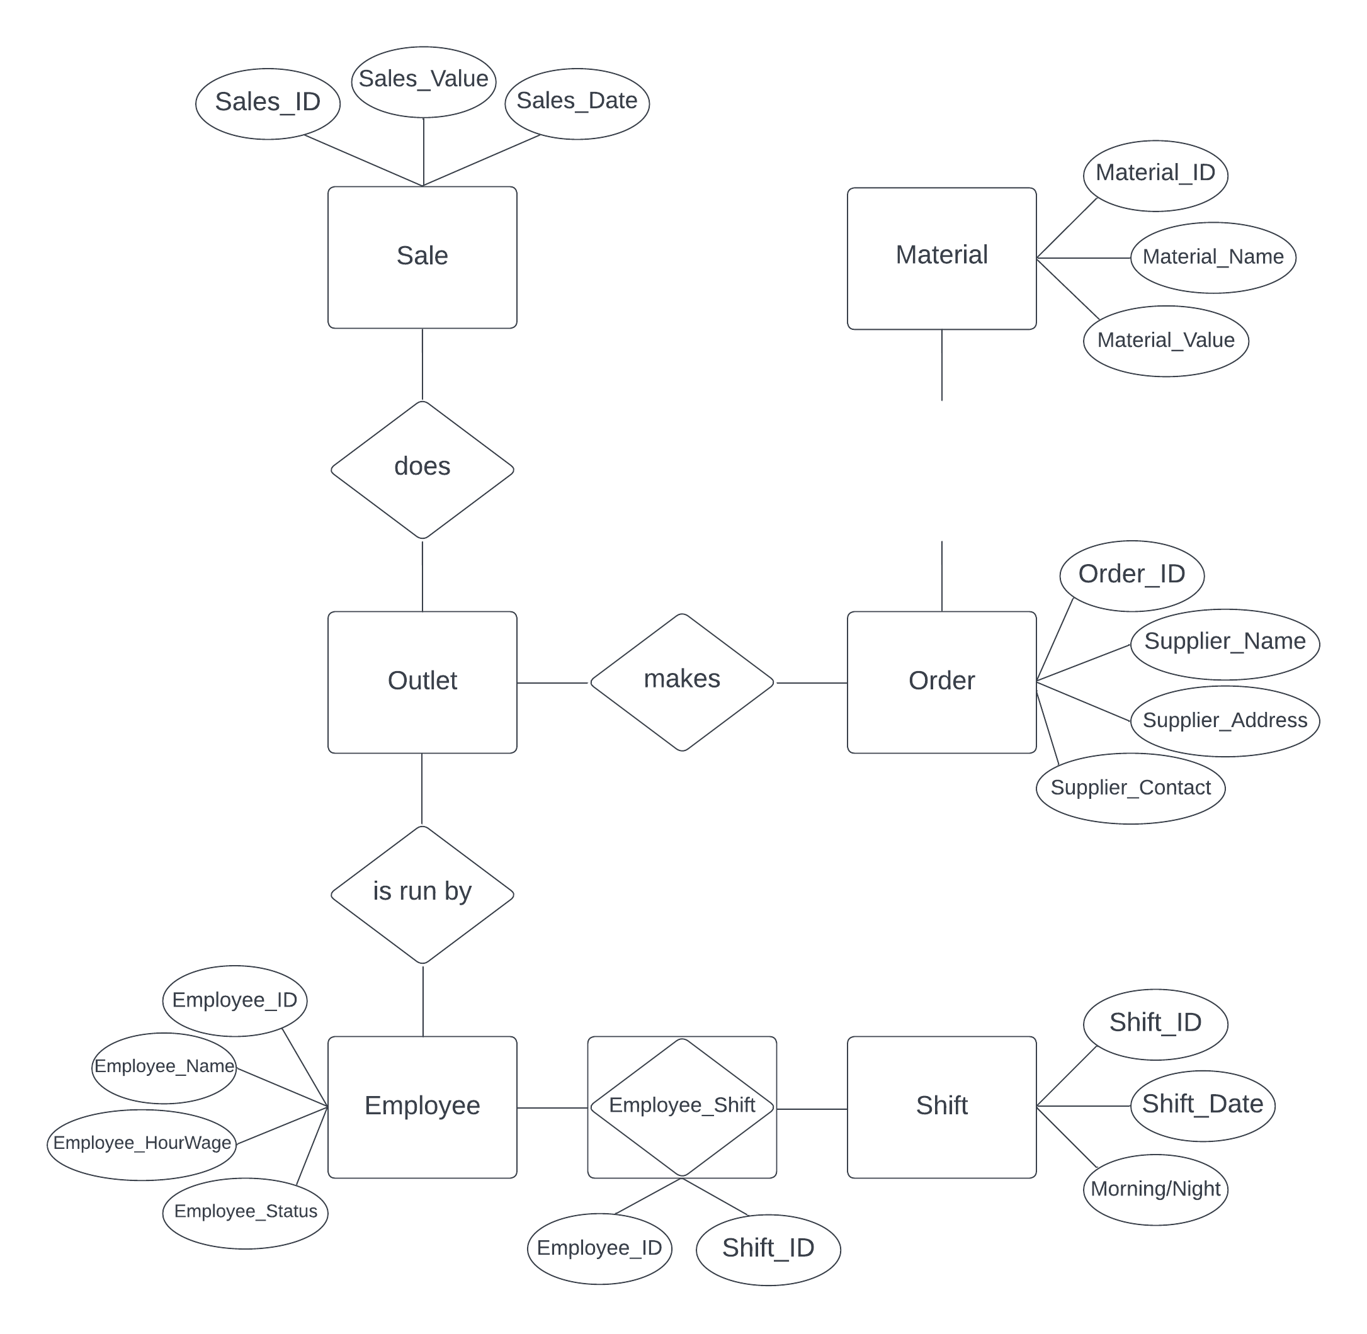
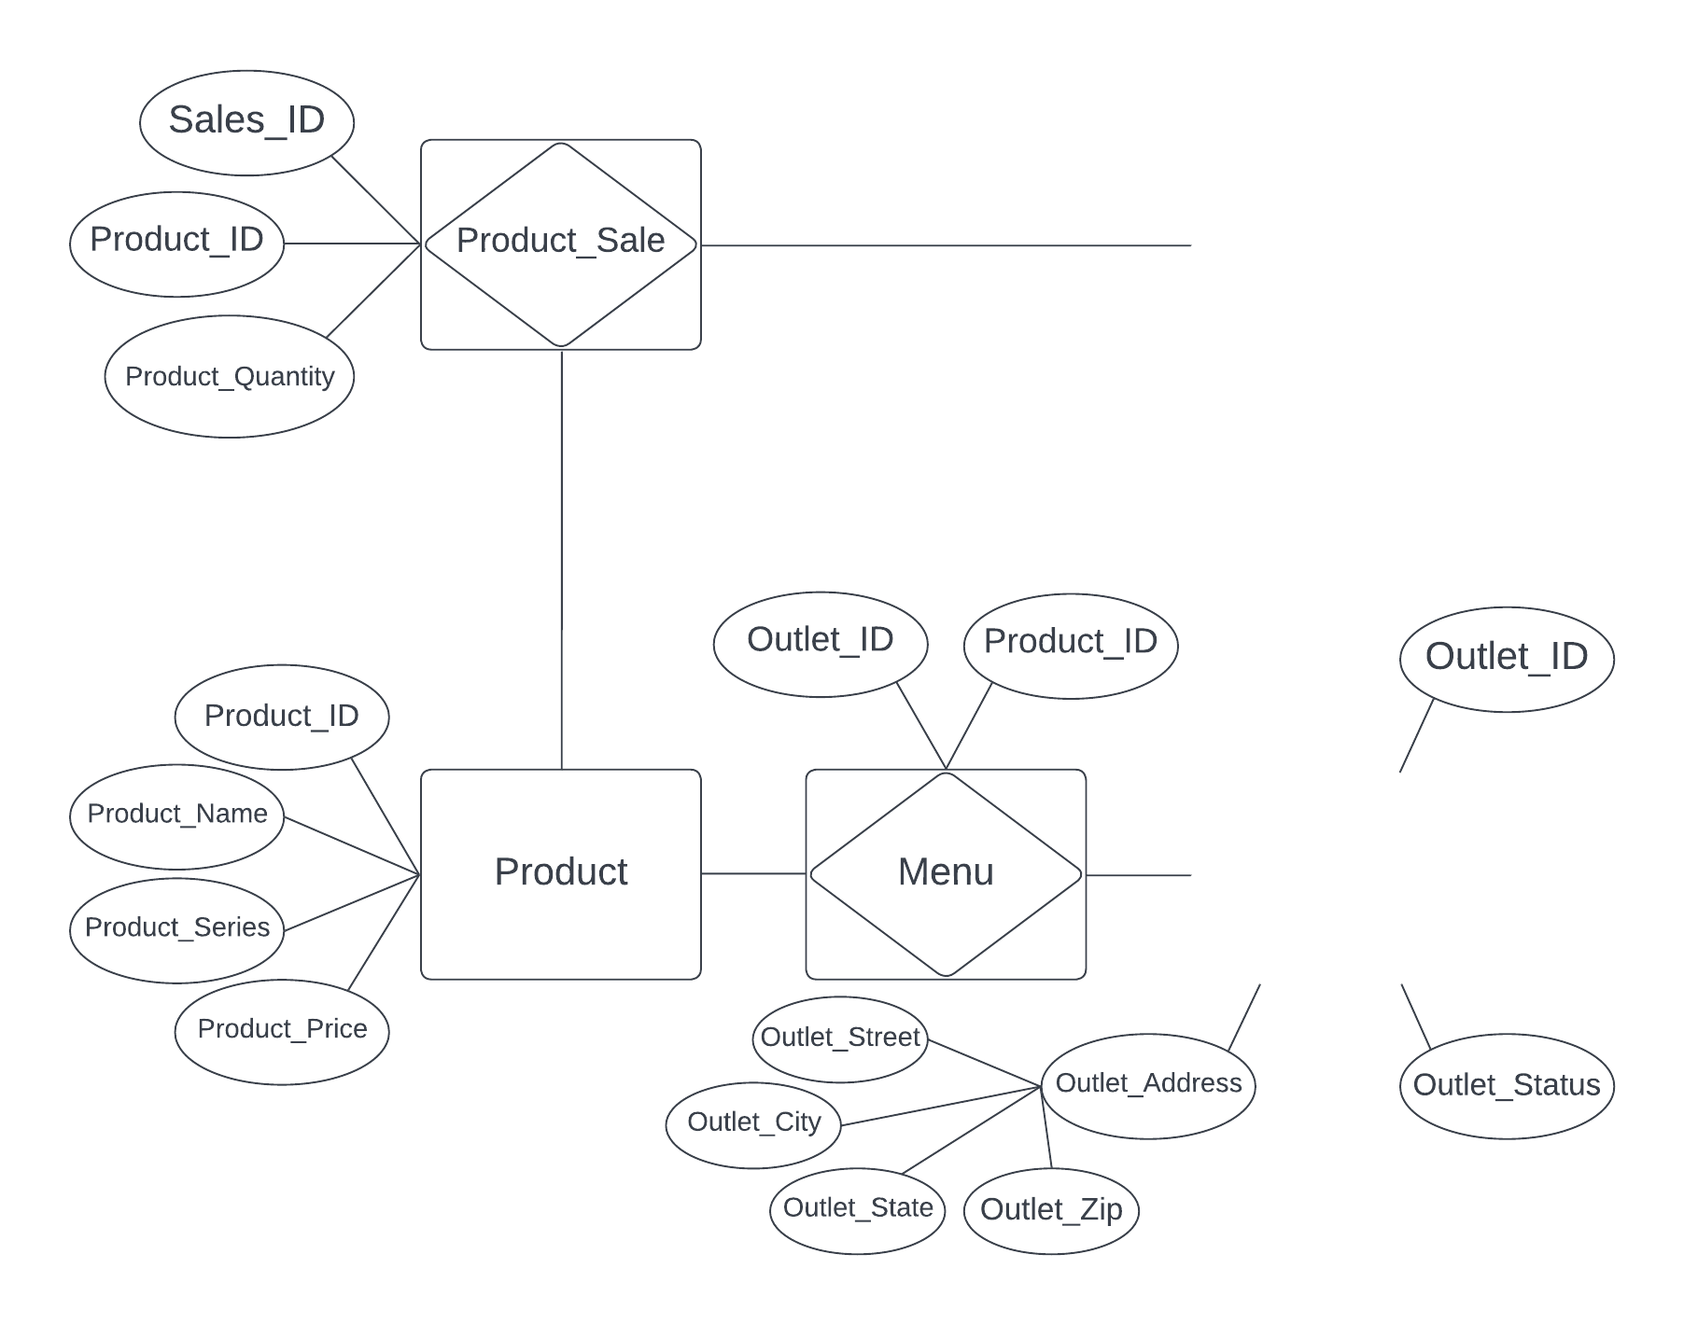
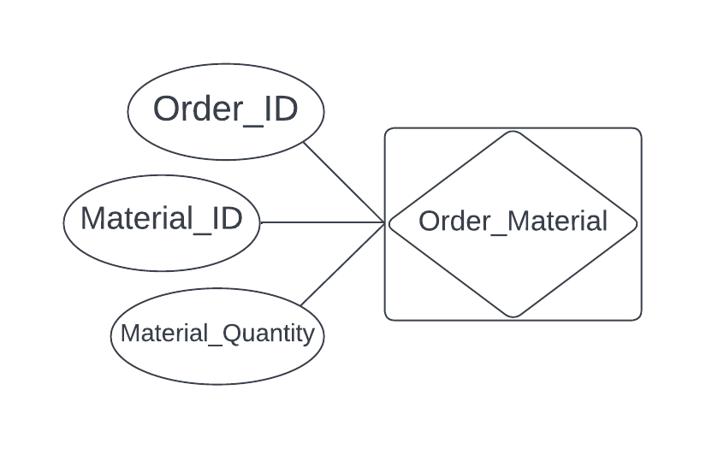
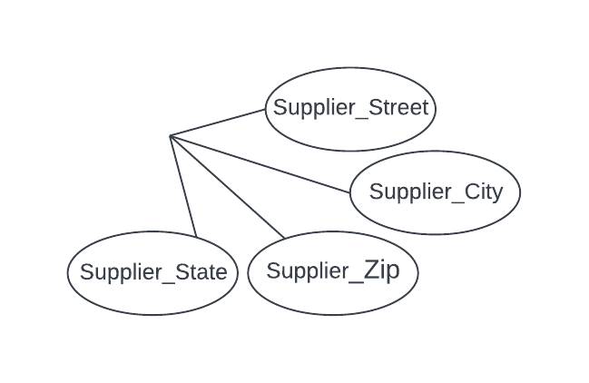
Conceptual Data Modelling
4

Slide 8
Relational Schema
Outlet(Outlet_ID, Outlet_Status, Outlet_Street, Outlet_City, Outlet_State, Outlet_Zip)
Order(Order_ID, Supplier_Contact, Supplier_Name, Supplier_Street, Supplier_City, Supplier_State, Supplier_Zip, Outlet_ID)
Material(Material_ID, Material_Name, Material_Value)
Employee(Employee_ID, Employee_Name, Employee_HourWage, Employee_Status, Outlet_ID)
Shift(Shift_ID, Shift_Date, Morning_Night)
Product(Product_ID, Product_Name, Product_Series, Product_Price)
Sale(Sales_ID, Sales_Date, Sales_Value, Outlet_ID)
Associative Tables:
Order_Material(Order_ID, Material_ID, Material_Quantity)
Shift_Employee(Shift_ID, Employee_ID)
Menu(Outlet_ID, Product_ID)
Product_Sale(Sales_ID, Product_ID, Product_Quantity)
5

Slide 9
DATABASE IMPLEMENTATION & SQL

Slide 10
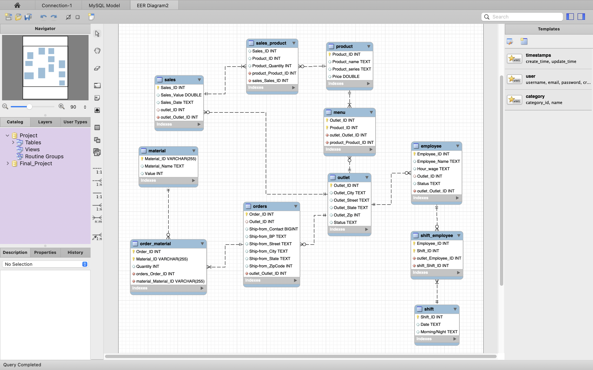
DBMS
Choosing MySQL as DBMS based on the requirement
Implementing the model in the platform
Avoids erroneous records, no nulls and helps in uniquely identifying each record

Slide 11
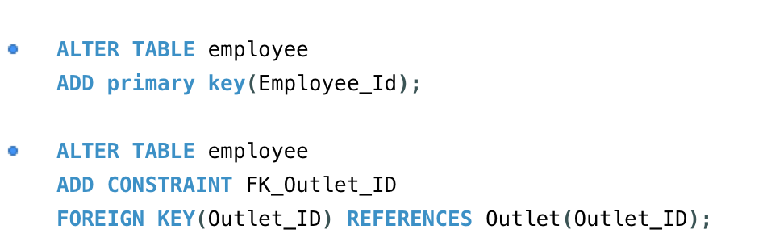

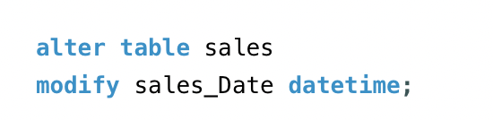
Implementation - SQL
DDL
Adding Primary and Foreign Key by altering tables
Modifying the columns type

Slide 12
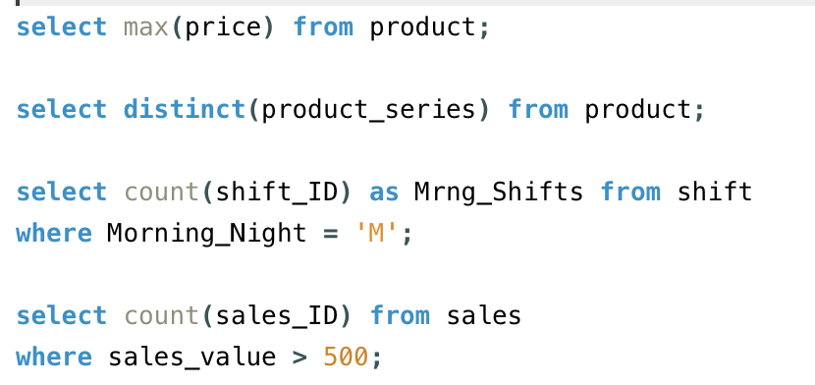
Implementation - SQL
Basic Queries
Using Basic queries to retrieve the information form database w.r.t individual entities
Maximum Price of any product? $6.25
What are the distinct product series that are sold at Kung-Fu?
How many morning shifts are present? 244
How many sales crossed $500 in a day? 87

Slide 13
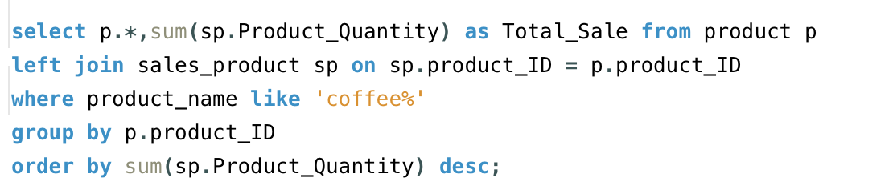
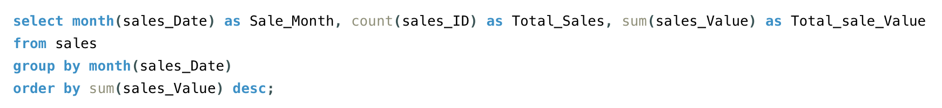
Implementation - SQL
Queries
Querying using Wildcards, Aliases and grouping based on necessity
Figuring out how many products were sold that are starting with coffee ? Coffee Milk Tea with 4470 units sold
Understanding the total sales within each month and the respective amount? April has highest sale amount

Slide 14
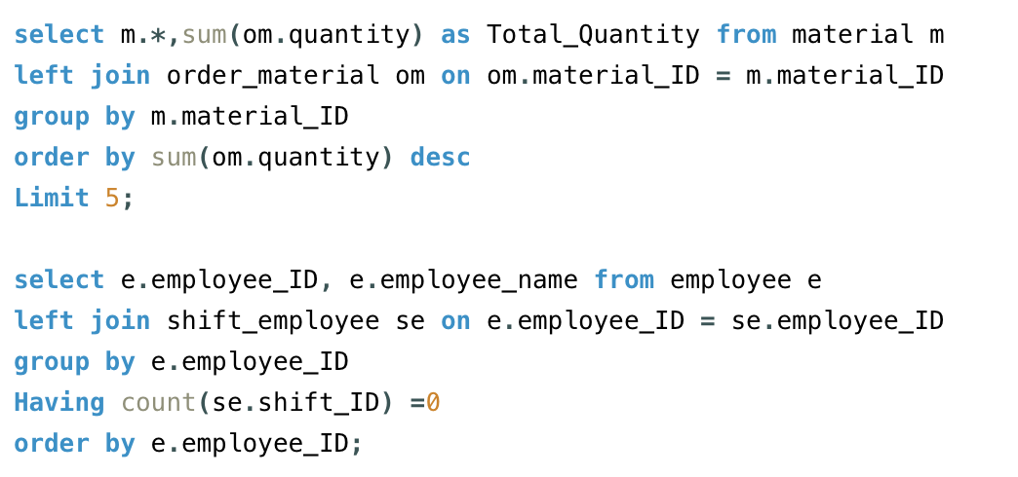
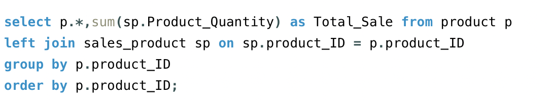
Implementation - SQL
Joins
Which Employee has done the Maximum Shifts? Hong C
What are the top products that are sold? All from milk tea series
Which 5 materials are ordered the most? Cane Sugar topped
Is there any employee with no shift? No
Are there any products that aren’t sold? No
Cost of all the materials material wise? Understand which material spend is more

Slide 15
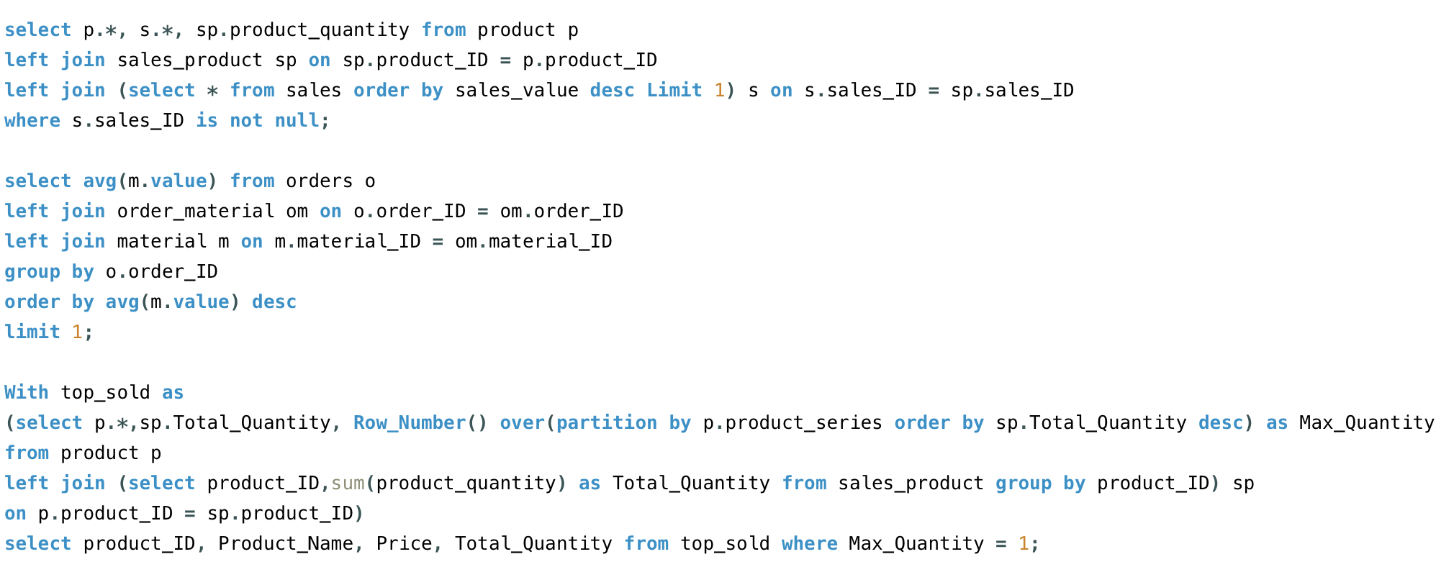
Implementation - SQL
Some Complex Queries
Using Multiple Joins, windows functions, select queries within joins etc.
What are the products sold and their quantities when there is maximum sale?
What is the max average material value across all orders?
Identify most ordered product within each product series?

Slide 16
Conclusion
Project workflow:
Business Benefits:
Normalized database reduces data redundancy
Migration to MySQL Server facilitates Application Integration
Addition of Outlet entity - Future-proof database design
Understood Business Scenario
Designed a conceptual model of the Database
Designed ER Diagram
Prepared Relational Schema
Organized data
Implemented Database to MySQL Server
Prepared and Executed test queries on Database.
8

Slide 17

Thank You!
Any Questions?
MGMT 582

