Slide 1

Zero Trust Security and Real Time Threat Detection in AWS Cloud
Student: Dahiya Mandeepsinh
Student ID: D24AIML081
Department : Artificial Intelligence and Machine Learning
Faculty Guide: Mr. Deep Mendha
Date: 15th November, 2025

Slide 2

The Need for Zero-Trust Cloud Security
Critical Challenges
Our Solution
Modern cloud environments face sophisticated threats including credential theft, unauthorized access, and network reconnaissance. Traditional perimeter-based security is insufficient.
This project implements a robust monitoring framework combining AWS-native tools with open-source IDS technology.
AWS EC2 for workload deployment
Cloud infrastructure requires continuous verification, real-time monitoring, and immediate threat response capabilities to protect critical workloads and data.
GuardDuty for cloud-native threat intelligence
Suricata IDS for packet-level analysis
Real-world attack simulations

Slide 3
Problem Statement
Port Scanning Attacks
Root Credential Misuse
Suspicious Outbound Traffic
Reconnaissance activities targeting exposed services and identifying vulnerable entry points in cloud infrastructure.
Unauthorized use of privileged accounts creating significant security risks and compliance violations.
Unauthorized data exfiltration attempts and command-and-control communications from compromised instances.
IAM Misconfiguration
Lack of Real-Time Monitoring
Overly permissive policies and improper role assignments leading to privilege escalation vulnerabilities.
Delayed threat detection and response capabilities resulting in extended dwell times for attackers.
"How can we detect and respond to suspicious activities in a cloud environment using Zero-Trust principles?"

Slide 4
Project Objectives & Scope
01
02
03
Deploy Monitored EC2 Workload
Enable GuardDuty Monitoring
Install Suricata IDS
Provision Ubuntu-based EC2 instance with Apache web server for realistic attack surface testing.
Activate AWS-native threat detection analyzing CloudTrail, VPC Flow Logs, and DNS logs.
Configure open-source intrusion detection system for deep packet inspection and signature-based detection.
04
05
06
Simulate Attack Scenarios
Analyze Security Findings
Recommend Remediation
Execute controlled port scans and credential misuse to generate authentic security alerts.
Correlate alerts from multiple sources to identify threats and understand attack patterns.
Develop actionable security improvements and incident response procedures.
07
Document Implementation
Prepare comprehensive technical documentation for knowledge transfer and replication.

Slide 5
System Architecture
Detection Layer
Analysis & Response
EC2 instance running Apache and Suricata
GuardDuty processing threat intelligence
VPC Flow Logs capturing network traffic
Suricata analyzing packet payloads
CloudTrail recording API activities
Centralized logging and alerting
DNS query logging enabled
Security findings dashboard

Slide 6






System Flow: Threat Detection Pipeline
Threat Sources
External attackers, malicious insiders, automated scanners targeting infrastructure
EC2 Workload
Apache web server exposed to internet traffic for monitoring and detection
Suricata IDS
Real-time packet inspection and signature matching on network traffic
Cloud Logs
CloudTrail, VPC Flow, DNS logs aggregated for analysis
GuardDuty
AI-powered threat detection using AWS threat intelligence
Security Alerts
Consolidated findings and recommended remediation actions

Slide 7
Technology Stack & Requirements
Minimum Requirements
AWS Services
Operating System
EC2 (t2.micro or larger)
Ubuntu 20.04 LTS
Compute: 2 vCPUs, 4GB RAM
GuardDuty
Apache2 web server
Storage: 20GB SSD for logs
CloudTrail
Linux command-line tools
Network: Public IP with security groups
VPC Flow Logs
Network utilities
Route 53 DNS Logs
IAM: Appropriate permissions for GuardDuty and logging services
IDS/IPS Tools
Suricata 6.x or higher
Rule set configuration
Log management
Alert processing

Slide 8
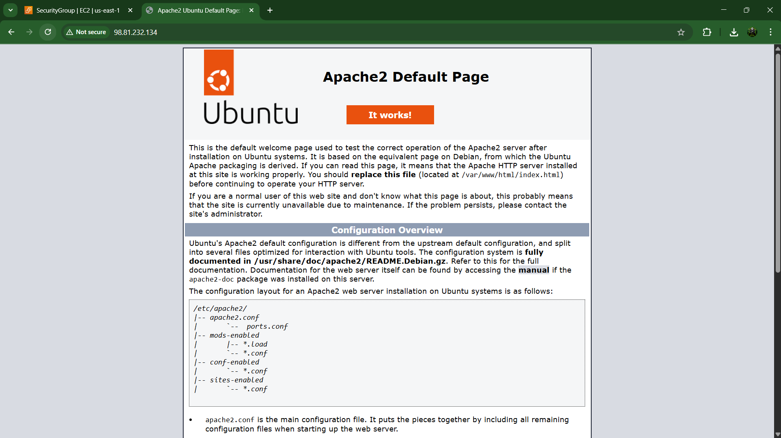
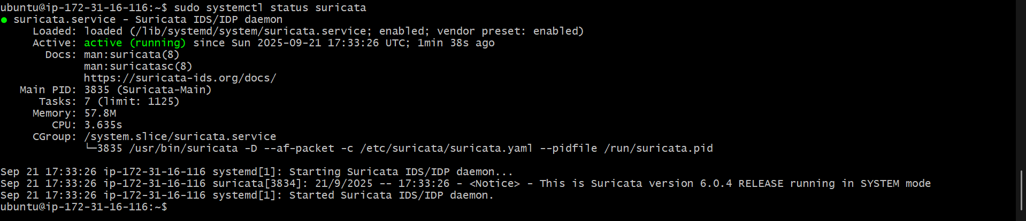
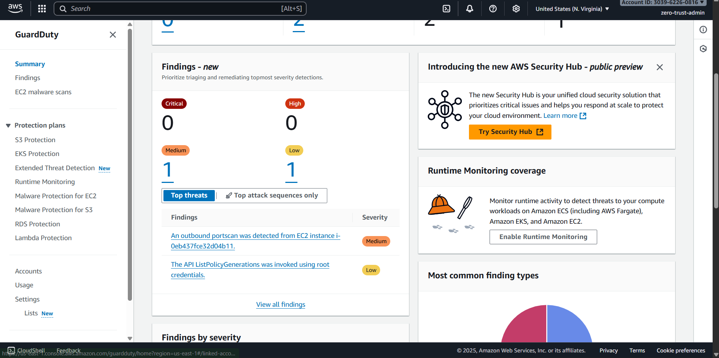
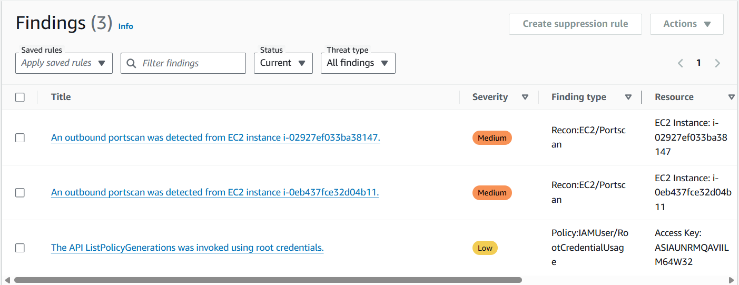
Implementation Evidence
Screenshots demonstrate successful deployment of all components: EC2 instance provisioned with Ubuntu, Apache web server operational, Suricata IDS initializing properly, GuardDuty generating security findings, and successful detection of simulated port scanning activities.

Slide 9
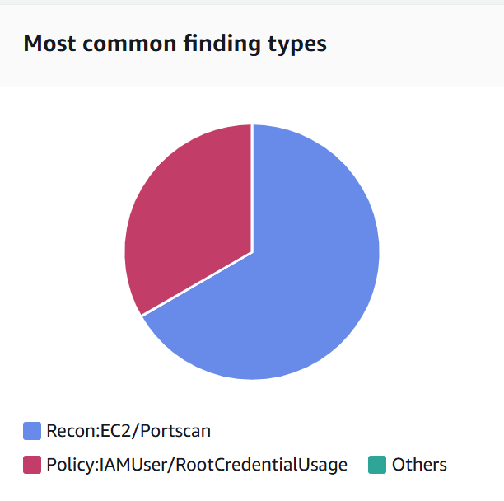
Results & Key Findings
Detection Summary
GuardDuty Alerts Generated
Suricata Performance
PortScan Detection: Successfully identified reconnaissance activities from external sources targeting common service ports.
IDS successfully initialized and began monitoring network traffic in real-time. Packet capture functional with log generation for analysis.
RootCredentialUsage: Detected unauthorized root account access attempts and policy violations.
Apache Functionality
Web server remained operational throughout testing, providing realistic attack surface for security monitoring validation.

Slide 10
Challenges, Learnings & Future Enhancements
Implementation Challenges
Future Enhancements
Suricata Rule Set Configuration
Complete Suricata Rule Deployment: Install comprehensive rule sets including Emerging Threats and custom signatures
Initial deployment lacked comprehensive detection rules, limiting signature-based threat identification capabilities.
Automated Response via Lambda: Implement serverless functions for automatic remediation actions
IAM Permission Complexity
SIEM Integration: Connect to centralized security platform for advanced correlation and reporting
Properly scoping permissions for GuardDuty and logging services required careful policy design to avoid misconfigurations.
Network Segmentation: Deploy multi-tier VPC architecture with isolated subnets
Log Correlation Difficulties
ML-Based Anomaly Detection: Leverage machine learning for behavioral analysis
Matching findings across Suricata logs and GuardDuty alerts required manual analysis and time-consuming investigation.
Infrastructure as Code: Automate deployment using Terraform or CloudFormation templates

Slide 11

Conclusion and Key Achievements
Project Accomplishments
Successfully deployed multi-layered Zero-Trust security architecture in AWS cloud environment
Demonstrated effective integration of cloud-native and open-source security tools
Validated real-time threat detection capabilities through controlled simulations
Established comprehensive monitoring across network, application, and cloud service layers
Zero-Trust Alignment
This project exemplifies core Zero-Trust principles: continuous verification through multi-source monitoring, least privilege access via restrictive IAM policies, and assume breach mentality with layered detection mechanisms. The architecture provides a robust framework for modern cloud security.
Thank You
Project Repository: Available for detailed review and documentation

