Slide 1
House sale price prediction Mandeep Rana

Slide 2
DATA set & Preprocessing
Training set has 1,460 rows of data and 81 features
Test set has 80 features – excluding target variable
Data has ‘Id’ to identify each house and its associated properties, such as:
Location
Infrastructure
Amenities
House Condition etc.
Missing values were treated in two different ways:
Removed
Replaced with the mean of that column values

Slide 3
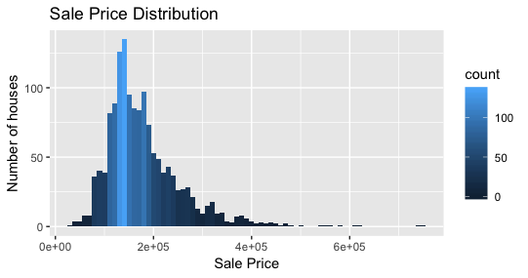
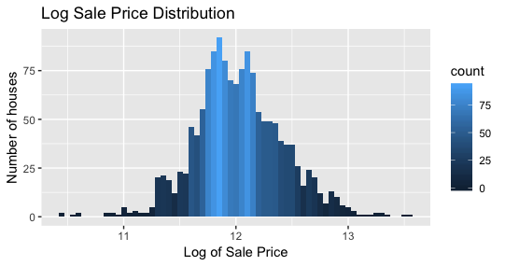
Feature engineering
Scaling by taking log of Sale Price to remove skewness
Helps in enhancing the model by softening the impact of outliers
Transforming biased to normal distribution

Slide 4
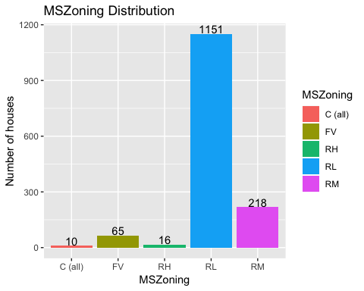
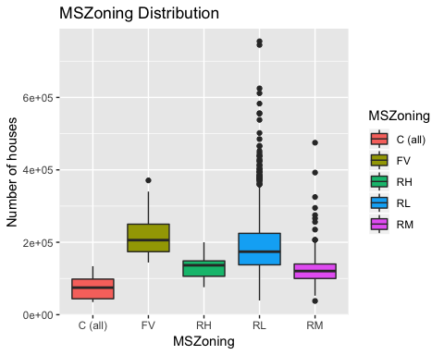
DESCRIPTIVE & EXPLORATORY ANALYSIS – 1. Zone
RL zone has highest number of houses which is 1,151
Sale Price of FV zone > Sale Price of C, which factor is driving the prices?
Area of FV zone > Area of C zone, means Area has huge influence on prices

Slide 5
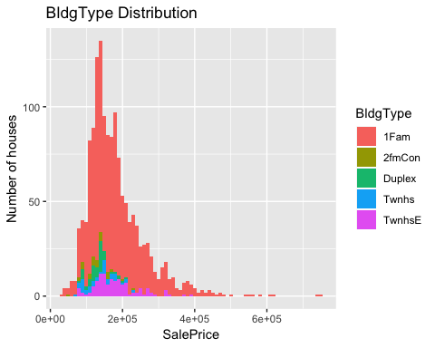
2. BUILDING TYPE
1 Family houses are distributed across all sale prices – low to high
Other type of houses lie in price range of 80,000 – 200,000
Therefore, 1 Family houses are in majority

Slide 6
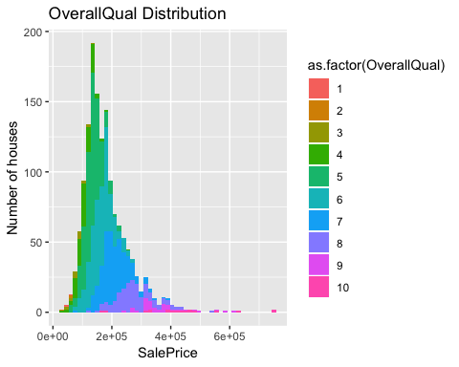
3. Overall quality
Higher the quality ratings, higher is the Sale Price, thus relation is symmetric
Population of houses with ratings < 6 are more
There are less number of houses that falls in good quality bracket

Slide 7
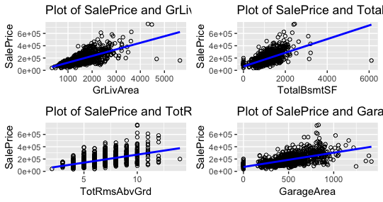
Relation: linear or non-linear?
Living area, Basement area, Rooms area, Garage Area have huge influence on price
Correlation with Sale Price is linear, means sale price will increase if values of these numeric features increases

Slide 8
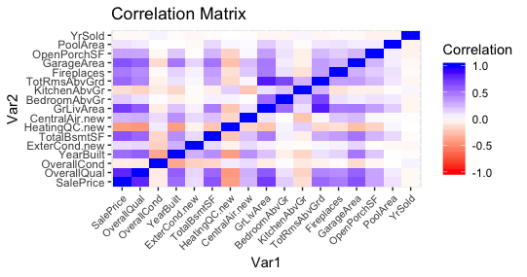
Correlation matrix
Features share positive correlation with Sale Price if closer to 1 (blue)
Features share negative correlation with Sale Price if closer to -1 (red)
No correlation with Sale Price if equal to 0

Slide 9
Evaluation statistics
Accuracy is calculated by considering – MAE & RMSE
Model that gives RMSE smaller or closer to 0 will be the best model
Residual for each model is calculated, i.e.; difference between actuals and predicted
Goal is to predict sale price of test set and select the best model
MAE = abs. difference between 2 variables
RMSE = sqrt(mean(difference between predicted & actuals))

Slide 10
Model selection
Model development of Linear Regression, CART, and Random Forest
Data is linear so LM performed well with RMSE of 0.16
Tuned CART with cp = 0.01, but still it didn’t give better results
Random Forest gave best results with RMSE of 0.13 and also tuned it
LM and Random Forest took less time to train but Random Forest gave best results
LM
CART
RF

Slide 11
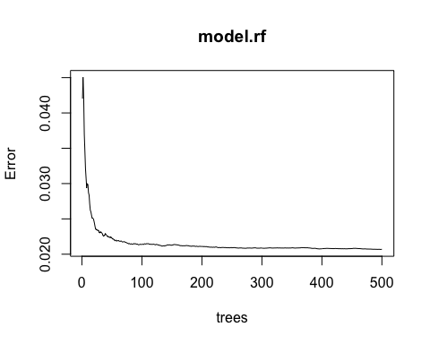
Tuning model
Number of trees = 300 or 400, gives similar accuracy as 500 (default), thus improving processing speed and reducing memory usage
Increasing or decreasing number of features per tree results in bad model

Slide 12
Model performance result
RMSE of 0.13 (accuracy of ~87%)
Random Forest is the best model
Future research includes: Neural Network, SVM, KNN
Kaggle submission ranked in top ~30% of the entire leaderboard

Slide 13


