Slide 1
EE698G: Probabilistic Mobile Robotics LIDAR ODOMETRY AND MAPPING (LOAM)
memBERS:
Aayush Dwivedi (14006)
Akshay Sharma (14062)
Mandeep singh (14363)

Slide 2
INTRODUCTION
LOAM: A real-time method for odometry and mapping using range measurements from a 2-axis LiDAR moving in 6-DOF
This achieves both low-drift and low-computational complexity without the need for high accuracy ranging or inertial measurements
Division of complex problem of simultaneous localization and mapping in two algorithms: 1. Odometry at high frequency 2. Matching and registration of the point cloud at low frequency
The parallel algorithm structure ensures feasibility of the problem to be solved in real-time

Slide 3
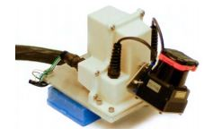

LiDAR Hardware
Custom built 3D lidar based on a Hokuyo UTM-30LX laser scanner
The laser scanner has a field of view of ${180}^{◦}$ with ${0.25}^{◦}$ resolution and 40 lines/sec scan rate
The laser scanner is connected to a motor, which is controlled to rotate at an angular speed of ${180}^{◦}$/s between $−{90}^{◦}$ and ${90}^{◦}$ with the horizontal orientation of the laser scanner as zero
An onboard encoder measures the motor rotation angle with a resolution of ${0.25}^{◦}$

Slide 4

FORMULATION
ASSUMPTIONS:
LiDAR is pre calibrated
The angular and linear velocities of the lidar are smooth and continuous over time, without abrupt changes.
NOTATIONS:
$P_{k}$: Point cloud perceived during $k^{th}$ sweep
Lidar coordinate system {L} : Origin at the geometric center of the lidar. The X-axis is pointing to the left, the Y-axis is pointing upward, and the Z-axis is pointing forward. The coordinates of a point $i$, $i ∈ P_{k}$, in $\left\{L_{k}\right\}$ are denoted as $X_{(k,i)}^{L}$
World coordinate system {W } coincides with {L} at the initial position. The coordinates of a point $i, i ∈ P_{k}$, in $\left\{W_{k}\right\}$ are $X_{(k,i)}^{W}$.

Slide 5
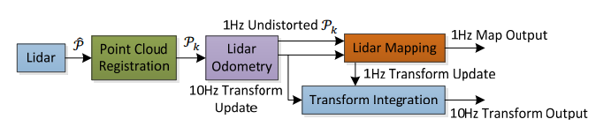

Software System
The lidar odometry takes the point cloud and computes the motion of the lidar between two consecutive sweeps
The estimated motion is used to correct distortion in $P_{k}$
The outputs are further processed by lidar mapping, which matches and registers the undistorted cloud onto a map

Slide 6


LiDAR ODOMETRY
FEATURE POINT EXTRACTION:
Feature Point: Sharp Edges and Planar surface patches
Let $i$ be a point in $P_{k}$, $i ∈ P_{k}$, and let S be the set of consecutive points of $i$ returned by the laser scanner in the same scan
Define a term to evaluate the smoothness of the local surface:
The points in a scan are sorted based on the $c$ values. A point $i$ can be selected as an edge or a planar point only if its $c$ value is larger or smaller than a threshold respectively.

Slide 7
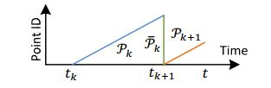

LiDAR ODOMETRY
FINDING FEATURE POINT CORRESPONDANCE:
$t_{k}$: Starting time of the sweep $k$
$\overline{P_{k}}$ : Reprojected point cloud of $P_{k}$ to time stamp of $t_{k+1}$
$ε_{k}$ : Set of edge points in $P_{k}$
$H_{k}$ : Set of planar points in $P_{k}$
$\tilde{ε_{k+1}}$: $ε_{k+1}$ reprojected to the beginning of the $(k+{1)}^{th}$ sweep
$\tilde{H_{k+1}}$: $H_{k+1}$ reprojected to the beginning of the $(k+{1)}^{th}$ sweep

Slide 8
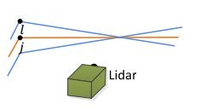

LiDAR ODOMETRY
FINDING FEATURE POINT CORRESPONDANCE:
For each point in $\tilde{ε_{k+1}}$ and $\tilde{H_{k+1}}$, we are going to find the closest neighbor point in $P_{k}$
EDGE POINT:
$i ∈\tilde{ε_{k+1}}$
Let $j$ be the closest neighbor of $i$ in $\overline{P_{k}}$, $j ∈\overline{P_{k}}$, and let $l$ be the closest neighbor of $i$ in the two consecutive scans to the scan of $j. (j, l)$ forms the correspondence of $I$
Verify both $j$ and $l$ are edge points by checking the smoothness of the local surface

Slide 9
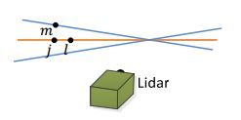

LiDAR ODOMETRY
FINDING FEATURE POINT CORRESPONDANCE:
PLANAR POINT:
$i ∈\tilde{H_{k+1}}$.
The planar patch is represented by three points
We find the closest neighbor of $i$ in $\overline{P_{k}}$, denoted as $j$. Then, we find another two points, $l$and $m$, as the closest neighbors of $i$, one in the same scan of $j,$ and the other in the two consecutive scans to the scan of $j.$
To verify that $j, l,$ and $m$ are all planar points, we check again the smoothness of the local surface

Slide 10

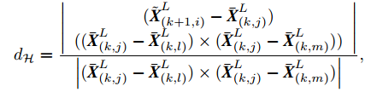

LiDAR ODOMETRY
DISTANCE FROM A FEATURE POINT TO ITS CORRESPONDENCE:
Lidar Motion is recovered by minimizing the overall distances of the feature points
For an edge point $i ∈\tilde{ε_{k+1}}$, if $(j, l)$ is the corresponding edge line, the point to line distance can be computed as
For a planar point $i ∈\tilde{H_{k+1}}$, if $(j, l, m)$is the corresponding planar patch, the point to plane distance is

Slide 11




LiDAR ODOMETRY
MOTION ESTIMATION:
$T_{k+1}^{L}$ : lidar pose transform between [$T_{k+1}^{L}$, $t$] $T_{k+1}^{L}= {\left[t_{x}, t_{y}, t_{z}, θ_{x}, θ_{y}, θ_{z}\right]}^{T}$
$T_{(k+1,i)}^{L}$ : pose transform between [$T_{k+1}^{L}$, $t_{i}$]. ($t_{i}$ : time stamp of $i ∈ P_{k+1}$)
$T_{(k+1,i)}^{L}$ can be computed by linear interpolation of $T_{k+1}^{L}$
R : rotation matrix defined by the Rodrigues formula

Slide 12





LiDAR ODOMETRY
MOTION ESTIMATION :
Establishing a geometric relationship between $E_{k+1}$ and $\tilde{E_{k+1}}$, or $H_{k+1}$ and $\tilde{H_{k+1}}$
Deriving a geometric relationship between an edge point in $E_{k+1}$ & corresponding edge line or a planar point in $H_{k+1}$ and the corresponding planar patch.
Combining we get:
Finally solving the lidar motion with the Levenberg Marquardt method, a nonlinear optimization algorithm to minimize $d$.

Slide 13
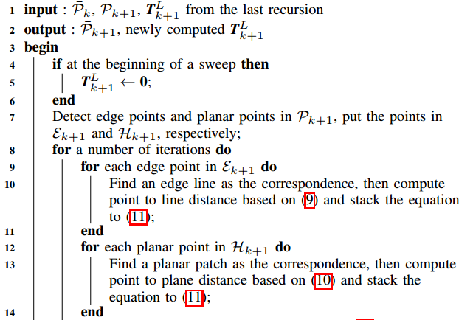
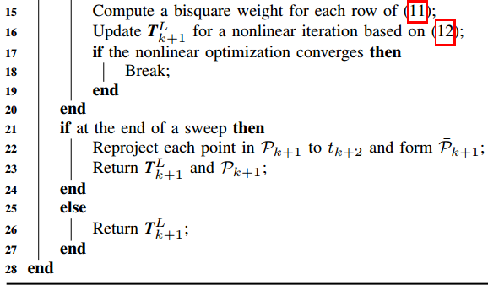
ALGORITHM 1: LIDAR ODOMETRY

Slide 14
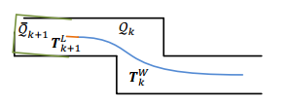

LiDAR MAPPING
Runs at a lower frequency then the odometry algorithm, and is called only once per sweep
At the end of ${\left(k + 1\right)}^{th}$ sweep, the lidar odometry generates a undistorted point cloud,$\overline{P_{k+1}}$and simultaneously a pose transform, $T_{k+1}^{L}$, containing the lidar motion during the sweep, between $[t_{k+1}, t_{k+2}]$
The mapping algorithm matches and registers $\overline{P_{k+1}}$ in the world coordinates, {W}
$Q_{k}$ : Point cloud on the map, accumulated until $k^{th}$ sweep
$T_{k}^{W}$ : Be the pose of the lidar on the map at the end of${ k}^{th}$ sweep, $t_{k+1}$

Slide 15

LiDAR MAPPING
With the outputs from the lidar odometry, the mapping algorithm extents $T_{k}^{W}$ for one sweep from $t_{k+1}$ to $t_{k+2}$, to obtain $T_{k+1}^{W}$, and projects $P_{k+1}$ into the world coordinates, {$W$}, denoted as $\overline{Q_{k+1}}$. Next, the algorithm matches $\overline{Q_{k+1}}$ with $Q_{k}$ by optimizing the lidar pose $T_{k+1}^{W}$.
Correspondences for the feature points of $\overline{Q_{k+1}}$, with the map $Q_{k}$:
we store the point cloud on the map, $Q_{k}$, in 10m cubic areas and the points in the cubes that intersect with $\overline{Q_{k+1}}$ are extracted and stored
We find the points in $Q_{k}$ within a certain region around the feature points. $S^{’}$: Set of surrounding points around the feature points
For an edge point, we only keep points on edge lines in $S^{’}$, and for a planar point, we only keep points on planar patches.
Using PCA we find the orientation of the edge line or the planar patch

Slide 16


LiDAR MAPPING
Optimization of the pose transformation after ${\left(k+1\right)}^{th}$ sweep:
Similar to lidar odometry we minimize the distance of the feature points from their correspondences using Levenberg Marquardt method

Slide 17
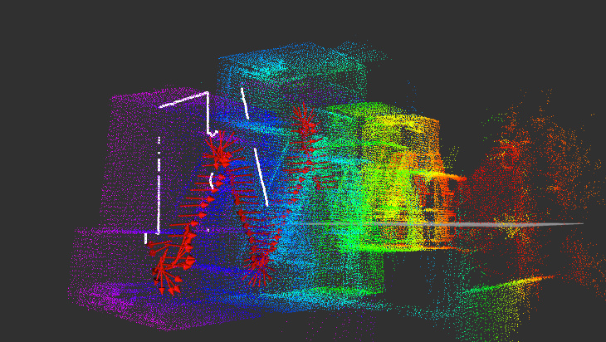
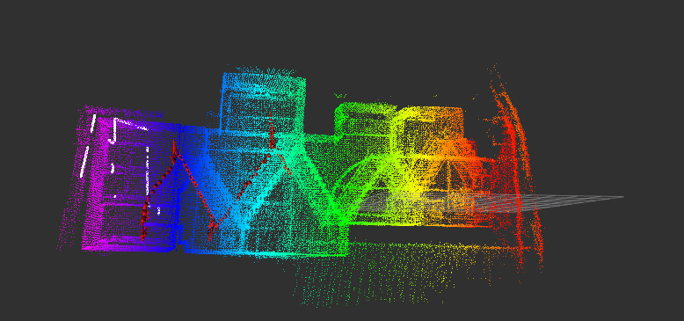
RESULTS

Slide 18
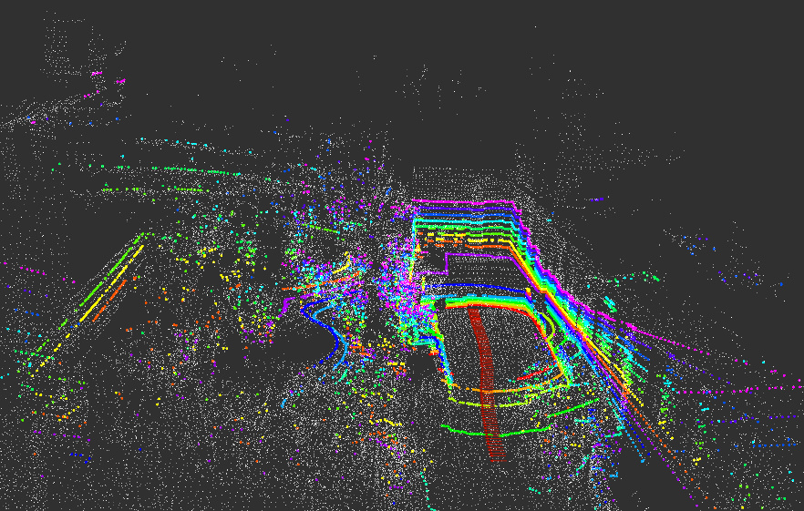
RESULTS

Slide 19
REFERENCES
Ji Zhang and Sanjiv Singh “LOAM: Lidar Odometry and Mapping in Real-time”
Github Source: https://github.com/daobilige-su/loam_back_and_forth
http://wiki.ros.org/loam_back_and_forth
Datasets: Staircase Dataset Indoor Outdoor Dataset

