Slide 1
Reducing Carbon Emissions Through Community-Based Delivery
Team Vector

Slide 2
The Problem
Lack of carbon footprint awareness
Individual grocery deliveries = high carbon emissions

Slide 3
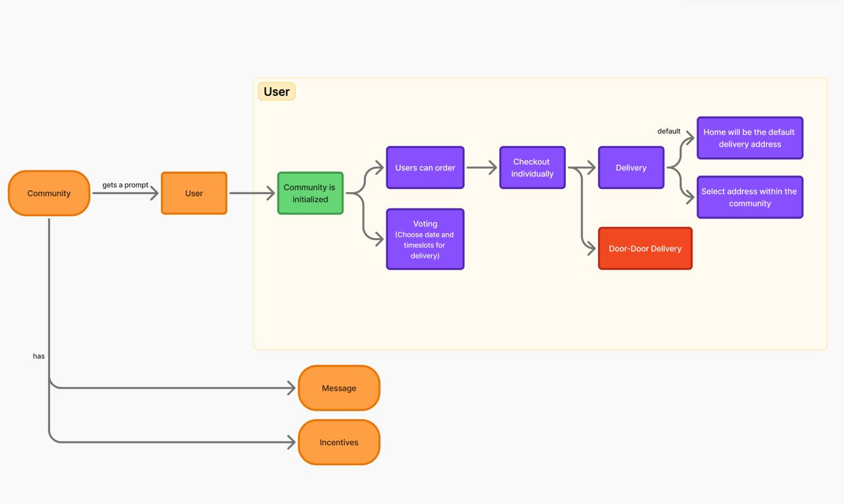
Solution

Slide 4
How it works
Prompt: Users are asked if they want to join the community
Voting: Users choose preferred delivery slots
Order & Checkout: Users order individually but checkout under the selected slot
Delivery: Orders are bundled and delivered efficiently

Slide 5
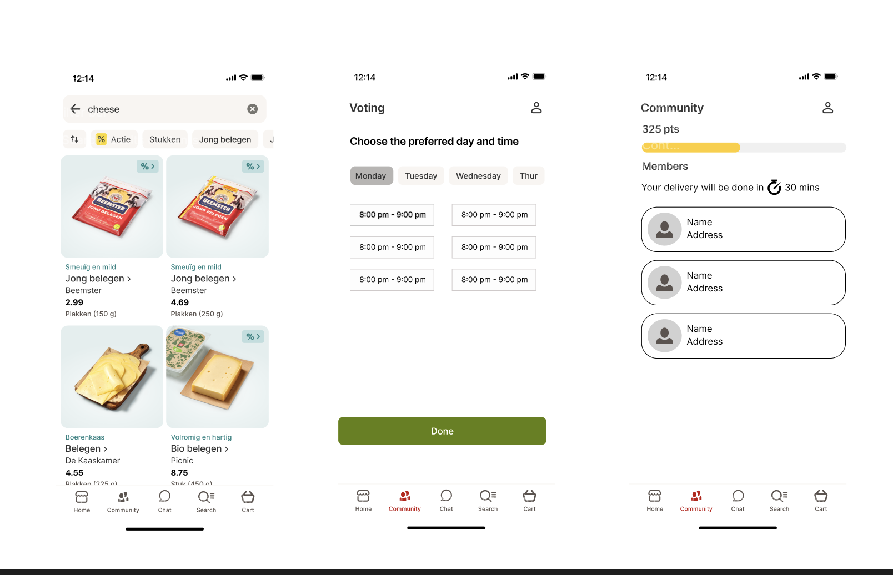

Slide 6
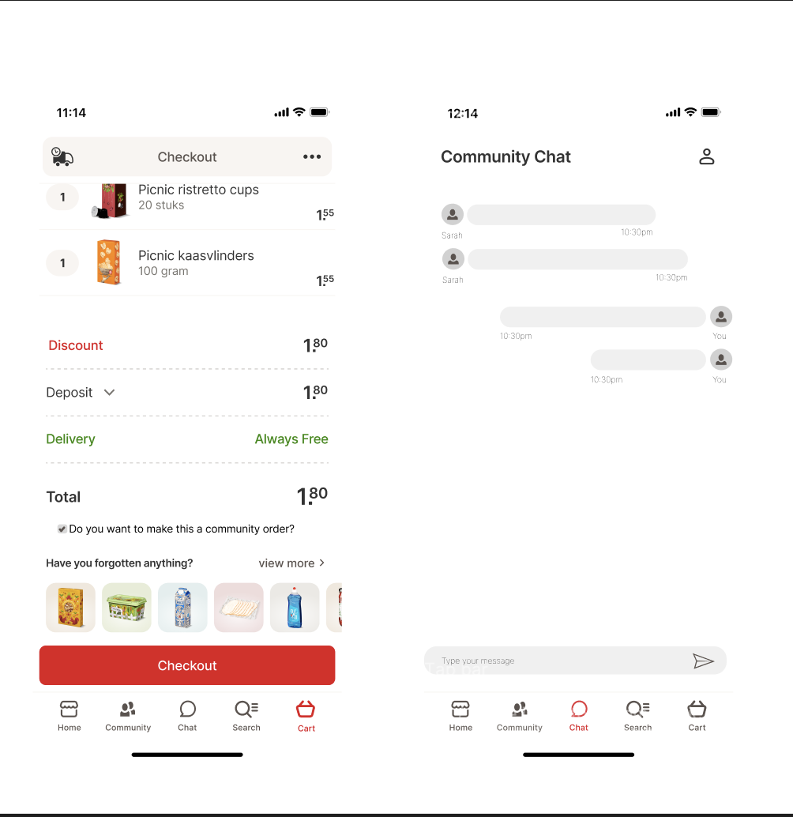

Slide 7
Demo

Slide 8
Tech stack overview
MERN Stack
AI/ML (Future Scope): Predictive grouping and slot recommendations

Slide 9
Features
Community Initialization: Based on user proximity and shared interest
Voting Mechanism: Users vote for preferred time slots
Address Selection: Choose between home or proxy delivery points within the community
Messaging: Chat with neighbors for coordination
Incentives: Earn points/cashbacks for group ordering

Slide 10
Benefits
Environmental Impact: Reduced carbon emissions with fewer trips
User Savings: Cashback and loyalty points
Convenience: Fewer missed deliveries and flexible slots
Community Building: Foster connections within neighborhoods

Slide 11
Roadmap
Phase 1: MVP launch in selected areas
Phase 2: Integration with Picnic's current delivery system
Phase 3: Expand to include vendor-side batching
Phase 4: Adding Gamification. A point based system for saving carbon emissions

Slide 12
ThankYou
Q&A

