Slide 1

Car Rentals
WEBSITE

Slide 2
INTRODUCTION
It is a website for taking a dream car on rent. The website is named as “CAR RENTALS” in this website customer can book their dream car on rent. To book a car customer needs to register themselves and login into their account. It is mandatory to have a valid driving licence to register themselves into the website. The rate of cars is per hours in the website.
This website helps our customer to fulfil their dreams and on the other side they don’t have to spend a lot of money for fulfilling their dreams.

Slide 3
Benefits for the customer.
Drive dream car without buying.
Book according to a budget.
Book any car virtually.
Proper sanity and their safety will be our most priority.

Slide 4
Benefits for the customer.
The payment process will be transparent.
Pre-inspection carried out.
Customer support.
Exclusive offers frequently.

Slide 5
Benefits for owner
Online availability amid pandemic
People surfing more in modern era.
Research shows upward trend in sales.

Slide 6
Benefits for owner
Competition in the market.
Easy management.
Easy tracking of customers.
Passive income from ads.

Slide 7
STEPS TO BOOK CAR

Slide 8
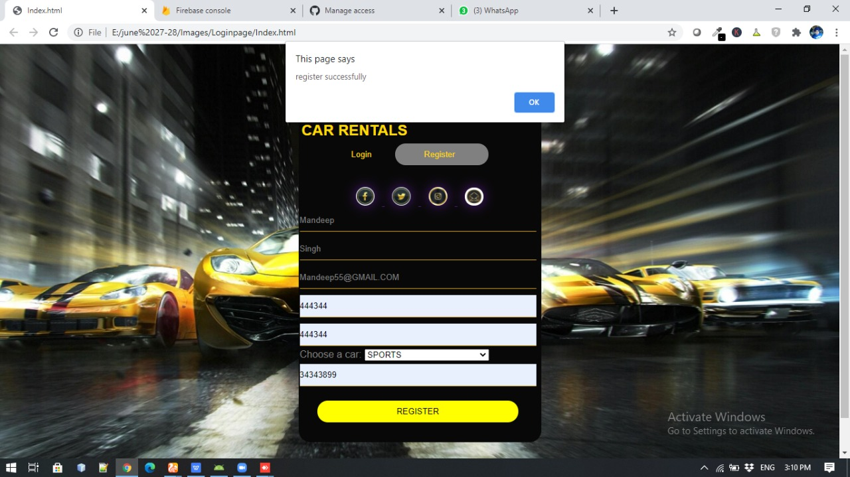
REGISTRATION

Slide 9
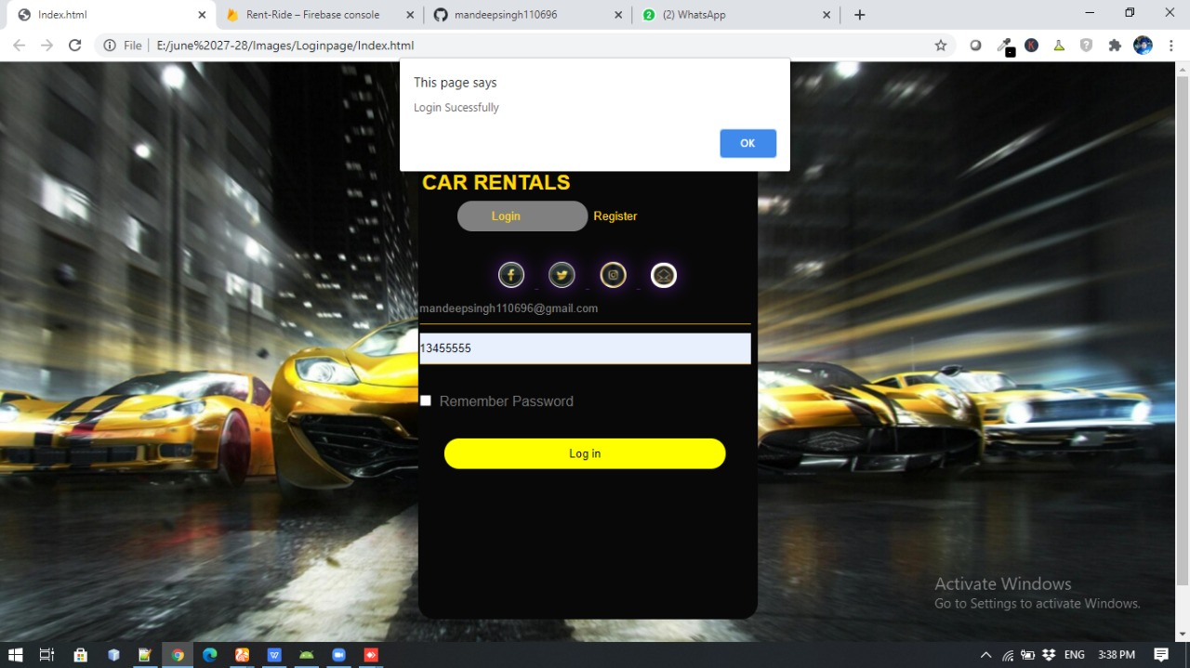
LOGIN

Slide 10
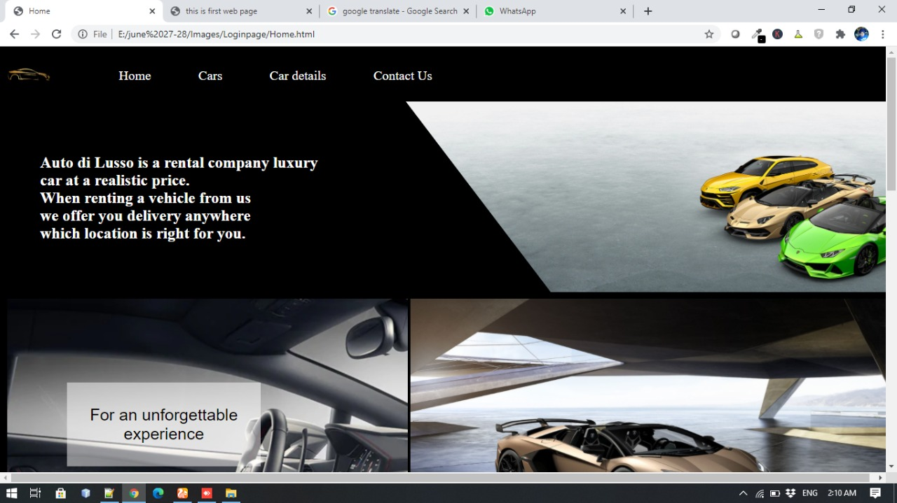
HOME

Slide 11
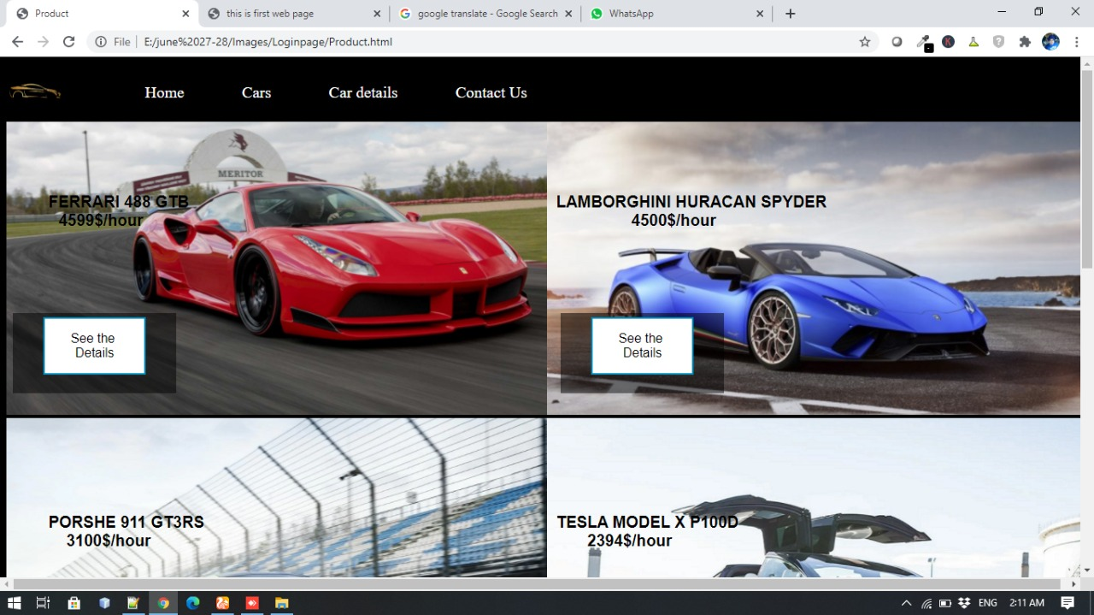
CARS

Slide 12
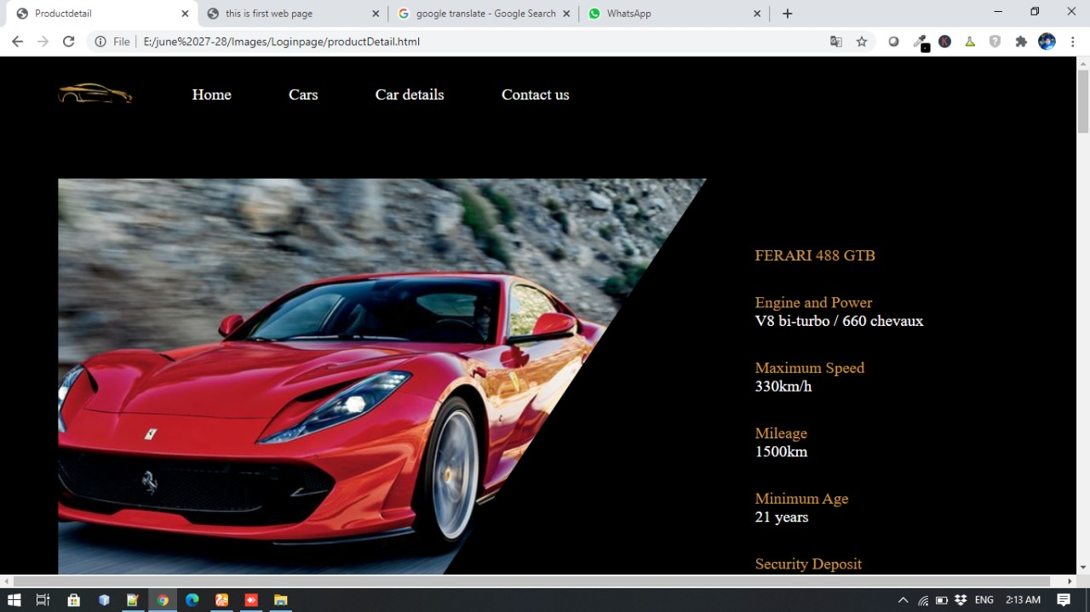
CARS DETAILS

Slide 13
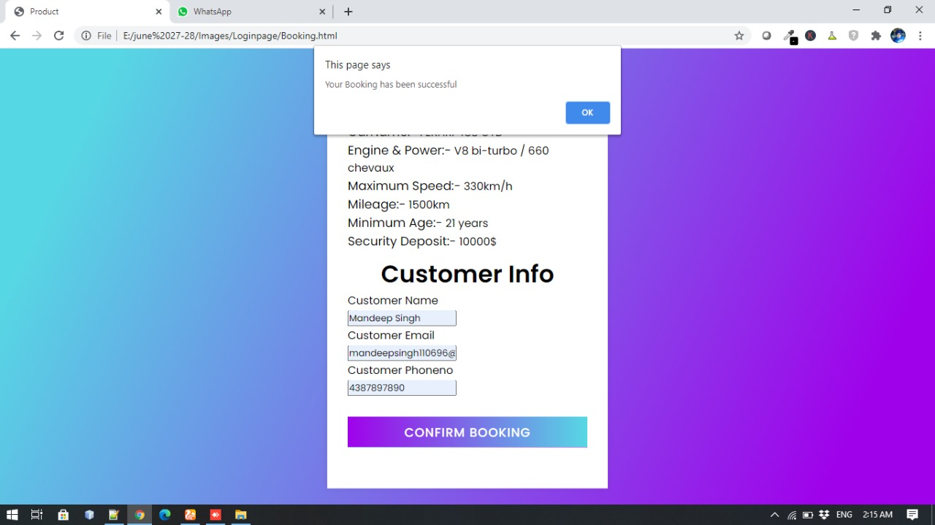
BOOKING

Slide 14
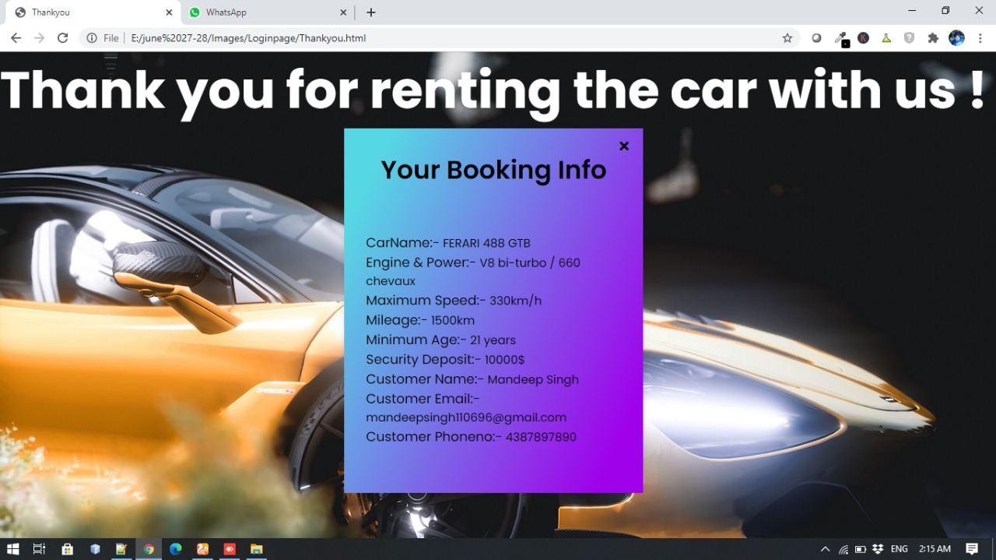
BOOKING CONFIRMATION

