Slide 1

Image Classification with Spatial Pooler Presented By: Mandeep Singh 1228409

Slide 2
CONTENT
INTRODUCTION
HTM SPATIAL POOLER
BREIF DESCRIPTION
METHODOLOGY
IMPLEMENTATION OF ALGORITHM
IMPLEMENTATION OF PROGRAM
CONCLUSION
REFERENCES

Slide 3
INTRODUCTION
Hierarchical temporal memory (HTM) is a theoretical framework that models a number of structural and algorithmic properties of the neocortex.
The HTM algorithm is designed to be used for classification problems with supervised or unsupervised learning data.
The algorithm learns with the help of a hierarchical network and a continuous stream of input data.
The success of HTM relies on the use of sparse distributed representations (SDRs)

Slide 4

HTM SPATIAL POOLER
The SP is a core component of HTM networks.
In an end-to-end HTM system, the SP transforms input patterns into SDRs in a continuous online fashion.
The HTM temporal memory learns temporal sequences of these SDRs and makes predictions for future inputs.

Slide 5
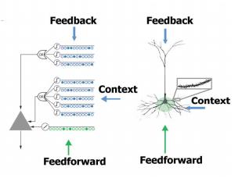
BREIF DESCRIPTION
Different cells within a mini-column represent this feedforward input in different temporal contexts.
Cells in a mini-column share the same feedforward classical receptive field.
This is how SP models common receptive field is learned from the input.
The SP output represents the activation of mini-columns in response to feedforward inputs.

Slide 6
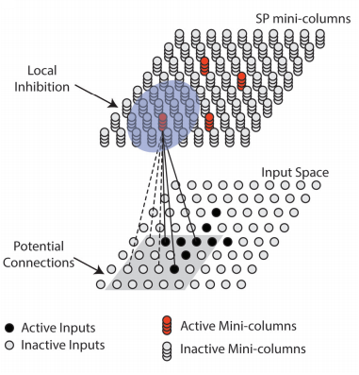
METHODOLOGY
A single layer in an HTM network is structured as a set of mini-columns, each with a set of cells. ​
Each SP mini-column forms synaptic connections to a population of input neurons.
The dimensionality of the input space depends on applications.
At any time, only a small fraction of the mini-columns with the most active inputs become active.

Slide 7
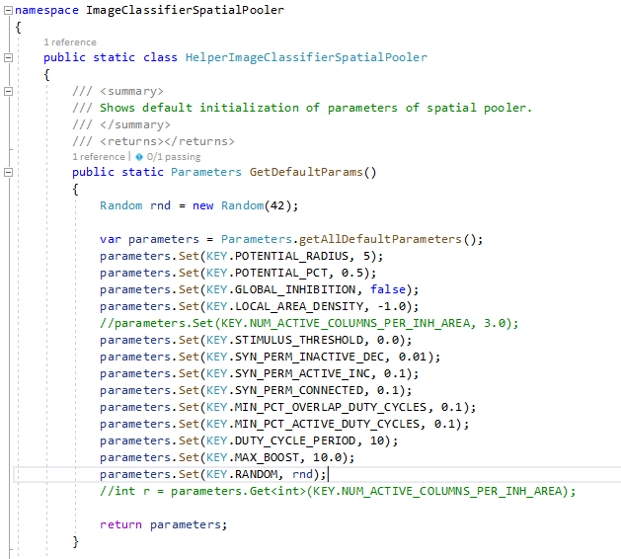
IMPLEMENTATION OF ALGORITHM
Spatial Pooler set to default parameters.

Slide 8


IMPLEMENTATION OF PROGRAM
Defining input and output parameters of Images
Setting input space dimenstions and Column space dimenstions
Setting the parameters of Potential Connection

Slide 9
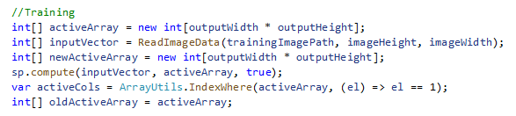
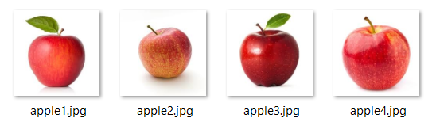
TRAINING DATA
In read image data method reads the data of training image in binary form. So, Input vector having the data of images in binary form.
Compute function contains input vector which has input patterns that shows a large number of data, grouped together into a common output representation that is active array. Active coloumn represent the activation of mini column, which have active input =1. Training Images

Slide 10
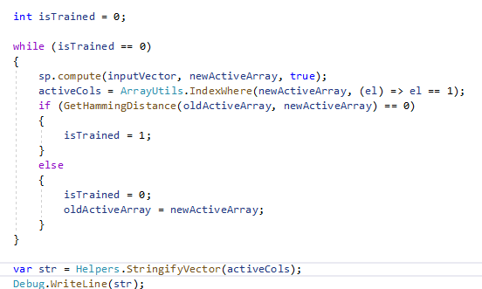
TRAINING DATA
Get Hamming Distance
Method used to compare the
Two array

Slide 11
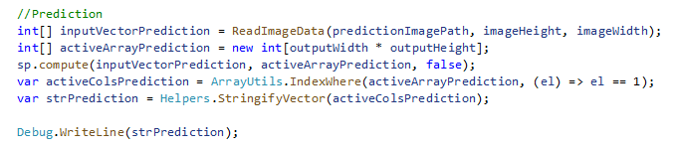
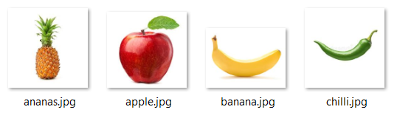
PREDICTION DATA
Prediction follows the Same procedure as training With same compute function.
Prediction Images Return percentage of matching indexes.

Slide 12
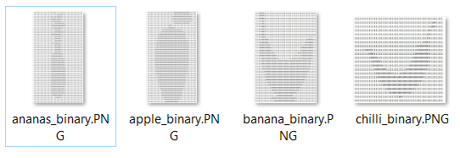
Output
Training Images:
Prediction Images:
Reading Data from binary images to identify the prediction and active column output

Slide 13
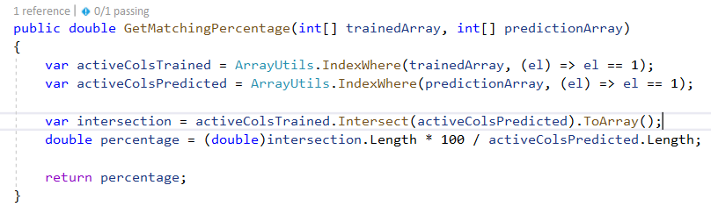
Output
GetMatchingPercentage method compares the active column of trained Images and active column of Prediction Images. Percentage of Intersection of these active columns gives us a result.
Our Model is trained for Apple because we are giving different data sets Images of Apple Only. So, it gives more percentage prediction towards Apple that is 90% .

Slide 14
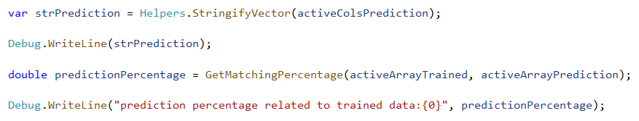
Output
The percentage can be calculated by
So our output will be in order as follows:
Name of the Image to be predicted,
Active column,
Prediction Percentage

Slide 15
Output
Unfortunately, it gives more percentage towards different data prediction images rather than giving less percentage. When we gave different data images for prediction. This error with more percentage behaviour can be reduced by giving more data set images for training.
So, with different images like ananas 72%, banana 77% and chilli 67% gave different percentages.

Slide 16
CONCLUSION
We described parameters of the HTM spatial pooler, a neurally inspired algorithm for learning SDRs.
The use of spatially pooled features (cortical activations) gives rise to a significant improvement in classification while employing less amount of training data.
The performed feature selection is capable of working with the dataset composed of images with low resolution and few changes in the contrast.
The HTM spatial pooler leads to a flexible sparse coding scheme that can be used in practical machine learning applications.

Slide 17
REFERENCES
[1] Kirtay, Murat, Lorenzo Vannucci, Ugo Albanese, Alessandro Ambrosano, Egidio Falotico, and Cecilia Laschi. "Spatial pooling as feature selection method for object recognition." In ESANN. 2018.
[2] Osegi, E. N. "Using the hierarchical temporal memory spatial pooler for short-term forecasting of electrical load time series." Applied Computing and Informatics (2018).
[3] W. Zhuo, Z. Cao, Y. Qin, Z. Yu and Y. Xiao, "Image classification using HTM cortical learning algorithms," Proceedings of the 21st International Conference on Pattern Recognition (ICPR2012), Tsukuba, 2012, pp. 2452-2455.
[4] http://nupic.docs.numenta.org/0.6.0/spatial-pooler.html
[5] D. Dobric, “NeoCortexApi,” 2019. [Online]. Available:https://github.com/ddobric/neocortexapi/.
[6] https://github.com/UniversityOfAppliedSciencesFrankfurt/se-cloud-2019-2020/blob/Mandeep_Singh/Source/HTM/UnitTestsProject/CortexNetworkTests/ImageClassifierSpatialPoolerTests/ImageClassifierSpatialPoolerTests.cs
[7] https://docs.microsoft.com/en-us/dotnet/machine-learning/tutorials/image-classification
[8] Mattsson, Olov. "Fruit recognition by hierarchical temporal memory." (2011).

Slide 18
THANK YOU

