Slide 1

Linear Regression
By Mandel Oats Based on notes by Andrew Ng

Slide 2
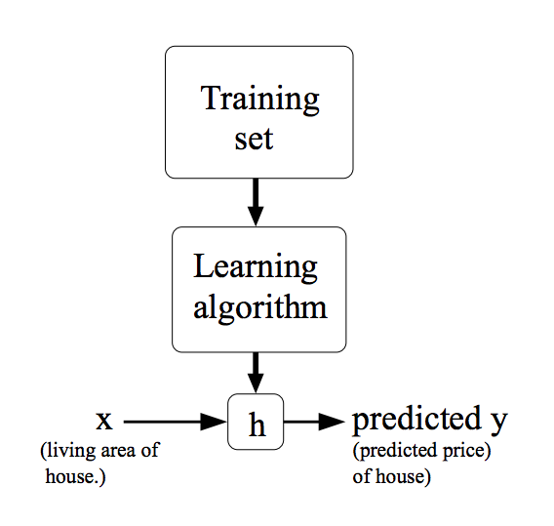
Machine Learning Model

Slide 3
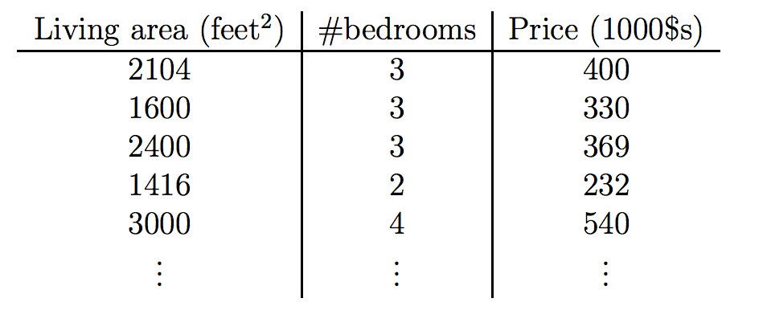



Training Set
$$x_{1}$$
$$x_{2}$$
$$y$$

Slide 4
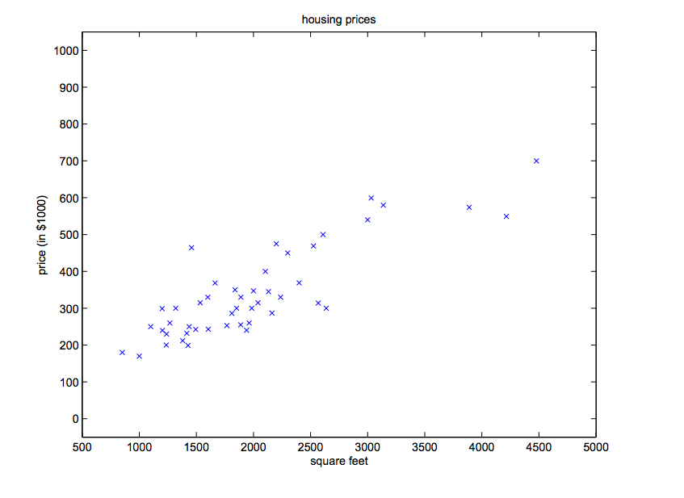
Plotting Data

Slide 5

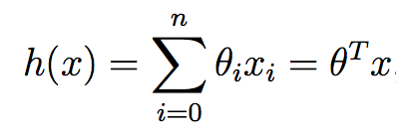
Hypothesis

Slide 6
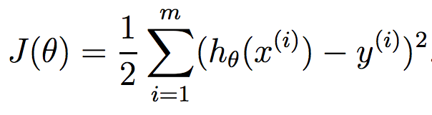
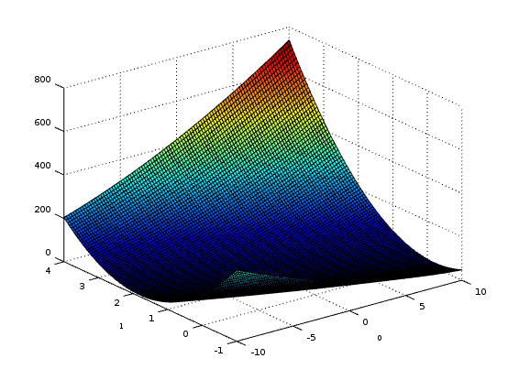
Ordinary Least Squares
Cost Function

Slide 7
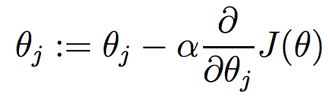
Gradient Descent
Update

Slide 8

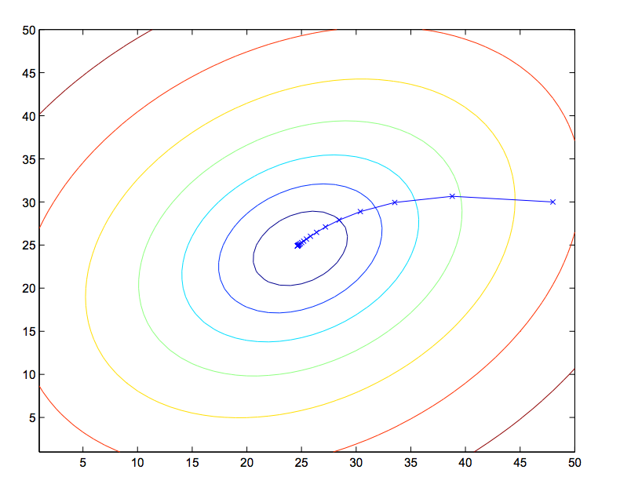
Batch Update Equation
Repeat until convergence
Guaranteed to converge to global minimum (Cost function is convex)

Slide 9
Alternative Minimization
Stochastic Gradient Descent
Not guaranteed to converge exactly
Better for large training set
Normal Equation

Slide 10




Normal Equation

Slide 11
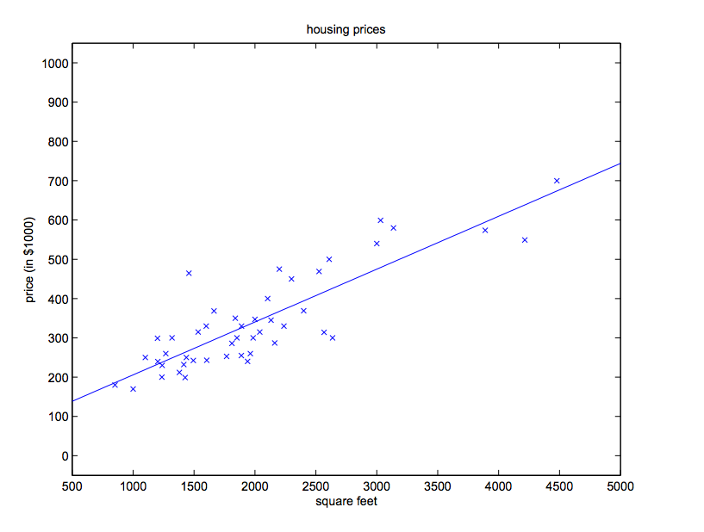
Linear Regression

Slide 12
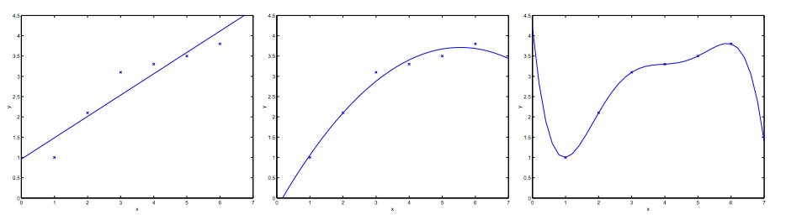
Polynomial Regression

Slide 13
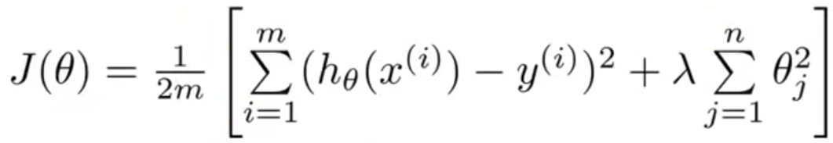
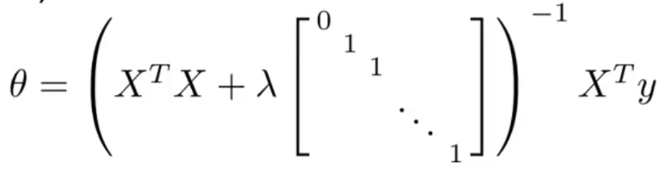
Regularization

Slide 14

Example

