Slide 1
ENGI 301 PCB Project
Parnika Mandewalkar
Due 12/12/2023 @ 11:59pm

Slide 2
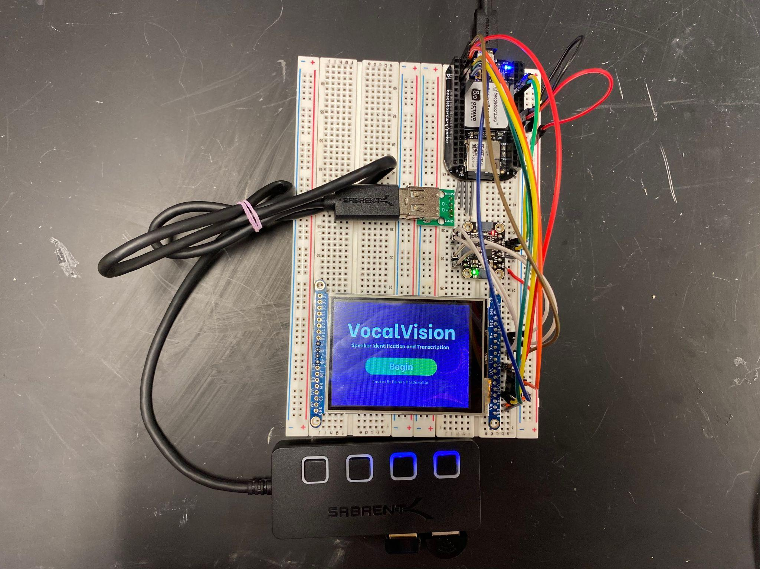
Background Information
Creating a PCB for my VocalVision project
Hardware:
SPI Display Screen
Two resistors
USB Breakout Board
I2C Touchscreen Controller

Slide 3
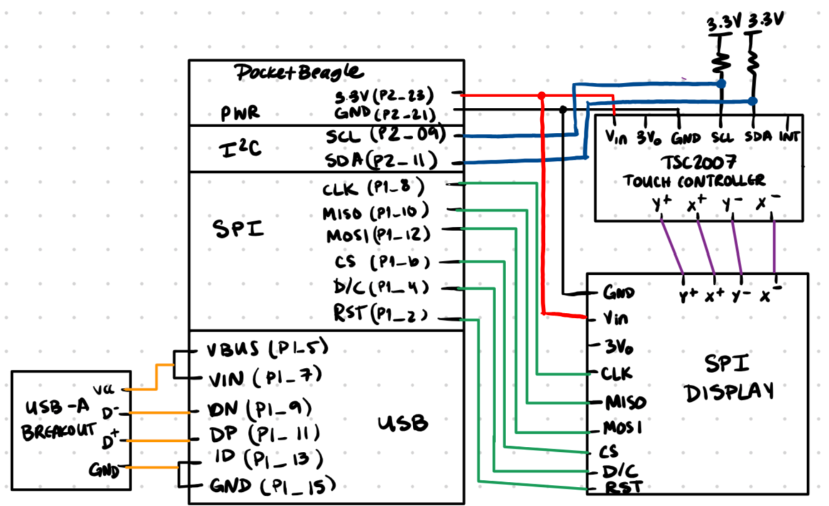
System Block Diagram – VocalVision

Slide 4
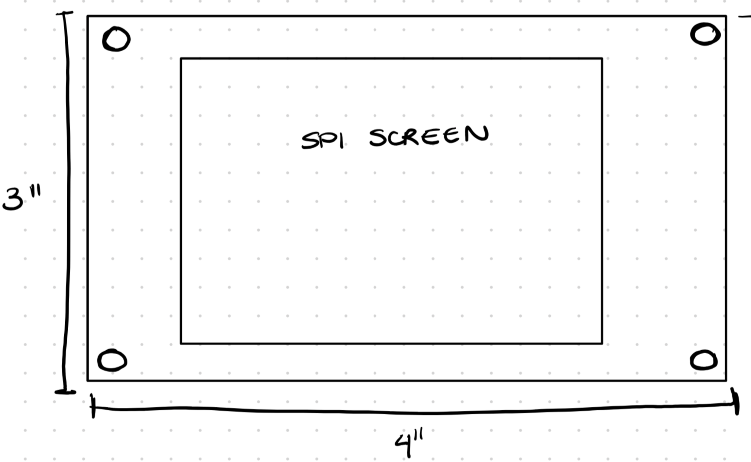
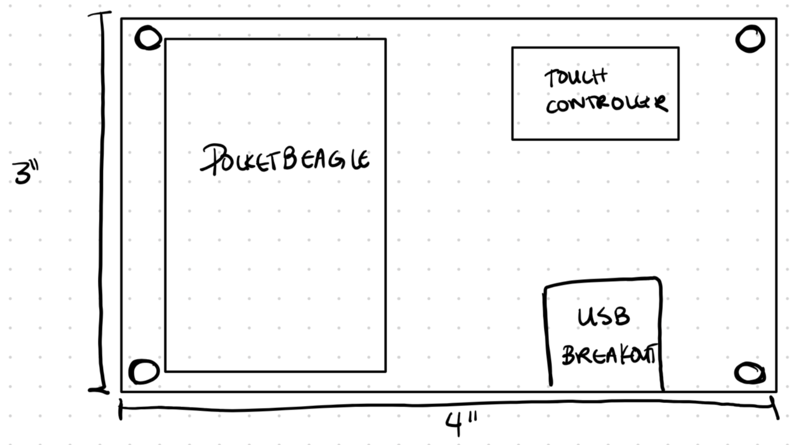
Mechanical Drawing
FRONT
BACK

