Slide 1
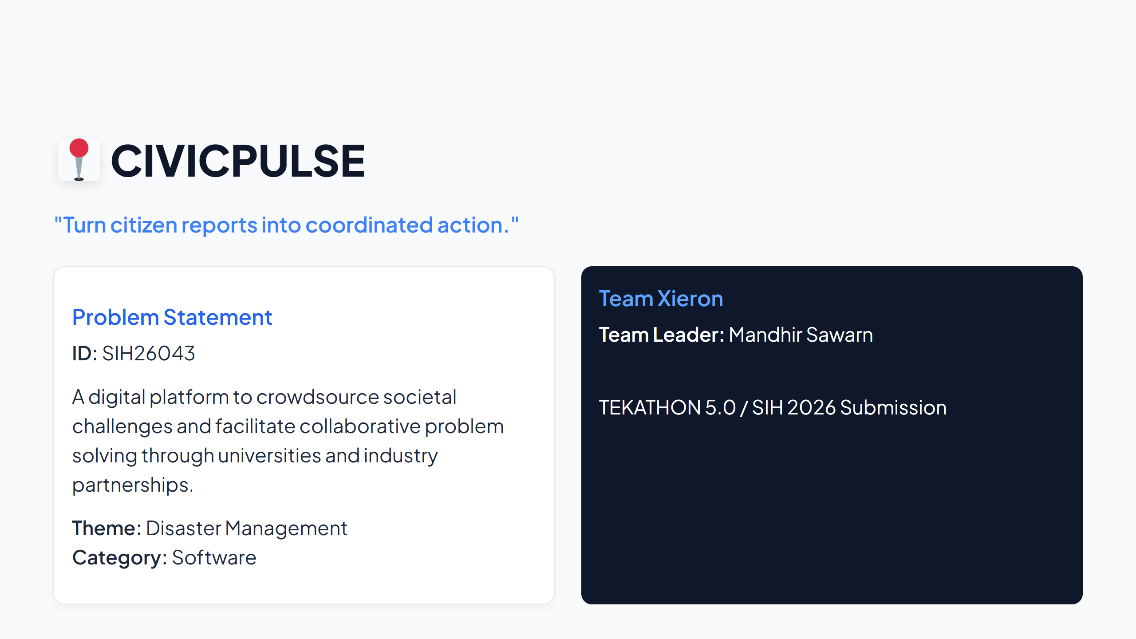
Notes:
SLIDE 1

Slide 2
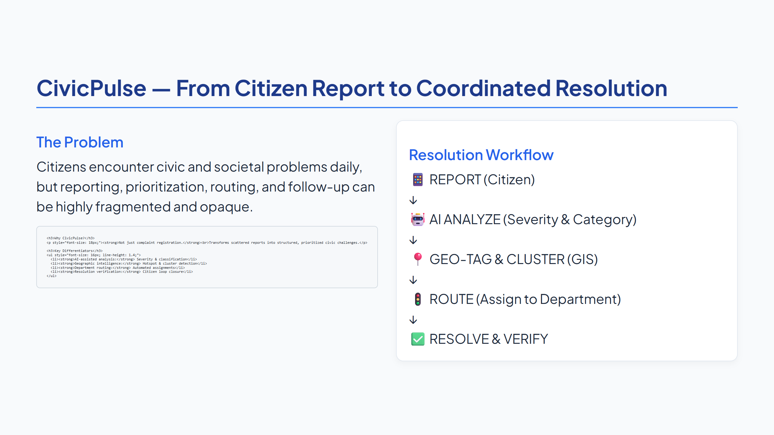
Notes:
SLIDE 2

Slide 3
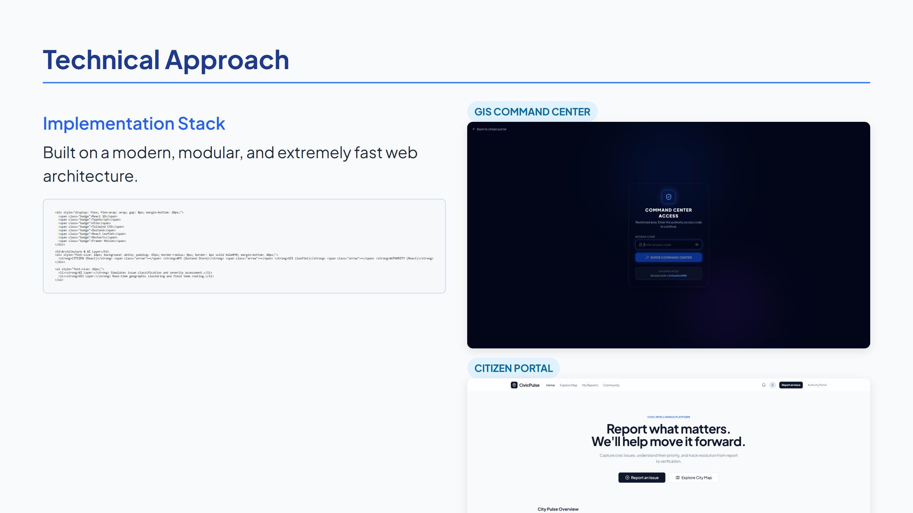
Notes:
SLIDE 3

Slide 4
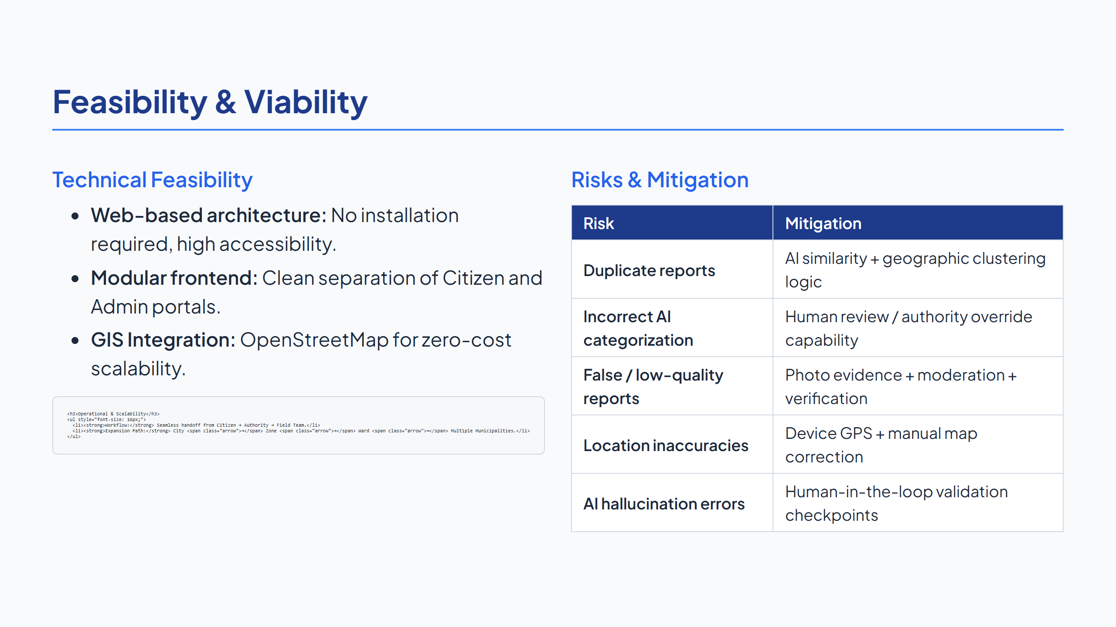
Notes:
SLIDE 4

Slide 5
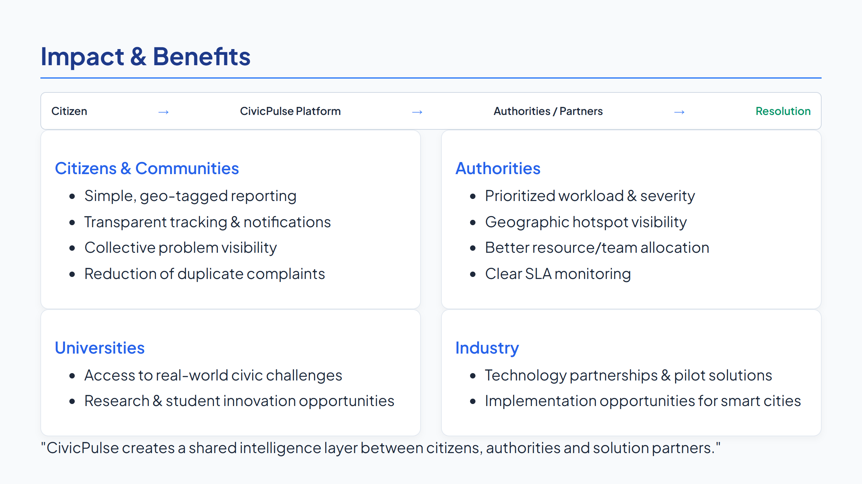
Notes:
SLIDE 5

Slide 6
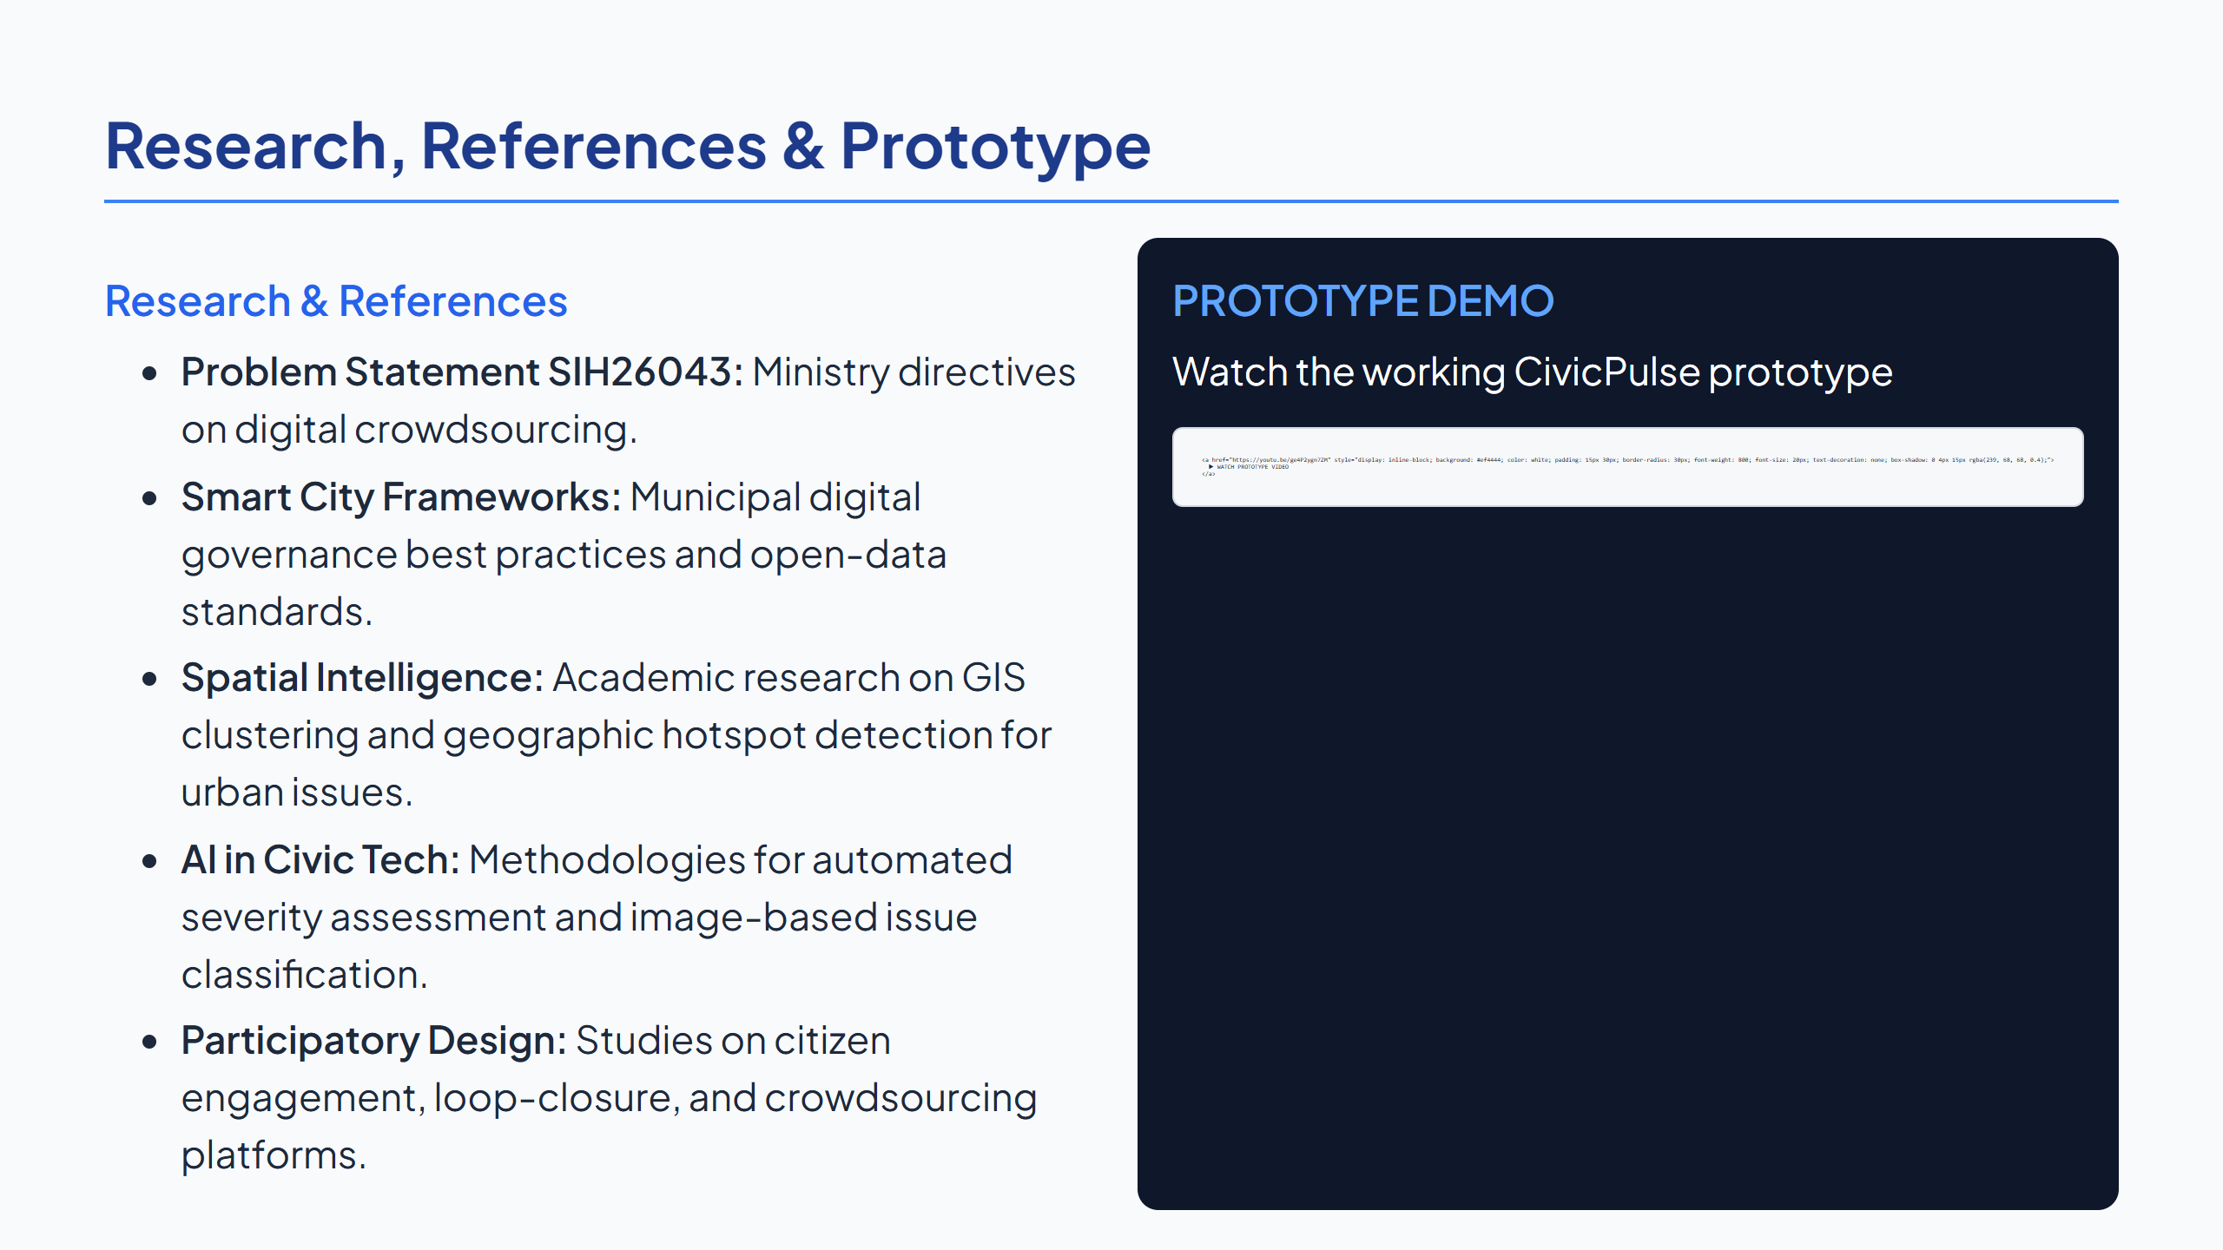
Notes:
SLIDE 6

