Slide 1
🏥 Hospital Patients Data Analysis

Slide 2
Introduction
Understand patient demographics and diagnoses
Evaluate hospital operations (branches, rooms) and departments loads
Billing impacts
Explore patterns

Slide 3
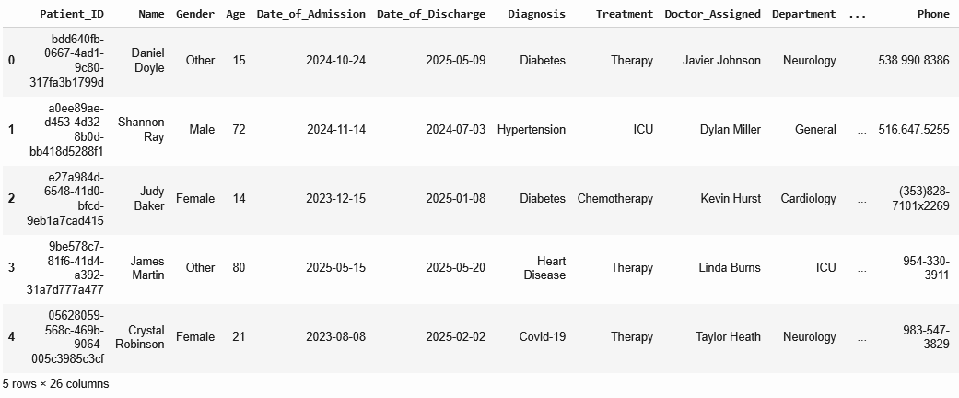
Data Set
1,000,000 Patient records
26 Columns: Age, Gender, Doctor_assigned, Billing etc.

Slide 4
Data Preprocessing
Handle missing values
Remove duplicates
Convert data types
Check missing values
df.isnull.sum()
Fill missing values
df[‘col’].fillna(‘value’)
Use df.drop_duplicates(inplace=True)
Use pd.to_datetime(df[‘col’])

Slide 5
Explore The Data (EDA)

Slide 6
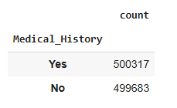
Analysis
Average age of patient
Average age: 50 years
More middle-aged patients
Top 3 diagnoses
Diabetes
Fracture
Hypertension
Patient with or without medical history

Slide 7
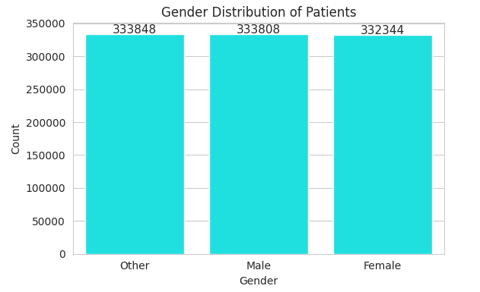
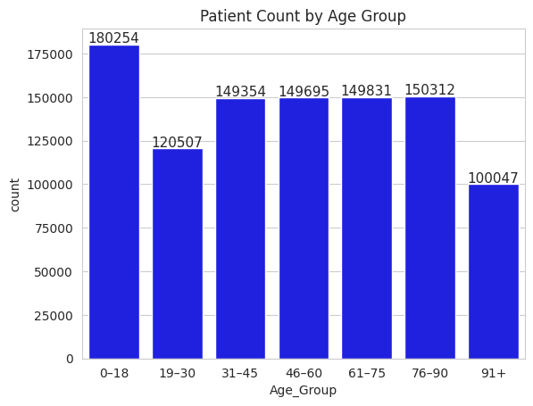
Gender distribution of patient
Highest number of hospital admissions by age group

Slide 8
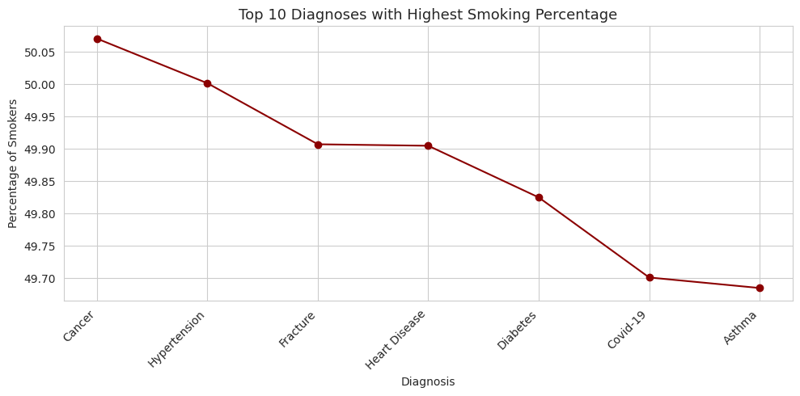
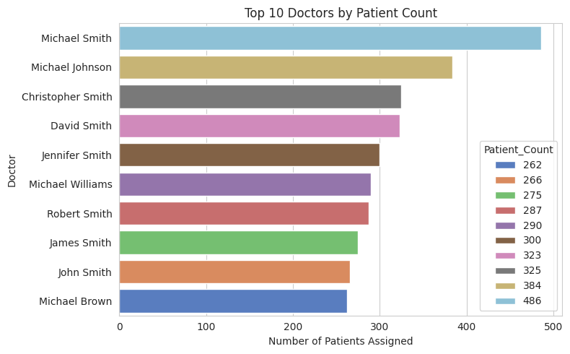
Smoker vs Diagnosis
35
Top performing doctor by patient volume
25
22
15

Slide 9
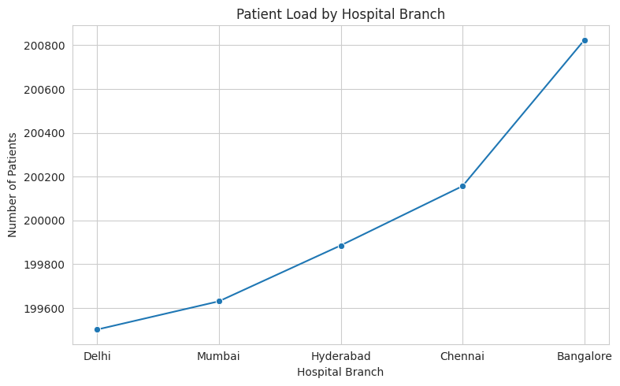
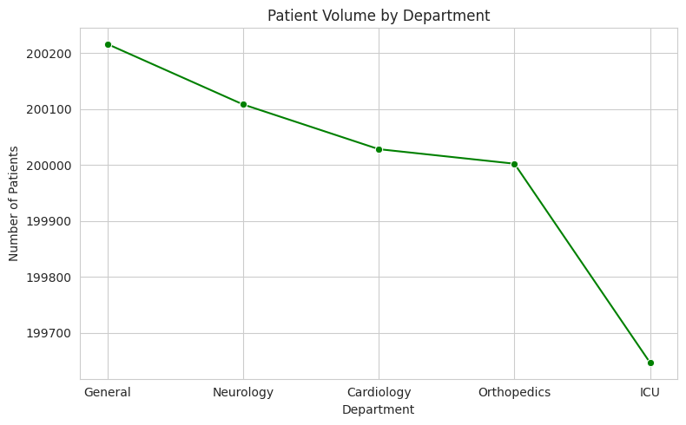
Branch with highest patient load
35
25
22
Patients handled by each department
15

Slide 10
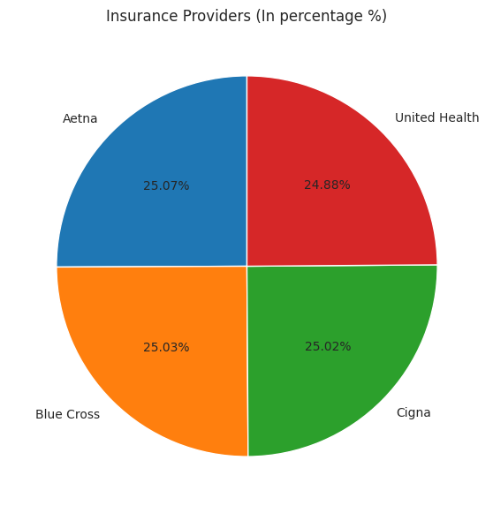
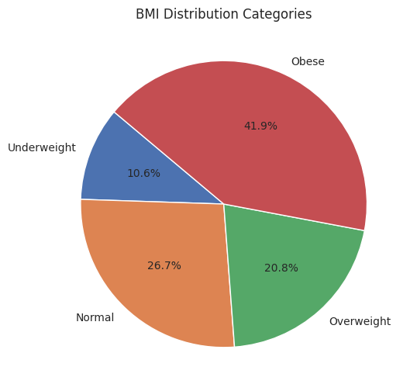
BMI trend among patients
35
25
22
15
Top insurance provider

Slide 11
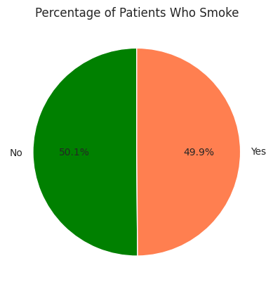
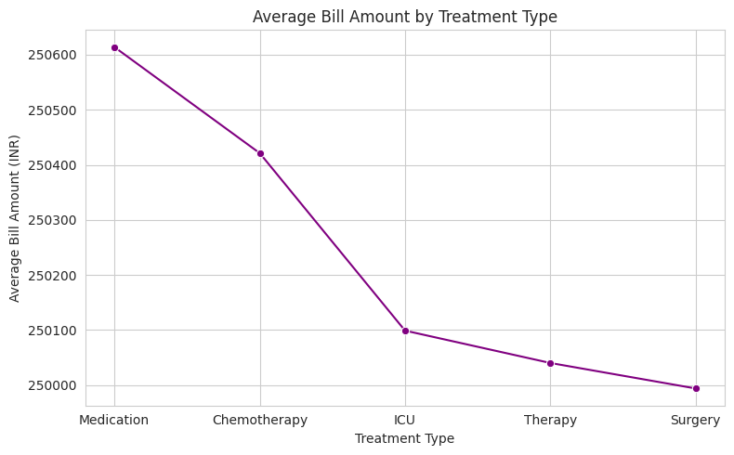
35
25
22
Average bill amount by treatment type
Patients who smoke

Slide 12
Correlation Between BMI and Diagnosis
Diabetes, Covid-19
Average BMI range from 27.9 to 28.04
Average Length of Stay
182 days
Correlation Between BMI and Bill Amount
No relationship
Room Occupancy by Branch
Bangalore: 223 patients / room
Delhi has lowest occupancy

Slide 13
THANK YOU

