Slide 1
Battle of neighborhoods By Mandisi Shunqukela IBM Professional Data Science Certificate: Applied Data Science Capstone Project
Battle of the Neighborhoods; what top three business types can an investor invest in or can someone consider opening in neighborhoods of Bronx and Queens (two New York boroughs)

Slide 2
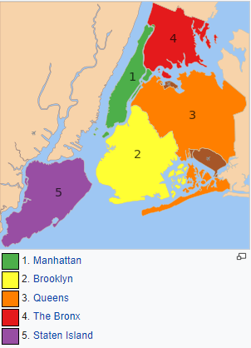
Introduction
Exploring the New York City (NYC) boroughs
It has five borougs
Bronx
Manhattan
Queens
Brooklyn
State Island

Slide 3
Focus on Queens and Bronx
What top three common business types can someone (business person/ invester) consider to start in neighborhoods of Bronx and Queens
Will render possible business types that can successfully run in the neighborhoods. This will hence assist one in choosing a kind of business to start or invest in.

Slide 4
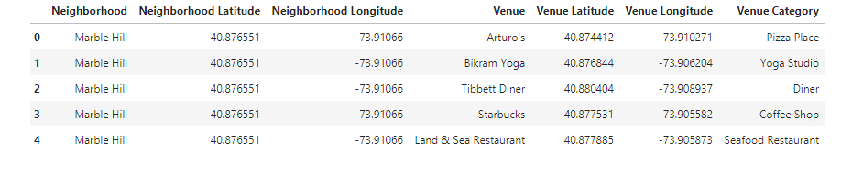
Tools used
Geopy library for spatial data
Foursquare API to explore venues
Folium library for maps
Typical location data in dataframe

Slide 5
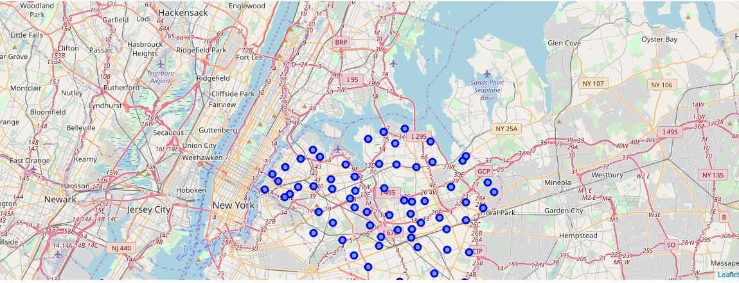
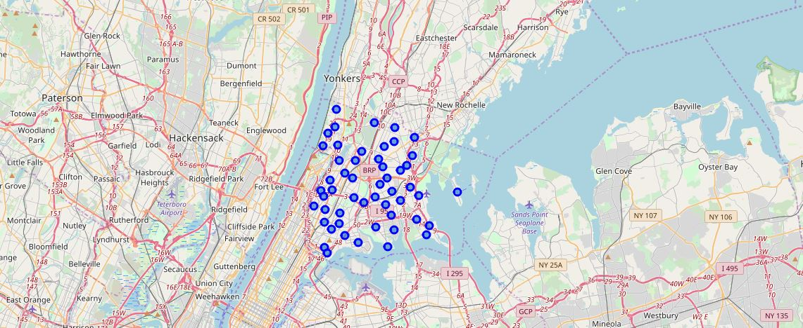
Focus on Queens and Bronx
Visualization of Queens and Bronx
Queens
Bronx

Slide 6
Methodology
Access the New York dataset source
Retrieve the boroughs data
Use geopy library to get spatial data of the neighborhoods of Bronx and Queens
Utilize Foursquare API to explore neighborhoods venues
Generate neighborhoods maps through folium library
Perform data cleaning and preparation i.e. data transformation and exploration
Explore and analyze the neighborhoods of Bronx and Queens
List top three most common business types from both boroughs for recommendation
Use k-Means to cluster the neighborhoods and analyze the resulting clusters
Generating the expected observations and provide concluding remarks

Slide 7
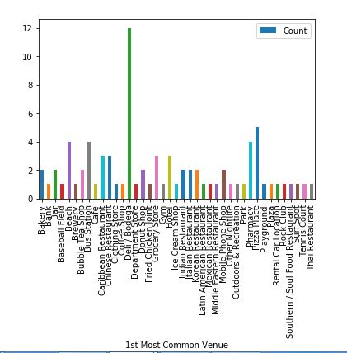
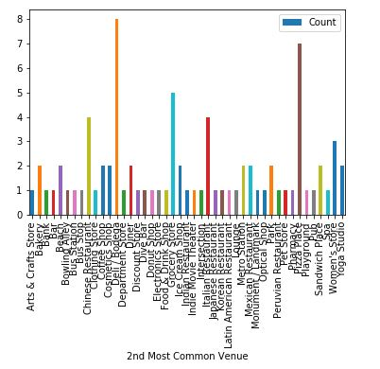
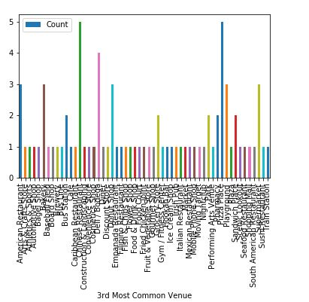
Results of Leading business types in Queens

Slide 8
Summary results of Queens
Level | 1st top most common venues | 2nd top most common venues | 3rd top most common venues
First | Deli/Bodega | Deli/Bodega | Chinese restaurant and Pizza place
Second | Pizza place | Pizza place | Deli/Bodega
Third | Pharmacy | Grocery store | Bakery, Supermarket, and American restaurant

Slide 9
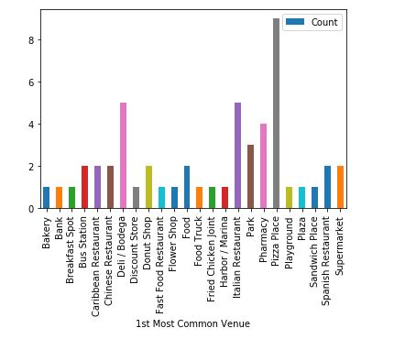
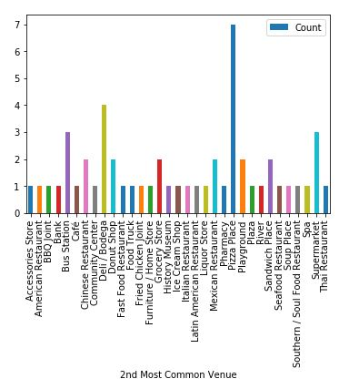
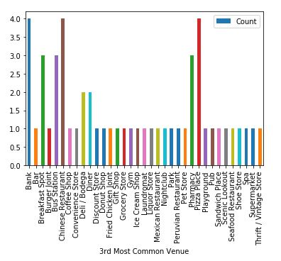
Results of Leading business types in Bronx

Slide 10
Summary results of Bronx
Level | 1st top most common venues | 2nd top most common venues | 3rd top most common venues
First | Pizza place | Pizza place, | Pizza place, Bank and Chinese restaurant
Second | Deli/Bodega and Italian restaurant | Deli/Bodega | Breakfast spot , Pharmacy
Third | Pharmacy | Supermarket | Deli/Bodega and Diner

Slide 11
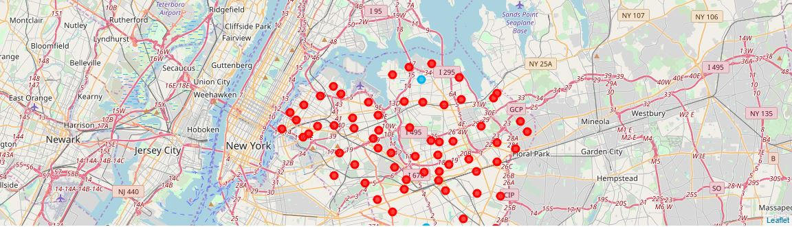
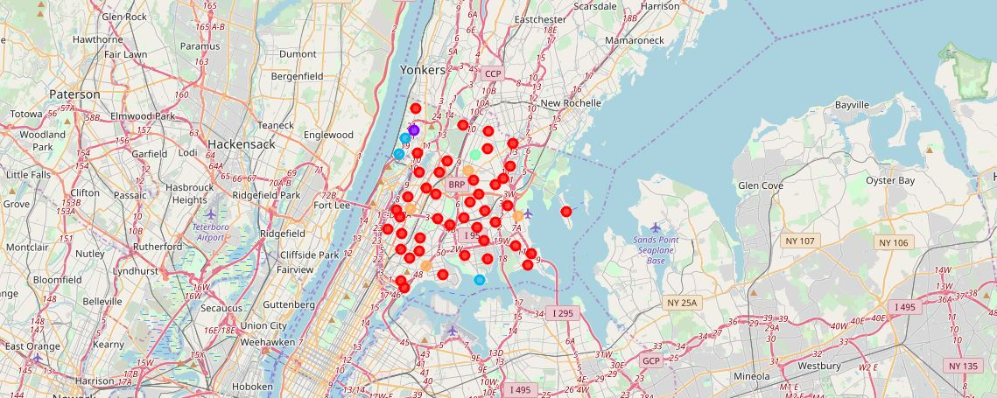
K-means clusters of Bronx and Queens
Queens
Bronx

Slide 12
Final results of recommended business types to start in Queens and Bronx
Level | Queens recommendations | Bronx recommendations
First | Deli/Bodega | Pizza place
Second | Pizza place | Deli/Bodega
Third | Pharmacy/Grocery store/Bakery, Supermarket, and/ American restaurant | Pharmacy/Supermarket and/Diner

Slide 13
Conclusion
One must invest in eatery business types
One can choose from the recommended business types
One can start a similar business type to recommended ones so to suit the market in Queens and Bronx neighborhoods
Chances of success for fast-food businesses in the neighborhoods of Queens and Bronx are high

