Slide 1
12
Setting Product Strategy
1

Slide 2
What is a Product?
A product is anything that can be offered to a market to satisfy a want or need, including physical goods, services, experiences, events, persons, places, properties, organizations, information, and ideas.
Copyright © 2011 Pearson Education, Inc. Publishing as Prentice Hall 12-<number>
Notes:
Marketing planning begins with formulating an offering to meet target customers’ needs or wants. In this chapter we focus on product strategies.

Slide 3
Product Differentiation
Product form
Features
Customization
Performance
Conformance
Durability
Reliability
Repairability
Style
Copyright © 2011 Pearson Education, Inc. Publishing as Prentice Hall 12-<number>
Notes:
Many products can be differentiated in form—the size, shape, or physical structure of a product. Most products can be offered with varying features that supplement their basic function. Marketers can differentiate products by customizing them. Most products occupy one of four performance levels: low, average, high, or superior. Performance quality is the level at which the product’s primary characteristics operate. Buyers expect a high conformance quality, the degree to which all produced units are identical and meet promised specifications. Durability, a measure of the product’s expected operating life under natural or stressful conditions, is a valued attribute for vehicles, kitchen appliances, and other durable goods. Buyers normally will pay a premium for more reliable products. Reliability is a measure of the probability that a product will not malfunction or fail within a specified time period. Repairability measures the ease of fixing a product when it malfunctions or fails. Style describes the product’s look and feel to the buyer. It creates distinctiveness that is hard to copy.

Slide 4
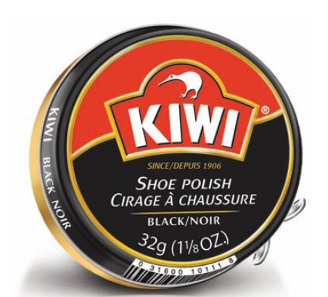
What is the Fifth P?
Packaging, sometimes called the 5th P, is all the activities of designing and producing the container for a product.
Copyright © 2011 Pearson Education, Inc. Publishing as Prentice Hall 12-<number>
Notes:
Many marketers have called packaging a fifth P, along with price, product, place, and promotion. Most, however, treat packaging and labeling as an element of product strategy. Warranties and guarantees can also be an important part of the product strategy and often appear on the package.

Slide 5
Factors Contributing to the
Emphasis on Packaging
Self-service
Consumer affluence
Company/brand image
Innovation opportunity
Copyright © 2011 Pearson Education, Inc. Publishing as Prentice Hall 12-<number>
Notes:
Various factors contribute to the growing use of packaging as a marketing tool.
An increasing number of products are sold on a self-serve basis. In an average supermarket, which may stock 15,000 items, the typical shopper passes some 300 products per minute. Given that 50 percent to 70 percent of all purchases are made in the store, the effective package must perform many sales tasks: attract attention, describe the product’s features, create consumer confidence, and make a favorable overall impression.
Rising affluence means consumers are willing to pay a little more for the convenience, appearance, dependability, and prestige of better packages.
Packages contribute to instant recognition of the company or brand. In the store, they can create a billboard effect, such as Garnier Fructis with its bright green packaging in the hair care aisle.
Unique or innovative packaging such as resealable spouts can bring big benefits to consumers and profits to producers.

Slide 6
Packaging Objectives
Identify the brand
Convey descriptive and persuasive information
Facilitate product transportation and protection
Assist at-home storage
Aid product consumption
Copyright © 2011 Pearson Education, Inc. Publishing as Prentice Hall 12-<number>
Notes:
Packaging must achieve a number of objectives:
1. Identify the brand.
2. Convey descriptive and persuasive information.
3. Facilitate product transportation and protection.
4. Assist at-home storage.
5. Aid product consumption.
To achieve these objectives and satisfy consumers’ desires, marketers must choose the aesthetic and functional components of packaging correctly. Aesthetic considerations relate to a package’s size and shape, material, color, text, and graphics.

Slide 7
Labeling
The label can be a simple attached tag or an elaborately designed graphic that is part of the package.
It might carry a great deal of information, or only the brand name.
Even if the seller prefers a simple label, the law may require more.
Copyright © 2011 Pearson Education, Inc. Publishing as Prentice Hall 12-<number>

Slide 8
Labeling
Sellers must label products
Labels perform several functions:
  The label identifies the product or brand
  The label might also grade the product
  The label might describe the product
  Finally, the label might promote the product through attractive graphics
  Labels eventually need freshening up
Copyright © 2011 Pearson Education, Inc. Publishing as Prentice Hall 12-<number>

