Slide 1
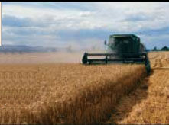
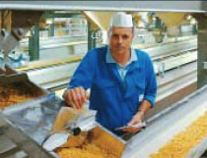


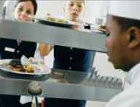

Operations Management
Chapter 16 –
JIT and Lean Operations
PowerPoint presentation to accompany
Heizer/Render
Principles of Operations Management, 7e
Operations Management, 9e

Slide 2
Outline
Global Company Profile:
Toyota Motor Corporation
Just-in-Time, the Toyota Production System, and Lean Operations
  Eliminate Waste
  Remove Variability
  Improve Throughput

Slide 3
Outline – Continued
Just-in-Time
  JIT Partnerships
  Concerns of Suppliers
JIT Layout
  Distance Reduction
  Increased Flexibility
  Impact on Employees
  Reduced Space and Inventory

Slide 4
Outline – Continued
JIT Inventory
  Reduce Variability
  Reduce Inventory
  Reduce Lot Sizes
  Reduce Setup Costs
JIT Scheduling
  Level Schedules
  Kanban

Slide 5
Outline – Continued
JIT Quality
Toyota Production System
  Continuous Improvement
  Respect for People
  Standard Work Practices
Lean Operations
  Building a Lean Organization
Lean Operations in Services

Slide 6
Learning Objectives
When you complete this chapter you should be able to:
Define just-in-time, TPS, and lean operations
Define the seven wastes and the 5 Ss
Explain JIT partnerships
Determine optimal setup time

Slide 7
Learning Objectives
When you complete this chapter you should be able to:
Define kanban
Compute the required number of kanbans
Explain the principles of the Toyota Production System

Slide 8
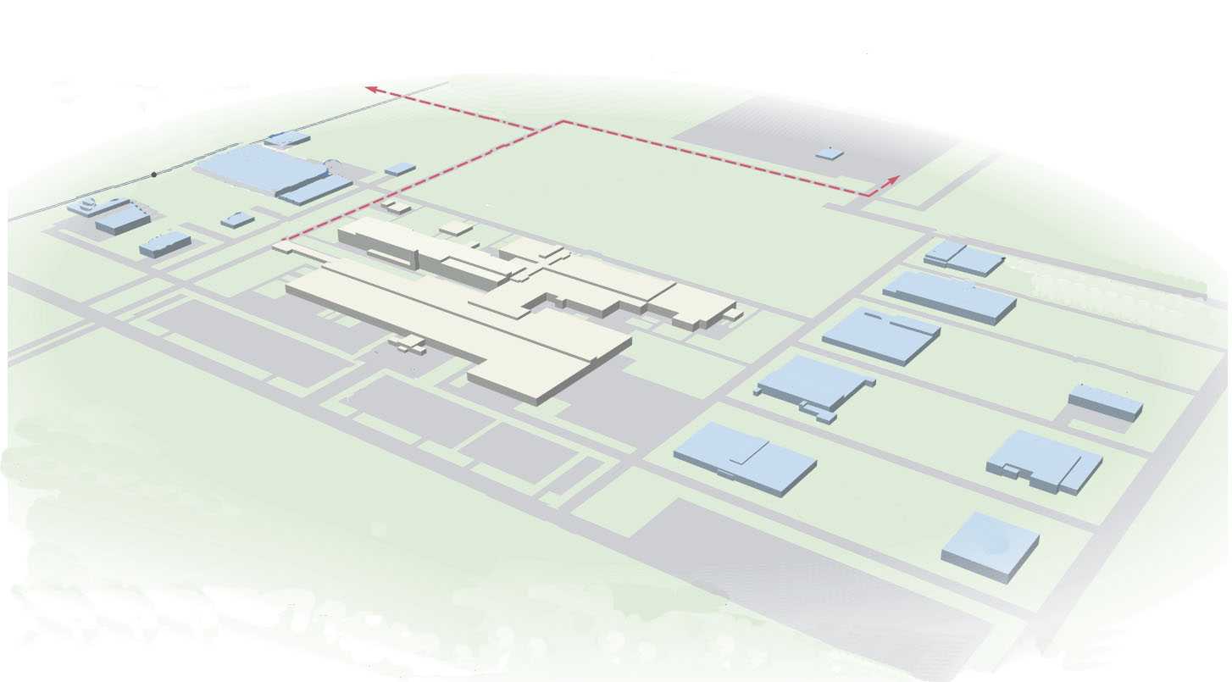
Toyota Motor Corporation
Largest vehicle manufacturer in the world with annual sales of over 9 million vehicles
Success due to two techniques, JIT and TPS
Continual problem solving is central to JIT
Eliminating excess inventory makes problems immediately evident

Slide 9
Toyota Motor Corporation
Central to TPS is a continuing effort to produce products under ideal conditions
Respect for people is fundamental
Small building but high levels of production
Subassemblies are transferred to the assembly line on a JIT basis
High quality and low assembly time per vehicle

Slide 10
Just-In-Time, TPS, and
Lean Operations
JIT is a philosophy of continuous and forced problem solving via a focus on throughput and reduced inventory
TPS emphasizes continuous improvement, respect for people, and standard work practices
Lean production supplies the customer with their exact wants when the customer wants it without waste

Slide 11
Just-In-Time, TPS, and
Lean Operations
JIT emphasizes forced problem solving
TPS emphasizes employee learning and empowerment in an assembly-line environment
Lean operations emphasize understanding the customer

Slide 12
Eliminate Waste
Waste is anything that does not add value from the customer point of view
Storage, inspection, delay, waiting in queues, and defective products do not add value and are 100% waste

Slide 13
Ohno’s Seven Wastes
Overproduction
Queues
Transportation
Inventory
Motion
Overprocessing
Defective products

Slide 14
Eliminate Waste
Other resources such as energy, water, and air are often wasted
Efficient, ethical, and socially responsible production minimizes inputs, reduces waste
Traditional “housekeeping” has been expanded to the 5 Ss

Slide 15
The 5 Ss
Sort/segregate – when in doubt, throw it out
Simplify/straighten – methods analysis tools
Shine/sweep – clean daily
Standardize – remove variations from processes
Sustain/self-discipline – review work and recognize progress

Slide 16
The 5 Ss
Sort/segregate – when in doubt, throw it out
Simplify/straighten – methods analysis tools
Shine/sweep – clean daily
Standardize – remove variations from processes
Sustain/self-discipline – review work and recognize progress
Two additional Ss
Safety – build in good practices
Support/maintenance – reduce variability and unplanned downtime

Slide 17
Remove Variability
JIT systems require managers to reduce variability caused by both internal and external factors
Variability is any deviation from the optimum process
Inventory hides variability
Less variability results in less waste

Slide 18
Sources of Variability
Incomplete or inaccurate drawings or specifications
Poor production processes resulting in incorrect quantities, late, or non-conforming units
Unknown customer demands

Slide 19
Sources of Variability
Incomplete or inaccurate drawings or specifications
Poor production processes resulting in incorrect quantities, late, or non-conforming units
Unknown customer demands
Both JIT and inventory reduction are effective tools in identifying causes of variability

Slide 20
Improve Throughput
The time it takes to move an order from receipt to delivery
The time between the arrival of raw materials and the shipping of the finished order is called manufacturing cycle time
A pull system increases throughput

Slide 21
Improve Throughput
By pulling material in small lots, inventory cushions are removed, exposing problems and emphasizing continual improvement
Manufacturing cycle time is reduced
Push systems dump orders on the downstream stations regardless of the need

Slide 22
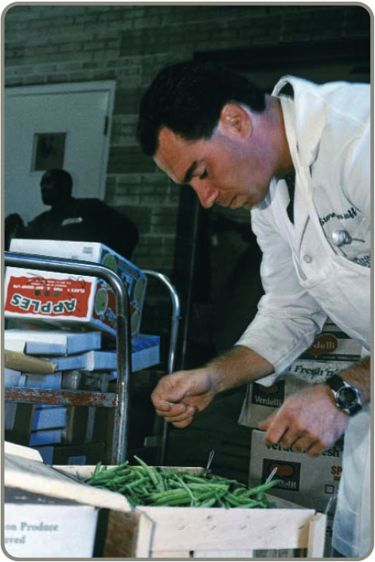
Just-In-Time (JIT)
Powerful strategy for improving operations
Materials arrive where they
are needed when they are
needed
Identifying problems and
driving out waste reduces
costs and variability and
improves throughput
Requires a meaningful
buyer-supplier relationship

Slide 23
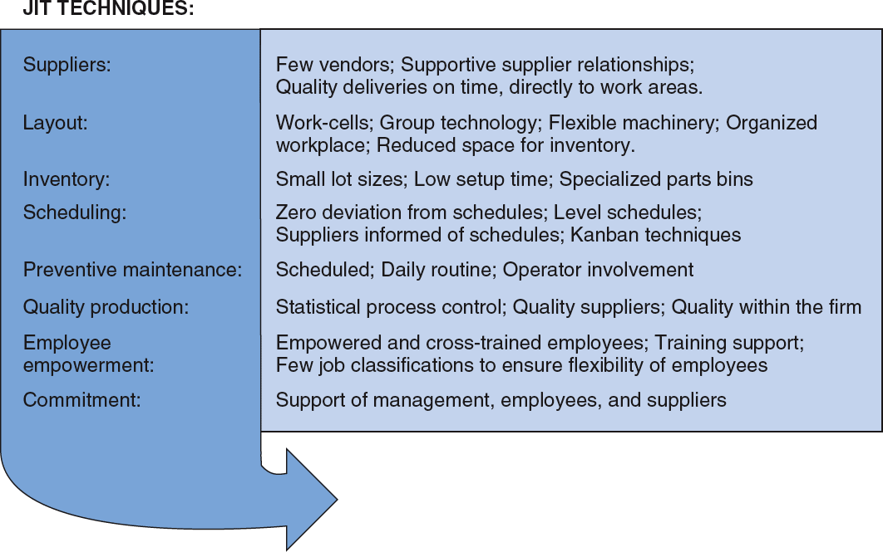
JIT and Competitive Advantage
Figure 16.1

Slide 24
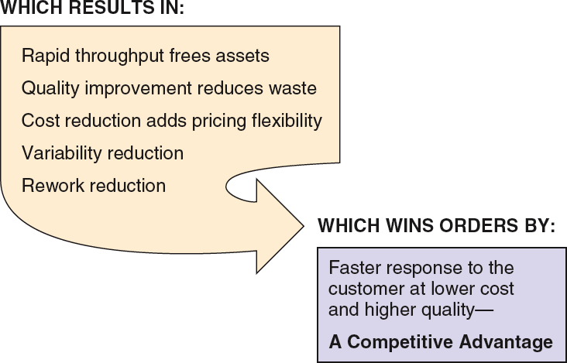
JIT and Competitive Advantage
Figure 16.1

Slide 25
JIT Partnerships
JIT partnerships exist when a supplier and purchaser work together to remove waste and drive down costs
Four goals of JIT partnerships are:
  Removal of unnecessary activities
  Removal of in-plant inventory
  Removal of in-transit inventory
  Improved quality and reliability

Slide 26
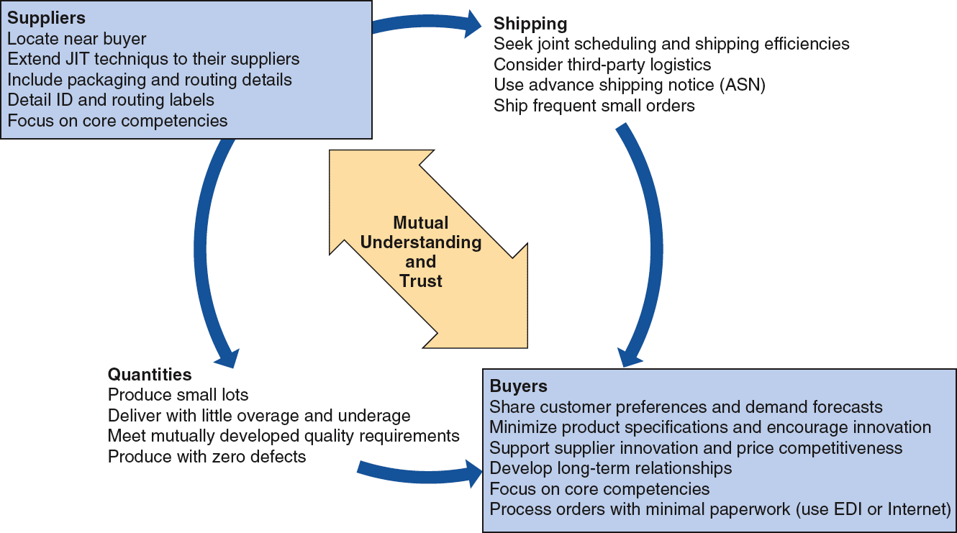
JIT Partnerships
Figure 16.2

Slide 27
Concerns of Suppliers
Diversification – ties to only one customer increases risk
Scheduling – don’t believe customers can create a smooth schedule
Changes – short lead times mean engineering or specification changes can create problems
Quality – limited by capital budgets, processes, or technology
Lot sizes – small lot sizes may transfer costs to suppliers

Slide 28
JIT Layout
Reduce waste due to movement
JIT Layout Tactics
Build work cells for families of products
Include a large number operations in a small area
Minimize distance
Design little space for inventory
Improve employee communication
Use poka-yoke devices
Build flexible or movable equipment
Cross-train workers to add flexibility
Table 16.1

Slide 29
Distance Reduction
Large lots and long production lines with single-purpose machinery are being replaced by smaller flexible cells
Often U-shaped for shorter paths and improved communication
Often using group technology concepts

Slide 30
Increased Flexibility
Cells designed to be rearranged as volume or designs change
Applicable in office environments as well as production settings
Facilitates both product and process improvement

Slide 31
Impact on Employees
Employees are cross trained for flexibility and efficiency
Improved communications facilitate the passing on of important information about the process
With little or no inventory buffer, getting it right the first time is critical

Slide 32
Reduced Space and Inventory
With reduced space, inventory must be in very small lots
Units are always moving because there is no storage

Slide 33
Inventory
Inventory is at the minimum level necessary to keep operations running
JIT Inventory Tactics
Use a pull system to move inventory
Reduce lot sizes
Develop just-in-time delivery systems with suppliers
Deliver directly to point of use
Perform to schedule
Reduce setup time
Use group technology
Table 16.2

Slide 34
Reduce Variability
Inventory level
Process downtime
Scrap
Setup time
Quality problems
Late deliveries
Figure 16.3

Slide 35
Reduce Variability
Inventory level
Process downtime
Scrap
Setup time
Quality problems
Late deliveries
Figure 16.3

Slide 36
Reduce Lot Sizes
200 –
100 –
Q₁ When average order size = 200
average inventory is 100
Inventory
Q₂ When average order size = 100
average inventory is 50
Time
Figure 16.4

Slide 37
Reduce Lot Sizes
Ideal situation is to have lot sizes of one pulled from one process to the next
Often not feasible
Can use EOQ analysis to calculate desired setup time
Two key changes necessary
  Improve material handling
  Reduce setup time

Slide 38
Lot Size Example
D = Annual demand = 400,000 units
d = Daily demand = 400,000/250 = 1,600 per day
p = Daily production rate = 4,000 units
Q = EOQ desired = 400
H = Holding cost = $20 per unit
S = Setup cost (to be determined)
2DS
H(1 - d/p)
2DS
H(1 - d/p)
Q =
Q² =
(Q²)(H)(1 - d/p)
2D
(3,200,000)(0.6)
800,000
S = = = $2.40
Setup time = $2.40/($30/hour) = 0.08 hr = 4.8 minutes

Slide 39
Reduce Setup Costs
High setup costs encourage large lot sizes
Reducing setup costs reduces lot size and reduces average inventory
Setup time can be reduced through preparation prior to shutdown and changeover

Slide 40
Lower Setup Costs
Holding cost
Sum of ordering and holding costs
Cost
T₁
Setup cost curves (S₁, S₂)
T₂
S₁
S₂
Lot size
Figure 16.5

Slide 41
Reduce Setup Times
Initial Setup Time
90 min —
Separate setup into preparation and actual setup, doing as much as possible while the machine/process is operating
(save 30 minutes)
Step 1
60 min —
Move material closer and improve material handling (save 20 minutes)
Step 2
Standardize and improve tooling (save 15 minutes)
45 min —
Step 3
25 min —
Step 4
Use one-touch system to eliminate adjustments (save 10 minutes)
15 min —
Training operators and standardizing work procedures (save 2 minutes)
13 min —
Step 5
Figure 16.6
Step 6
Repeat cycle until subminute setup is achieved
—

Slide 42
JIT Scheduling
Schedules must be communicated inside and outside the organization
Level schedules
  Process frequent small batches
  Freezing the schedule helps stability
Kanban
  Signals used in a pull system

Slide 43
JIT Scheduling
Better scheduling improves performance
JIT Scheduling Tactics
Communicate schedules to suppliers
Make level schedules
Freeze part of the schedule
Perform to schedule
Seek one-piece-make and one-piece move
Eliminate waste
Produce in small lots
Use kanbans
Make each operation produce a perfect part
Table 16.3

Slide 44
Level Schedules
Process frequent small batches rather than a few large batches
Make and move small lots so the level schedule is economical
“Jelly bean” scheduling
Freezing the schedule closest to the due dates can improve performance

Slide 45
Scheduling Small Lots
JIT Level Material-Use Approach
A
A
B
B
B
C
A
A
B
B
B
C
Large-Lot Approach
A
A
A
A
A
A
B
B
B
B
B
B
B
B
B
C
C
C
Time
Figure 16.7

Slide 46
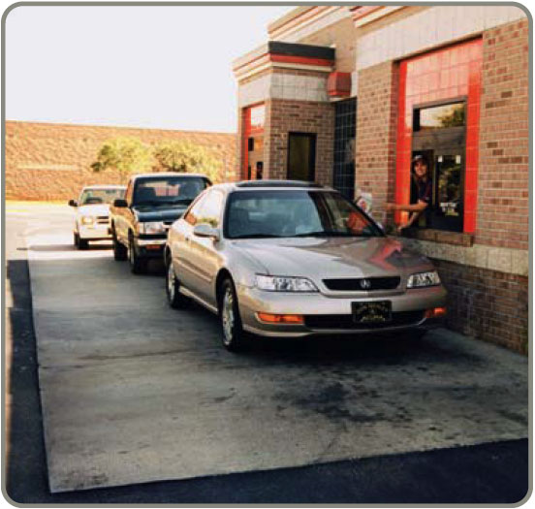
Kanban
Kanban is the Japanese word for card
The card is an authorization for the next container of material to be produced
A sequence of kanbans
pulls material through
the process
Many different sorts of
signals are used, but
the system is still called
a kanban

Slide 47
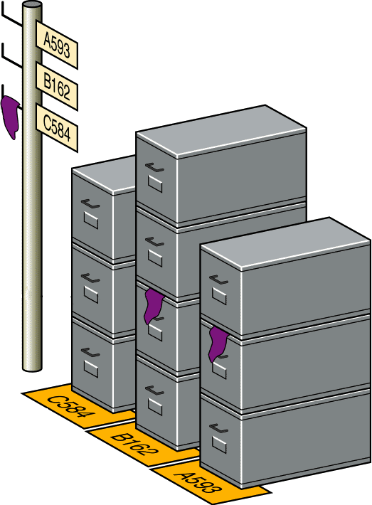
Kanban
User removes a standard sized container
Signal is seen by the producing department as authorization to replenish
Signal marker on boxes
Figure 16.8
Part numbers mark location

Slide 48
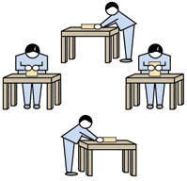
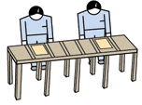

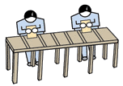
Kanban
Kanban
Finished goods
Customer order
Work cell
Ship
Raw Material Supplier
Kanban
Final assembly
Kanban
Kanban
Kanban
Purchased Parts Supplier
Sub-assembly
Kanban
Figure 16.9

Slide 49
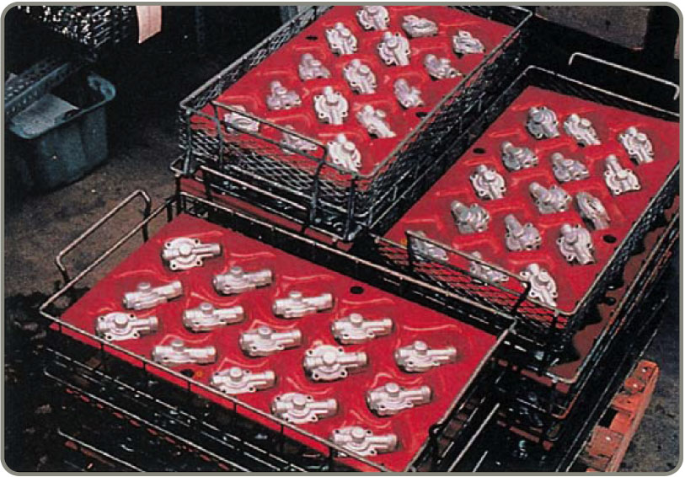
More Kanban
When the producer and user are not in visual contact, a card can be used
When the producer and user are in visual contact, a light or flag or empty spot on the floor may be adequate
Since several
components may
be required,
several different
kanban techniques
may be employed

Slide 50
More Kanban
Usually each card controls a specific quantity or parts
Multiple card systems may be used if there are several components or different lot sizes
In an MRP system, the schedule can be thought of as a build authorization and the kanban a type of pull system that initiates actual production

Slide 51
More Kanban
Kanban cards provide a direct control and limit on the amount of work-in-process between cells
If there is an immediate storage area, a two-card system can be used with one card circulating between the user and storage area and the other between the storage area and the producer

Slide 52
The Number of Kanban Cards or Containers
Need to know the lead time needed to produce a container of parts
Need to know the amount of safety stock needed
Demand during Safety
lead time + stock
Size of container
Number of kanbans
(containers)
=

Slide 53
Number of Kanbans Example
Daily demand = 500 cakes
Production lead time = 2 days
(Wait time +
Material handling time +
Processing time)
Safety stock = 1/2 day
Container size = 250 cakes
Demand during lead time = 2 days x 500 cakes = 1,000
1,000 + 250
250
Number of kanbans = = 5

Slide 54
Advantages of Kanban
Allow only limited amount of faulty or delayed material
Problems are immediately evident
Puts downward pressure on bad aspects of inventory
Standardized containers reduce weight, disposal costs, wasted space, and labor

Slide 55
Quality
Strong relationship
  JIT cuts the cost of obtaining good quality because JIT exposes poor quality
  Because lead times are shorter, quality problems are exposed sooner
  Better quality means fewer buffers and allows simpler JIT systems to be used

Slide 56
JIT Quality Tactics
Use statistical process control
Empower employees
Build fail-safe methods (poka-yoke, checklists, etc.)
Expose poor quality with small lot JIT
Provide immediate feedback
Table 16.4

Slide 57
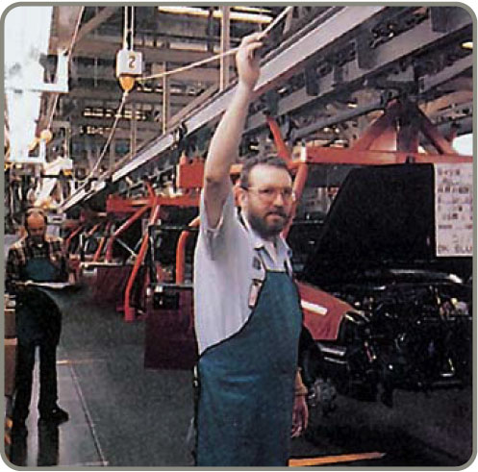
Toyota Production System
Continuous improvement
  Build an organizational culture and value system that stresses improvement of all processes
  Part of everyone’s job
Respect for people
  People are treated as
  knowledge workers
  Engage mental and
  physical capabilities
  Empower employees

Slide 58
Toyota Production System
Standard work practice
  Work shall be completely specified as to content, sequence, timing, and outcome
  Internal and external customer-supplier connection are direct
  Product and service flows must be simple and direct
  Any improvement must be made in accordance with the scientific method at the lowest possible level of the organization

Slide 59
Lean Operations
Different from JIT in that it is externally focused on the customer
Starts with understanding what the customer wants
Optimize the entire process from the customer’s perspective

Slide 60
Building a Lean Organization
Transitioning to a lean system can be difficult
Lean systems tend to have the following attributes
  Use JIT techniques
  Build systems that help employees produce perfect parts
  Reduce space requirements

Slide 61
Building a Lean Organization
Develop partnerships with suppliers
Educate suppliers
Eliminate all but value-added activities
Develop employees
Make jobs challenging
Build worker flexibility

Slide 62
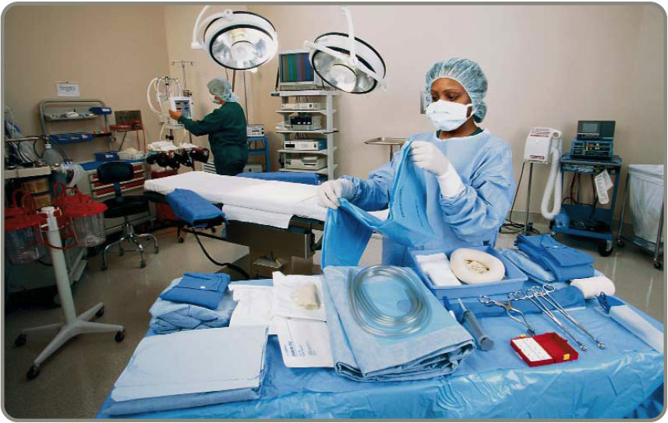
JIT in Services
The JIT techniques used in manufacturing are used in services
  Suppliers
  Layouts
  Inventory
  Scheduling

