Slide 1
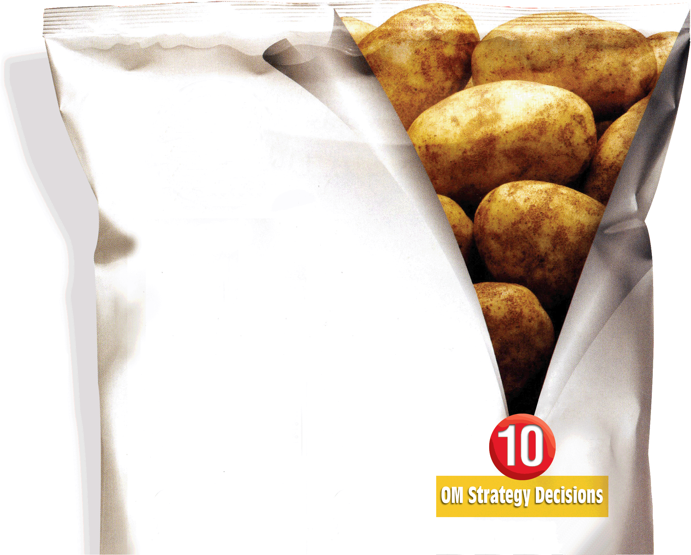

2
The Global Environment and Operations Strategy
PowerPoint presentation to accompany
Heizer and Render
Operations Management, 10e, Global Edition
Principles of Operations Management, 8e, Global Edition
PowerPoint slides by Jeff Heyl

Slide 2
Outline
Global Company Profile: Boeing
A Global View of Operations
  Cultural and Ethical Issues
Developing Missions And Strategies
  Mission
  Strategy

Slide 3
Outline – Continued
Achieving Competitive Advantage Through Operations
  Competing On Differentiation
  Competing On Cost
  Competing On Response
Ten Strategic OM Decisions

Slide 4
Outline – Continued
Strategy Development and Implementation
  Key Success Factors and Core Competencies
  Build and Staff the Organization
  Integrate OM with Other Activities

Slide 5
Outline – Continued
Global Operations Strategy Options
  International Strategy
  Multidomestic Strategy
  Global Strategy
  Transnational Strategy

Slide 6
Learning Objectives
When you complete this chapter you should be able to:
Define mission and strategy
Identify and explain three strategic approaches to competitive advantage
Identify and define the 10 decisions of operations management

Slide 7
Learning Objectives
When you complete this chapter you should be able to:
Understand the significant key success factors and core competencies
Identify and explain four global operations strategy options

Slide 8
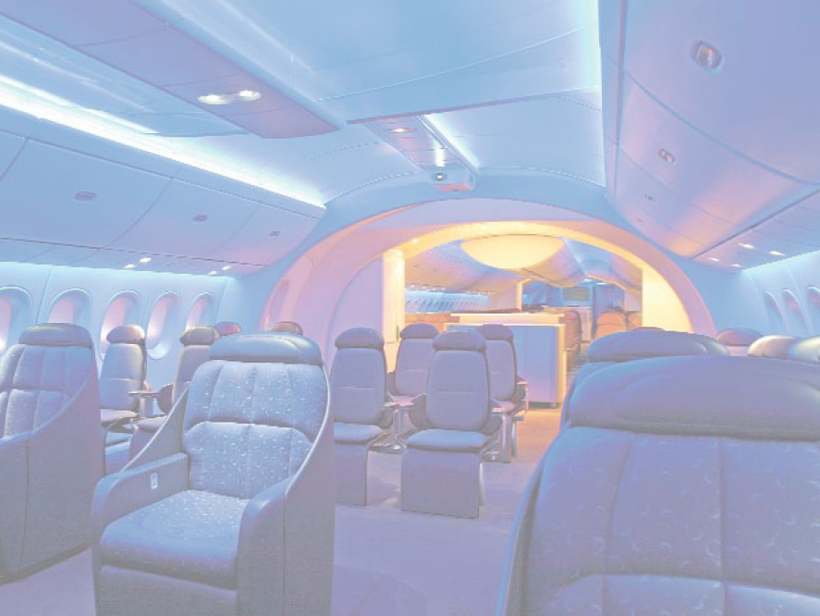
Some Boeing Suppliers (787)
Firm Country Component
Latecoere France Passenger doors
Labinel France Wiring
Dassault France Design and
PLM software
Messier-Bugatti France Electric brakes
Thales France Electrical power
conversion system
and integrated
standby flight display
Messier-Dowty France Landing gear structure
Diehl Germany Interior lighting

Slide 9
Some Boeing Suppliers (787)
Firm Country Component
Cobham UK Fuel pumps and valves
Rolls-Royce UK Engines
Smiths Aerospace UK Central computer
system
BAE SYSTEMS UK Electronics
Alenia Aeronautics Italy Upper center
fuselage &
horizontal stabilizer
Toray Industries Japan Carbon fiber for
wing and tail units

Slide 10
Some Boeing Suppliers (787)
Firm Country Component
Fuji Heavy Japan Center wing box
Industries
Kawasaki Heavy Japan Forward fuselage,
Industries fixed section of wing,
landing gear well
Teijin Seiki Japan Hydraulic actuators
Mitsubishi Heavy Japan Wing box
Industries
Chengdu Aircraft China Rudder
Group
Hafei Aviation China Parts

Slide 11
Some Boeing Suppliers (787)
Firm Country Component
Korean Aviation South Wingtips
Korea
Saab Sweden Cargo access doors

Slide 12
Global Strategies
Boeing – sales and production are worldwide
Benetton – moves inventory to stores around the world faster than its competition by building flexibility into design, production, and distribution
Sony – purchases components from suppliers in Thailand, Malaysia, and around the world

Slide 13
Global Strategies
Volvo – considered a Swedish company but until recently was controlled by an American company, Ford. The current Volvo S40 is built in Belgium and shares its platform with the Mazda 3 built in Japan and the Ford Focus built in Europe.
Haier – A Chinese company, produces compact refrigerators (it has one-third of the US market) and wine cabinets (it has half of the US market) in South Carolina

Slide 14
Growth of World Trade
35 –
30 –
25 –
20 –
15 –
10 –
5 –
0 –
Collapse of the Berlin Wall
Percent
| | | | | | | | | | |
1960 1965 1970 1975 1980 1985 1990 1995 2000 2005 2010 (est*)
Year
Figure 2.1

Slide 15
Some Multinational Corporations
% Sales % Assets
Outside Outside
Home Home Home % Foreign
Company Country Country Country Workforce
Citicorp USA 34 46 NA
Colgate- USA 72 63 NA
Palmolive
Dow USA 60 50 NA
Chemical
Gillette USA 62 53 NA
Honda Japan 63 36 NA
IBM USA 57 47 51
Notes:
This slide can be used to further explore the characteristics of multinational companies

Slide 16
Some Multinational Corporations
% Sales % Assets
Outside Outside
Home Home Home % Foreign
Company Country Country Country Workforce
ICI Britain 78 50 NA
Nestle Switzerland 98 95 97
Philips Netherlands 94 85 82
Electronics
Siemens Germany 51 NA 38
Unilever Britain & 95 70 64
Netherlands

Slide 17
Reasons to Globalize
Reasons to Globalize
Tangible Reasons
Reduce costs (labor, taxes, tariffs, etc.)
Improve supply chain
Provide better goods and services
Understand markets
Learn to improve operations
Attract and retain global talent
Intangible Reasons

Slide 18
Reduce Costs
Foreign locations with lower wage rates can lower direct and indirect costs
  Maquiladoras
  World Trade Organization (WTO)
  North American Free Trade Agreement (NAFTA)
  APEC, SEATO, MERCOSUR, CAFTA
  European Union (EU)

Slide 19
Improve the Supply Chain
Locating facilities closer to unique resources
  Auto design to California
  Athletic shoe production to China
  Perfume manufacturing in France

Slide 20
Provide Better Goods and Services
Objective and subjective characteristics of goods and services
  On-time deliveries
  Cultural variables
  Improved customer service

Slide 21
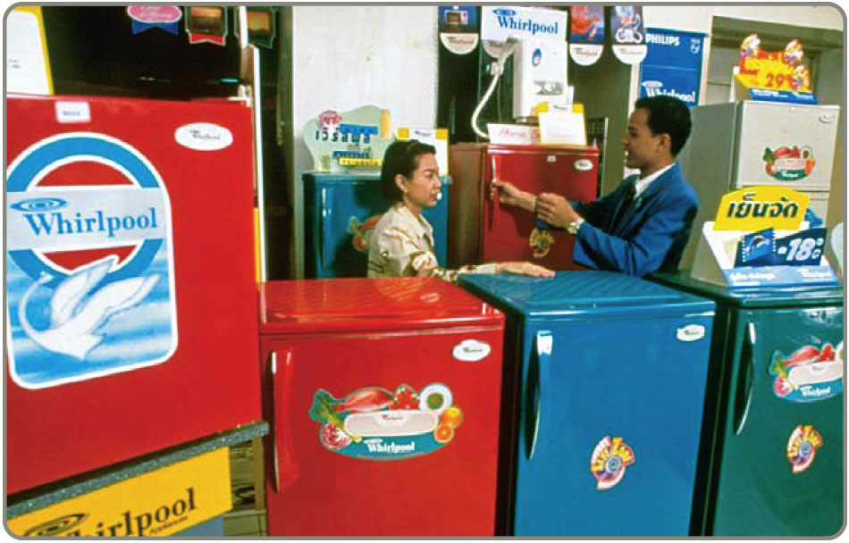
Understand Markets
Interacting with foreign customers and suppliers can lead to new opportunities
  Cell phone
  design from
  Europe
  Cell phone
  fads from
  Japan
  Extend the product life cycle

Slide 22
Learn to Improve Operations
Remain open to the free flow of ideas
  General Motors partnered with a Japanese auto manufacturer to learn new approaches to production and inventory control
  Equipment and layout have been improved using Scandinavian ergonomic competence

Slide 23
Attract and Retain Global Talent
Offer better employment opportunities
  Better growth opportunities and insulation against unemployment
  Relocate unneeded personnel to more prosperous locations

Slide 24
Cultural and Ethical Issues
Cultures can be quite different
Attitudes can be quite different towards
Punctuality
Lunch breaks
Environment
Intellectual
property
Thievery
Bribery
Child labor

Slide 25
Companies Want To Consider
National literacy rate
Rate of innovation
Rate of technology change
Number of skilled workers
Political stability
Product liability laws
Export restrictions
Variations in language
Work ethic
Tax rates
Inflation
Availability of raw materials
Interest rates
Population
Number of miles of highway
Phone system

Slide 26
Match Product & Parent
Braun Household Appliances
Firestone Tires
Godiva Chocolate
Haagen-Dazs Ice Cream
Jaguar Autos
MGM Movies
Lamborghini Autos
Alpo Petfoods
Volkswagen
Bridgestone
Campbell Soup
Tata Motors Limited
Proctor and Gamble
Nestlé
Pillsbury
Sony

Slide 27
Match Product & Parent
Braun Household Appliances
Firestone Tires
Godiva Chocolate
Haagen-Dazs Ice Cream
Jaguar Autos
MGM Movies
Lamborghini Autos
Alpo Petfoods
Volkswagen
Bridgestone
Campbell Soup
Tata Motors Limited
Proctor and Gamble
Nestlé
Pillsbury
Sony

Slide 28
Match Product & Country
Braun Household Appliances
Firestone Tires
Godiva Chocolate
Haagen-Dazs Ice Cream
Jaguar Autos
MGM Movies
Lamborghini Autos
Alpo Pet Foods
Great Britain
Germany
Japan
United States
Switzerland
India

Slide 29
Match Product & Country
Braun Household Appliances
Firestone Tires
Godiva Chocolate
Haagen-Dazs Ice Cream
Jaguar Autos
MGM Movies
Lamborghini Autos
Alpo Pet Foods
Great Britain
Germany
Japan
United States
Switzerland
India

Slide 30
Developing Missions and Strategies
Mission statements tell an organization where it is going
The Strategy tells the organization how to get there

Slide 31

Mission
Mission - where are you going?
  Organization’s purpose for being
  Answers ‘What do we provide society?’
  Provides boundaries and focus

Slide 32
Merck
The mission of Merck is to provide society with superior products and services—innovations and solutions that improve the quality of life and satisfy customer needs—to provide employees with meaningful work and advancement opportunities and investors with a superior rate of return.
Figure 2.2

Slide 33
Hard Rock Cafe
Our Mission: To spread the spirit of Rock ’n’ Roll by delivering an exceptional entertainment and dining experience. We are committed to being an important, contributing member of our community and offering the Hard Rock family a fun, healthy, and nurturing work environment while ensuring our long-term success.
Figure 2.2

Slide 34
Arnold Palmer Hospital
Arnold Palmer Hospital for Children provides state-of-the-art, family centered healthcare focused on restoring the joy of childhood in an environment of compassion, healing, and hope.
Figure 2.2

Slide 35
Factors Affecting Mission
Philosophy and Values
Profitability and Growth
Environment
Mission
Customers
Public Image
Benefit to Society

Slide 36
Sample Missions
Sample Company Mission
To manufacture and service an innovative, growing, and profitable worldwide microwave communications business that exceeds our customers’ expectations.
Sample Operations Management Mission
To produce products consistent with the company’s mission as the worldwide low-cost manufacturer.
Figure 2.3

Slide 37
Sample Missions
Sample OM Department Missions
Product design | To design and produce products and services with outstanding quality and inherent customer value.
Quality management | To attain the exceptional value that is consistent with our company mission and marketing objectives by close attention to design, procurement, production, and field service operations
Process design | To determine, design, and produce the production process and equipment that will be compatible with low-cost product, high quality, and good quality of work life at economical cost.
Figure 2.3

Slide 38
Sample Missions
Sample OM Department Missions
Location | To locate, design, and build efficient and economical facilities that will yield high value to the company, its employees, and the community.
Layout design | To achieve, through skill, imagination, and resourcefulness in layout and work methods, production effectiveness and efficiency while supporting a high quality of work life.
Human resources | To provide a good quality of work life, with well-designed, safe, rewarding jobs, stable employment, and equitable pay, in exchange for outstanding individual contribution from employees at all levels.
Figure 2.3

Slide 39
Sample Missions
Sample OM Department Missions
Supply-chain management | To collaborate with suppliers to develop innovative products from stable, effective, and efficient sources of supply.
Inventory | To achieve low investment in inventory consistent with high customer service levels and high facility utilization.
Scheduling | To achieve high levels of throughput and timely customer delivery through effective scheduling.
Maintenance | To achieve high utilization of facilities and equipment by effective preventive maintenance and prompt repair of facilities and equipment.
Figure 2.3

Slide 40
Strategic Process
Organization’s Mission
Functional Area Missions
Finance/ Accounting
Marketing
Operations

Slide 41

Strategy
Action plan to achieve mission
Functional areas have strategies
Strategies exploit opportunities and strengths, neutralize threats, and avoid weaknesses

Slide 42
Strategies for Competitive Advantage
Differentiation – better, or at least different
Cost leadership – cheaper
Response – rapid response

Slide 43
Competing on Differentiation
Uniqueness can go beyond both the physical characteristics and service attributes to encompass everything that impacts customer’s perception of value
Safeskin gloves – leading edge products
Walt Disney Magic Kingdom – experience differentiation
Hard Rock Cafe – dining experience

Slide 44
Competing on Cost
Provide the maximum value as perceived by customer. Does not imply low quality.
Southwest Airlines – secondary airports, no frills service, efficient utilization of equipment
Wal-Mart – small overhead, shrinkage, distribution costs
Franz Colruyt – no bags, low light, no music, doors on freezers

Slide 45
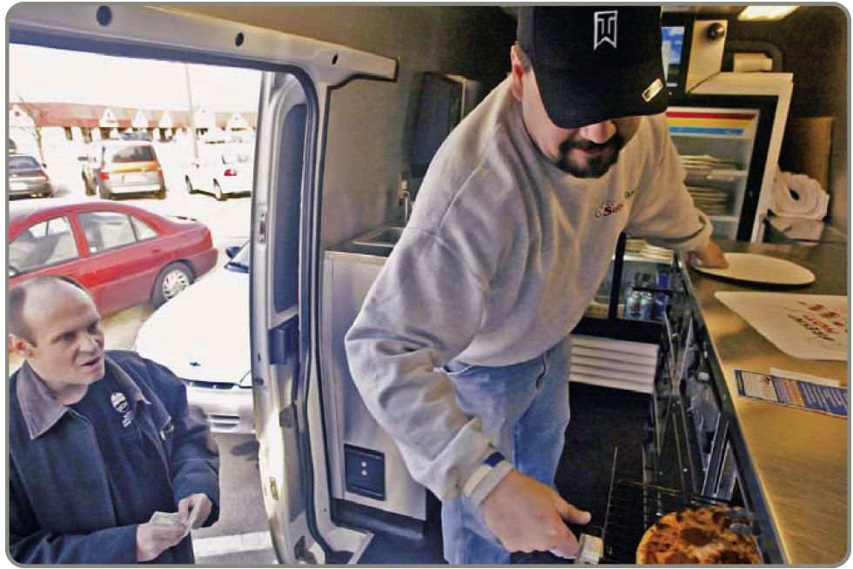
Competing on Response
Flexibility is matching market changes in design innovation and volumes
  A way of life at Hewlett-Packard
Reliability is meeting schedules
  German machine industry
Timeliness is quickness
in design, production,
and delivery
  Johnson Electric,
  Pizza Hut, Motorola

Slide 46
OM’s Contribution to Strategy
10 Operations Competitive
Decisions Approach Example Advantage
Product
Quality
Process
Location
Layout
Human
resource
Supply chain
Inventory
Scheduling
Maintenance
DIFFERENTIATION
Innovative design … Safeskin’s innovative gloves
Broad product line … Fidelity Security’s mutual funds
After-sales service … Caterpillar’s heavy equipment service
Experience … Hard Rock Café’s dining experience
COST LEADERSHIP
Low overhead … Franz-Colruyt’s warehouse-type stores
Effective capacity
use … Southwest Airline’s
aircraft utilization
Inventory
management … Wal Mart’s sophisticated
distribution system
RESPONSE
Flexibility … Hewlett-Packard’s response to volatile world market
Reliability … FedEx’s “absolutely, positively, on time”
Quickness … Pizza Hut’s 5-minute guarantee
at lunchtime
Differentiation
(better)
Response
(faster)
Cost leadership
(cheaper)
Figure 2.4

Slide 47
10 Strategic OM Decisions
Goods and service design
Quality
Process and capacity design
Location selection
Layout design
Human resources and job design
Supply-chain management
Inventory
Scheduling
Maintenance

Slide 48
Goods and Services and the 10 OM Decisions
Operations Decisions | Goods | Services
Goods and service design | Product is usually tangible | Product is not tangible
Quality | Many objective standards | Many subjective standards
Process and capacity design | Customers not involved | Customer may be directly involved Capacity must match demand
Table 2.1

Slide 49
Goods and Services and the 10 OM Decisions
Operations Decisions | Goods | Services
Location selection | Near raw materials and labor | Near customers
Layout design | Production efficiency | Enhances product and production
Human resources and job design | Technical skills, consistent labor standards, output based wages | Interact with customers, labor standards vary
Table 2.1

Slide 50
Goods and Services and the 10 OM Decisions
Operations Decisions | Goods | Services
Supply chain | Relationship critical to final product | Important, but may not be critical
Inventory | Raw materials, work-in-process, and finished goods may be held | Cannot be stored
Scheduling | Level schedules possible | Meet immediate customer demand
Table 2.1

Slide 51
Goods and Services and the 10 OM Decisions
Operations Decisions | Goods | Services
Maintenance | Often preventive and takes place at production site | Often “repair” and takes place at customer’s site
Table 2.1

Slide 52
Managing Global Service Operations
Requires a different perspective on:
Capacity planning
Location planning
Facilities design and layout
Scheduling

Slide 53
Process Design
High
Moderate
Low
Process-focused
JOB SHOPS
(Print shop, emergency room, machine shop, fine-dining
restaurant)
Mass Customization
Customization at high Volume
(Dell Computer’s PC,
cafeteria)
Repetitive (modular) focus
ASSEMBLY LINE
(Cars, appliances, TVs, fast-food restaurants)
Variety of Products
Product focused
CONTINUOUS
(Steel, beer, paper, bread, institutional kitchen)
Low Moderate High
Volume

Slide 54
Operations Strategies of Two Drug Companies
 | Brand Name Drugs, Inc. | Generic Drug Corp.
Competitive Advantage | Product Differentiation | Low Cost
Product Selection and Design | Heavy R&D investment; extensive labs; focus on development in a broad range of drug categories | Low R&D investment; focus on development of generic drugs
Quality | Major priority, exceed regulatory requirements | Meets regulatory requirements on a country by country basis
Table 2.2

Slide 55
Operations Strategies of Two Drug Companies
 | Brand Name Drugs, Inc. | Generic Drug Corp.
Competitive Advantage | Product Differentiation | Low Cost
Process | Product and modular process; long production runs in specialized facilities; build capacity ahead of demand | Process focused; general processes; “job shop” approach, short-run production; focus on high utilization
Location | Still located in the city where it was founded | Recently moved to low-tax, low-labor-cost environment
Table 2.2

Slide 56
Operations Strategies of Two Drug Companies
 | Brand Name Drugs, Inc. | Generic Drug Corp.
Competitive Advantage | Product Differentiation | Low Cost
Scheduling | Centralized production planning | Many short-run products complicate scheduling
Layout | Layout supports automated product-focused production | Layout supports process-focused “job shop” practices
Table 2.2

Slide 57
Operations Strategies of Two Drug Companies
 | Brand Name Drugs, Inc. | Generic Drug Corp.
Competitive Advantage | Product Differentiation | Low Cost
Human Resources | Hire the best; nationwide searches | Very experienced top executives; other personnel paid below industry average
Supply Chain | Long-term supplier relationships | Tends to purchase competitively to find bargains
Table 2.2

Slide 58
Operations Strategies of Two Drug Companies
 | Brand Name Drugs, Inc. | Generic Drug Corp.
Competitive Advantage | Product Differentiation | Low Cost
Inventory | High finished goods inventory to ensure all demands are met | Process focus drives up work-in-process inventory; finished goods inventory tends to be low
Maintenance | Highly trained staff; extensive parts inventory | Highly trained staff to meet changing demand
Table 2.2

Slide 59
Issues In Operations Strategy
Resources view
Value Chain analysis
Porter’s Five Forces model
Operating in a system with many external factors
Constant change

Slide 60
Product Life Cycle
Introduction Growth Maturity Decline
Best period to increase market share
R&D engineering is critical
Practical to change price or quality image
Strengthen niche
Poor time to change image, price, or quality
Competitive costs become critical
Defend market position
Cost control critical
Company Strategy/Issues
Drive-through restaurants
Internet search engines
CD-ROMs
iPods
LCD & plasma TVs
Xbox 360
Sales
Avatars
Boeing 787
Analog TVs
Twitter
Figure 2.5

Slide 61
Product Life Cycle
Introduction Growth Maturity Decline
Product design and development critical
Frequent product and process design changes
Short production runs
High production costs
Limited models
Attention to quality
Forecasting critical
Product and process reliability
Competitive product improvements and options
Increase capacity
Shift toward product focus
Enhance distribution
Standardization
Fewer product changes, more minor changes
Optimum capacity
Increasing stability of process
Long production runs
Product improvement and cost cutting
Little product differentiation
Cost minimization
Overcapacity in the industry
Prune line to eliminate items not returning good margin
Reduce capacity
OM Strategy/Issues
Figure 2.5

Slide 62
SWOT Analysis
Mission
Internal Strengths
External Opportunities
Analysis
Internal Weaknesses
External Threats
Strategy

Slide 63
Strategy Development Process
Analyze the Environment
Identify the strengths, weaknesses, opportunities, and threats. Understand the environment, customers, industry, and competitors.
Determine the Corporate Mission
State the reason for the firm’s existence and identify the value it wishes to create.
Form a Strategy
Build a competitive advantage, such as low price, design, or volume flexibility, quality, quick delivery, dependability, after-sale service, broad product lines.
Figure 2.6

Slide 64
Strategy Development and Implementation
Identify key success factors
Build and staff the organization
Integrate OM with other activities
The operations manager’s job is to implement an OM strategy, provide competitive advantage, and increase productivity

Slide 65
Key Success Factors
Support a Core Competence and Implement Strategy by
Identifying and Executing the Key Success Factors in the Functional Areas
Marketing
Service Distribution Promotion Channels of distribution Product positioning (image, functions)
Finance/Accounting
Leverage Cost of capital Working capital Receivables Payables Financial control Lines of credit
Production/Operations
Decisions | Sample Options | Chapter
Product Quality Process Location Layout Human resource Supply chain Inventory Schedule Maintenance | Customized, or standardized Define customer expectations and how to achieve them Facility size, technology, capacity Near supplier or near customer Work cells or assembly line Specialized or enriched jobs Single or multiple suppliers When to reorder, how much to keep on hand Stable or fluctuating production rate Repair as required or preventive maintenance | 5 6, S6 7, S7 8 9 10 11, S11 12, 14, 16 13, 15 17
Figure 2.7

Slide 66
Activity Mapping at
Southwest Airlines
Courteous, but Limited Passenger Service
Lean, Productive Employees
Short Haul, Point-to-Point Routes, Often to Secondary Airports
Competitive Advantage:
Low Cost
High Aircraft Utilization
Frequent, Reliable Schedules
Standardized Fleet of Boeing 737 Aircraft
Figure 2.8

Slide 67
Activity Mapping at
Southwest Airlines
Courteous, but Limited Passenger Service
Lean, Productive Employees
Short Haul, Point-to-Point Routes, Often to Secondary Airports
Automated ticketing machines
No seat assignments
No baggage transfers
No meals (peanuts)
Competitive Advantage:
Low Cost
High Aircraft Utilization
Frequent, Reliable Schedules
Standardized Fleet of Boeing 737 Aircraft
Figure 2.8

Slide 68
Activity Mapping at
Southwest Airlines
Courteous, but Limited Passenger Service
No meals (peanuts)
Lower gate costs at secondary airports
High number of flights reduces employee idle time between flights
Lean, Productive Employees
Short Haul, Point-to-Point Routes, Often to Secondary Airports
Competitive Advantage:
Low Cost
High Aircraft Utilization
Frequent, Reliable Schedules
Standardized Fleet of Boeing 737 Aircraft
Figure 2.8

Slide 69
Activity Mapping at
Southwest Airlines
High number of flights reduces employee idle time between flights
Saturate a city with flights, lowering administrative costs (advertising, HR, etc.) per passenger for that city
Pilot training required on only one type of aircraft
Reduced maintenance inventory required because of only one type of aircraft
Courteous, but Limited Passenger Service
Lean, Productive Employees
Short Haul, Point-to-Point Routes, Often to Secondary Airports
Competitive Advantage:
Low Cost
High Aircraft Utilization
Frequent, Reliable Schedules
Standardized Fleet of Boeing 737 Aircraft
Figure 2.8

Slide 70
Activity Mapping at
Southwest Airlines
Pilot training required on only one type of aircraft
Reduced maintenance inventory required because of only one type of aircraft
Excellent supplier relations with Boeing has aided financing
Courteous, but Limited Passenger Service
Lean, Productive Employees
Short Haul, Point-to-Point Routes, Often to Secondary Airports
Competitive Advantage:
Low Cost
High Aircraft Utilization
Frequent, Reliable Schedules
Standardized Fleet of Boeing 737 Aircraft
Figure 2.8

Slide 71
Activity Mapping at
Southwest Airlines
Courteous, but Limited Passenger Service
Reduced maintenance inventory required because of only one type of aircraft
Flexible employees and standard planes aid scheduling
Maintenance personnel trained only one type of aircraft
20-minute gate turnarounds
Lean, Productive Employees
Short Haul, Point-to-Point Routes, Often to Secondary Airports
Flexible union contracts
Competitive Advantage:
Low Cost
High Aircraft Utilization
Frequent, Reliable Schedules
Standardized Fleet of Boeing 737 Aircraft
Figure 2.8

Slide 72
Activity Mapping at
Southwest Airlines
Automated ticketing machines
Empowered employees
High employee compensation
Hire for attitude, then train
High level of stock ownership
High number of flights reduces employee idle time between flights
Courteous, but Limited Passenger Service
Lean, Productive Employees
Short Haul, Point-to-Point Routes, Often to Secondary Airports
Competitive Advantage:
Low Cost
High Aircraft Utilization
Frequent, Reliable Schedules
Standardized Fleet of Boeing 737 Aircraft
Figure 2.8

Slide 73
Four International Operations Strategies
High
International
Strategy
Figure 2.9
Import/export or license existing product
Examples
U.S. Steel
Harley Davidson
Cost Reduction Considerations
Low
Low
High
Local Responsiveness Considerations
(Quick Response and/or Differentiation)

Slide 74
Four International Operations Strategies
High
Figure 2.9
Cost Reduction Considerations
International Strategy
Import/export or license existing product
Examples
U.S. Steel
Harley Davidson
Low
Low
High
Local Responsiveness Considerations
(Quick Response and/or Differentiation)

Slide 75
Four International Operations Strategies
Global
Strategy
High
Figure 2.9
Standardized product
Economies of scale
Cross-cultural learning
Examples
Texas Instruments
Caterpillar
Otis Elevator
Cost Reduction Considerations
International Strategy
Import/export or license existing product
Examples
U.S. Steel
Harley Davidson
Low
Low
High
Local Responsiveness Considerations
(Quick Response and/or Differentiation)

Slide 76
Four International Operations Strategies
High
Figure 2.9
Global Strategy
Standardized product
Economies of scale
Cross-cultural learning
Examples:
Texas Instruments
Caterpillar
Otis Elevator
Cost Reduction Considerations
International Strategy
Import/export or license existing product
Examples
U.S. Steel
Harley Davidson
Low
Low
High
Local Responsiveness Considerations
(Quick Response and/or Differentiation)

Slide 77
Four International Operations Strategies
Multidomestic
Strategy
High
Figure 2.9
Use existing domestic model globally
Franchise, joint ventures, subsidiaries
Examples
Heinz
McDonald’s
The Body Shop
Hard Rock Cafe
Global Strategy
Standardized product
Economies of scale
Cross-cultural learning
Examples:
Texas Instruments
Caterpillar
Otis Elevator
Cost Reduction Considerations
International Strategy
Import/export or license existing product
Examples
U.S. Steel
Harley Davidson
Low
Low
High
Local Responsiveness Considerations
(Quick Response and/or Differentiation)

Slide 78
Four International Operations Strategies
High
Figure 2.9
Global Strategy
Standardized product
Economies of scale
Cross-cultural learning
Examples:
Texas Instruments
Caterpillar
Otis Elevator
Cost Reduction Considerations
International Strategy
Multidomestic Strategy
Use existing
domestic model globally
Franchise, joint ventures,
subsidiaries
Examples
Heinz The Body Shop
McDonald’s Hard Rock Cafe
Import/export or license existing product
Examples
U.S. Steel
Harley Davidson
Low
Low
High
Local Responsiveness Considerations
(Quick Response and/or Differentiation)

Slide 79
Four International Operations Strategies
Transnational
Strategy
High
Figure 2.9
Global Strategy
Move material, people, ideas across national boundaries
Economies of scale
Cross-cultural learning
Examples
Coca-Cola
Nestlé
Standardized product
Economies of scale
Cross-cultural learning
Examples:
Texas Instruments
Caterpillar
Otis Elevator
Cost Reduction Considerations
International Strategy
Multidomestic Strategy
Use existing
domestic model globally
Franchise, joint ventures,
subsidiaries
Examples
Heinz The Body Shop
McDonald’s Hard Rock Cafe
Import/export or license existing product
Examples
U.S. Steel
Harley Davidson
Low
Low
High
Local Responsiveness Considerations
(Quick Response and/or Differentiation)

Slide 80
Four International Operations Strategies
High
Figure 2.9
Global Strategy
Transnational Strategy
Standardized product
Economies of scale
Cross-cultural learning
Examples:
Texas Instruments
Caterpillar
Otis Elevator
Move material, people, ideas across national boundaries
Economies of scale
Cross-cultural learning
Examples
Coca-Cola
Nestlé
Cost Reduction Considerations
International Strategy
Multidomestic Strategy
Use existing
domestic model globally
Franchise, joint ventures,
subsidiaries
Examples
Heinz The Body Shop
McDonald’s Hard Rock Cafe
Import/export or license existing product
Examples
U.S. Steel
Harley Davidson
Low
Low
High
Local Responsiveness Considerations
(Quick Response and/or Differentiation)

Slide 81
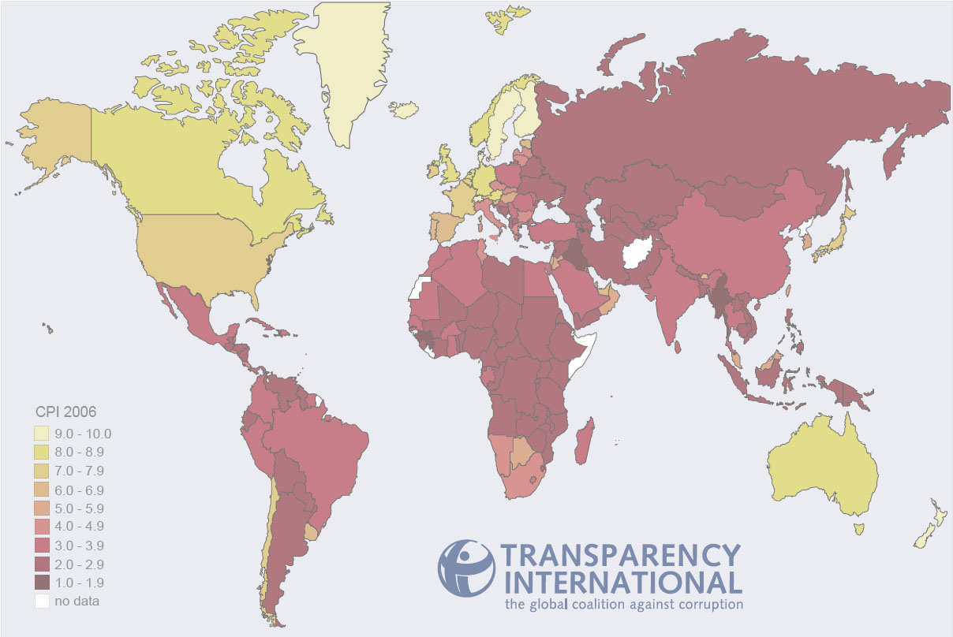
Ranking Corruption
Rank Country 2009 CPI Score (out of 10)
1 New Zealand 9.4
2 Demark 9.3
3 Singapore, Sweden 9.2
5 Switzerland 9.0
8 Australia, Canada, Iceland 8.7
12 Hong Kong 8.2
14 Germany 8.0
17 Japan, UK 7.7
19 USA 7.5
37 Taiwan 5.6
39 South Korea 5.5
56 Malaysia 4.5
79 China 3.6
89 Mexico 3.3
146 Russia 2.2
Least Corrupt
Most Corrupt
Notes:
CPI is the Corrupt Perceptions Index calculated by Transparency International, an organization dedicated to fighting business corruption. The Index is calculated from up to 13 different individual scores. For details and the methodology, see www.transparency.org.
In case students are interested, the country with the lowest score in the 2006 survey was Haiti with a score of 1.8 out of 10.

Slide 82

All rights reserved. No part of this publication may be reproduced, stored in a retrieval system, or transmitted, in any form or by any means, electronic, mechanical, photocopying, recording, or otherwise, without the prior written permission of the publisher.
Printed in the United States of America.

