Slide 1
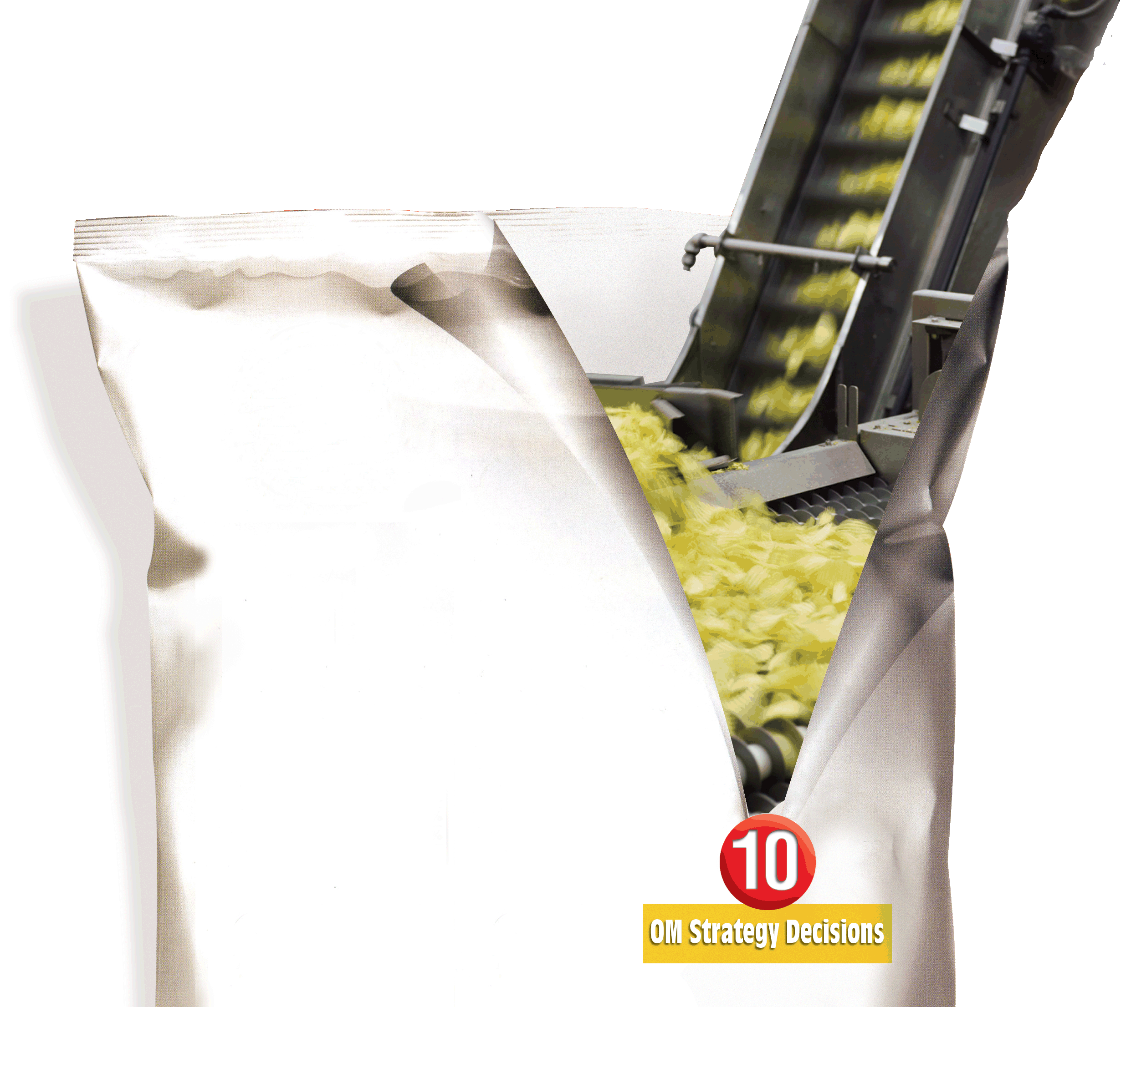

5
Product Design
PowerPoint presentation to accompany
Heizer and Render
Operations Management, 10e, Global Edition
Principles of Operations Management, 8e, Global Edition
PowerPoint slides by Jeff Heyl

Slide 2
Outline
Global Company Profile: Regal Marine
Goods and Services Selection
  Product Strategy Options Support Competitive Advantage
  Product Life Cycles
  Life Cycle and Strategy
  Product-by-Value Analysis

Slide 3
Outline - Continued
Generating New Products
  New Product Opportunities
  Importance of New Products
Product Development
  Product Development System
  Quality Function Deployment (QFD)
  Organizing for Product Development
  Manufacturability and Value Engineering

Slide 4
Outline - Continued
Issues for Product Design
  Robust Design
  Modular Design
  Computer-Aided Design (CAD)
  Computer-Aided Manufacturing (CAM)
  Virtual Reality Technology
  Value Analysis

Slide 5
Outline - Continued
Ethics, Environmentally Friendly Design, and Sustainability
  Systems and Life Cycle Perspectives
  Laws and Industry Standards
Time-Based Competition
  Purchasing Technology by Acquiring a Firm
  Joint Ventures
  Alliances

Slide 6
Outline - Continued
Defining a Product
  Make-or-Buy Decisions
  Group Technology
Documents For Production
  Product Life-Cycle Management (PLM)
Service Design
  Documents for Services

Slide 7
Outline - Continued
Application of Decision Trees to Product Design
Transition to Production

Slide 8
Learning Objectives
When you complete this chapter you should be able to :
Define product life cycle
Describe a product development system
Build a house of quality
Describe how time-based competition is implemented

Slide 9
Learning Objectives
When you complete this chapter you should be able to :
Describe how products and services are defined by operations management
Describe the documents needed for production
Describe customer participation in the design and production of services
Apply decision trees to product issues

Slide 10
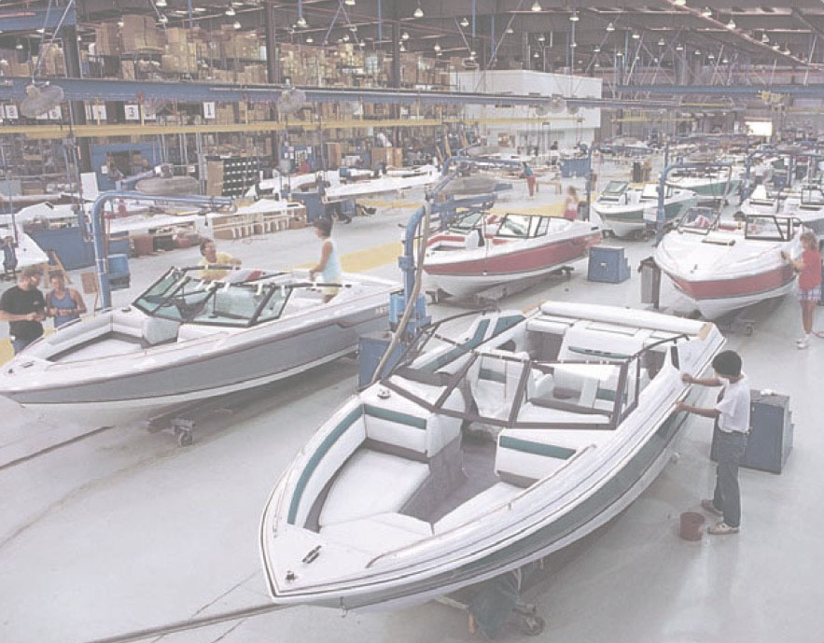
Regal Marine
Global market
3-dimensional CAD system
  Reduced product development time
  Reduced problems with tooling
  Reduced problems in production
Assembly line production
JIT

Slide 11
Product Decision
The objective of the product decision is to develop and implement a product strategy that meets the demands of the marketplace with a competitive advantage

Slide 12
Product Decision
The good or service the organization provides society
Top organizations typically focus on core products
Customers buy satisfaction, not just a physical good or particular service
Fundamental to an organization's strategy with implications throughout the operations function

Slide 13
Product Strategy Options
Differentiation
  Shouldice Hospital
Low cost
  Taco Bell
Rapid response
  Toyota

Slide 14
Product Life Cycles
May be any length from a few hours to decades
The operations function must be able to introduce new products successfully

Slide 15
Product Life Cycles
Cost of development and production
Sales revenue
Net revenue (profit)
Sales, cost, and cash flow
Cash flow
Negative cash flow
Loss
Introduction Growth Maturity Decline
Figure 5.1

Slide 16
Product Life Cycle
Introductory Phase
Fine tuning may warrant unusual expenses for
  Research
  Product development
  Process modification and enhancement
  Supplier development

Slide 17
Product Life Cycle
Growth Phase
Product design begins to stabilize
Effective forecasting of capacity becomes necessary
Adding or enhancing capacity may be necessary

Slide 18
Product Life Cycle
Maturity Phase
Competitors now established
High volume, innovative production may be needed
Improved cost control, reduction in options, paring down of product line

Slide 19
Product Life Cycle
Decline Phase
Unless product makes a special contribution to the organization, must plan to terminate offering

Slide 20
Product Life Cycle Costs
100 –
80 –
60 –
40 –
20 –
0 –
Costs committed
Costs incurred
Percent of total cost
Ease of change
Concept Detailed Manufacturing Distribution,
design design service,
prototype and disposal

Slide 21
Product-by-Value Analysis
Lists products in descending order of their individual dollar contribution to the firm
Lists the total annual dollar contribution of the product
Helps management evaluate alternative strategies

Slide 22
Product-by-Value Analysis
Sam’s Furniture Factory
 | Individual Contribution ($) | Total Annual Contribution ($)
Love Seat | $102 | $36,720
Arm Chair | $87 | $51,765
Foot Stool | $12 | $6,240
Recliner | $136 | $51,000

Slide 23
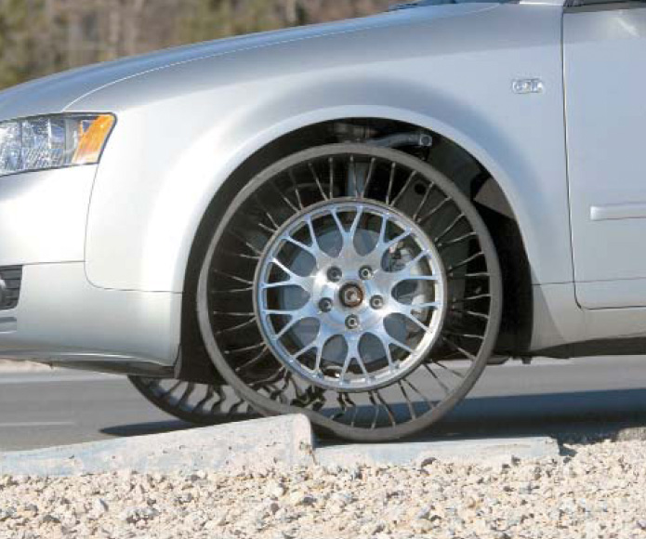
New Product Opportunities
Understanding the
customer
Economic change
Sociological and
demographic change
Technological change
Political/legal change
Market practice, professional standards, suppliers, distributors
Brainstorming is a useful tool

Slide 24
Importance of New Products
50%
40%
30%
20%
10%
Percentage of Sales from New Products
Industry leader
Top third
Middle third
Bottom third
Position of Firm in Its Industry
Figure 5.2a

Slide 25
Disney Attendance
50
40
30
20
10
0
Magic Kingdom
Epcot
Figure 5.2b
Disney-Hollywood
Animal Kingdom
Millions of visitors
‘93 ‘95 ‘97 ‘99 ‘01 ‘03 ‘05 ‘07

Slide 26
Cisco Product Revenue
35
30
25
20
15
10
5
0
Other
Figure 5.2c
Switches
Routers
Billions of dollars
‘02 ‘03 ‘04 ‘05 ‘06 ’07 ‘08

Slide 27
Product Development System
Ideas
Ability
Figure 5.3
Customer Requirements
Functional Specifications
Product Specifications
Scope for design and engineering teams
Scope of product development team
Design Review
Test Market
Introduction
Evaluation

Slide 28
Quality Function Deployment
Identify customer wants
Identify how the good/service will satisfy customer wants
Relate customer wants to product hows
Identify relationships between the firm’s hows
Develop importance ratings
Evaluate competing products
Compare performance to desirable technical attributes

Slide 29
QFD House of Quality
Interrelationships
Customer importance ratings
How to satisfy
customer wants
What the customer
wants
Relationship
matrix
Competitive assessment
Target values
Weighted rating
Technical
evaluation
Notes:
1

Slide 30
House of Quality Example
Your team has been charged with designing a new camera for Great Cameras, Inc.
The first action is
to construct a
House of Quality

Slide 31
House of Quality Example
Interrelationships
How to Satisfy
Customer Wants
What the Customer
Wants
Relationship
Matrix
Analysis of
Competitors
What the customer wants
Technical
Attributes and
Evaluation
Customer
importance
rating
(5 = highest)
Lightweight 3
Easy to use 4
Reliable 5
Easy to hold steady 2
Color correction 1

Slide 32
House of Quality Example
Interrelationships
How to Satisfy
Customer Wants
What the Customer
Wants
Relationship
Matrix
Analysis of
Competitors
Technical
Attributes and
Evaluation
Low electricity requirements
Aluminum components
Auto focus
Auto exposure
Paint pallet
Ergonomic design
How to Satisfy
Customer Wants

Slide 33
House of Quality Example
Interrelationships
How to Satisfy
Customer Wants
What the Customer
Wants
Relationship
Matrix
Analysis of
Competitors
High relationship
Medium relationship
Low relationship
Technical
Attributes and
Evaluation
Lightweight 3
Easy to use 4
Reliable 5
Easy to hold steady 2
Color corrections 1
Relationship matrix

Slide 34
House of Quality Example
Interrelationships
How to Satisfy
Customer Wants
What the Customer
Wants
Relationship
Matrix
Analysis of
Competitors
Technical
Attributes and
Evaluation
Relationships between the things we can do
Low electricity requirements
Aluminum components
Auto focus
Auto exposure
Paint pallet
Ergonomic design

Slide 35
House of Quality Example
Interrelationships
How to Satisfy
Customer Wants
What the Customer
Wants
Relationship
Matrix
Analysis of
Competitors
Technical
Attributes and
Evaluation
Lightweight 3
Easy to use 4
Reliable 5
Easy to hold steady 2
Color corrections 1
Our importance ratings 22 9 27 27 32 25
Weighted rating

Slide 36
House of Quality Example
Interrelationships
How to Satisfy
Customer Wants
What the Customer
Wants
Relationship
Matrix
Analysis of
Competitors
Technical
Attributes and
Evaluation
Company A
Company B
How well do competing products meet customer wants
Lightweight 3
Easy to use 4
Reliable 5
Easy to hold steady 2
Color corrections 1
G P
G P
F G
G P
P P
Our importance ratings 22 5

Slide 37
House of Quality Example
Interrelationships
How to Satisfy
Customer Wants
What the Customer
Wants
Relationship
Matrix
Analysis of
Competitors
0.5 A
75%
2’ to ∞
2 circuits
Failure 1 per 10,000
Panel ranking
Technical
Attributes and
Evaluation
Target values
(Technical attributes)
Company A 0.7 60% yes 1 ok G
Company B 0.6 50% yes 2 ok F
Us 0.5 75% yes 2 ok G
Technical evaluation

Slide 38
House of Quality Example
Low electricity requirements
Aluminum components
Auto focus
Auto exposure
Paint pallet
Ergonomic design
Company A
Company B
Completed House of Quality
Lightweight 3
Easy to use 4
Reliable 5
Easy to hold steady 2
Color correction 1
Our importance ratings
G P
G P
F G
G P
P P
22 9 27 27 32 25
0.5 A
75%
2’ to ∞
2 circuits
Failure 1 per 10,000
Panel ranking
Target values
(Technical attributes)
Company A 0.7 60% yes 1 ok G
Company B 0.6 50% yes 2 ok F
Us 0.5 75% yes 2 ok G
Technical evaluation

Slide 39
House of Quality Sequence
Deploying resources through the organization in response to customer requirements
Quality plan
Production process
Specific components
Production process
House 4
Design characteristics
Specific components
House 3
Design characteristics
House 2
Customer requirements
House 1
Figure 5.4

Slide 40
Organizing for Product Development
Historically – distinct departments
  Duties and responsibilities are defined
  Difficult to foster forward thinking
A Champion
  Product manager drives the product through the product development system and related organizations

Slide 41
Organizing for Product Development
Team approach
  Cross functional – representatives from all disciplines or functions
  Product development teams, design for manufacturability teams, value engineering teams
Japanese “whole organization” approach
  No organizational divisions

Slide 42
Manufacturability and
Value Engineering
Benefits:
  Reduced complexity of products
  Reduction of environmental impact
  Additional standardization of products
  Improved functional aspects of product
  Improved job design and job safety
  Improved maintainability (serviceability) of the product
  Robust design

Slide 43
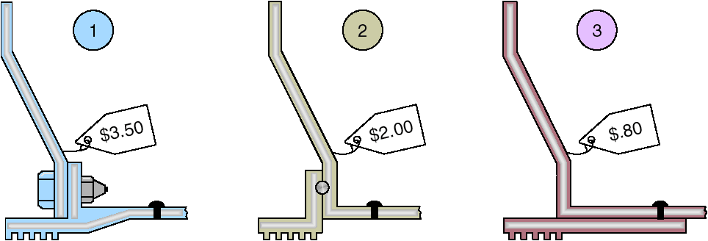
Cost Reduction of a Bracket via Value Engineering
Figure 5.5

Slide 44
Issues for Product Development
Robust design
Modular design
Computer-aided design (CAD)
Computer-aided manufacturing (CAM)
Virtual reality technology
Value analysis
Environmentally friendly design

Slide 45
Robust Design
Product is designed so that small variations in production or assembly do not adversely affect the product
Typically results in lower cost and higher quality

Slide 46
Modular Design
Products designed in easily segmented components
Adds flexibility to both production and marketing
Improved ability to satisfy customer requirements

Slide 47
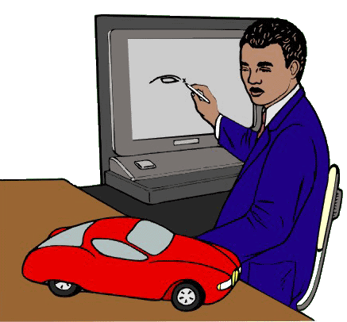
Computer Aided Design (CAD)
Using computers to design products and prepare engineering documentation
Shorter development cycles, improved accuracy, lower cost
Information and designs can be deployed worldwide

Slide 48
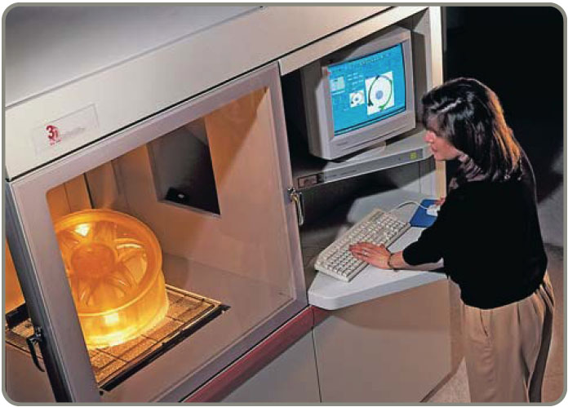
Extensions of CAD
Design for Manufacturing and Assembly (DFMA)
  Solve manufacturing problems during the design stage
3-D Object Modeling
  Small prototype
  development
CAD through the
internet
International data
exchange through STEP

Slide 49
Computer-Aided Manufacturing (CAM)
Utilizing specialized computers and program to control manufacturing equipment
Often driven by the CAD system (CAD/CAM)

Slide 50
Benefits of CAD/CAM
Product quality
Shorter design time
Production cost reductions
Database availability
New range of capabilities

Slide 51
Virtual Reality Technology
Computer technology used to develop an interactive, 3-D model of a product from the basic CAD data
Allows people to ‘see’ the finished design before a physical model is built
Very effective in large-scale designs such as plant layout

Slide 52
Value Analysis
Focuses on design improvement during production
Seeks improvements leading either to a better product or a product which can be produced more economically with less environmental impact

Slide 53
Ethics, Environmentally Friendly Designs, and Sustainability
It is possible to enhance productivity and deliver goods and services in an environmentally and ethically responsible manner
In OM, sustainability means ecological stability
Conservation and renewal of resources through the entire product life cycle

Slide 54
Ethics, Environmentally Friendly Designs, and Sustainability
Design
  Polyester film and shoes
Production
  Prevention in production and packaging
Destruction
  Recycling in automobiles

Slide 55
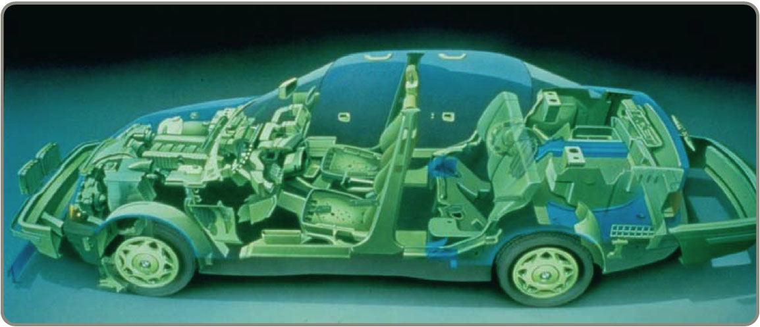
Ethics, Environmentally Friendly Designs, and Sustainability

Slide 56
The Ethical Approach
View product design from a systems perspective
  Inputs, processes, outputs
  Costs to the firm/costs to society
Consider the entire life cycle of the product

Slide 57
The Ethical Approach
Goals
  Developing safe end environmentally sound practices
  Minimizing waste of resources
  Reducing environmental liabilities
  Increasing cost-effectiveness of complying with environmental regulations
  Begin recognized as a good corporate citizen

Slide 58
Guidelines for Environmentally Friendly Designs
Make products recyclable
Use recycled materials
Use less harmful ingredients
Use lighter components
Use less energy
Use less material

Slide 59
Laws and Industry Standards
For Design …
Food and Drug Administration
Consumer Products Safety Commission
National Highway Safety Administration
Children’s Product Safety Act

Slide 60
Laws and Industry Standards
For Manufacture/Assembly …
Occupational Safety and Health Administration
Environmental Protection Agency
Professional ergonomic standards
State and local laws dealing with employment standards, discrimination, etc.

Slide 61
Laws and Industry Standards
For Disassembly/Disposal …
Vehicle Recycling Partnership
Increasingly rigid laws worldwide

Slide 62
Time-Based Competition
Product life cycles are becoming shorter and the rate of technological change is increasing
Developing new products faster can result in a competitive advantage

Slide 63
Product Development Continuum
EXTERNAL DEVELOPMENT STRATEGIES
Alliances
Joint ventures
Purchase technology or expertise
by acquiring the developer
Figure 5.6
INTERNAL DEVELOPMENT STRATEGIES
Migrations of existing products
Enhancements to existing products
New internally developed products
Internal Cost of product development Shared
Lengthy Speed of product development Rapid and/
or Existing
High Risk of product development Shared

Slide 64
Acquiring Technology
By Purchasing a Firm
  Speeds development
  Issues concern the fit between the acquired organization and product and the host
Through Joint Ventures
  Both organizations learn
  Risks are shared
Through Alliances
  Cooperative agreements between independent organizations

Slide 65
Defining The Product
First definition is in terms of functions
Rigorous specifications are developed during the design phase
Manufactured products will have an engineering drawing
Bill of material (BOM) lists the components of a product

Slide 66
Product Documents
Engineering drawing
  Shows dimensions, tolerances, and materials
  Shows codes for Group Technology
Bill of Material
  Lists components, quantities and where used
  Shows product structure

Slide 67

Monterey Jack Cheese
(a) U.S. grade AA. Monterey cheese shall conform to the following requirements:
(1) Flavor. Is fine and highly pleasing, free from undesirable flavors and odors. May possess a very slight acid or feed flavor.
(2) Body and texture. A plug drawn from the cheese shall be reasonably firm. It shall have numerous small mechanical openings evenly distributed throughout the plug. It shall not possess sweet holes, yeast holes, or other gas holes.
(3) Color. Shall have a natural, uniform, bright and attractive appearance.
(4) Finish and appearance—bandaged and
paraffin-dipped. The rind shall be sound,
firm, and smooth providing a good
protection to the cheese.
Code of Federal Regulation, Parts 53 to 109, General Service Administration

Slide 68
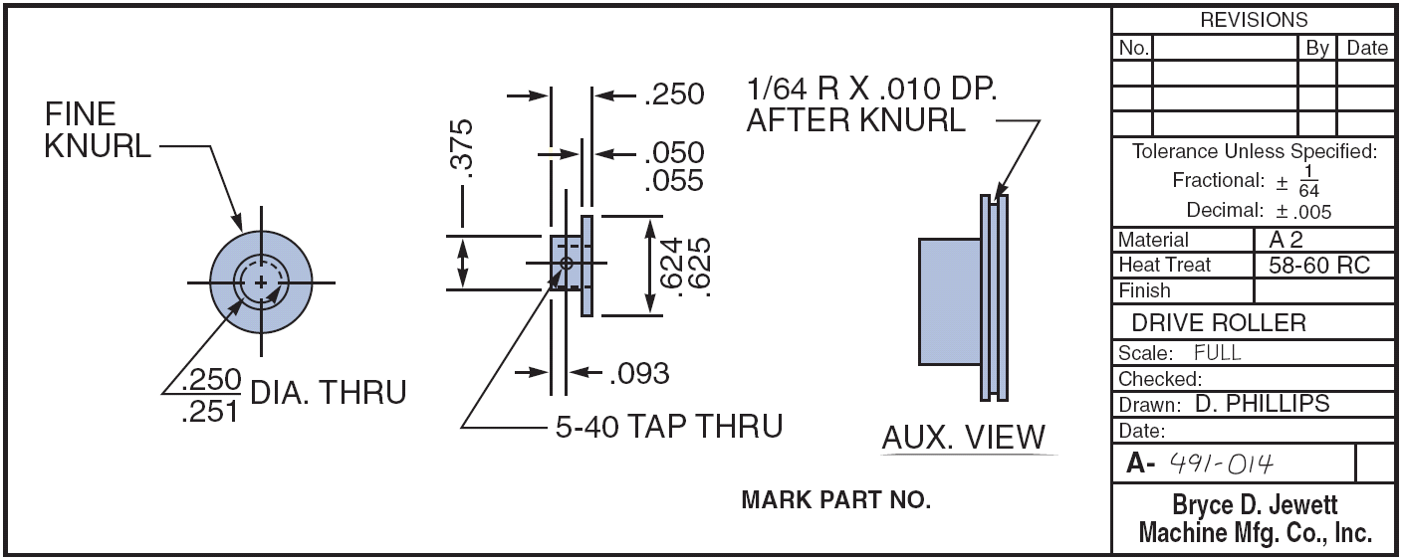
Engineering Drawings
Figure 5.8

Slide 69
Bills of Material
BOM for Panel Weldment
NUMBER DESCRIPTION QTY
A 60-71 PANEL WELDM’T 1
A 60-7 LOWER ROLLER ASSM. 1
R 60-17 ROLLER 1
R 60-428 PIN 1
P 60-2 LOCKNUT 1
A 60-72 GUIDE ASSM. REAR 1
R 60-57-1 SUPPORT ANGLE 1
A 60-4 ROLLER ASSM. 1
02-50-1150 BOLT 1
A 60-73 GUIDE ASSM. FRONT 1
A 60-74 SUPPORT WELDM’T 1
R 60-99 WEAR PLATE 1
02-50-1150 BOLT 1
Figure 5.9 (a)

Slide 70
Bills of Material
Hard Rock Cafe’s Hickory BBQ Bacon Cheeseburger
DESCRIPTION QTY
Bun 1
Hamburger patty 8 oz.
Cheddar cheese 2 slices
Bacon 2 strips
BBQ onions 1/2 cup
Hickory BBQ sauce 1 oz.
Burger set
Lettuce 1 leaf
Tomato 1 slice
Red onion 4 rings
Pickle 1 slice
French fries 5 oz.
Seasoned salt 1 tsp.
11-inch plate 1
HRC flag 1
Figure 5.9 (b)

Slide 71
Group Technology
Parts grouped into families with similar characteristics
Coding system describes processing and physical characteristics
Part families can be produced
in dedicated manufacturing cells

Slide 72
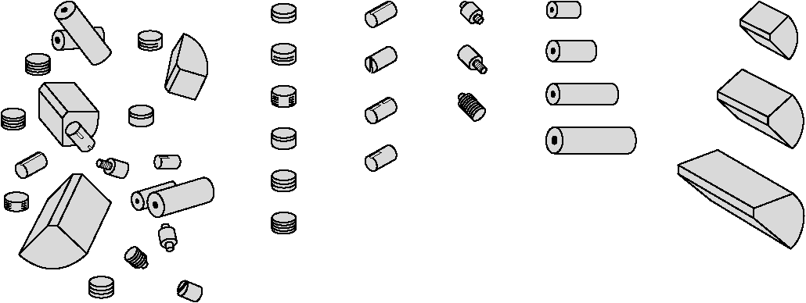
Group Technology Scheme
(b) Grouped Cylindrical Parts (families of parts)
(a) Ungrouped Parts
Grooved Slotted Threaded Drilled Machined
Figure 5.10

Slide 73
Group Technology Benefits
Improved design
Reduced raw material and purchases
Simplified production planning and control
Improved layout, routing, and machine loading
Reduced tooling setup time, work-in-process, and production time

Slide 74
Documents for Production
Assembly drawing
Assembly chart
Route sheet
Work order
Engineering change notices (ECNs)

Slide 75
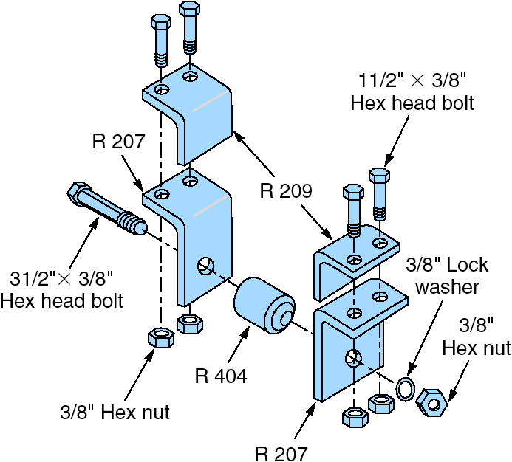
Assembly Drawing
Shows exploded view of product
Details relative locations to show how to assemble the product
Figure 5.11 (a)

Slide 76
Assembly Chart
1
R 209 Angle
R 207 Angle
Left
bracket
assembly
Identifies the point of production where components flow into subassemblies and ultimately into the final product
2
SA
1
A1
Bolts w/nuts (2)
3
R 209 Angle
4
R 207 Angle
Right
bracket
assembly
5
SA
2
A2
Bolts w/nuts (2)
6
Bolt w/nut
7
R 404 Roller
8
A3
Lock washer
Poka-yoke inspection
9
Part number tag
10
A4
Box w/packing material
11
A5
Figure 5.11 (b)

Slide 77
Route Sheet
Lists the operations and times required to produce a component
Setup Operation
Process Machine Operations Time Time/Unit
1 Auto Insert 2 Insert Component 1.5 .4
Set 56
2 Manual Insert Component .5 2.3
Insert 1 Set 12C
3 Wave Solder Solder all 1.5 4.1
components
to board
4 Test 4 Circuit integrity .25 .5
test 4GY

Slide 78
Work Order
Instructions to produce a given quantity of a particular item, usually to a schedule
Work Order
Item Quantity Start Date Due Date
Production Delivery
Dept Location
157C 125 5/2/08 5/4/08
F32 Dept K11

Slide 79
Engineering Change Notice (ECN)
A correction or modification to a product’s definition or documentation
  Engineering drawings
  Bill of material
Quite common with long product life cycles, long manufacturing lead times, or rapidly changing technologies

Slide 80
Configuration Management
The need to manage ECNs has led to the development of configuration management systems
A product’s planned and changing components are accurately identified and control and accountability for change are identified and maintained

Slide 81
Product Life-Cycle Management (PLM)
Integrated software that brings together most, if not all, elements of product design and manufacture
  Product design
  CAD/CAM, DFMA
  Product routing
  Materials
  Assembly
  Environmental

Slide 82
Service Design
Service typically includes direct interaction with the customer
  Increased opportunity for customization
  Reduced productivity
Cost and quality are still determined at the design stage
  Delay customization
  Modularization
  Reduce customer interaction, often through automation

Slide 83
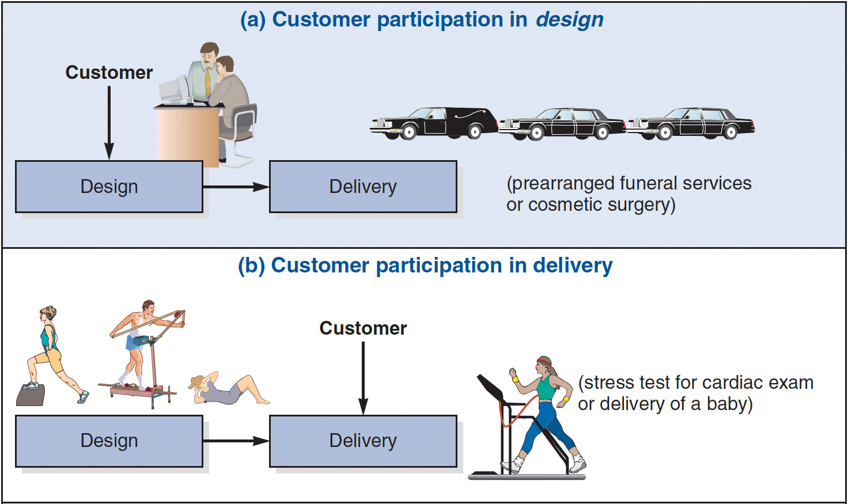
Service Design
Figure 5.12

Slide 84
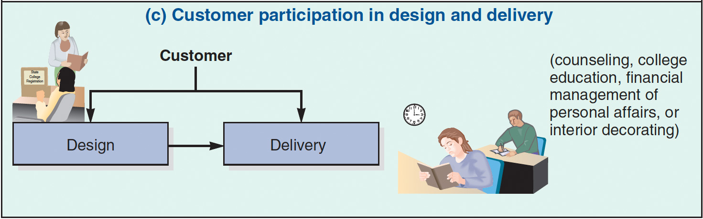
Service Design
Figure 5.12

Slide 85
Moments of Truth
Concept created by Jan Carlzon of Scandinavian Airways
Critical moments between the customer and the organization that determine customer satisfaction
There may be many of these moments
These are opportunities to gain or lose business

Slide 86
Moments-of-Truth
Computer Company Hotline
Experience Enhancers
Standard Expectations
The technician was sincerely concerned and apologetic about my problem
He asked intelligent questions that allowed me to feel confident in his abilities
The technician offered various times to have work done to suit my schedule
Ways to avoid future problems were suggested
Experience Detractors
Only one local number needs to be dialed
I never get a busy signal
I get a human being to answer my call quickly and he or she is pleasant and responsive to my problem
A timely resolution to my problem is offered
The technician is able to explain to me what I can expect to happen next
I had to call more than once to get through
A recording spoke to me rather than a person
While on hold, I get silence, and wonder if I am disconnected
The technician sounded like he was reading a form of routine questions
The technician sounded uninterested
I felt the technician rushed me
Best
Better
Figure 5.13

Slide 87
Documents for Services
High levels of customer interaction necessitates different documentation
Often explicit job instructions for moments-of-truth
Scripts and storyboards are other techniques

Slide 88
First Bank Corp. Drive-up Teller Service Guidelines
Be especially discreet when talking to the customer through the microphone.
Provide written instructions for customers who must fill out forms you provide.
Mark lines to be completed or attach a note with instructions.
Always say “please” and “thank you” when speaking through the microphone.
Establish eye contact with the customer if the distance allows it.
If a transaction requires that the customer park the car and come into the lobby, apologize for the inconvenience.

Slide 89
Application of Decision Trees to Product Design
Particularly useful when there are a series of decisions and outcomes which lead to other decisions and outcomes

Slide 90
Application of Decision Trees to Product Design
Procedures
Include all possible alternatives and states of nature - including “doing nothing”
Enter payoffs at end of branch
Determine the expected value of each branch and “prune” the tree to find the alternative with the best expected value

Slide 91
Decision Tree Example
(.4)
High sales
Purchase CAD
(.6) Low sales
Hire and train engineers
(.4)
High sales
(.6)
Low sales
Do nothing
Figure 5.14

Slide 92
Decision Tree Example
(.4)
High sales
$2,500,000 Revenue
- 1,000,000 Mfg cost ($40 x 25,000)
- 500,000 CAD cost
$1,000,000 Net
Purchase CAD
(.6) Low sales
$800,000 Revenue
- 320,000 Mfg cost ($40 x 8,000)
- 500,000 CAD cost
- $20,000 Net loss
Hire and train engineers
(.4)
High sales
EMV (purchase CAD system) = (.4)($1,000,000) + (.6)(- $20,000)
(.6)
Low sales
Do nothing
Figure 5.14

Slide 93
Decision Tree Example
(.4)
High sales
$2,500,000 Revenue
- 1,000,000 Mfg cost ($40 x 25,000)
- 500,000 CAD cost
$1,000,000 Net
Purchase CAD
$388,000
(.6) Low sales
$800,000 Revenue
- 320,000 Mfg cost ($40 x 8,000)
- 500,000 CAD cost
- $20,000 Net loss
Hire and train engineers
(.4)
High sales
EMV (purchase CAD system) = (.4)($1,000,000) + (.6)(- $20,000)
= $388,000
(.6)
Low sales
Do nothing
Figure 5.14

Slide 94
Decision Tree Example
(.4)
High sales
$2,500,000 Revenue
- 1,000,000 Mfg cost ($40 x 25,000)
- 500,000 CAD cost
$1,000,000 Net
Purchase CAD
$388,000
(.6) Low sales
$800,000 Revenue
- 320,000 Mfg cost ($40 x 8,000)
- 500,000 CAD cost
- $20,000 Net loss
Hire and train engineers
$365,000
(.4)
High sales
$2,500,000 Revenue
- 1,250,000 Mfg cost ($50 x 25,000)
- 375,000 Hire and train cost
$875,000 Net
(.6)
Low sales
$800,000 Revenue
- 400,000 Mfg cost ($50 x 8,000)
- 375,000 Hire and train cost
$25,000 Net
Do nothing $0
$0 Net
Figure 5.14

Slide 95
Transition to Production
Know when to move to production
  Product development can be viewed as evolutionary and never complete
  Product must move from design to production in a timely manner
Most products have a trial production period to insure producibility
  Develop tooling, quality control, training
  Ensures successful production

Slide 96
Transition to Production
Responsibility must also transition as the product moves through its life cycle
  Line management takes over from design
Three common approaches to managing transition
  Project managers
  Product development teams
  Integrate product development and manufacturing organizations

Slide 97

All rights reserved. No part of this publication may be reproduced, stored in a retrieval system, or transmitted, in any form or by any means, electronic, mechanical, photocopying, recording, or otherwise, without the prior written permission of the publisher.
Printed in the United States of America.

