Slide 1


8
Location Decisions
PowerPoint presentation to accompany
Heizer and Render
Operations Management, 10e, Global Edition
Principles of Operations Management, 8e, Global Edition
PowerPoint slides by Jeff Heyl

Slide 2
Outline
Global Company Profile: FedEx
The Strategic Importance of Location

Slide 3
Outline – Continued
Factors That Affect Location Decisions
  Labor Productivity
  Exchange Rates and Currency Risks
  Costs
  Political Risk, Values, and Culture
  Proximity to Markets
  Proximity to Suppliers
  Proximity to Competitors (Clustering)

Slide 4
Outline – Continued
Methods of Evaluating Location Alternatives
  The Factor-Rating Method
  Locational Break-Even Analysis
  Center-of-Gravity Method
  Transportation Model

Slide 5
Outline – Continued
Service Location Strategy
  How Hotel Chains Select Sites
  The Call Center Industry
  Geographic Information Systems

Slide 6
Learning Objectives
When you complete this chapter you should be able to:
Identify and explain seven major factors that effect location decisions
Compute labor productivity
Apply the factor-rating method
Complete a locational break-even analysis graphically and mathematically

Slide 7
Learning Objectives
When you complete this chapter you should be able to:
Use the center-of-gravity method
Understand the differences between service and industrial-sector location strategies

Slide 8

Federal Express
Central hub concept
  Enables service to more locations with fewer aircraft
  Enables matching of aircraft flights with package loads
  Reduces mishandling and delay in transit because there is total control of packages from pickup to delivery

Slide 9
Location Strategy
The objective of location strategy is to maximize the benefit of location to the firm

Slide 10
Location Strategy
One of the most important decisions a firm makes
Increasingly global in nature
Significant impact on fixed and variable costs
Decisions made relatively infrequently
The objective is to maximize the benefit of location to the firm

Slide 11
Location and Costs
Location decisions based on low cost require careful consideration
Once in place, location-related costs are fixed in place and difficult to reduce
Determining optimal facility location is a good investment

Slide 12
Location and Innovation
Cost is not always the most important aspect of a strategic decision
Four key attributes when strategy is based on innovation
  High-quality and specialized inputs
  An environment that encourages investment and local rivalry
  A sophisticated local market
  Local presence of related and supporting industries

Slide 13
Location Decisions
Long-term decisions
Decisions made infrequently
Decision greatly affects both fixed and variable costs
Once committed to a location, many resource and cost issues are difficult to change

Slide 14
Location Decisions
Country Decision
Key Success Factors
Political risks, government rules, attitudes, incentives
Cultural and economic issues
Location of markets
Labor talent, attitudes, productivity, costs
Availability of supplies, communications, energy
Exchange rates and currency risks
Figure 8.1

Slide 15
Location Decisions
Region/ Community Decision
Key Success Factors
Corporate desires
Attractiveness of region
Labor availability and costs
Costs and availability of utilities
Environmental regulations
Government incentives and fiscal policies
Proximity to raw materials and customers
Land/construction costs
MN
WI
MI
IL
IN
OH
Figure 8.1

Slide 16
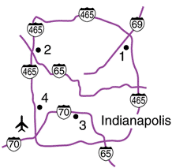
Location Decisions
Site Decision
Key Success Factors
Site size and cost
Air, rail, highway, and waterway systems
Zoning restrictions
Proximity of services/ supplies needed
Environmental impact issues
Figure 8.1

Slide 17
Global Competitiveness Index of Countries
Country 2009 Rank 2005 Rank
Switzerland 1 4
USA 2 1
Japan 8 10
Canada 9 13
UK 13 9
Israel 27 23
China 29 48
Italy 48 38
India 49 22
Mexico 60 59
Russia 63 53
Table 8.1

Slide 18
Factors That Affect
Location Decisions
Labor productivity
  Wage rates are not the only cost
  Lower productivity may increase total cost
Labor cost per day
Productivity (units per day)
= Cost per unit
Connecticut
Juarez
$70
60 units
$25
20 units
= $1.17 per unit
= $1.25 per unit

Slide 19
Factors That Affect
Location Decisions
Exchange rates and currency risks
  Can have a significant impact on costs
  Rates change over time
Costs
  Tangible - easily measured costs such as utilities, labor, materials, taxes
  Intangible - less easy to quantify and include education, public transportation, community, quality-of-life

Slide 20
Factors That Affect
Location Decisions
Exchange rates and currency risks
  Can have a significant impact on cost structure
  Rates change over time
Costs
  Tangible - easily measured costs such as utilities, labor, materials, taxes
  Intangible - less easy to quantify and include education, public transportation, community, quality-of-life
Location decisions based on costs alone can create difficult ethical situations

Slide 21
Factors That Affect
Location Decisions
Political risk, values, and culture
  National, state, local governments attitudes toward private and intellectual property, zoning, pollution, employment stability may be in flux
  Worker attitudes towards turnover, unions, absenteeism
  Globally cultures have different attitudes towards punctuality, legal, and ethical issues

Slide 22
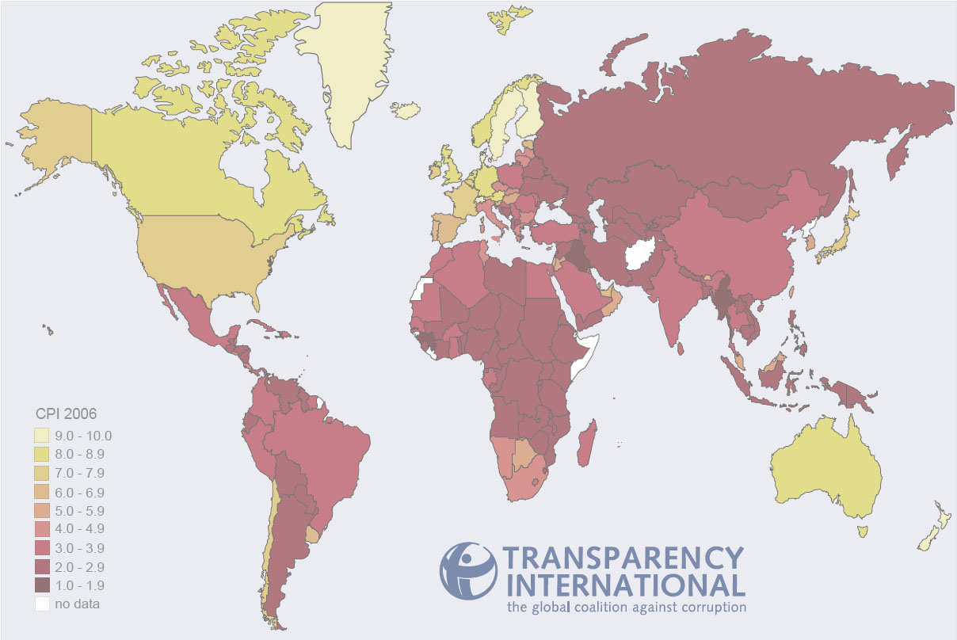
Ranking Corruption
Rank Country 2009 CPI Score (out of 10)
1 New Zealand 9.4
2 Demark 9.3
3 Singapore, Sweden 9.2
5 Switzerland 9.0
8 Australia, Canada, Iceland 8.7
12 Hong Kong 8.2
14 Germany 8.0
17 Japan, UK 7.7
19 USA 7.5
37 Taiwan 5.6
39 South Korea 5.5
56 Malaysia 4.5
79 China 3.6
89 Mexico 3.3
146 Russia 2.2
Least Corrupt
Most Corrupt
Notes:
CPI is the Corrupt Perceptions Index calculated by Transparency International, an organization dedicated to fighting business corruption. The Index is calculated from up to 13 different individual scores. For details and the methodology, see www.transparency.org.
In case students are interested, the country with the lowest score in the 2006 survey was Haiti with a score of 1.8 out of 10.

Slide 23
Factors That Affect
Location Decisions
Proximity to markets
  Very important to services
  JIT systems or high transportation costs may make it important to manufacturers
Proximity to suppliers
  Perishable goods, high transportation costs, bulky products

Slide 24
Factors That Affect
Location Decisions
Proximity to competitors
  Called clustering
  Often driven by resources such as natural, information, capital, talent
  Found in both manufacturing and service industries

Slide 25
Clustering of Companies
Industry | Locations | Reason for clustering
Wine making | Napa Valley (US) Bordeaux region (France) | Natural resources of land and climate
Software firms | Silicon Valley, Boston, Bangalore (India) | Talent resources of bright graduates in scientific/technical areas, venture capitalists nearby
Race car builders | Huntington/North Hampton region (England) | Critical mass of talent and information
Table 8.3

Slide 26
Clustering of Companies
Industry | Locations | Reason for clustering
Theme parks (Disney World, Universal Studios) | Orlando, Florida | A hot spot for entertainment, warm weather, tourists, and inexpensive labor
Electronics firms | Northern Mexico | NAFTA, duty free export to US
Computer hardware manufacturers | Singapore, Taiwan | High technological penetration rate and per capita GDP, skilled/educated workforce with large pool of engineers
Table 8.3

Slide 27
Clustering of Companies
Industry | Locations | Reason for clustering
Fast food chains (Wendy’s, McDonald’s, Burger King, and Pizza Hut) | Sites within 1 mile of each other | Stimulate food sales, high traffic flows
General aviation aircraft (Cessna, Learjet, Boeing) | Wichita, Kansas | Mass of aviation skills
Orthopedic device manufacturing | Warsaw, Indiana | Ready supply of skilled workers, strong U.S. market
Table 8.3

Slide 28
Factor-Rating Method
Popular because a wide variety of factors can be included in the analysis
Six steps in the method
  Develop a list of relevant factors called key success factors
  Assign a weight to each factor
  Develop a scale for each factor
  Score each location for each factor
  Multiply score by weights for each factor for each location
  Recommend the location with the highest point score

Slide 29
Factor-Rating Example
Key Scores
Success (out of 100) Weighted Scores
Factor Weight France Denmark France Denmark
Labor
availability
and attitude .25 70 60 (.25)(70) = 17.5 (.25)(60) = 15.0
People-to-
car ratio .05 50 60 (.05)(50) = 2.5 (.05)(60) = 3.0
Per capita
income .10 85 80 (.10)(85) = 8.5 (.10)(80) = 8.0
Tax structure .39 75 70 (.39)(75) = 29.3 (.39)(70) = 27.3
Education
and health .21 60 70 (.21)(60) = 12.6 (.21)(70) = 14.7
Totals 1.00 70.4 68.0
Table 8.4

Slide 30
Locational
Break-Even Analysis
Method of cost-volume analysis used for industrial locations
Three steps in the method
  Determine fixed and variable costs for each location
  Plot the cost for each location
  Select location with lowest total cost for expected production volume

Slide 31
Locational Break-Even Analysis Example
Three locations:
Selling price = $120
Expected volume = 2,000 units
Fixed Variable Total
City Cost Cost Cost
Akron $30,000 $75 $180,000
Bowling Green $60,000 $45 $150,000
Chicago $110,000 $25 $160,000
Total Cost = Fixed Cost + (Variable Cost x Volume)

Slide 32
Locational Break-Even Analysis Example
–
$180,000 –
–
$160,000 –
$150,000 –
–
$130,000 –
–
$110,000 –
–
–
$80,000 –
–
$60,000 –
–
–
$30,000 –
–
$10,000 –
–
Chicago cost curve
Annual cost
Bowling Green cost curve
Akron cost curve
Akron lowest cost
Bowling Green lowest cost
Chicago lowest cost
| | | | | | |
0 500 1,000 1,500 2,000 2,500 3,000
Figure 8.2
Volume

Slide 33
Center-of-Gravity Method
Finds location of distribution center that minimizes distribution costs
Considers
  Location of markets
  Volume of goods shipped to those markets
  Shipping cost (or distance)

Slide 34
Center-of-Gravity Method
Place existing locations on a coordinate grid
  Grid origin and scale is arbitrary
  Maintain relative distances
Calculate X and Y coordinates for ‘center of gravity’
  Assumes cost is directly proportional to distance and volume shipped

Slide 35
Center-of-Gravity Method
∑d_{ix}Q_{i}
∑Q_{i}
x - coordinate =
i
i
∑d_{iy}Q_{i}
∑Q_{i}
y - coordinate =
i
i
where d_{ix} = x-coordinate of location i
d_{iy} = y-coordinate of location i
Q_{i} = Quantity of goods moved to or from location i

Slide 36
Center-of-Gravity Method
North-South
New York (130, 130)
120 –
90 –
60 –
30 –
–
Chicago (30, 120)
Pittsburgh (90, 110)
Atlanta (60, 40)
| | | | | |
30 60 90 120 150
East-West
Arbitrary origin
Figure 8.3

Slide 37
Center-of-Gravity Method
Number of Containers
Store Location Shipped per Month
Chicago (30, 120) 2,000
Pittsburgh (90, 110) 1,000
New York (130, 130) 1,000
Atlanta (60, 40) 2,000
(30)(2000) + (90)(1000) + (130)(1000) + (60)(2000)
2000 + 1000 + 1000 + 2000
x-coordinate =
= 66.7
(120)(2000) + (110)(1000) + (130)(1000) + (40)(2000)
2000 + 1000 + 1000 + 2000
y-coordinate =
= 93.3

Slide 38
Center-of-Gravity Method
North-South
New York (130, 130)
120 –
90 –
60 –
30 –
–
Chicago (30, 120)
Pittsburgh (90, 110)
+
Center of gravity (66.7, 93.3)
Atlanta (60, 40)
| | | | | |
30 60 90 120 150
East-West
Arbitrary origin
Figure 8.3

Slide 39
Transportation Model
Finds amount to be shipped from several points of supply to several points of demand
Solution will minimize total production and shipping costs
A special class of linear programming problems

Slide 40
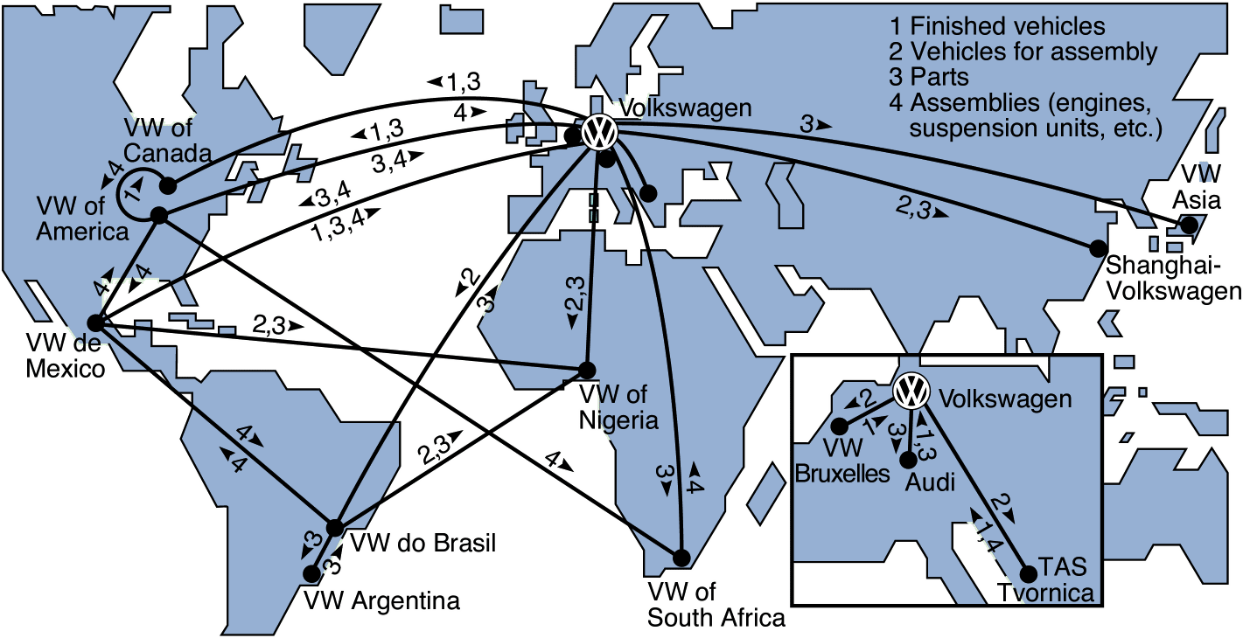
Worldwide Distribution of Volkswagens and Parts
Figure 8.4

Slide 41
Service Location Strategy
Purchasing power of customer-drawing area
Service and image compatibility with demographics of the customer-drawing area
Competition in the area
Quality of the competition
Uniqueness of the firm’s and competitors’ locations
Physical qualities of facilities and neighboring businesses
Operating policies of the firm
Quality of management

Slide 42
Location Strategies
Service/Retail/Professional Location Goods-Producing Location
Revenue Focus Cost Focus
Volume/revenue
Drawing area; purchasing power
Competition; advertising/pricing
Physical quality
Parking/access; security/lighting; appearance/image
Cost determinants
Rent
Management caliber
Operations policies (hours, wage rates)
Tangible costs
Transportation cost of raw material
Shipment cost of finished goods
Energy and utility cost; labor; raw material; taxes, and so on
Intangible and future costs
Attitude toward union
Quality of life
Education expenditures by state
Quality of state and local government
Table 8.6

Slide 43
Location Strategies
Service/Retail/Professional Location Goods-Producing Location
Techniques Techniques
Regression models to determine importance of various factors
Factor-rating method
Traffic counts
Demographic analysis of drawing area
Purchasing power analysis of area
Center-of-gravity method
Geographic information systems
Transportation method
Factor-rating method
Locational break-even analysis
Crossover charts
Table 8.6

Slide 44
Location Strategies
Service/Retail/Professional Location Goods-Producing Location
Assumptions Assumptions
Location is a major determinant of revenue
High customer-contact issues are critical
Costs are relatively constant for a given area; therefore, the revenue function is critical
Location is a major determinant of cost
Most major costs can be identified explicitly for each site
Low customer contact allows focus on the identifiable costs
Intangible costs can be evaluated
Table 8.6

Slide 45
How Hotel Chains Select Sites
Location is a strategically important decision in the hospitality industry
La Quinta started with 35 independent variables and worked to refine a regression model to predict profitability
The final model had only four variables
  Price of the inn
  Median income levels
  State population per inn
  Location of nearby colleges
r² = .51
51% of the profitability is predicted by just these four variables!

Slide 46
The Call Center Industry
Requires neither face-to-face contact nor movement of materials
Has very broad location options
Traditional variables are no longer relevant
Cost and availability of labor may drive location decisions

Slide 47
Geographic Information Systems (GIS)
Important tool to help in location analysis
Enables more complex demographic analysis
Available data bases include
  Detailed census data
  Detailed maps
  Utilities
  Geographic features
  Locations of major services

Slide 48
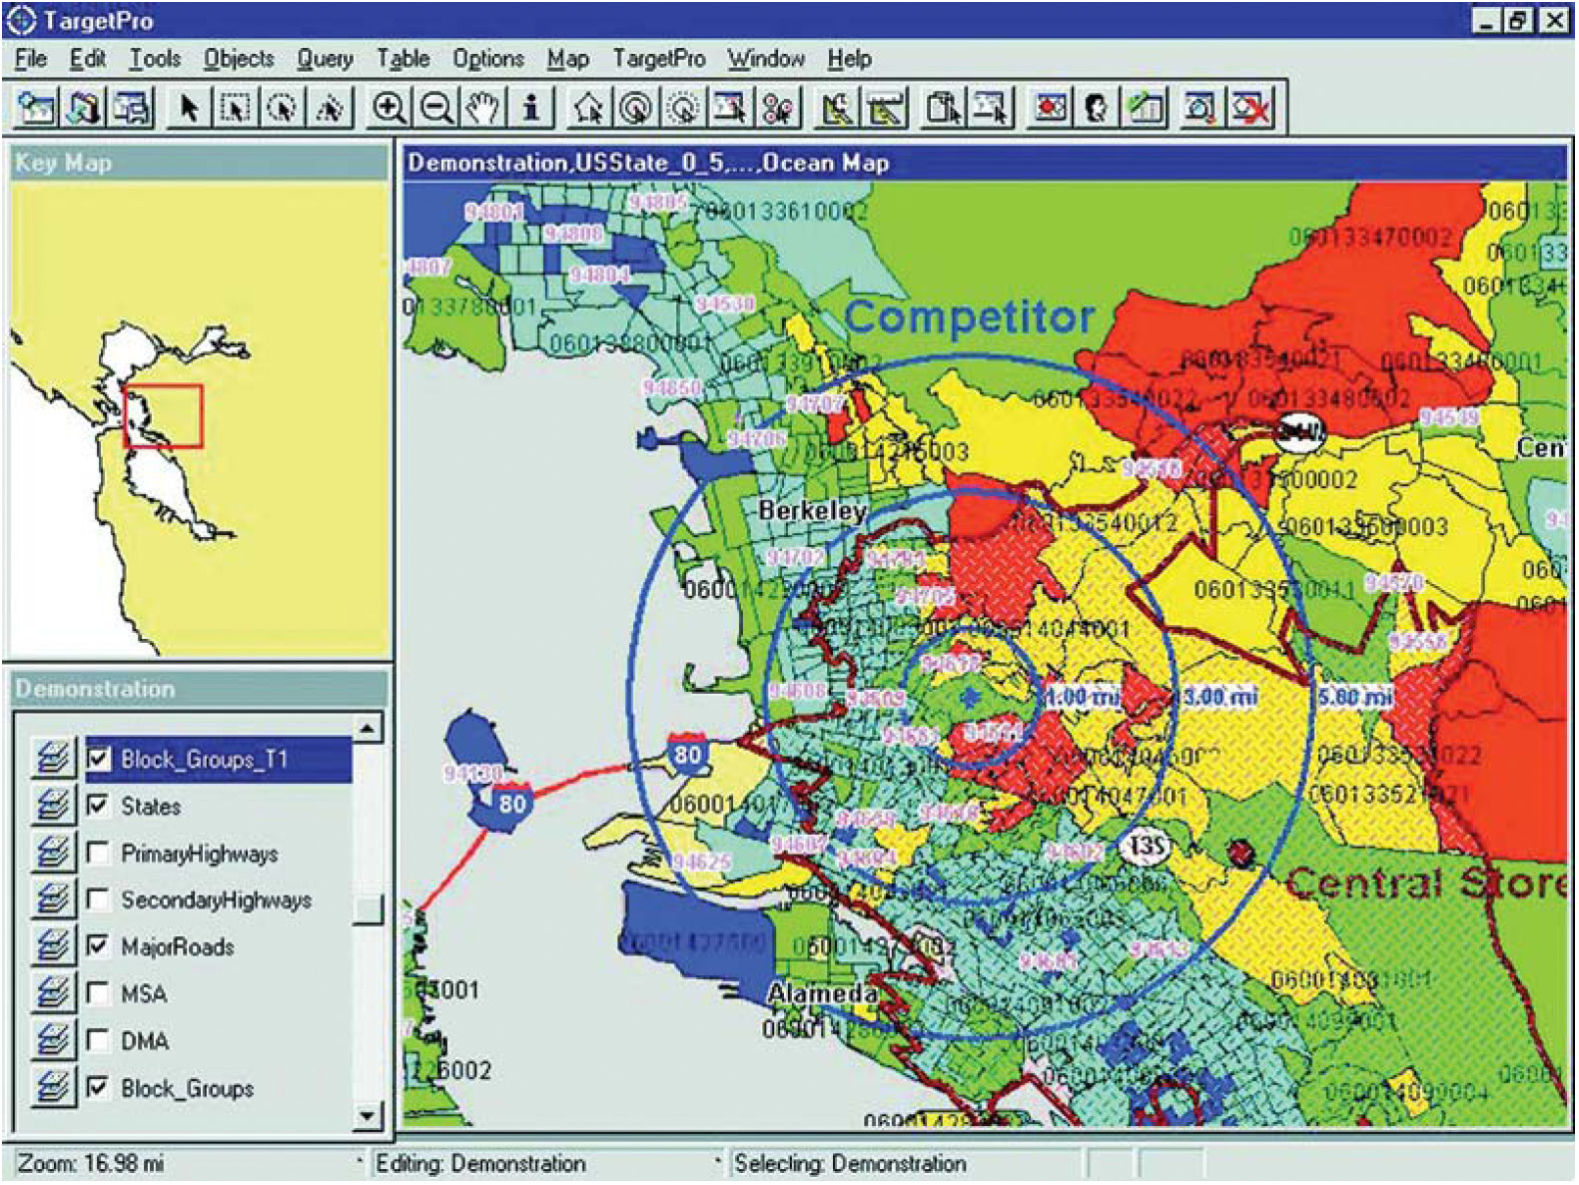
Geographic Information Systems (GIS)

Slide 49

All rights reserved. No part of this publication may be reproduced, stored in a retrieval system, or transmitted, in any form or by any means, electronic, mechanical, photocopying, recording, or otherwise, without the prior written permission of the publisher.
Printed in the United States of America.

