Slide 1


12
Managing Inventory
PowerPoint presentation to accompany
Heizer and Render
Operations Management, 10e, Global Edition
Principles of Operations Management, 8e,
Global Edition
PowerPoint slides by Jeff Heyl

Slide 2
Outline
Global Company Profile: Amazon.com
The Importance of Inventory
  Functions of Inventory
  Types of Inventory

Slide 3
Outline – Continued
Managing Inventory
  ABC Analysis
  Record Accuracy
  Cycle Counting
  Control of Service Inventories
Inventory Models
  Independent vs. Dependent Demand
  Holding, Ordering, and Setup Costs

Slide 4
Outline – Continued
Inventory Models for Independent Demand
  The Basic Economic Order Quantity (EOQ) Model
  Minimizing Costs
  Reorder Points
  Production Order Quantity Model
  Quantity Discount Models

Slide 5
Outline – Continued
Probabilistic Models and Safety Stock
  Other Probabilistic Models
Single-Period Model
Fixed-Period (P) Systems

Slide 6
Learning Objectives
When you complete this chapter you should be able to:
Conduct an ABC analysis
Explain and use cycle counting
Explain and use the EOQ model for independent inventory demand
Compute a reorder point and safety stock

Slide 7
Learning Objectives
When you complete this chapter you should be able to:
Apply the production order quantity model
Explain and use the quantity discount model
Understand service levels and probabilistic inventory models

Slide 8
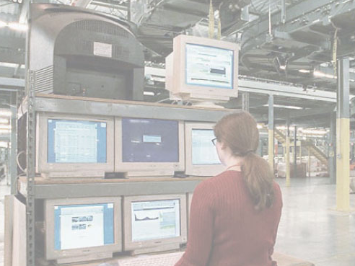
Amazon.com
Amazon.com started as a “virtual” retailer – no inventory, no warehouses, no overhead; just computers taking orders to be filled by others
Growth has forced Amazon.com to become a world leader in warehousing and inventory management

Slide 9

Amazon.com
Each order is assigned by computer to the closest distribution center that has the product(s)
A “flow meister” at each distribution center assigns work crews
Lights indicate products that are to be picked and the light is reset
Items are placed in crates on a conveyor, bar code scanners scan each item 15 times to virtually eliminate errors

Slide 10
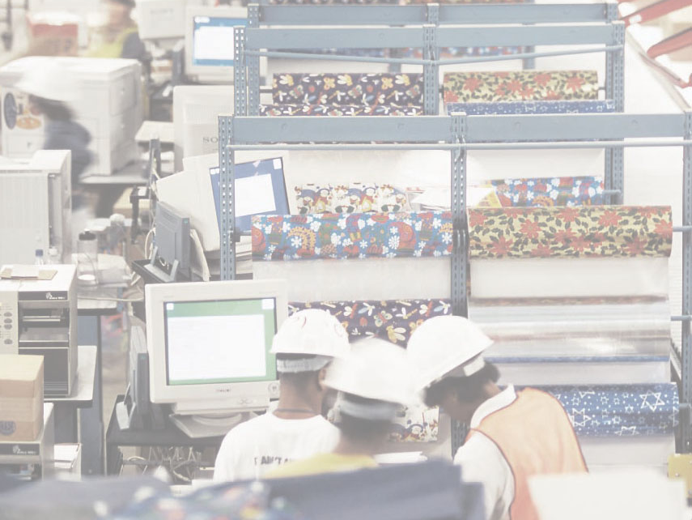
Amazon.com
Crates arrive at central point where items are boxed and labeled with new bar code
Gift wrapping is done by hand at 30 packages per hour
Completed boxes are packed, taped, weighed and labeled before leaving warehouse in a truck
Order arrives at customer within 2 - 3 days

Slide 11
Inventory Management
The objective of inventory management is to strike a balance between inventory investment and customer service

Slide 12
Importance of Inventory
One of the most expensive assets of many companies representing as much as 50% of total invested capital
Operations managers must balance inventory investment and customer service

Slide 13
Functions of Inventory
To decouple or separate various parts of the production process
To decouple the firm from fluctuations in demand and provide a stock of goods that will provide a selection for customers
To take advantage of quantity discounts
To hedge against inflation

Slide 14
Types of Inventory
Raw material
  Purchased but not processed
Work-in-process
  Undergone some change but not completed
  A function of cycle time for a product
Maintenance/repair/operating (MRO)
  Necessary to keep machinery and processes productive
Finished goods
  Completed product awaiting shipment

Slide 15
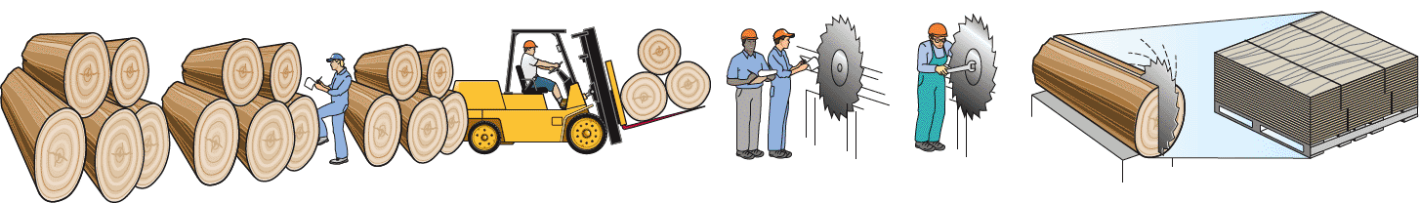
The Material Flow Cycle
Cycle time
95% 5%
Input Wait for Wait to Move Wait in queue Setup Run Output
inspection be moved time for operator time time
Figure 12.1

Slide 16
Managing Inventory
How inventory items can be classified
How accurate inventory records can be maintained

Slide 17
ABC Analysis
Divides inventory into three classes based on annual dollar volume
  Class A - high annual dollar volume
  Class B - medium annual dollar volume
  Class C - low annual dollar volume
Used to establish policies that focus on the few critical parts and not the many trivial ones

Slide 18
ABC Analysis
Item Stock Number | Percent of Number of Items Stocked | Annual Volume (units) | x | Unit Cost | = | Annual Dollar Volume | Percent of Annual Dollar Volume |  | Class
#10286 | 20% | 1,000 |  | $ 90.00 |  | $ 90,000 | 38.8% |  | A
#11526 |  | 500 |  | 154.00 |  | 77,000 | 33.2% |  | A
#12760 |  | 1,550 |  | 17.00 |  | 26,350 | 11.3% |  | B
#10867 | 30% | 350 |  | 42.86 |  | 15,001 | 6.4% |  | B
#10500 |  | 1,000 |  | 12.50 |  | 12,500 | 5.4% |  | B
72%
23%

Slide 19
ABC Analysis
Item Stock Number | Percent of Number of Items Stocked | Annual Volume (units) | x | Unit Cost | = | Annual Dollar Volume | Percent of Annual Dollar Volume |  | Class
#12572 |  | 600 |  | $ 14.17 |  | $ 8,502 | 3.7% |  | C
#14075 |  | 2,000 |  | .60 |  | 1,200 | .5% |  | C
#01036 | 50% | 100 |  | 8.50 |  | 850 | .4% |  | C
#01307 |  | 1,200 |  | .42 |  | 504 | .2% |  | C
#10572 |  | 250 |  | .60 |  | 150 | .1% |  | C
 |  | 8,550 |  |  |  | $232,057 | 100.0%
5%

Slide 20
ABC Analysis
A Items
80 –
70 –
60 –
50 –
40 –
30 –
20 –
10 –
0 –
Percent of annual dollar usage
B Items
C Items
| | | | | | | | | |
10 20 30 40 50 60 70 80 90 100
Percent of inventory items
Figure 12.2

Slide 21
ABC Analysis
Other criteria than annual dollar volume may be used
  Anticipated engineering changes
  Delivery problems
  Quality problems
  High unit cost

Slide 22
ABC Analysis
Policies employed may include
  More emphasis on supplier development for A items
  Tighter physical inventory control for A items
  More care in forecasting A items

Slide 23
Record Accuracy
Accurate records are a critical ingredient in production and inventory systems
Allows organization to focus on what is needed
Necessary to make precise decisions about ordering, scheduling, and shipping
Incoming and outgoing record keeping must be accurate
Stockrooms should be secure

Slide 24

Cycle Counting
Items are counted and records updated on a periodic basis
Often used with ABC analysis
to determine cycle
Has several advantages
  Eliminates shutdowns and interruptions
  Eliminates annual inventory adjustment
  Trained personnel audit inventory accuracy
  Allows causes of errors to be identified and corrected
  Maintains accurate inventory records

Slide 25
Cycle Counting Example
5,000 items in inventory, 500 A items, 1,750 B items, 2,750 C items
Policy is to count A items every month (20 working days), B items every quarter (60 days), and C items every six months (120 days)
Item Class | Quantity | Cycle Counting Policy | Number of Items Counted per Day
A | 500 | Each month | 500/20 = 25/day
B | 1,750 | Each quarter | 1,750/60 = 29/day
C | 2,750 | Every 6 months | 2,750/120 = 23/day
 |  |  | 77/day

Slide 26
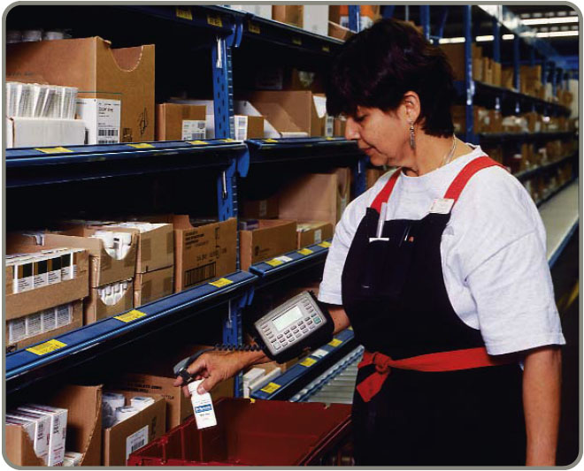
Control of Service Inventories
Can be a critical component
of profitability
Losses may come from
shrinkage or pilferage
Applicable techniques include
  Good personnel selection, training, and discipline
  Tight control on incoming shipments
  Effective control on all goods leaving facility

Slide 27
Independent Versus
Dependent Demand
Independent demand - the demand for item is independent of the demand for any other item in inventory
Dependent demand - the demand for item is dependent upon the demand for some other item in the inventory

Slide 28
Holding, Ordering, and Setup Costs
Holding costs - the costs of holding or “carrying” inventory over time
Ordering costs - the costs of placing an order and receiving goods
Setup costs - cost to prepare a machine or process for manufacturing an order

Slide 29
Holding Costs
Category | Cost (and range) as a Percent of Inventory Value
Housing costs (building rent or depreciation, operating costs, taxes, insurance) | 6% (3 - 10%)
Material handling costs (equipment lease or depreciation, power, operating cost) | 3% (1 - 3.5%)
Labor cost | 3% (3 - 5%)
Investment costs (borrowing costs, taxes, and insurance on inventory) | 11% (6 - 24%)
Pilferage, space, and obsolescence | 3% (2 - 5%)
Overall carrying cost | 26%
Table 12.1

Slide 30
Holding Costs
Category | Cost (and range) as a Percent of Inventory Value
Housing costs (building rent or depreciation, operating costs, taxes, insurance) | 6% (3 - 10%)
Material handling costs (equipment lease or depreciation, power, operating cost) | 3% (1 - 3.5%)
Labor cost | 3% (3 - 5%)
Investment costs (borrowing costs, taxes, and insurance on inventory) | 11% (6 - 24%)
Pilferage, space, and obsolescence | 3% (2 - 5%)
Overall carrying cost | 26%
Holding costs vary considerably depending on the business, location, and interest rates. Generally greater than 15%, some high tech items have holding costs greater than 40%.
Table 12.1

Slide 31
Inventory Models for Independent Demand
Need to determine when and how much to order
Basic economic order quantity
Production order quantity
Quantity discount model

Slide 32
Basic EOQ Model
Important assumptions
Demand is known, constant, and independent
Lead time is known and constant
Receipt of inventory is instantaneous and complete
Quantity discounts are not possible
Only variable costs are setup and holding
Stockouts can be completely avoided

Slide 33
Inventory Usage Over Time
Usage rate
Average inventory on hand
Q
2
Order quantity = Q (maximum inventory level)
Inventory level
Minimum inventory
0
Time
Figure 12.3

Slide 34
Minimizing Costs
Objective is to minimize total costs
Total cost of holding and setup (order)
Minimum total cost
Holding cost
Annual cost
Setup (or order) cost
Optimal order quantity (Q*)
Order quantity
Table 12.4(c)

Slide 35
The EOQ Model
D
Q
Annual setup cost = S
Q = Number of pieces per order
Q* = Optimal number of pieces per order (EOQ)
D = Annual demand in units for the inventory item
S = Setup or ordering cost for each order
H = Holding or carrying cost per unit per year
Annual setup cost = (Number of orders placed per year)
x (Setup or order cost per order)
Annual demand
Number of units in each order
Setup or order cost per order
=
D
Q
= (S)

Slide 36
The EOQ Model
D
Q
Annual setup cost = S
Q
2
Q = Number of pieces per order
Q* = Optimal number of pieces per order (EOQ)
D = Annual demand in units for the inventory item
S = Setup or ordering cost for each order
H = Holding or carrying cost per unit per year
Annual holding cost = H
Annual holding cost = (Average inventory level)
x (Holding cost per unit per year)
Order quantity
2
= (Holding cost per unit per year)
Q
2
= (H)

Slide 37
The EOQ Model
D
Q
Annual setup cost = S
Q
2
Q = Number of pieces per order
Q* = Optimal number of pieces per order (EOQ)
D = Annual demand in units for the inventory item
S = Setup or ordering cost for each order
H = Holding or carrying cost per unit per year
Annual holding cost = H
Optimal order quantity is found when annual setup cost equals annual holding cost
D
Q
Q
2
S = H
Solving for Q*
2DS = Q²H
Q² = 2DS/H
Q* = 2DS/H

Slide 38
An EOQ Example
Determine optimal number of needles to order
D = 1,000 units
S = $10 per order
H = $.50 per unit per year
2DS
H
Q* =
2(1,000)(10)
0.50
Q* =
= 40,000 = 200 units

Slide 39
An EOQ Example
Determine optimal number of needles to order
D = 1,000 units Q* = 200 units
S = $10 per order
H = $.50 per unit per year
Expected number of orders
Demand
Order quantity
D
Q*
= N = =
1,000
200
N = = 5 orders per year

Slide 40
An EOQ Example
Determine optimal number of needles to order
D = 1,000 units Q* = 200 units
S = $10 per order N = 5 orders per year
H = $.50 per unit per year
Number of working
days per year
N
Expected time between orders
= T =
250
5
T = = 50 days between orders

Slide 41
An EOQ Example
Determine optimal number of needles to order
D = 1,000 units Q* = 200 units
S = $10 per order N = 5 orders per year
H = $.50 per unit per year T = 50 days
Total annual cost = Setup cost + Holding cost
D
Q
Q
2
TC = S + H
1,000
200
200
2
TC = ($10) + ($.50)
TC = (5)($10) + (100)($.50) = $50 + $50 = $100

Slide 42
Robust Model
The EOQ model is robust
It works even if all parameters and assumptions are not met
The total cost curve is relatively flat in the area of the EOQ

Slide 43
An EOQ Example
Management underestimated demand by 50%
D = 1,000 units Q* = 200 units
S = $10 per order N = 5 orders per year
H = $.50 per unit per year T = 50 days
1,500 units
D
Q
Q
2
TC = S + H
1,500
200
200
2
TC = ($10) + ($.50) = $75 + $50 = $125
Total annual cost increases by only 25%

Slide 44
An EOQ Example
Actual EOQ for new demand is 244.9 units
D = 1,000 units Q* = 244.9 units
S = $10 per order N = 5 orders per year
H = $.50 per unit per year T = 50 days
1,500 units
D
Q
Q
2
TC = S + H
Only 2% less than the total cost of $125 when the order quantity was 200
1,500
244.9
244.9
2
TC = ($10) + ($.50)
TC = $61.24 + $61.24 = $122.48

Slide 45
Reorder Points
EOQ answers the “how much” question
The reorder point (ROP) tells “when” to order
Demand per day
Lead time for a new order in days
ROP =
= d x L
D
Number of working days in a year
d =

Slide 46
Reorder Point Curve
Q*
Resupply takes place as order arrives
Slope = units/day = d
Inventory level (units)
ROP (units)
Time (days)
Lead time = L
Figure 12.5

Slide 47
Reorder Point Example
Demand = 8,000 iPods per year
250 working day year
Lead time for orders is 3 working days
D
Number of working days in a year
d =
= 8,000/250 = 32 units
ROP = d x L
= 32 units per day x 3 days = 96 units

Slide 48
Production Order Quantity Model
Used when inventory builds up over a period of time after an order is placed
Used when units are produced and sold simultaneously

Slide 49
Production Order Quantity Model
Part of inventory cycle during which production (and usage) is taking place
Demand part of cycle with no production
Inventory level
Maximum inventory
t
Time
Figure 12.6

Slide 50
Production Order Quantity Model
Q = Number of pieces per order p = Daily production rate
H = Holding cost per unit per year d = Daily demand/usage rate
t = Length of the production run in days
Annual inventory holding cost
= (Average inventory level) x
Holding cost
per unit per year
Annual inventory level
= (Maximum inventory level)/2
Maximum inventory level
Total produced during the production run
Total used during the production run
= –
= pt – dt

Slide 51
Production Order Quantity Model
Q = Number of pieces per order p = Daily production rate
H = Holding cost per unit per year d = Daily demand/usage rate
t = Length of the production run in days
Maximum inventory level
Total produced during the production run
Total used during the production run
= –
= pt – dt
However, Q = total produced = pt ; thus t = Q/p
Maximum inventory level
Q
p
Q
p
d
p
= p – d = Q 1 –
Maximum inventory level
2
Q
2
d
p
Holding cost = (H) = 1 – H

Slide 52
Production Order Quantity Model
Q = Number of pieces per order p = Daily production rate
H = Holding cost per unit per year d = Daily demand/usage rate
D = Annual demand
Setup cost = (D/Q)S
Holding cost = HQ[1 - (d/p)]
1
2
1
2
(D/Q)S = HQ[1 - (d/p)]
2DS
H[1 - (d/p)]
Q² =
2DS
H[1 - (d/p)]
Q* =
p

Slide 53
Production Order Quantity Example
D = 1,000 units p = 8 units per day
S = $10 d = 4 units per day
H = $0.50 per unit per year
2DS
H[1 - (d/p)]
Q* =
2(1,000)(10)
0.50[1 - (4/8)]
Q* = = 80,000
= 282.8 or 283 hubcaps

Slide 54
Production Order Quantity Model
Note:
D
Number of days the plant is in operation
1,000
250
d = 4 = =
When annual data are used the equation becomes
2DS
Q* =
annual demand rate
annual production rate
H 1 –

Slide 55
Quantity Discount Models
Reduced prices are often available when larger quantities are purchased
Trade-off is between reduced product cost and increased holding cost
Total cost = Setup cost + Holding cost + Product cost
D
Q
Q
2
TC = S + H + PD

Slide 56
Quantity Discount Models
A typical quantity discount schedule
Discount Number | Discount Quantity | Discount (%) | Discount Price (P)
1 | 0 to 999 | no discount | $5.00
2 | 1,000 to 1,999 | 4 | $4.80
3 | 2,000 and over | 5 | $4.75
Table 12.2

Slide 57
Quantity Discount Models
Steps in analyzing a quantity discount
For each discount, calculate Q*
If Q* for a discount doesn’t qualify, choose the smallest possible order size to get the discount
Compute the total cost for each Q* or adjusted value from Step 2
Select the Q* that gives the lowest total cost

Slide 58
Quantity Discount Models
Total cost curve for discount 2
Total cost curve for discount 1
Total cost $
Total cost curve for discount 3
b
a
Q* for discount 2 is below the allowable range at point a and must be adjusted upward to 1,000 units at point b
1st price break
2nd price break
0
1,000
2,000
Order quantity
Figure 12.7

Slide 59
Quantity Discount Example
Calculate Q* for every discount
2DS
IP
Q* =
2(5,000)(49)
(.2)(5.00)
Q₁* = = 700 cars/order
2(5,000)(49)
(.2)(4.80)
Q₂* = = 714 cars/order
2(5,000)(49)
(.2)(4.75)
Q₃* = = 718 cars/order

Slide 60
Quantity Discount Example
Calculate Q* for every discount
2DS
IP
Q* =
2(5,000)(49)
(.2)(5.00)
Q₁* = = 700 cars/order
2(5,000)(49)
(.2)(4.80)
Q₂* = = 714 cars/order
1,000 — adjusted
2(5,000)(49)
(.2)(4.75)
Q₃* = = 718 cars/order
2,000 — adjusted

Slide 61
Quantity Discount Example
Discount Number | Unit Price | Order Quantity | Annual Product Cost | Annual Ordering Cost | Annual Holding Cost | Total
1 | $5.00 | 700 | $25,000 | $350 | $350 | $25,700
2 | $4.80 | 1,000 | $24,000 | $245 | $480 | $24,725
3 | $4.75 | 2,000 | $23.750 | $122.50 | $950 | $24,822.50
Table 12.3
Choose the price and quantity that gives the lowest total cost
Buy 1,000 units at $4.80 per unit

Slide 62
Probabilistic Models and Safety Stock
Used when demand is not constant or certain
Use safety stock to achieve a desired service level and avoid stockouts
ROP = d x L + ss
Annual stockout costs = the sum of the units short x the probability x the stockout cost/unit
x the number of orders per year

Slide 63
Safety Stock Example
ROP = 50 units Stockout cost = $40 per frame
Orders per year = 6 Carrying cost = $5 per frame per year
Number of Units | Probability
30 | .2
40 | .2
ROP → 50 | .3
60 | .2
70 | .1
 | 1.0

Slide 64
Safety Stock Example
ROP = 50 units Stockout cost = $40 per frame
Orders per year = 6 Carrying cost = $5 per frame per year
Safety Stock | Additional Holding Cost | Stockout Cost | Total Cost
20 | (20)($5) = $100 | $0 | $100
10 | (10)($5) = $ 50 | (10)(.1)($40)(6) = $240 | $290
0 | $ 0 | (10)(.2)($40)(6) + (20)(.1)($40)(6) = $960 | $960
A safety stock of 20 frames gives the lowest total cost
ROP = 50 + 20 = 70 frames

Slide 65
Probabilistic Demand
Minimum demand during lead time
Maximum demand during lead time
Inventory level
Mean demand during lead time
ROP = 350 + safety stock of 16.5 = 366.5
ROP →
Normal distribution probability of demand during lead time
Expected demand during lead time (350 kits)
Safety stock
16.5 units
0
Lead time
Time
Figure 12.8
Place order
Receive order

Slide 66
Probabilistic Demand
Use prescribed service levels to set safety stock when the cost of stockouts cannot be determined
ROP = demand during lead time + Zσ_{dLT}
where Z = number of standard deviations
σ_{dLT} = standard deviation of demand during lead time

Slide 67
Probabilistic Demand
Probability of
no stockout
95% of the time
Risk of a stockout (5% of area of normal curve)
Mean demand 350
ROP = ? kits
Quantity
Safety stock
0
z
Number of
standard deviations

Slide 68
Probabilistic Example
Average demand = μ = 350 kits
Standard deviation of demand during lead time = σ_{dLT} = 10 kits
5% stockout policy (service level = 95%)
Using Appendix I, for an area under the curve of 95%, the Z = 1.65
Safety stock = Zσ_{dLT} = 1.65(10) = 16.5 kits
Reorder point = expected demand during lead time + safety stock
= 350 kits + 16.5 kits of safety stock
= 366.5 or 367 kits

Slide 69
Other Probabilistic Models
When data on demand during lead time is not available, there are other models available
When demand is variable and lead time is constant
When lead time is variable and demand is constant
When both demand and lead time are variable

Slide 70
Other Probabilistic Models
Demand is variable and lead time is constant
ROP = (average daily demand
x lead time in days) + Zσ_{dLT}
where σ_{d} = standard deviation of demand per day
σ_{dLT} = σ_{d} lead time

Slide 71
Probabilistic Example
Average daily demand (normally distributed) = 15
Standard deviation = 5
Lead time is constant at 2 days
90% service level desired
Z for 90% = 1.28
From Appendix I
ROP = (15 units x 2 days) + Zσ_{dLT}
= 30 + 1.28(5)( 2)
= 30 + 9.02 = 39.02 ≈ 39
Safety stock is about 9 iPods

Slide 72
Other Probabilistic Models
Lead time is variable and demand is constant
ROP = (daily demand x average lead time in days)
= Z x (daily demand) x σ_{LT}
where σ_{LT} = standard deviation of lead time in days

Slide 73
Probabilistic Example
Z for 98% = 2.055
From Appendix I
Daily demand (constant) = 10
Average lead time = 6 days
Standard deviation of lead time = σ_{LT} = 3
98% service level desired
ROP = (10 units x 6 days) + 2.055(10 units)(3)
= 60 + 61.65 = 121.65
Reorder point is about 122 cameras

Slide 74
Other Probabilistic Models
Both demand and lead time are variable
ROP = (average daily demand
x average lead time) + Zσ_{dLT}
where σ_{d} = standard deviation of demand per day
σ_{LT} = standard deviation of lead time in days
σ_{dLT} = (average lead time x σ_{d}²)
+ (average daily demand)² x σ_{LT}²

Slide 75
Probabilistic Example
Average daily demand (normally distributed) = 150
Standard deviation = σ_{d} = 16
Average lead time 5 days (normally distributed)
Standard deviation = σ_{LT} = 1 day
95% service level desired
Z for 95% = 1.65
From Appendix I
ROP = (150 packs x 5 days) + 1.65σ_{dLT}
= (150 x 5) + 1.65 (5 days x 16²) + (150² x 1²)
= 750 + 1.65(154) = 1,004 packs

Slide 76
Single Period Model
Only one order is placed for a product
Units have little or no value at the end of the sales period
C_{s} = Cost of shortage = Sales price/unit – Cost/unit
C_{o} = Cost of overage = Cost/unit – Salvage value
C_{s}
C_{s} + C_{o}
Service level =

Slide 77
Single Period Example
Average demand = μ = 120 papers/day
Standard deviation = σ = 15 papers
C_{s} = cost of shortage = $1.25 - $.70 = $.55
C_{o} = cost of overage = $.70 - $.30 = $.40
C_{s}
C_{s} + C_{o}
Service level =
=
= = .578
.55
.55 + .40
Service level 57.8%
.55
.95
μ = 120
Optimal stocking level

Slide 78
Single Period Example
From Appendix I, for the area .578, Z ≅ .20
The optimal stocking level
= 120 copies + (.20)(σ)
= 120 + (.20)(15) = 120 + 3 = 123 papers
The stockout risk = 1 – service level
= 1 – .578 = .422 = 42.2%

Slide 79
Fixed-Period (P) Systems
Orders placed at the end of a fixed period
Inventory counted only at end of period
Order brings inventory up to target level
Only relevant costs are ordering and holding
Lead times are known and constant
Items are independent from one another

Slide 80
Fixed-Period (P) Systems
Target quantity (T)
Q₂
Q₄
Q₁
P
Q₃
On-hand inventory
P
P
Time
Figure 12.9

Slide 81
Fixed-Period (P) Example
3 jackets are back ordered No jackets are in stock
It is time to place an order Target value = 50
Order amount (Q) = Target (T) - On-hand inventory - Earlier orders not yet received + Back orders
Q = 50 - 0 - 0 + 3 = 53 jackets

Slide 82
Fixed-Period Systems
Inventory is only counted at each review period
May be scheduled at convenient times
Appropriate in routine situations
May result in stockouts between periods
May require increased safety stock

Slide 83

All rights reserved. No part of this publication may be reproduced, stored in a retrieval system, or transmitted, in any form or by any means, electronic, mechanical, photocopying, recording, or otherwise, without the prior written permission of the publisher.
Printed in the United States of America.

