Slide 1

Operations and Supply Chain Management
Durban
19 November 2016

Slide 2
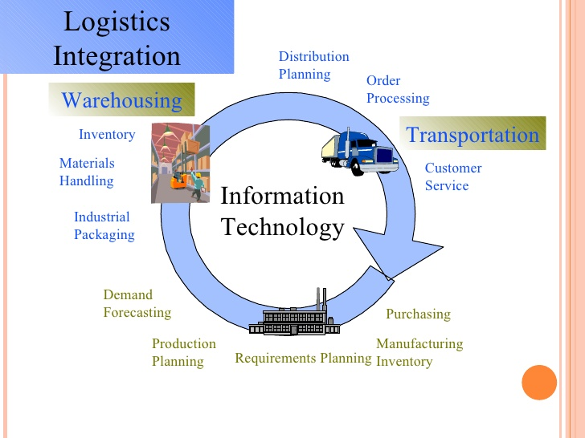

Slide 3
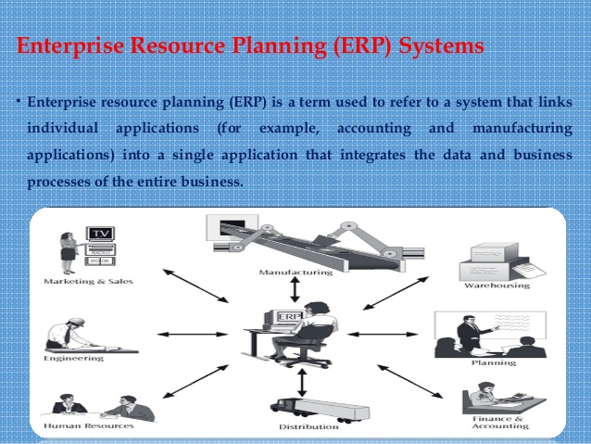

Slide 4
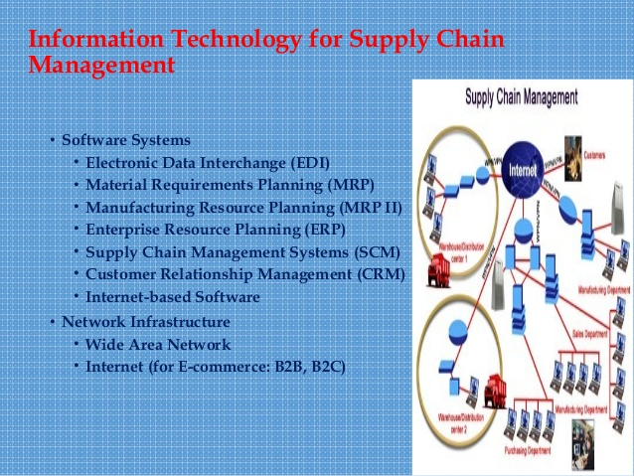

Slide 5
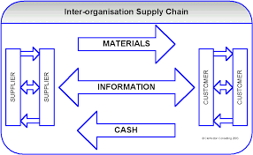

Slide 6
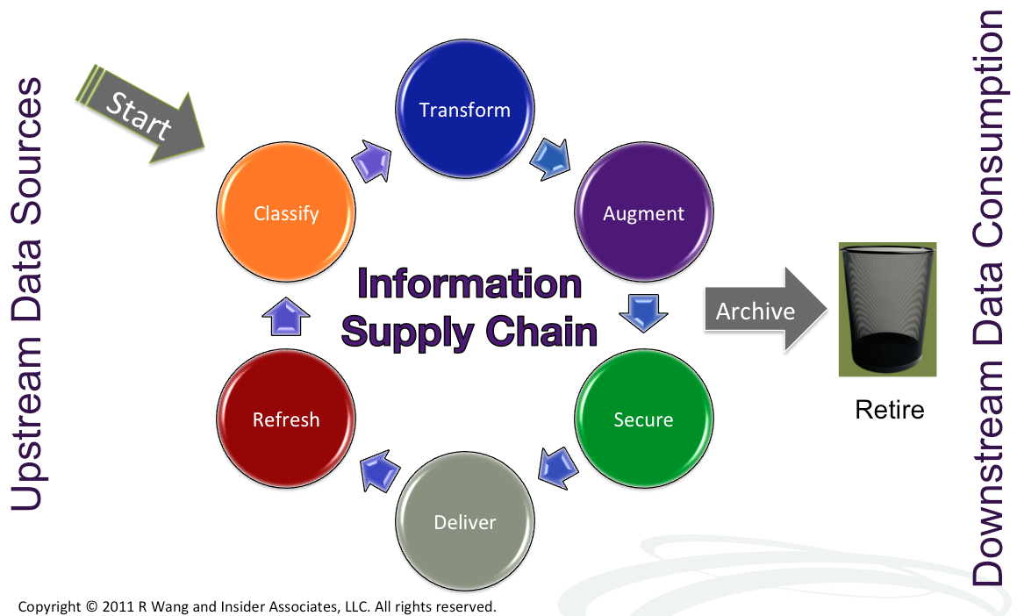

Slide 7
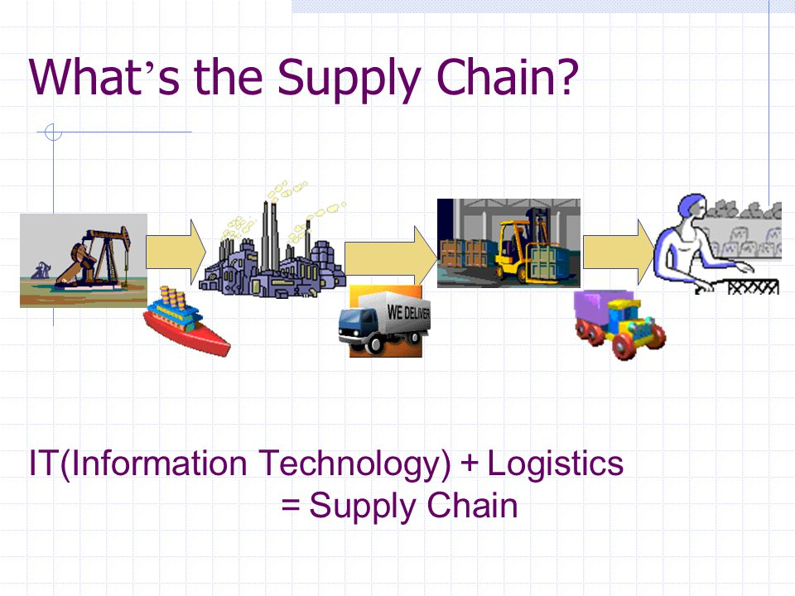

Slide 8
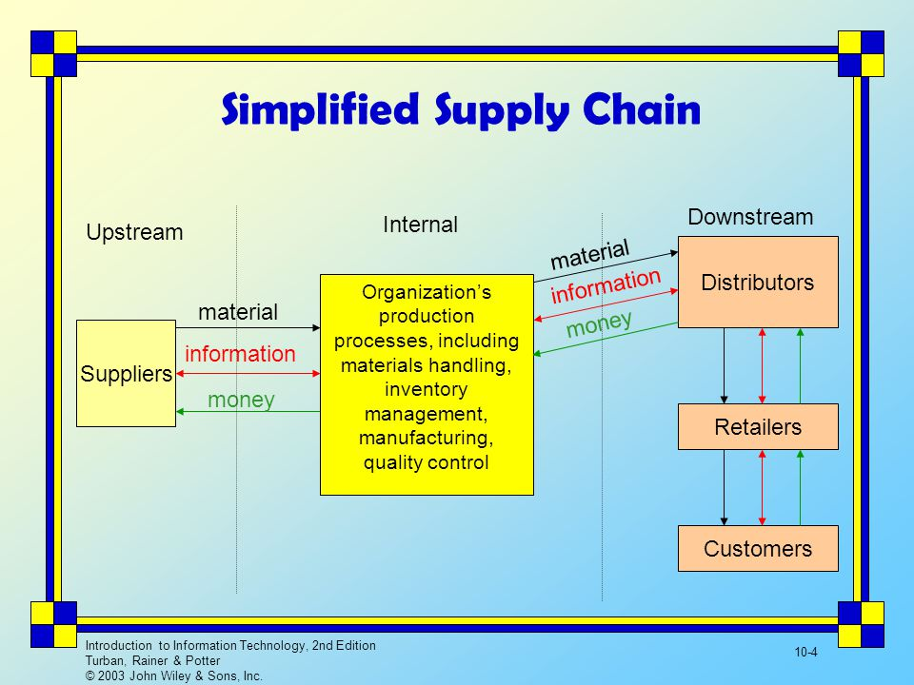

Slide 9
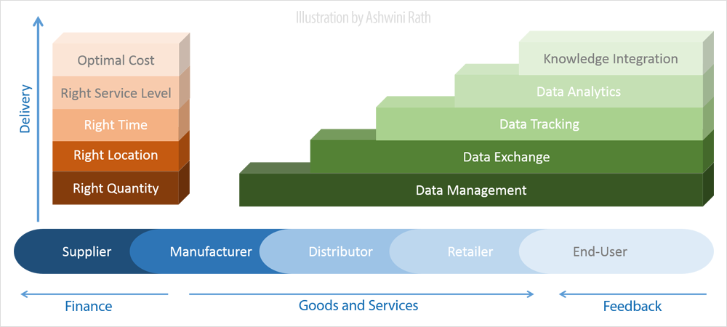
Notes:
The Supply Chain Management (SCM) pertains to managing, exchanging, tracking and analyzing data from suppliers of raw materials to manufacturers, and finally, to customers through all intermediary channels of distribution, transport and retailing so as to ensure delivery of products and services in right quantities at right location in time while maintaining requisite service level with optimal costs. It transcends the organizational boundaries in its scope, and pervades the entire ecosystem to be responsible for its effective functioning.

Slide 10
Supply Chain Information Flows
Customer
Relationship
Management
Supplier
Relationship
Management
Internal Supply
Chain Management
Strategic decision making
Tactical Planning
Routine decision making
Execution and transaction processing

Slide 11
Supply Chain Management Informations Systems Map
Strategic
decision
making
SRM
applications
DSS
CRM
applications
Network Design
Tactical
planning
Warehouse and transportation planning
Routine
decision
making
ERP
Applications
Warehouse management and transport execution
Execution
and
transaction
processing
Suppliers
Internal
Supply Chain
Customers
Logistics

Slide 12
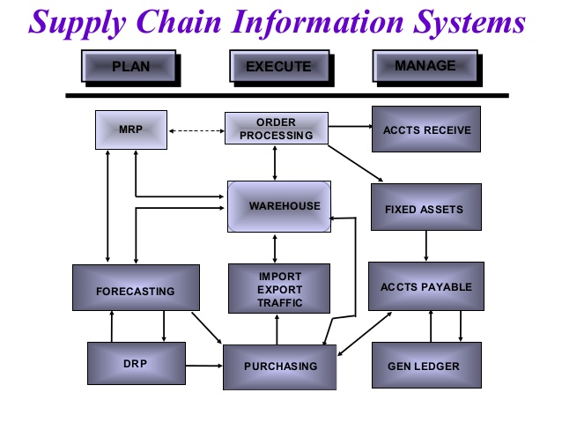

Slide 13
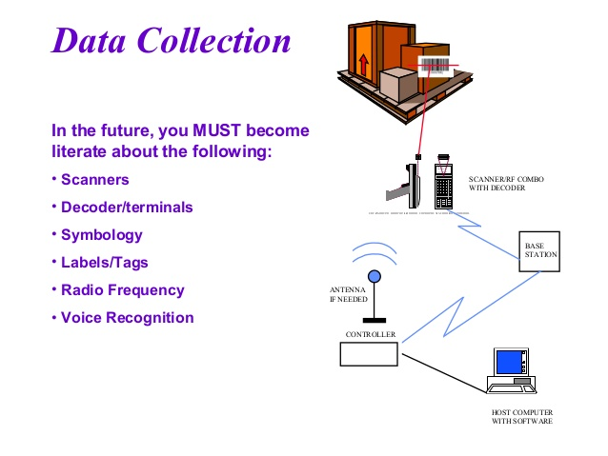

Slide 14
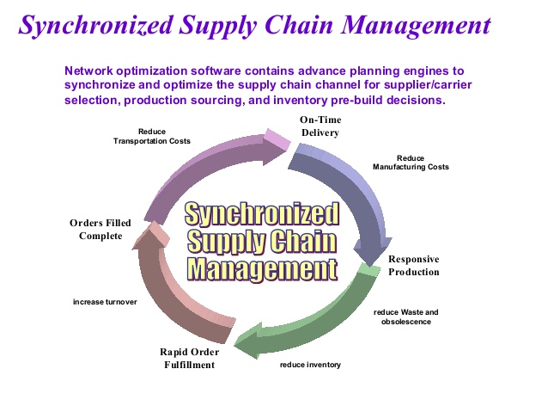

Slide 18
Notes:
‘
‘
\gtfrtggrtrrr5r545443d

