Slide 1
N
Netflix Content Analysis
Big Data Insights Using Hadoop, PySpark & Spark SQL
CSP 554 Big Data Technologies | Illinois Institute of Technology
Fnu Mandakini — Data Ingestion & HDFS Aditya Mandlik — PySpark Processing Jainil Modi — Spark SQL & Analysis Saadullah Mohammed — Python Visualization Shifaa Nazeersaheb Nadaf — Tableau & Reporting

Slide 2
Project Overview
Goal Analyze Netflix's content catalog using a full big data stack from HDFS ingestion to Spark SQL querying and Python visualization to uncover actionable insights about genre trends, geographic distribution, content ratings, and growth patterns.
Team Roles
Fnu Mandakini
Data Ingestion & HDFS
Aditya Mandlik
PySpark Processing
Jainil Modi
Spark SQL & Analysis
7,789
~7,700
Saadullah Mohammed
Python Visualization
Raw Rows
Cleaned Rows
Shifaa N. Nadaf
Tableau & Reporting
CSP 554 — Illinois Institute of Technology
2 / 12

Slide 3
End-to-End Data Pipeline
M1
M2
M3
M4
M5
M6
Literature
Review
HDFS
Ingestion
PySpark
Cleaning
Spark SQL
Analysis
Python
Visualization
Interactive Tableau Dashboard, Report &
Presentation
Fnu Mandakini
Fnu Mandakini
Aditya Mandlik
Jainil Modi
Saadullah Mohammed
Shifaa N. Nadaf
Apr 13
Apr 18
Apr 22
Apr 24
Apr 29
May 3
Netflix CSV → HDFS → Cleaned CSV (7,700 rows, 20 cols) → SQL Results → 6 Visualizations → Report
CSP 554 — Illinois Institute of Technology
3 / 12

Slide 4
Dataset at a Glance
7,631
69%
31%
Total Titles
Movies
TV Shows
after cleaning & dedup
5,268 titles
2,363 titles
2019
#1
US
Peak Year
Top Genre
Top Country
2,126 titles added
Dramas (1,373)
2,795 titles
CSP 554 — Illinois Institute of Technology
4 / 12

Slide 5
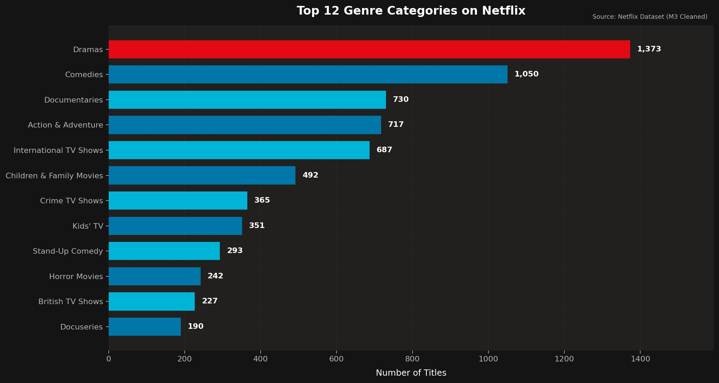
Finding 1: Genre Distribution
Top 12 Genre Categories on Netflix | Source: M3 Cleaned Dataset
Key Insights
Dramas lead with 1,373 titles — 31% more than Comedies (1,050)
Documentaries (730) and Action & Adventure (717) form a strong mid-tier
International TV Shows rank 5th (687), showing strong global content investment
Kids' content (Children & Family + Kids' TV) totals 843 titles
Stand-Up Comedy (293) highlights demand for short-form entertainment
CSP 554 — Illinois Institute of Technology
5 / 12

Slide 6
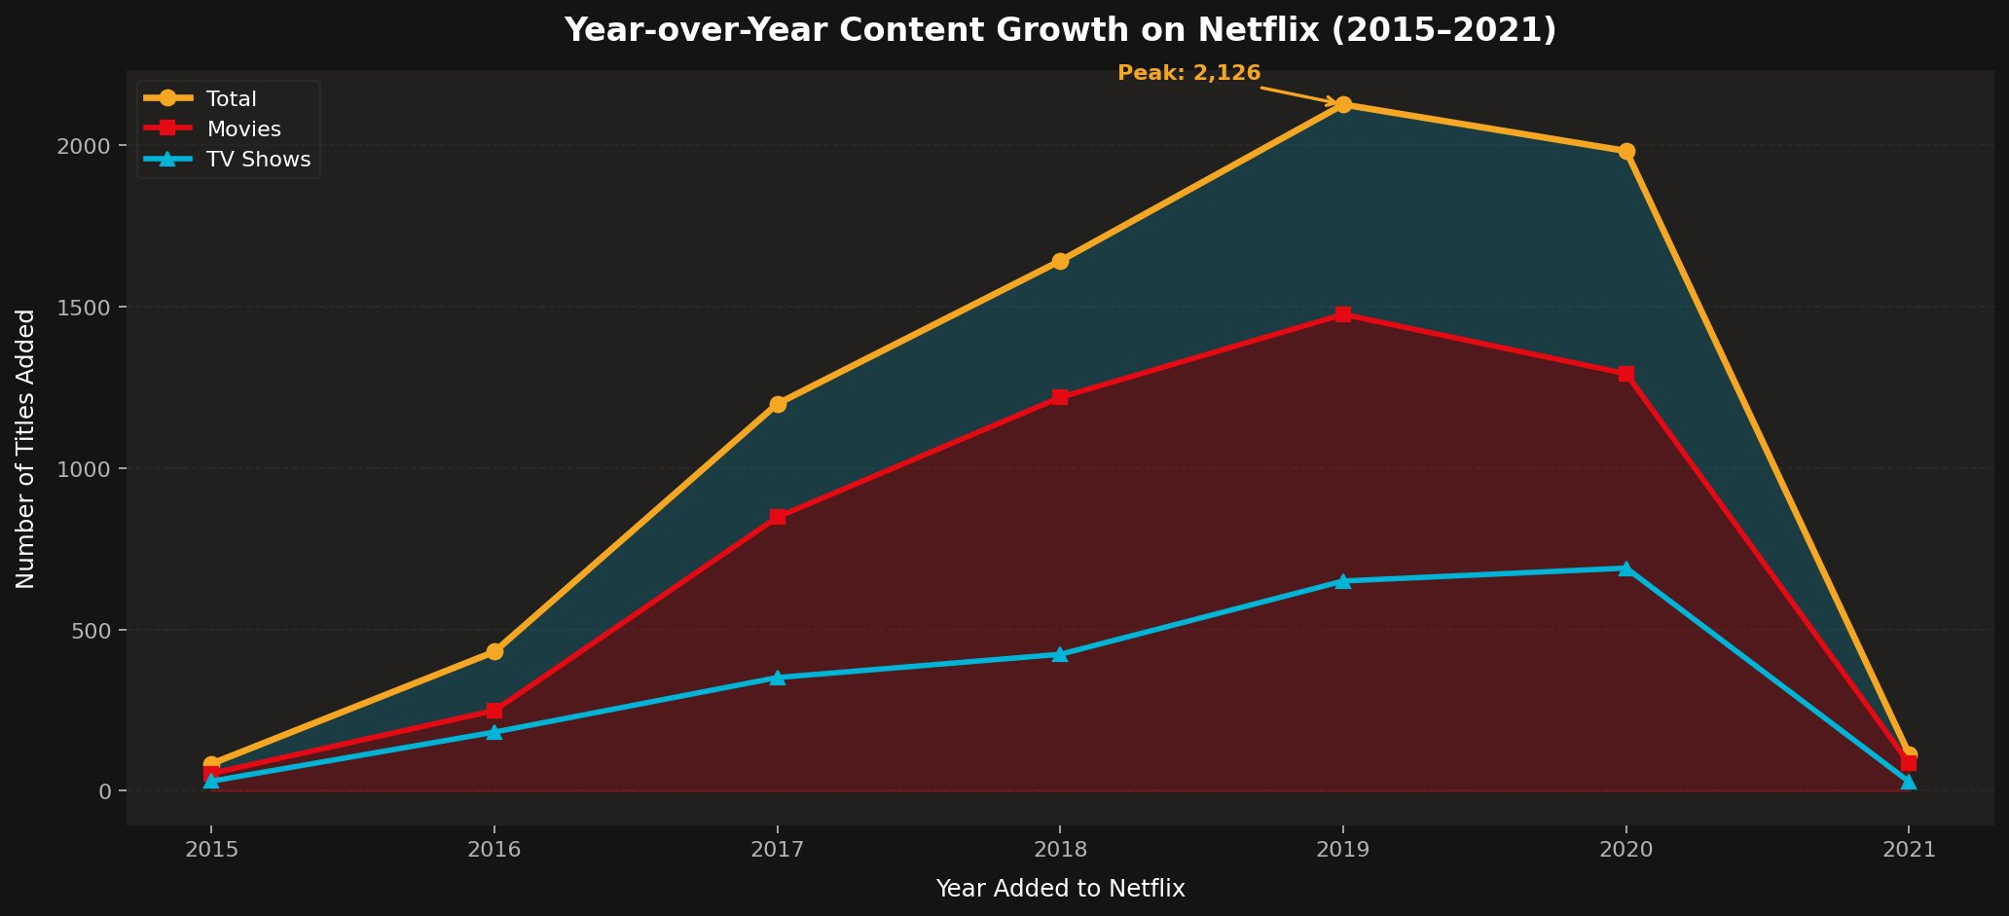
Finding 2: Content Growth Trends
Year-over-Year Titles Added to Netflix | 2015 – 2021
Key Insights
Peak: 2,126 titles added in 2019 — a 25× increase since 2015
Movies consistently outnumber TV Shows in annual additions
2020 saw a 7% decline from peak (1,982 total), linked to production slowdowns
2021 data appears truncated due to mid-year dataset cutoff
TV Show additions remained steadier (650–710) from 2019–2020
CSP 554 — Illinois Institute of Technology
6 / 12

Slide 7
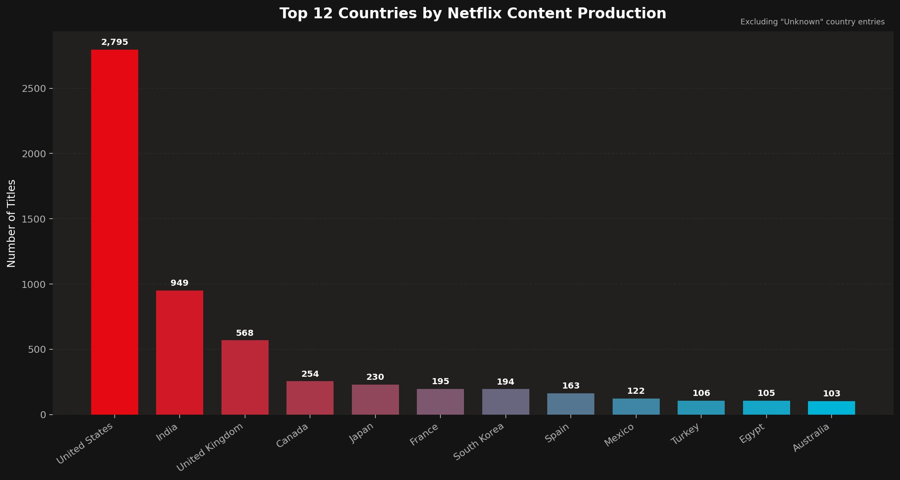
Finding 3: Geographic Breakdown
Top 12 Countries by Netflix Content Production | "Unknown" entries excluded
Key Insights
United States dominates with 2,795 titles — 36% of the known catalog
India is a strong #2 at 949 titles (12%), driven by Bollywood & regional content
UK (568) and Canada (254) reflect English-language licensing depth
South Korea (194) punches above its weight — Korean drama demand is global
Egypt (105) is the only African country in the top 12, signaling growth opportunity
CSP 554 — Illinois Institute of Technology
7 / 12

Slide 8
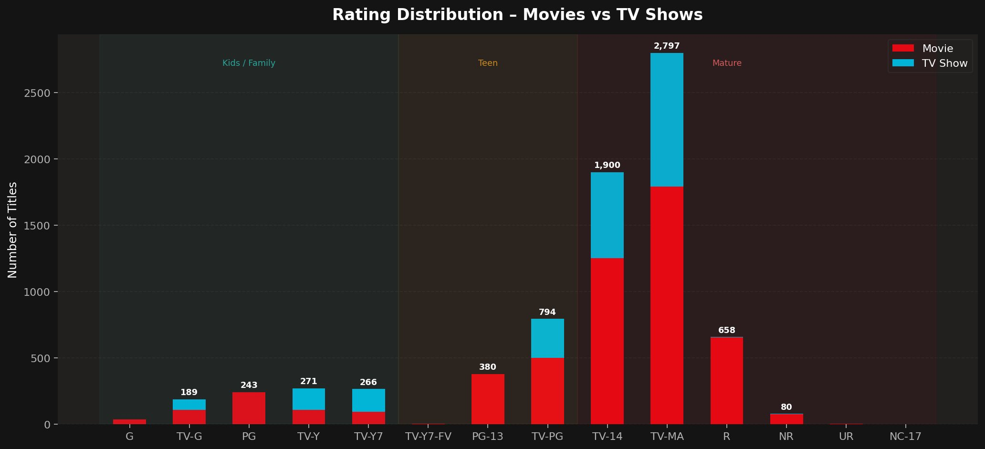
Finding 4: Rating Distribution
Content Ratings by Type — Movies vs TV Shows | Stacked View
Key Insights
TV-MA dominates: 2,797 titles — nearly 1 in 3 of all Netflix content
TV-14 (1,900) is second — together TV-MA + TV-14 = 62% of the catalog
Mature & Teen content = ~87% of the library, reflecting adult-first strategy
Kids/Family zone (G through TV-Y7) totals ~969 titles (13%)
R-rated movies add 658 more adult titles not in the TV rating system
CSP 554 — Illinois Institute of Technology
8 / 12

Slide 9
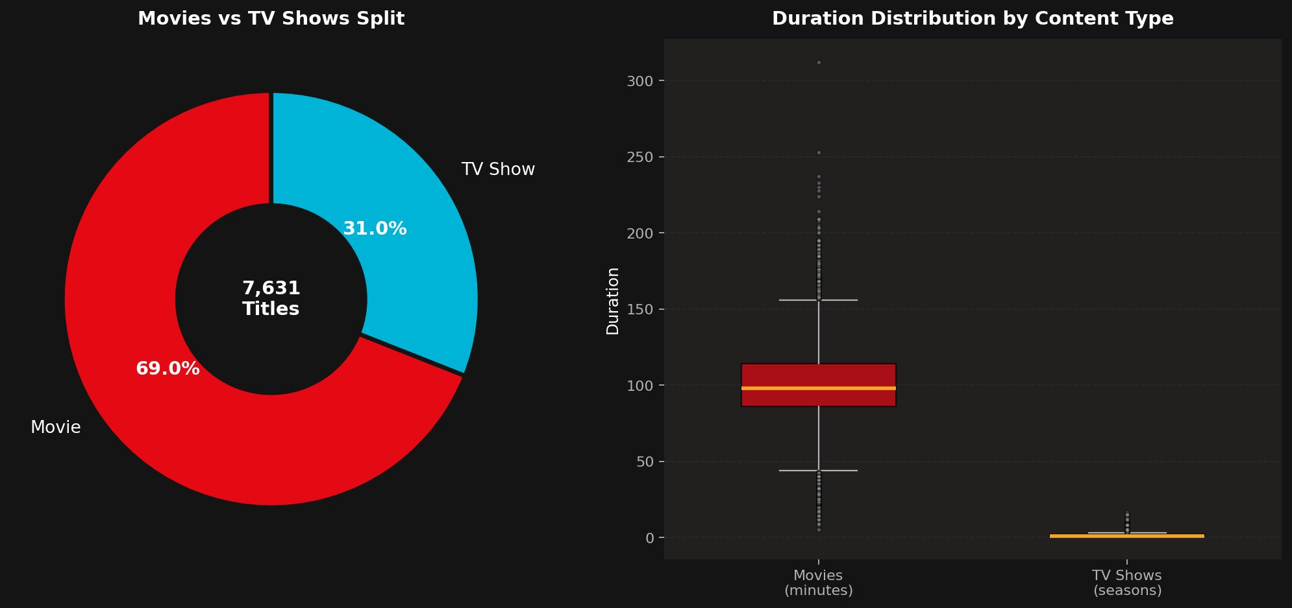
Finding 5: Content Type & Duration
7,631 Total Titles — Movies vs TV Shows Split and Duration Distribution
Key Insights
Movies are 69% of the catalog (5,268) vs TV Shows at 31% (2,363)
Median movie runtime ≈ 100 minutes; IQR: 85–115 minutes
Median TV Show duration = 1 season; most have 1–3 seasons
TV Show outliers > 10 seasons are legacy broadcast series
Despite TV Show minority in volume, they drive most press & subscriber buzz
CSP 554 — Illinois Institute of Technology
9 / 12

Slide 10
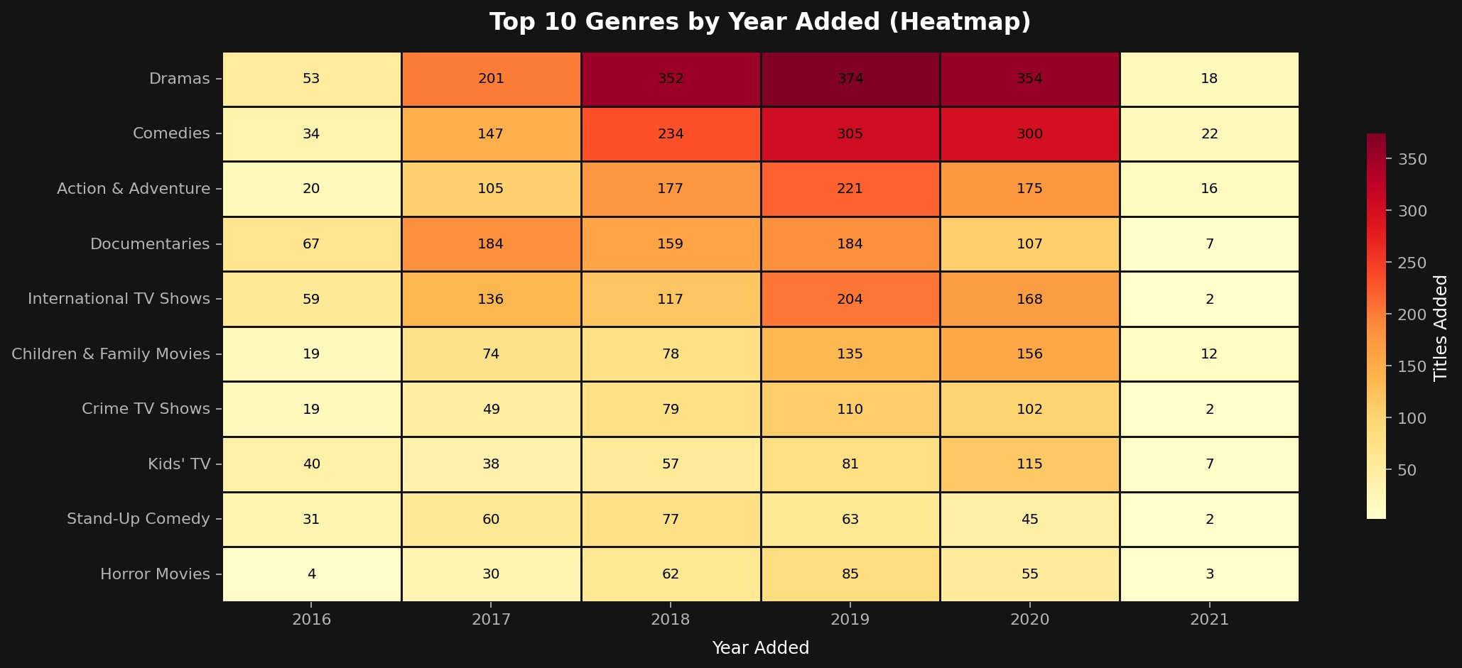
Finding 6: Genre Trends Over Time
Top 10 Genres by Year Added | Heatmap View | 2016 – 2021
Key Insights
Dramas peaked in 2019 (374) and stayed high in 2018 & 2020
Documentaries showed a distinct plateau — 184 in 2017, 2019 — then dropped
Children & Family Movies showed a rising trend through 2020 (156)
Stand-Up Comedy peaked in 2017–2018, then gradually declined
2021 near-zero values reflect mid-year dataset cutoff, not real decline
CSP 554 — Illinois Institute of Technology
10 / 12

Slide 11
Conclusions
Drama-Dominant Library
2019 Content Peak
US & India Dominate
01
Dramas (1,373) and Comedies (1,050) form the backbone of Netflix's catalog essential for recommendation systems.
02
Additions surged to 2,126 in 2019 a 25× increase from 2015 then declined, signaling market maturation.
03
US (2,795) and India (949) together account for 48% of known-country content. South Korea (194) punches above weight.
Mature-Skewed Ratings
Movies Outnumber Shows
04
TV-MA + TV-14 = 62% of the catalog. Netflix is fundamentally an adult entertainment platform.
05
At 69:31, movies dominate by volume but TV Shows are Netflix's primary brand-building vehicle.
CSP 554 — Illinois Institute of Technology
11 / 12

Slide 12
Thank You
Questions & Discussion
Dataset: github.com/rfordatascience/tidytuesday | Course: CSP 554 — Illinois Institute of Technology

