Slide 1
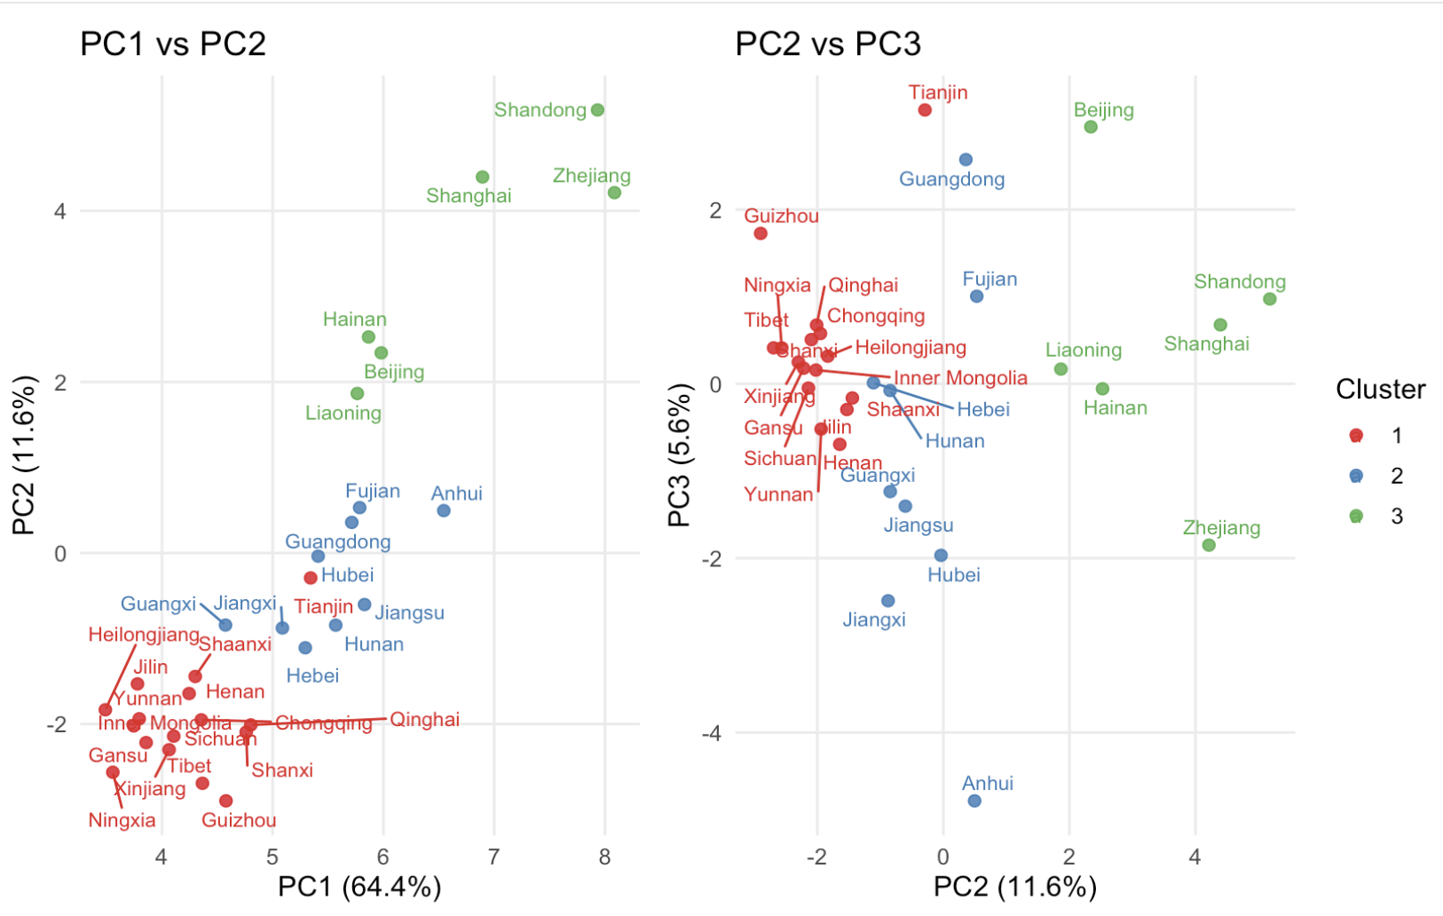
PCA using environmental antibiotics concentrations (Zhang) and Antibiotics resistance data (CARSS) for each province
3 groups distinguished by K-means clustering. These groups of provinces have similar patterns of antibiotic resistance and environmental contamination.
Compare resistance to antibiotics and sediment antibiotics concentrations between three groups
What do provinces in each group have in common? (look at yearbook statistics)

