Slide 1



Input Data
Standardization and
Harmonization
Province-level interoperable datasets
Literature
env_province.csv
    1,672 Records
    31 Provinces
    108 Antibiotics
    6 Matrices
    175 Source refs
    Years 2005-2025
Environmental antibiotics concentrations
    Consistent Antibiotic names (INN)
    Mapping to Antibiotic classes
    Unifying sample types (Matrices)
    Harmonizing Provinces
    Standardized matrix-specific units
CARSS
resistance_province.csv
Clinical microbial antibiotics
resistance
    16,461 Records
    31 Provinces
    34 Antibiotics
    5 Pathogens
    Years 2019-2024
NBS
yearbook_province.csv
Statistical Yearbook Socioeconomic metrics
    1,302 Records
    31 Provinces
    24 Metrics
    Years 2015-2025

Slide 2
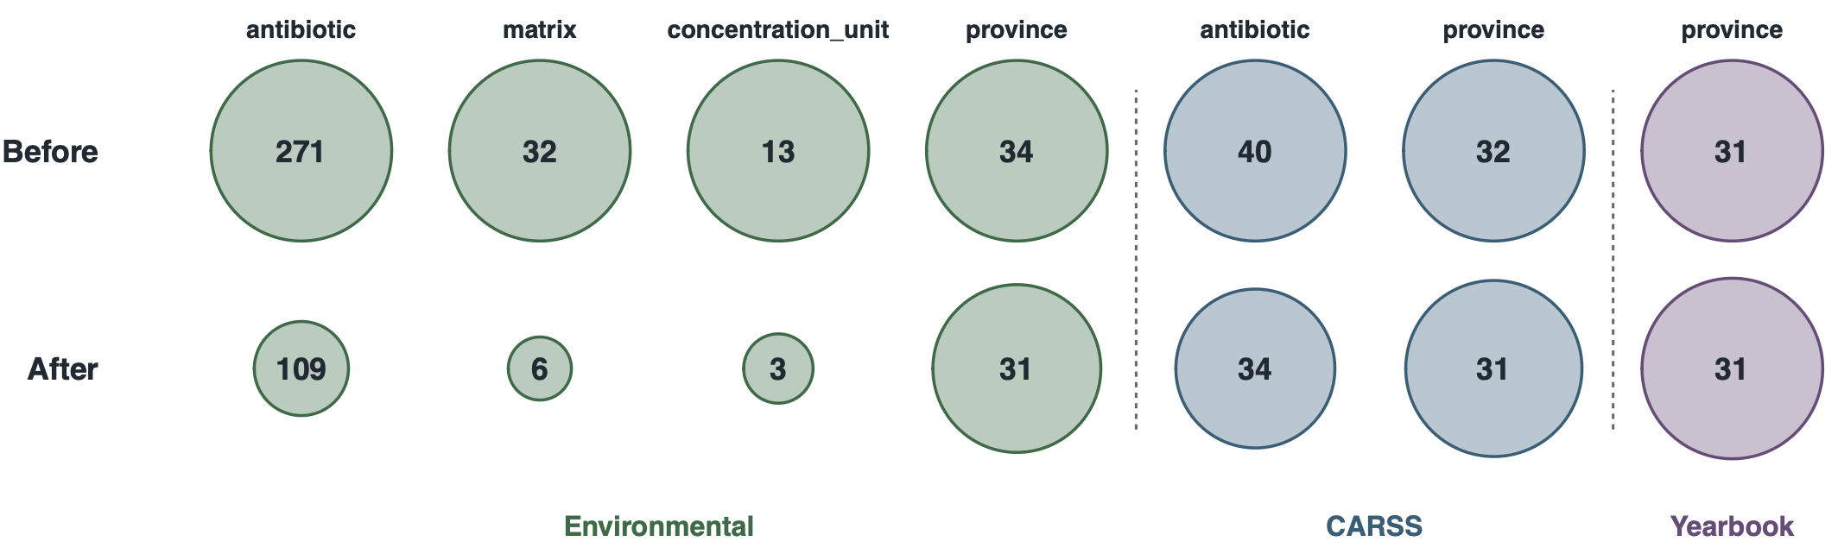
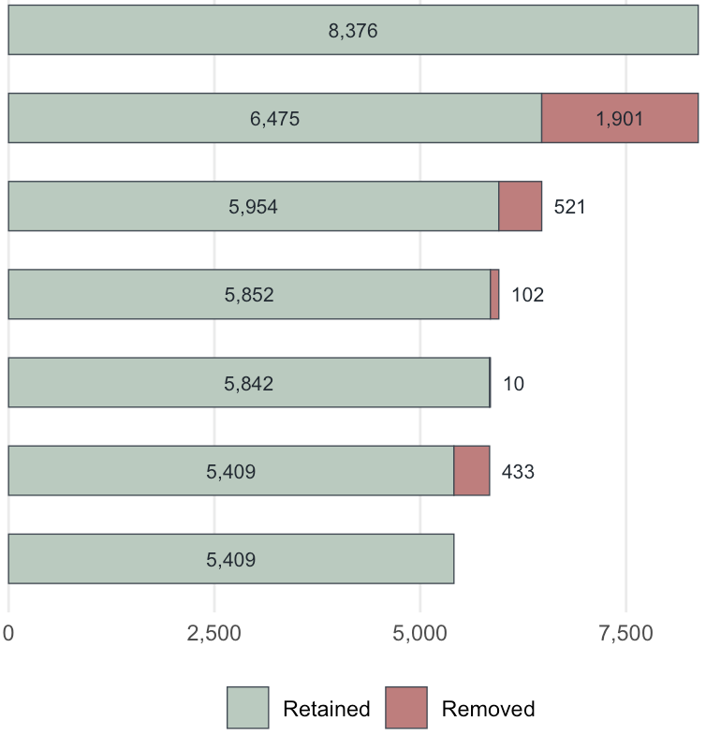
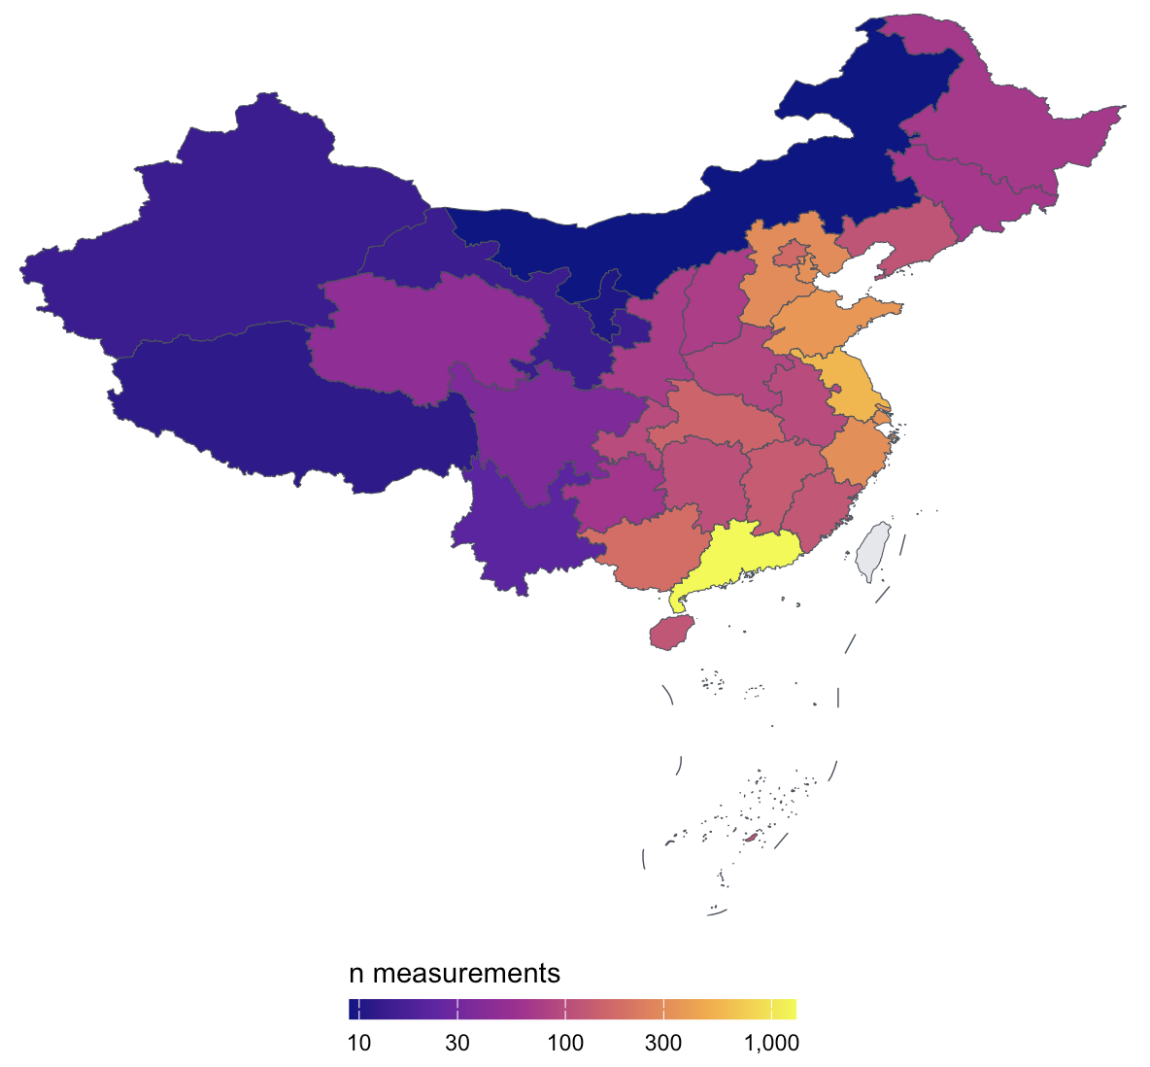
A
Unique values before vs after harmonization
B
Environmental records QC filters
C
Sample density | geographical skew
Inputs: Raw environmental measurements
n records
8,360
Missing concentration or antibiotic name excluded
8,360
Non-province place excluded
6,475
Class totals / non-antibiotics / solid waste
5,954
Incompatible unit - matrix pairs
5,852
Duplicates (source-rank / season collapse)
5,842
Retained env_records: cleaned measurements
5,409

Slide 3
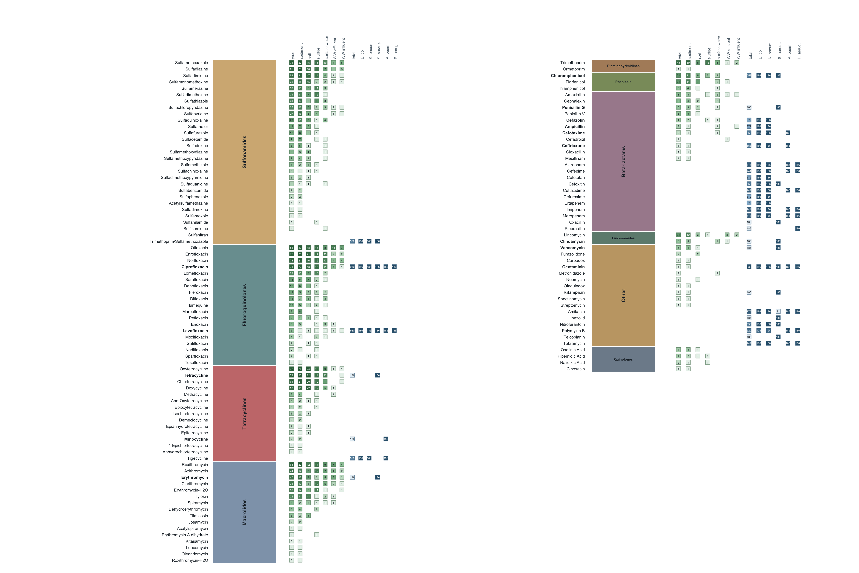
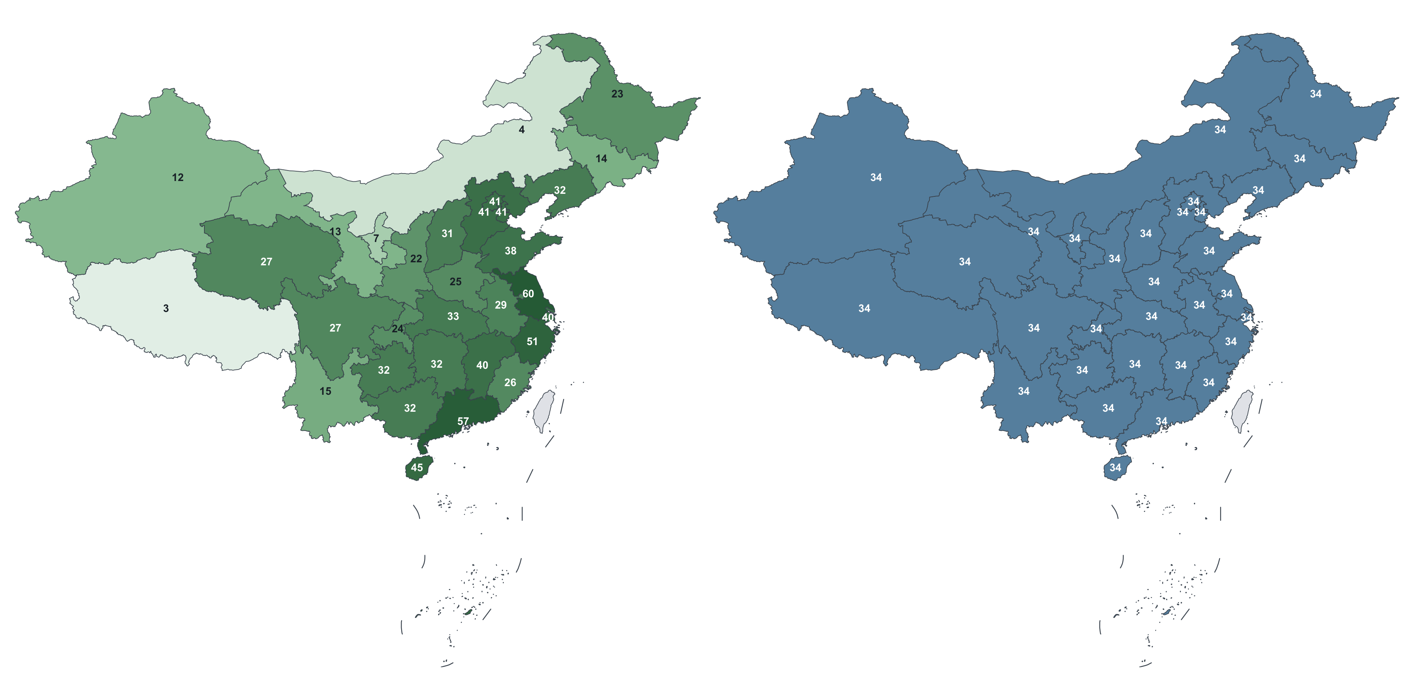
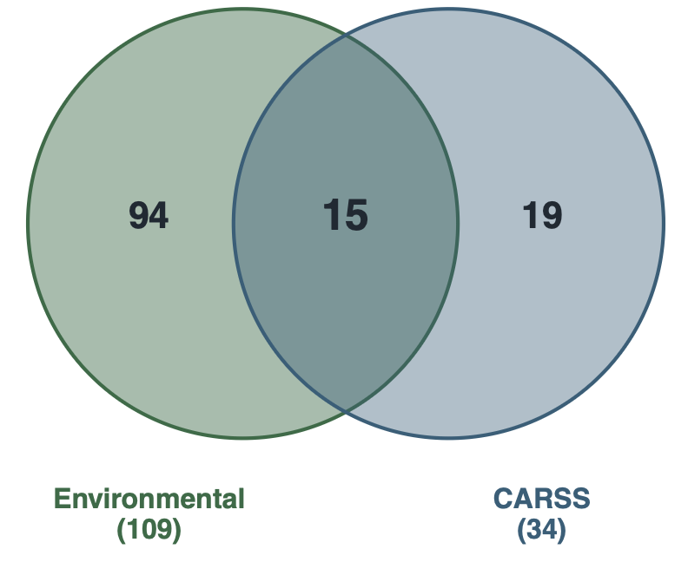
A
Antibiotics coverage by dataset and sample groups
B
Environmental vs CARSS
antibiotics
C
Environmental antibiotics coverage by province

