Slide 1
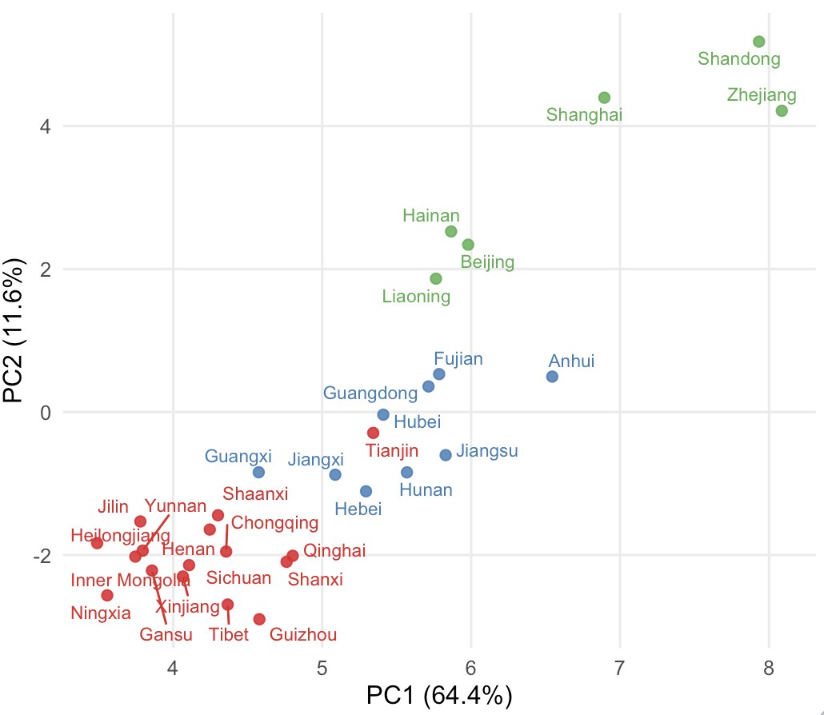
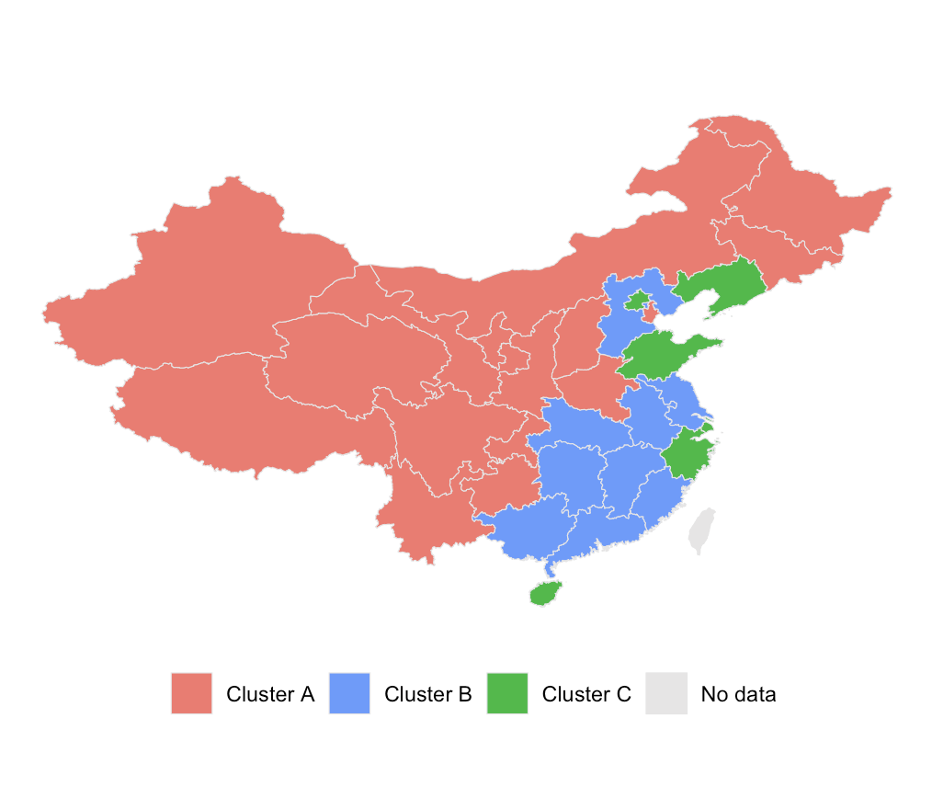
A
B
Zhang data curated by me
Notes:
Plots made in Script R/analysis/province_group_by_antibiotics.R

Slide 2
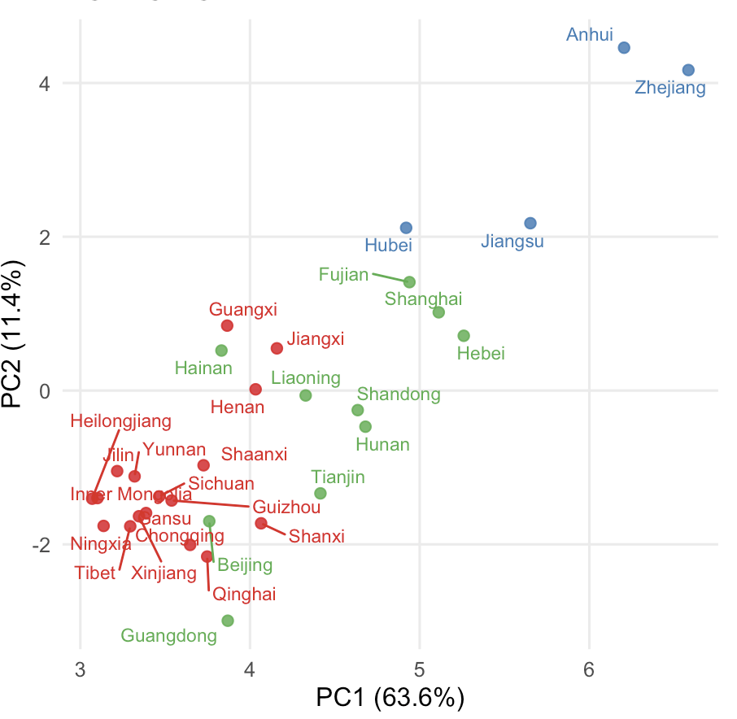
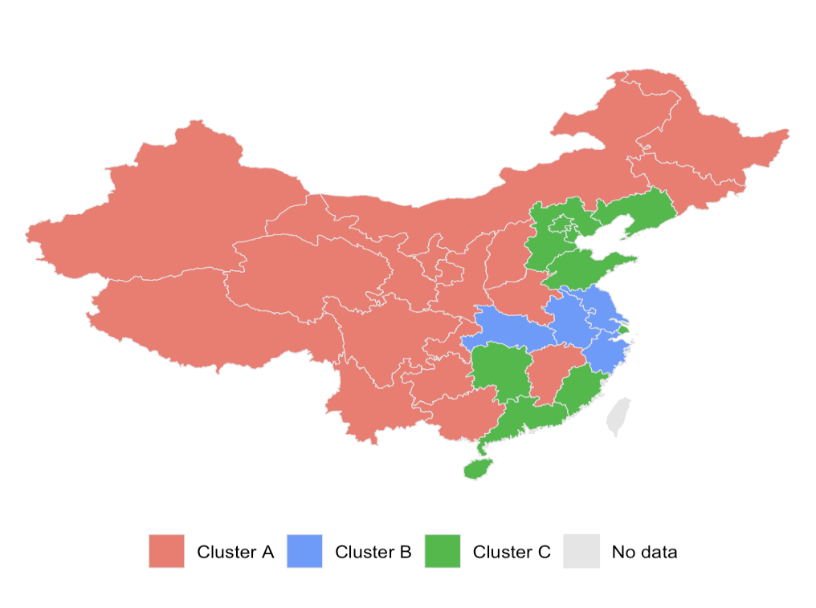
A
B
Interpolated values
Notes:
Plots made in Script R/analysis/province_group_by_antibiotics.R

Slide 3
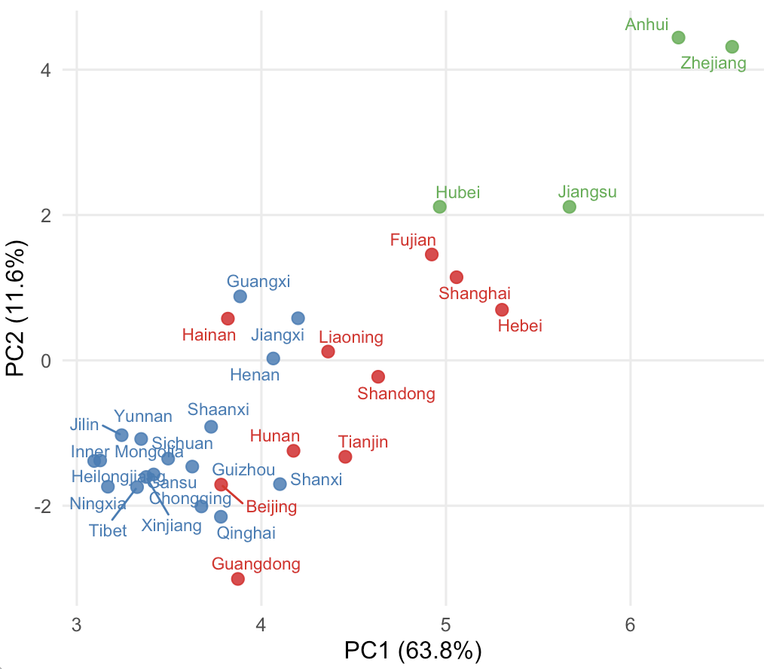
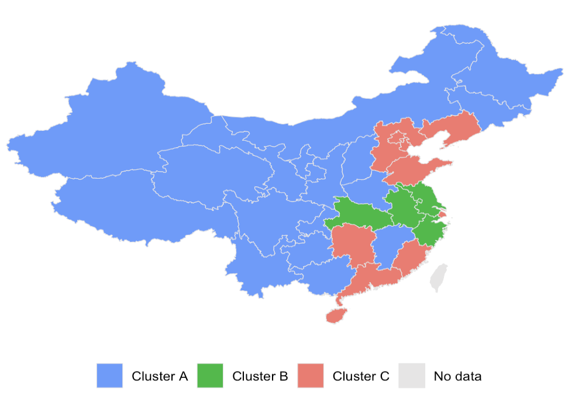
A
B
Not interpolated values
Notes:
Plots made in Script R/analysis/province_group_by_antibiotics.R

Slide 4
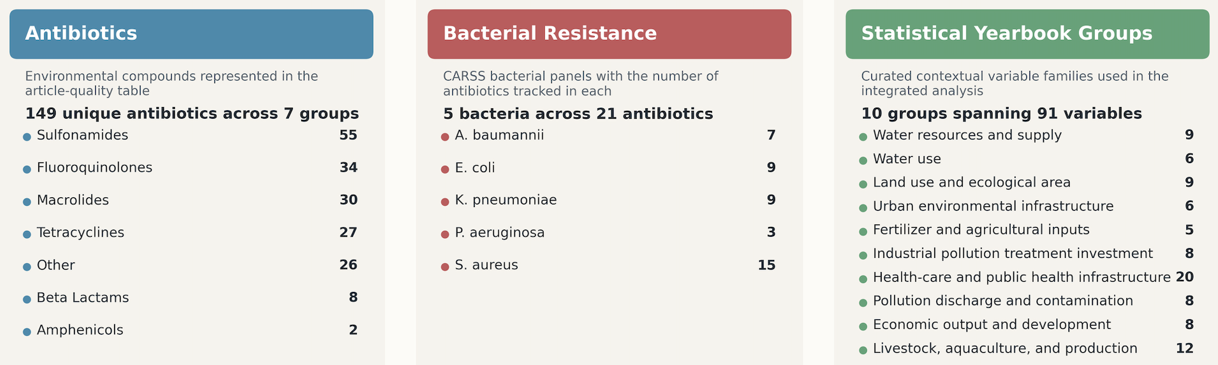

Slide 5
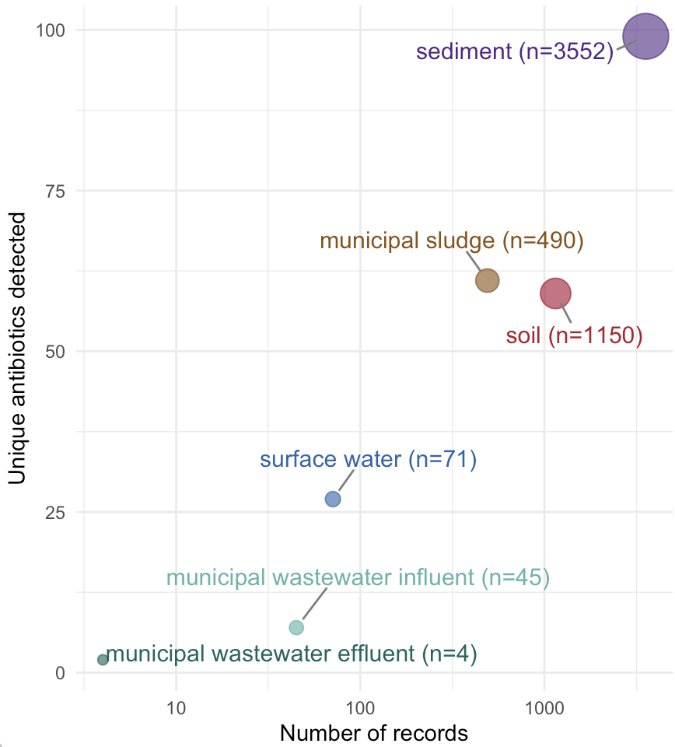
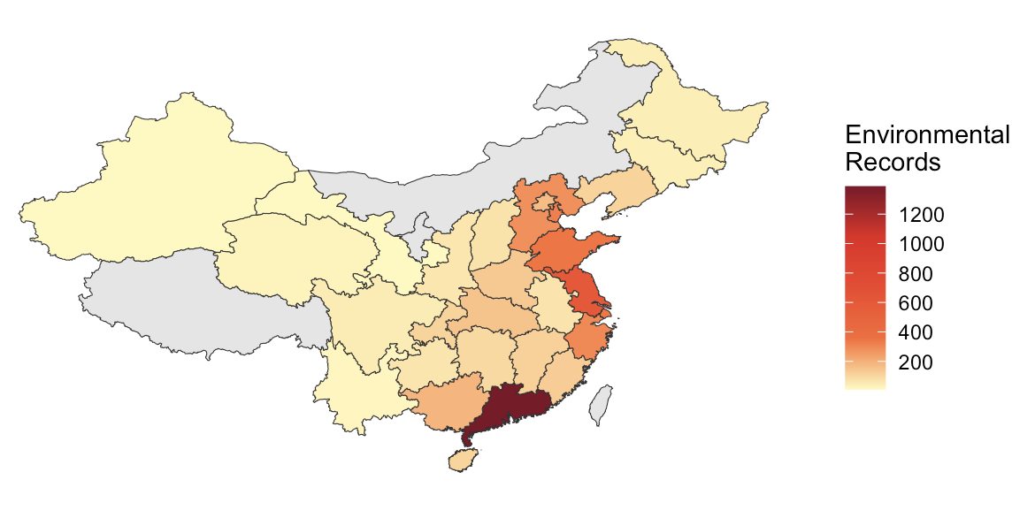
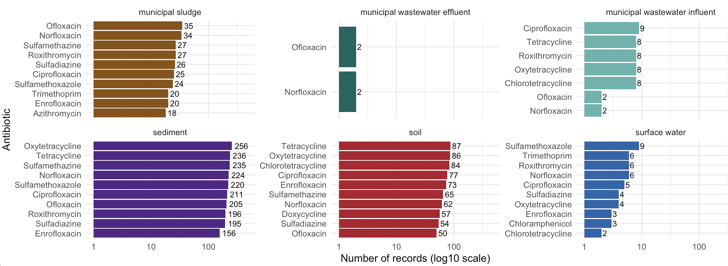
A
B
C
Notes:
Improve: instead of N, also show the 35 reported means and max

Slide 6
Environmental Concentrations 2004-2024
Clinical Antibiotic Resistance 2024
5308 records 7676 measurements
28 provinces 222 peer-reviewed studies
111 antibiotics
5 matrices:
1189 antibiotic resistance records
31 provinces
18 antibiotics
5 bacteria:
sediment
soil
municipal sludge
surface water
municipal wastewater influent
3552
1150
490
71
45
S. aureus
E. coli
K. pneumoniae
A. baumannii
P. aeruginosa
321
279
279
217
93
Unique Antibiotics
Socioeconomic Variables 2024
unique antibiotics
2849 statistical records
93 Statistical Yearbook variables
31 provinces
10 groups:
Groups
Environmental
Clinical
sulfonamides
fluoroquinolones
macrolides
tetracyclines
beta-lactams
amphenicols
other
42
26
21
21
7
2
26
Water resources
Water use
Land use and ecological area
Urban environmental infrastructure
Fertilizer and agriculture inputs
Industrial pollution treatment investment
Public health infrastructure
Pollution discharge and contamination
Economic output and development
Livestock, aquaculture and production
9
6
9
6
5
8
20
8
8
12
100
11
7

Slide 7
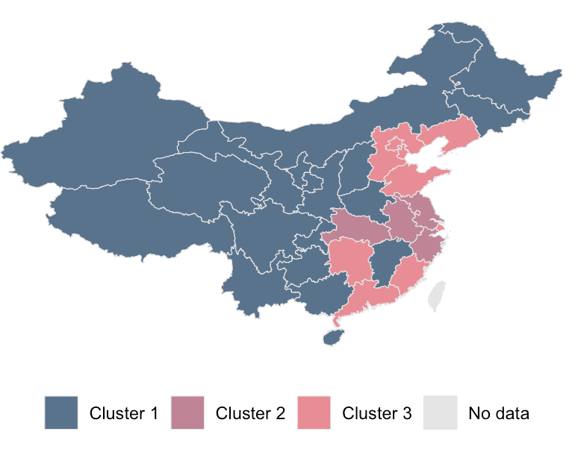
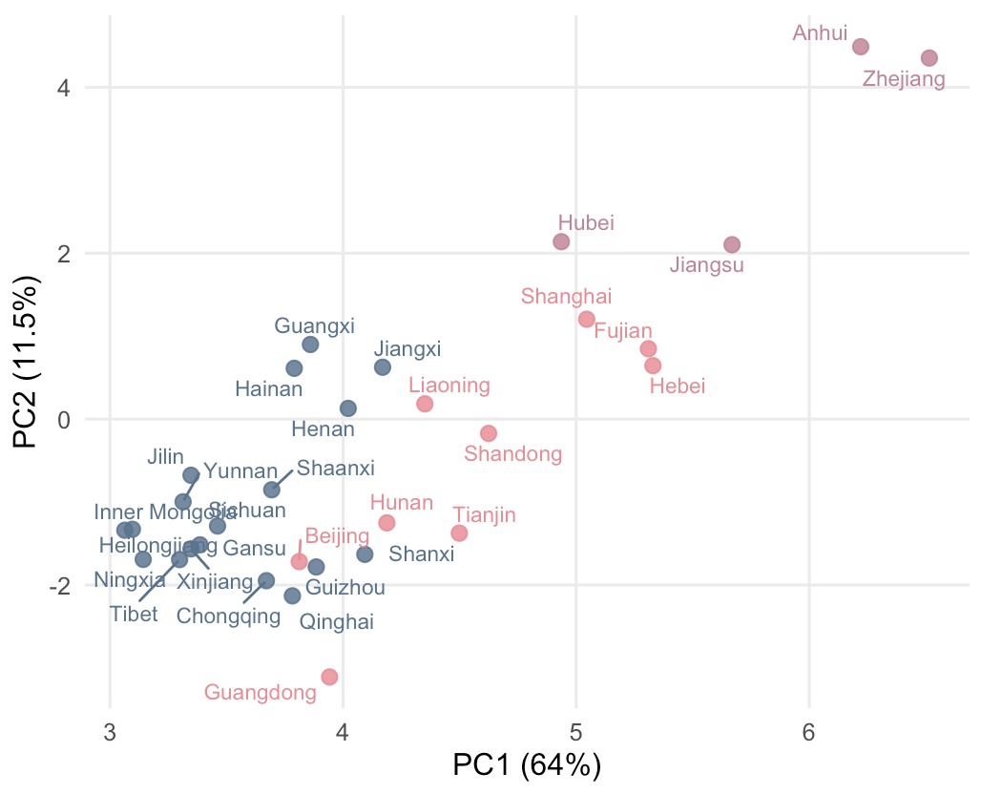
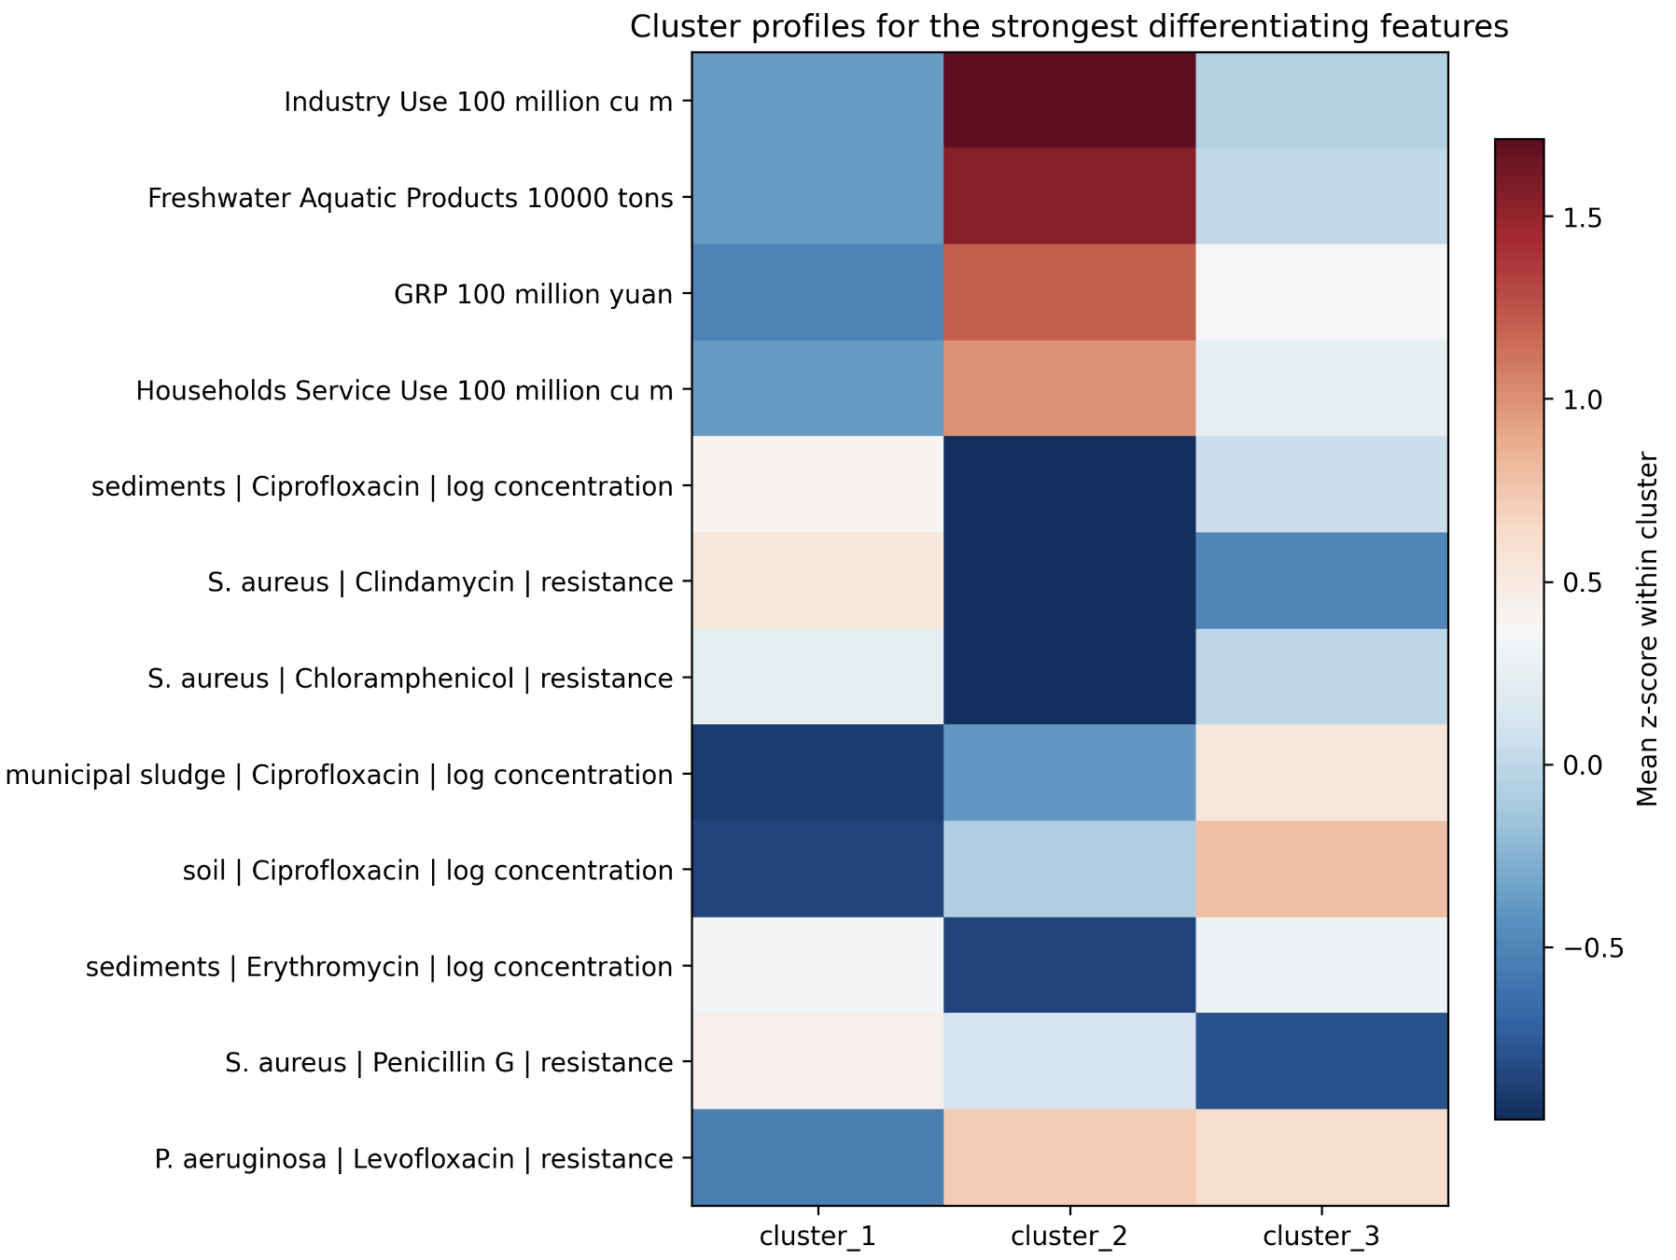
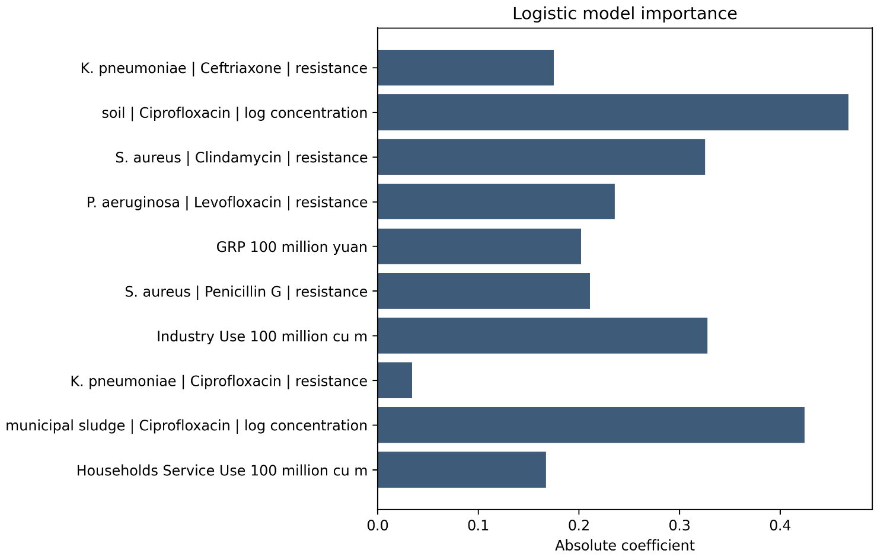
A
K3 Provincial Clustering
B
PCA & K-means Clustering
C
K3 Strongest Differentiating Features
D
K3 Top Explanatory Features
Notes:
Plots made in Script R/analysis/province_group_by_antibiotics.R. add names of clusters, change color scheme. Add heatmap of feature importance.

Slide 8
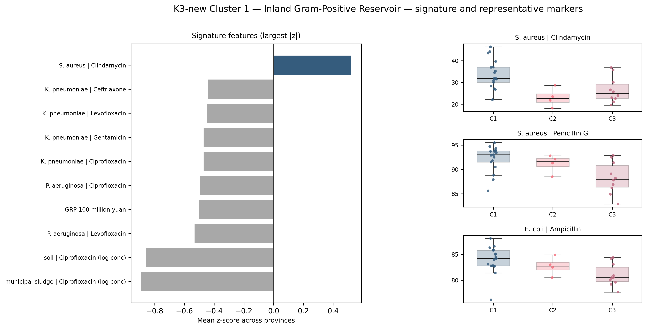
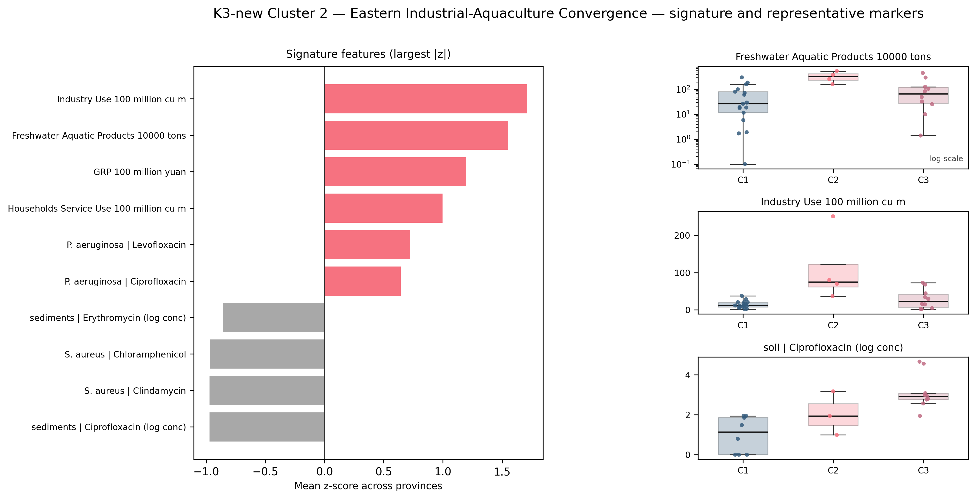
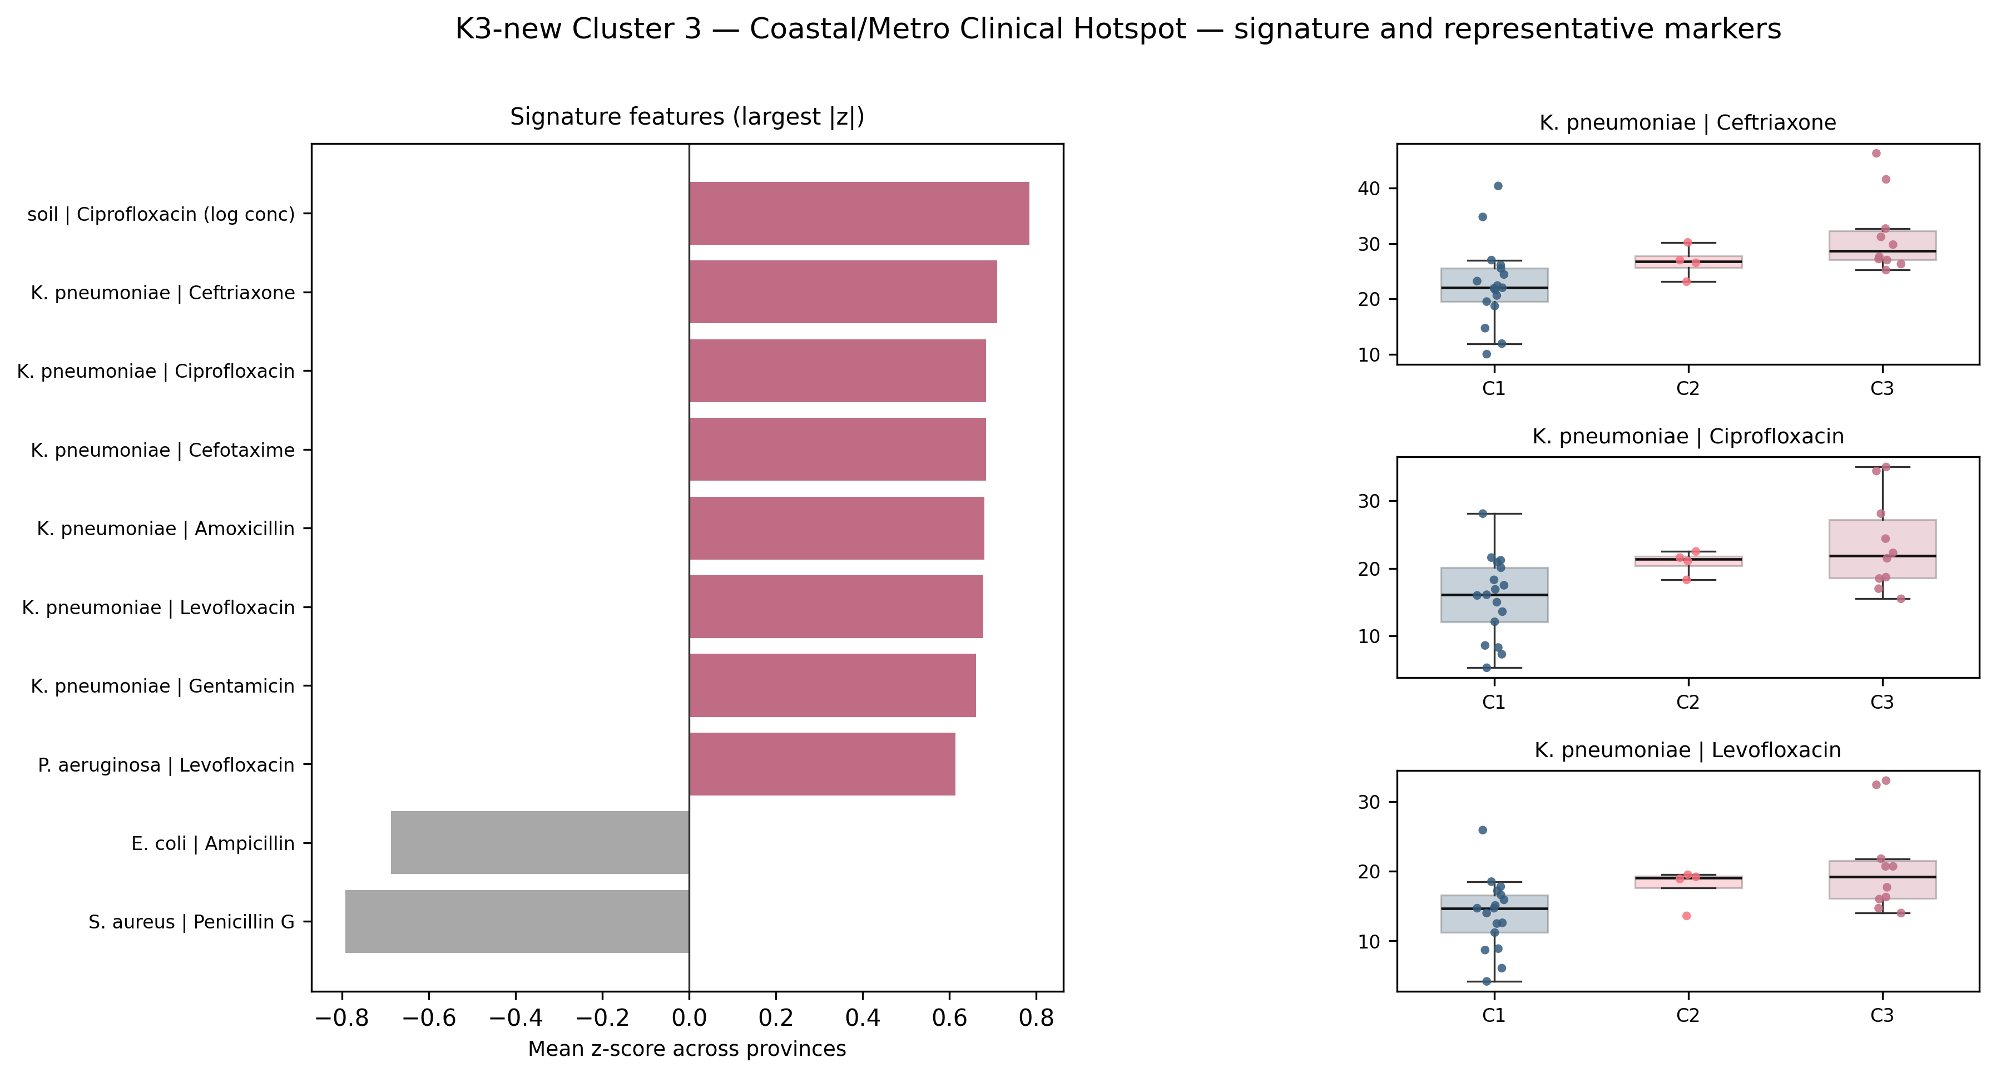
Cluster 1 Inland Gram-Positive Reservoir
Cluster 2 Eastern Industrial Aquaculture
Cluster 3 Coastal Clinical Hotspot

Slide 9
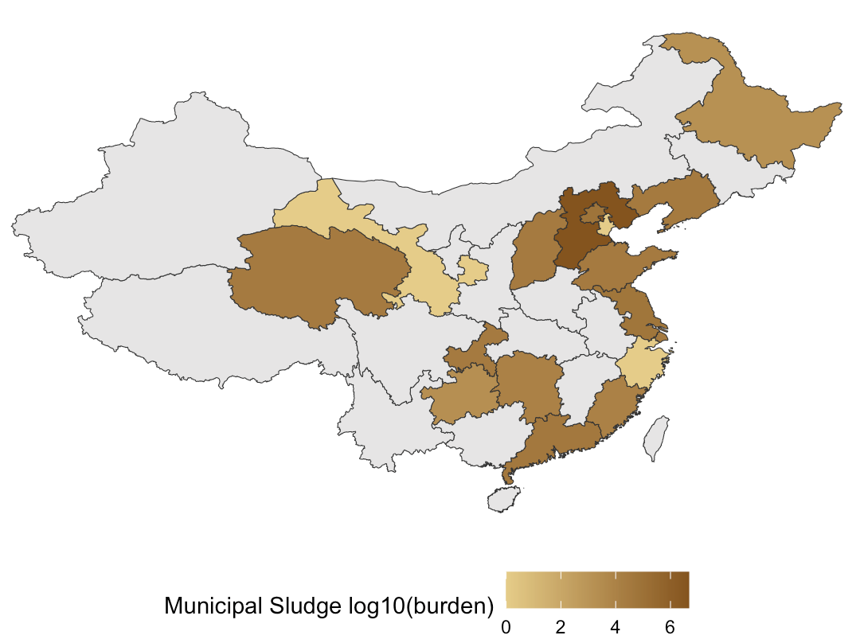
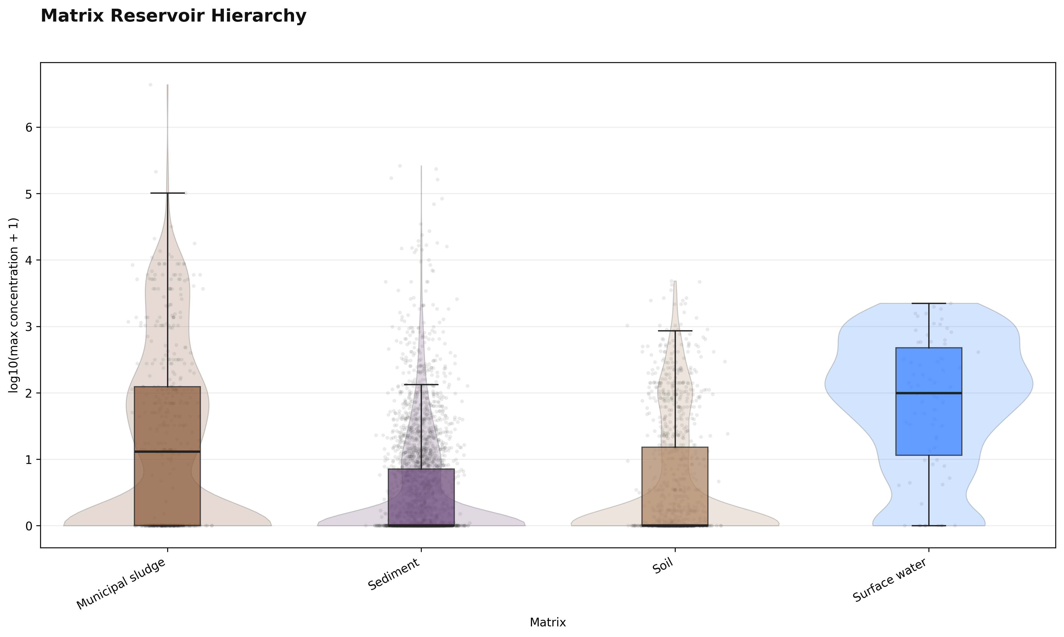
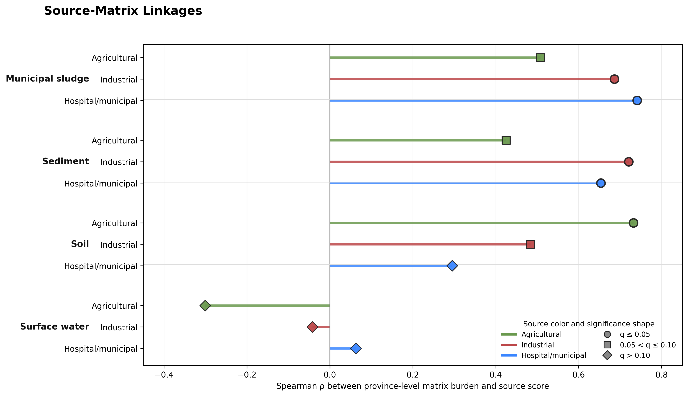
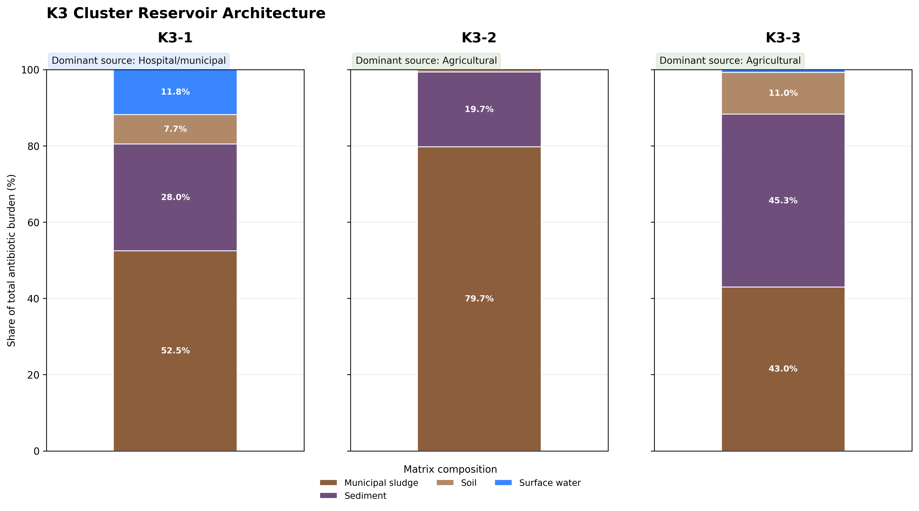
A
Environmental Burden
B
Matrix Reservoir Hierarchy
C
Source-Matrix Linkages
D
Cluster Reservoir Architecture

Slide 10
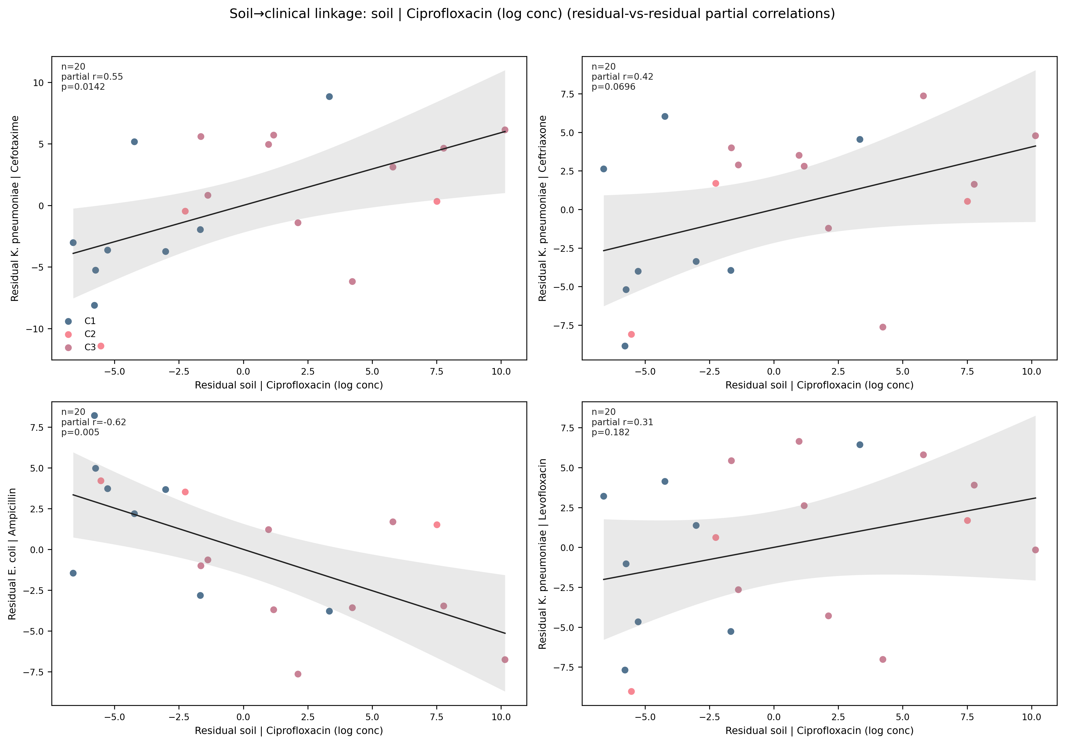
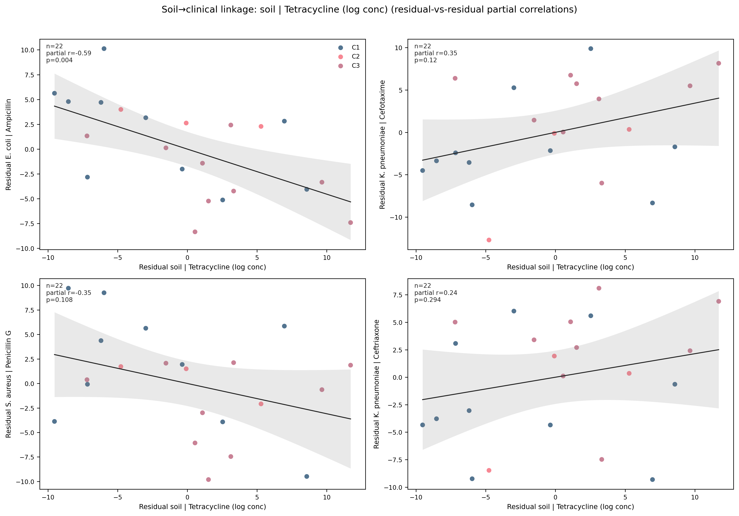
A
Soil – Ciprofloxacin
B
Soil - Tetracycline

Slide 11
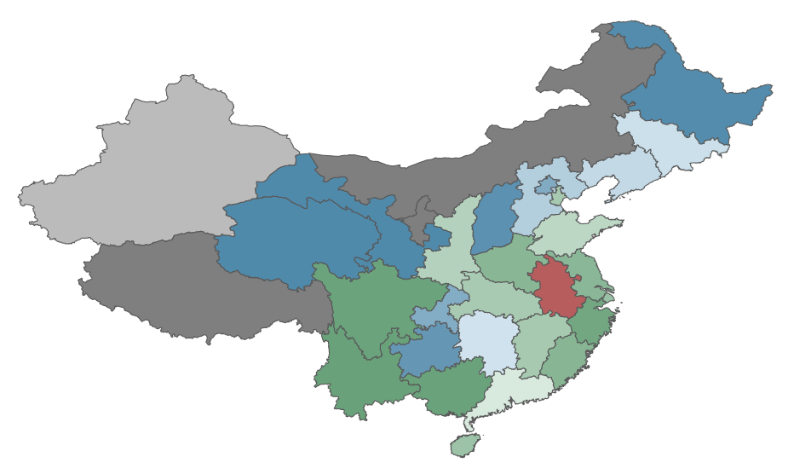
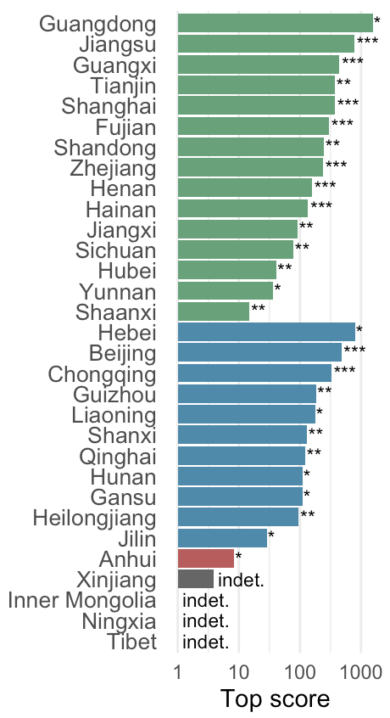
A
Relative Margin
B
Top Scores

