Slide 1
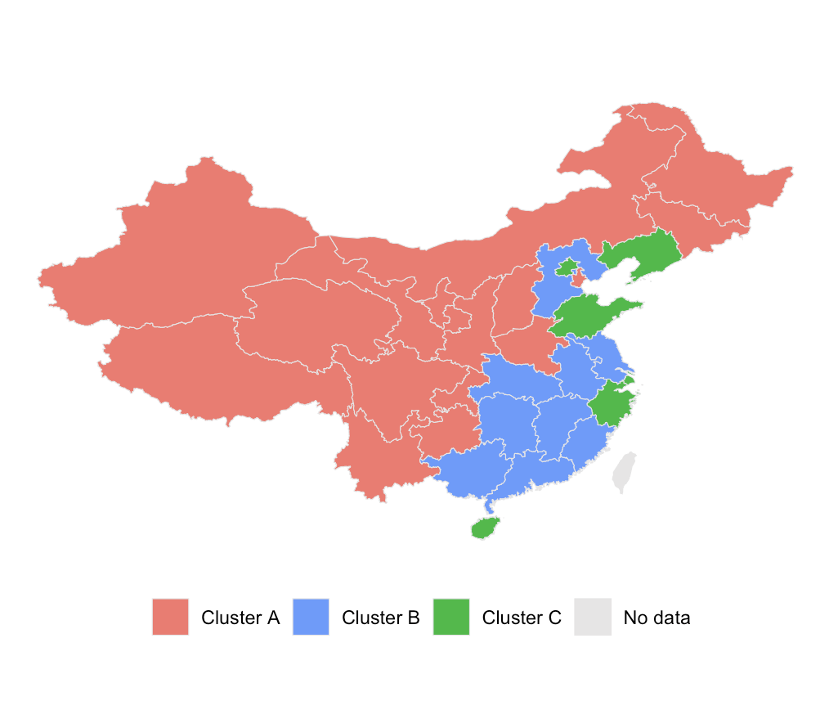
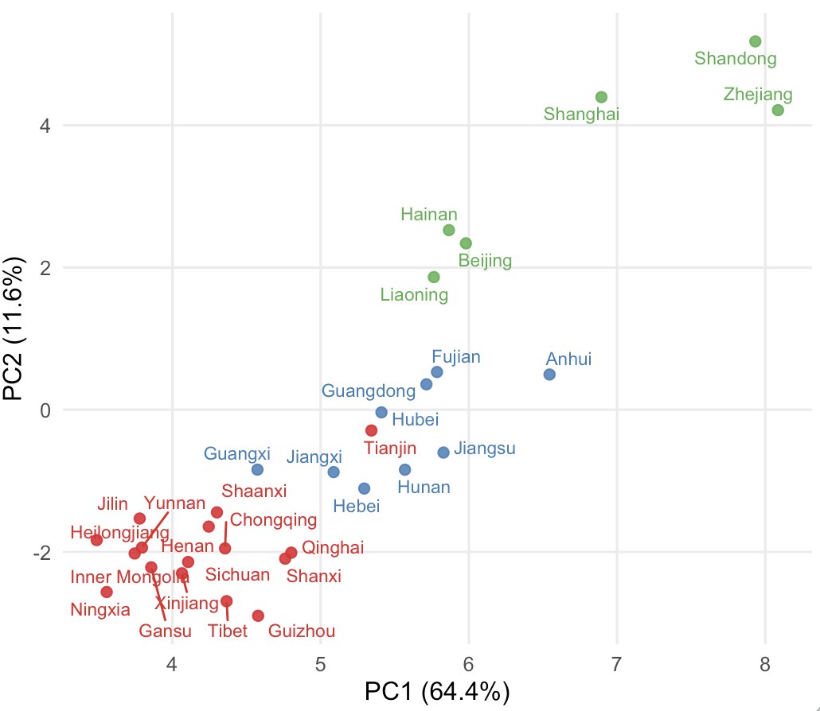
A
B
Notes:
Plots made in Script R/analysis/province_group_by_antibiotics.R

