Slide 1
Housing prices analysis
Created by:
Git outta here
Larry Chew
Laura Shummon maass
mando iwanaga

Slide 2
Correlation Matrix
Drop Long & Lat — Lat highly correlated with zip code. Not interested in distance variable.
Drop Year Renovated — Small renovations over time not recorded.
SqFt Living — High correlation with nearest 15, created new relative variable.

Slide 3
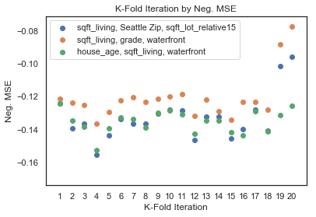
Model selection
Negative Mean Squared Error (MSE) of K-Folds
Looked for:
Small variation between K-Folds (20)
Small variation between Training and Test
Higher values (negative MSE)

Slide 4
Linear Regression
Y = 13.05 + 2.79 X1 + 1.85 X2 + 0.62 X2
Example of Functionality:
SqFt Living = 1,000
Grade = 7
Waterfront = 1
Y = $2,820 (normalized price)
Y = $607,910 (actual price)
Y Intercept
SqFt Living
Grade
Waterfront

