Slide 1
Project-1 Unix Shell

Slide 2
Project Members
Donthula Srivalli - 700758954
Jagarlamudi vinay-700759802
Mandoji Sai Tejaswi-700758342
Neha Reddy Pannala-700758690
Sai Sampath Ramisetti-700759397

Slide 3
Description
This is UNIX SHELL in java language.In this project creating child processes,history features like input and output redirect commands using pipe in operating systems.

Slide 4
About Unix Shell :-
In original Unix shell was written in the mid 1970s by Stephen R. Bourne while he was at AT&T labs in New Jersey.
Bourne shell was the first shell to appear on unix systems,thus is referred to as “the shell”.
A Unix shell is a command-line interpreter or shell that provides a command line user interface for operating systems.
Shell is an environment in which we can run our commands.
Shell has different flavors of operating systems and each flavors has its own set of recognized commands and functions.
The prompt, $ which is called the command prompt is displayed, you can type command.
Shell reads your input after you press Enter.
It determines the command at the first word of our input.

Slide 5
This Shell is organized into four parts:
Creating the child process and executing the command in the child.
Providing the history feature.
Adding support of input and output redirection.
Allowing the parent and child processes to communicate via pipe.
The basic shell commands are below. Ls → This used to list the files. Mkdir → To create a new directory. Cd → To change from one directory to another directory. Pwd → To print the working directory. Exit → To exit from the command prompt.
The program is executed by the below commands javac JShell.java → To compile the program. java Jshell → To get output from the program.

Slide 6
Git Bash
Git Bash is a command line interface (CLI) program that provides a Unix-like environment for running Git commands on Windows operating systems. It's a part of Git for Windows, which is a package that includes Git, Git GUI, and other utilities to enable Git functionality on Windows machines.
Git Bash also supports shell scripting using Bash, which enables users to automate tasks and create custom workflows for their projects.

Slide 7
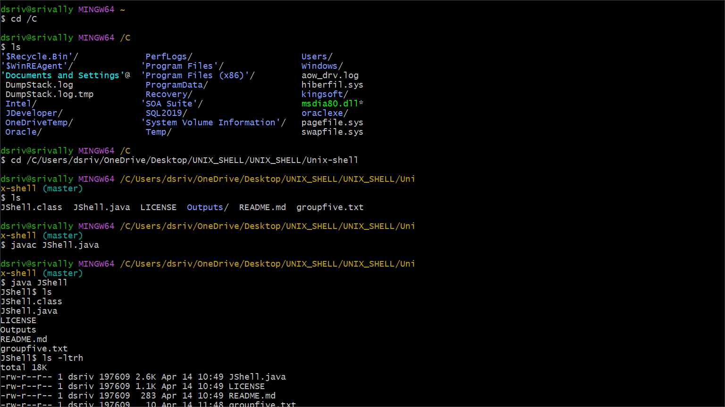
Input and output of the Program

Slide 8
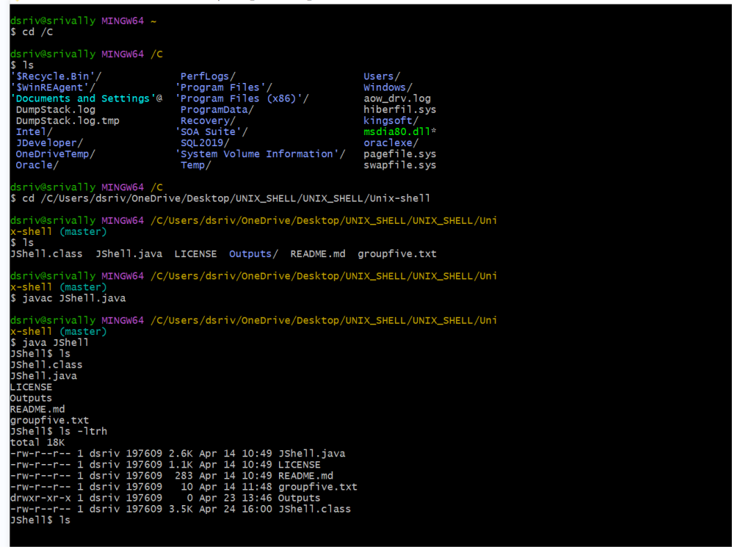
Screenshot-2

Slide 9
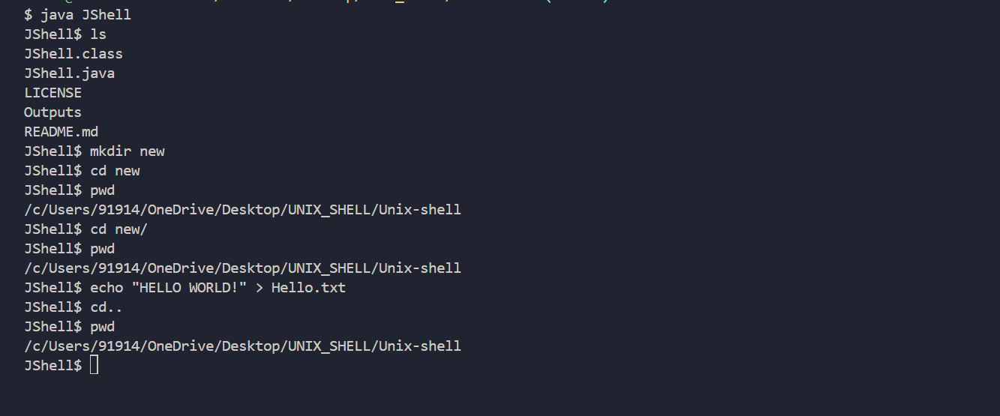
Screenshot-3

Slide 10
Conclusion.
Unix is an operating system that supports multitasking and multi-user features.
There are three main components of the unix they are kernel, the shell and the file system.
The kernel component directly communicates with the hardware.
The shell is an interface between the user and the kernel.
The file system controls how data is stored and retrieved
Shell Scripting commands can be a powerful tool for automating tasks and manipulating files and directories.
Unix shell is a both command-line interface and a scripting language.

