Slide 1
Handwriting Digit Recognition System
A Convolutional Neural Network Approach
Team 12 1. Veerendra Goud Bellapukonda - 700772385
2. V V S N Govind Chinni - 700771324
3. Sai Tejaswi Mandoji - 700758342
4. Vyshnavi Pinnamaneni – 700756479

Slide 2
Introduction
Background:
- Millions of handwritten digits are processed daily in banking and postal services.
Why It Matters:
- Accurate digit recognition is essential for automation.
Problem Statement:
- From scribbles to precision: Making machines understand handwriting!

Slide 3
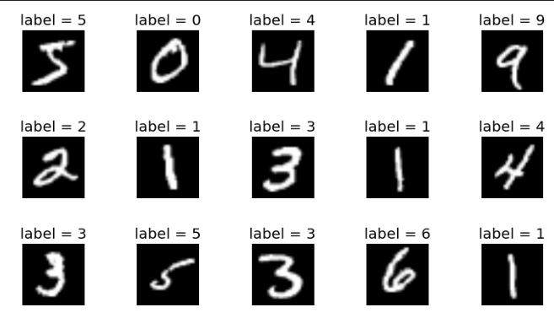
Dataset Overview
- Source: MNIST Dataset
- Features: Grayscale, 28x28 resolution
- Distribution: Balanced across digits 0-9
- Visualized sample data

Slide 4
Dataset Cleaning
- Challenges: Noisy data, overlapping digits
- Techniques:
- Noise reduction (Gaussian Blurring)
- Contour extraction with OpenCV
- Outlier detection using PCA

Slide 5
Model Architecture
- Convolutional Neural Network (CNN)
- Layers:
- Convolution + ReLU (Feature extraction)
- MaxPooling (Dimensionality reduction)
- Fully Connected for Classification
- Hyperparameters:
- Optimizer: Adam
- Learning Rate: 0.001

Slide 6
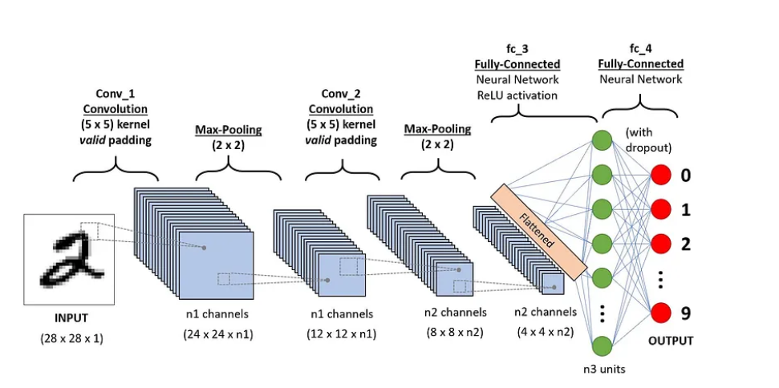
CNN sequence to classify handwritten digits

Slide 7
Training and Validation
- Data Splits:
- Train: 80%, Validation: 10%, Test: 10%
- Techniques:
- Data Augmentation
- Early Stopping
- Metrics:
- Accuracy, Precision, Recall, F1-Score

Slide 8
Results
- Training Accuracy: 98%
- Validation Accuracy: 95%
- Visualizations:
- Confusion Matrix
- Loss and Accuracy Curves

Slide 9
Experimentation
- Model Comparisons:
- CNN vs. SVM vs. Random Forest
- Ablation Studies:
- Impact of Dropout Layers
- Learning Rate Tuning

Slide 10
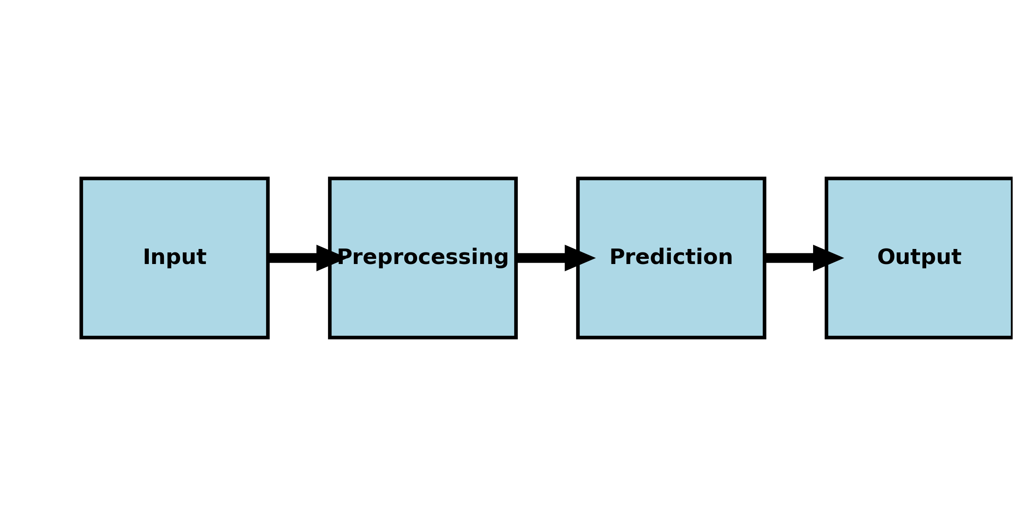
Real-Time Application (GUI)
- Features:
- Real-time digit recognition using Tkinter
- Confidence Scores displayed

Slide 11
Future Work
- Extend capabilities to multilingual text recognition
- Deploy the system as a web application
- Experiment with Transformer-based models for image recognition

Slide 12
Conclusion
- Successfully built a robust ML pipeline for digit recognition.
- Demonstrated real-time recognition with GUI.
- Future potential in OCR systems and mobile deployment.

